Slide 1
Deep Stereo
Frank Dellaert, Fall 2020
Image from Žbontar & LeCun, 2016

Slide 2
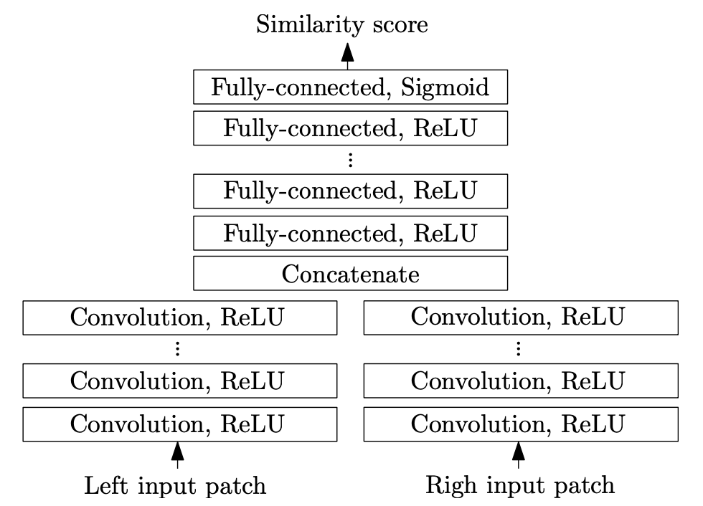
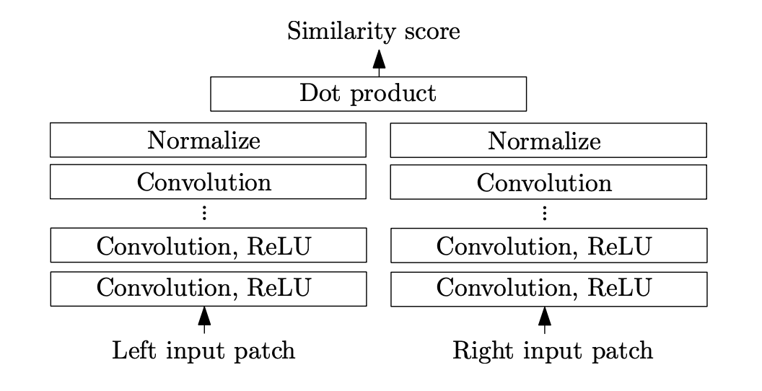
First Idea: matching costs
Two versions: fast, and accurate
Tries to make distance between positive examples (matched patches) and negative (incorrectly matched patches) large

Slide 3
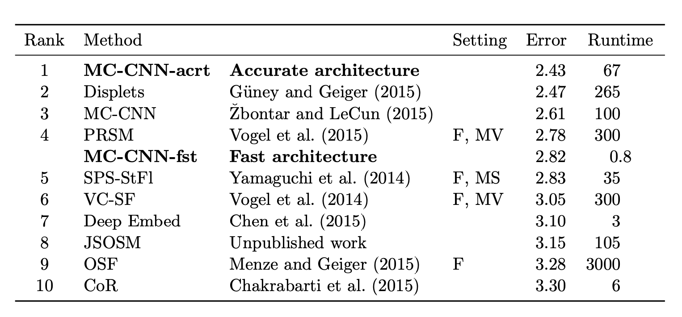
Results
On KITTI (2012) dataset, in October 2015
percentage of misclassified pixels

Slide 4
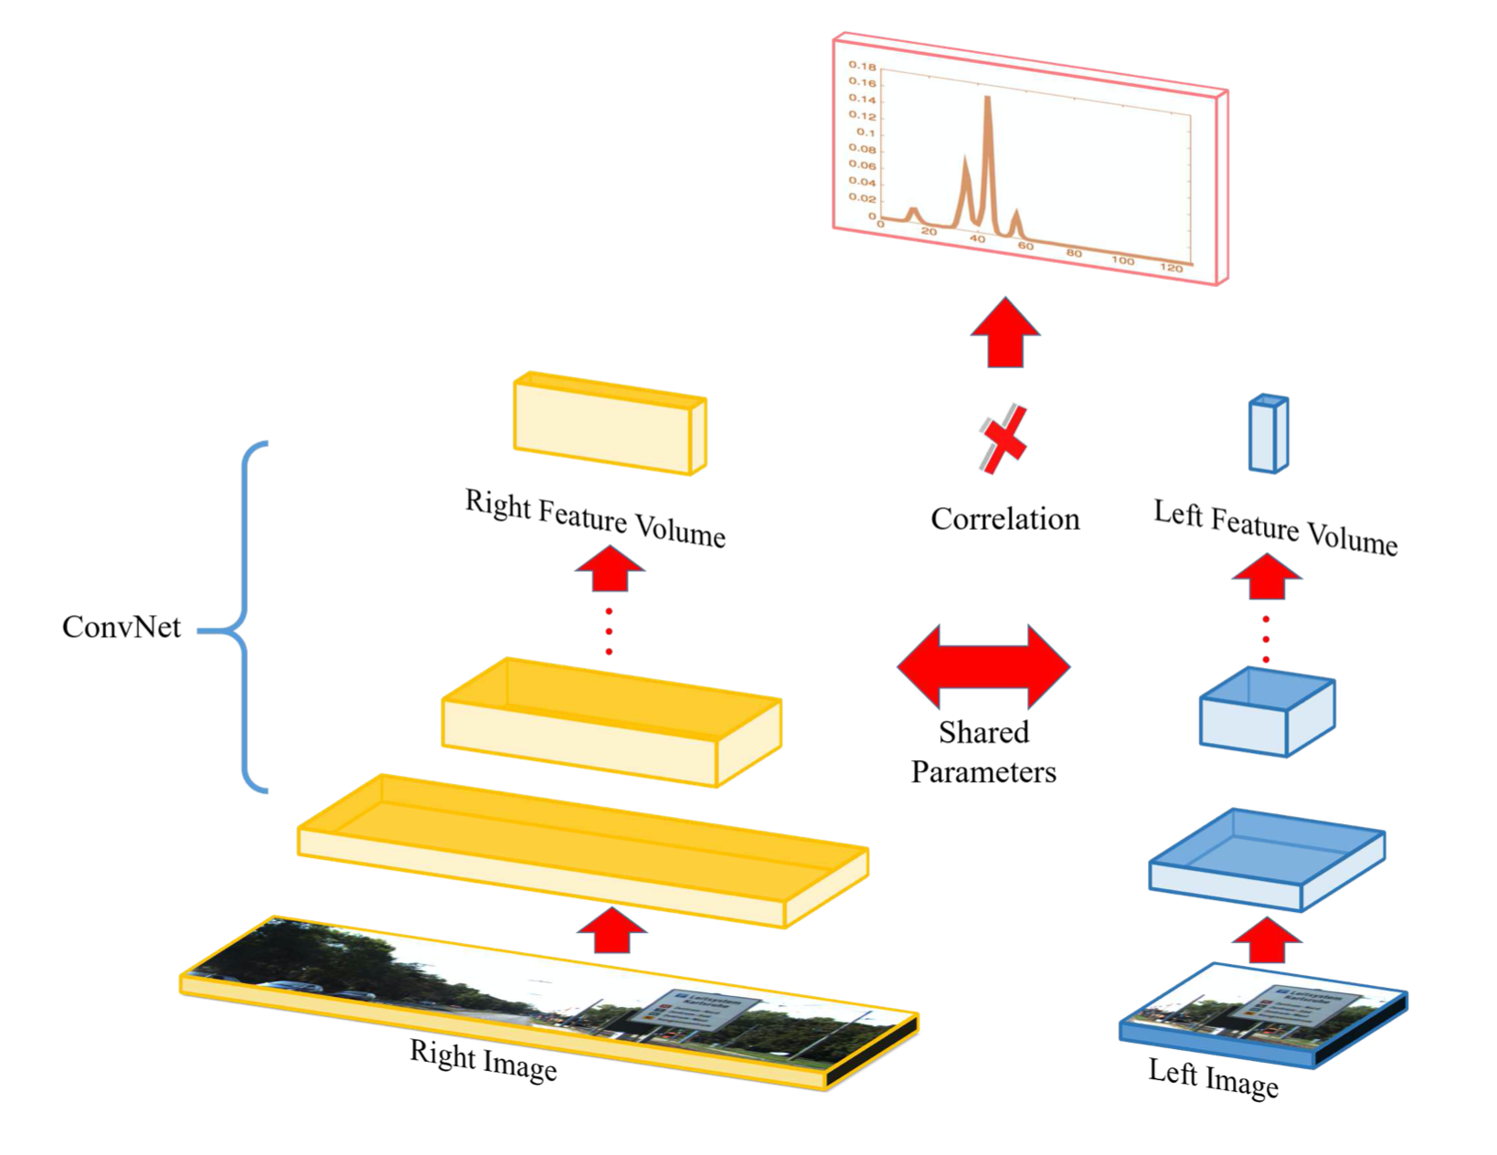
Similar idea:
CVPR 2016
CNN for feature representation, shared parameters
Probability density over disparities

Slide 5
Results (percentage over threshold)

Slide 6
Cost Volume Aggregation
ICCV 2017
CNN for features, shared weights, then 3D convolutions

Slide 7
Results on Scene Flow Dataset (from CVPR 2016)

Slide 8
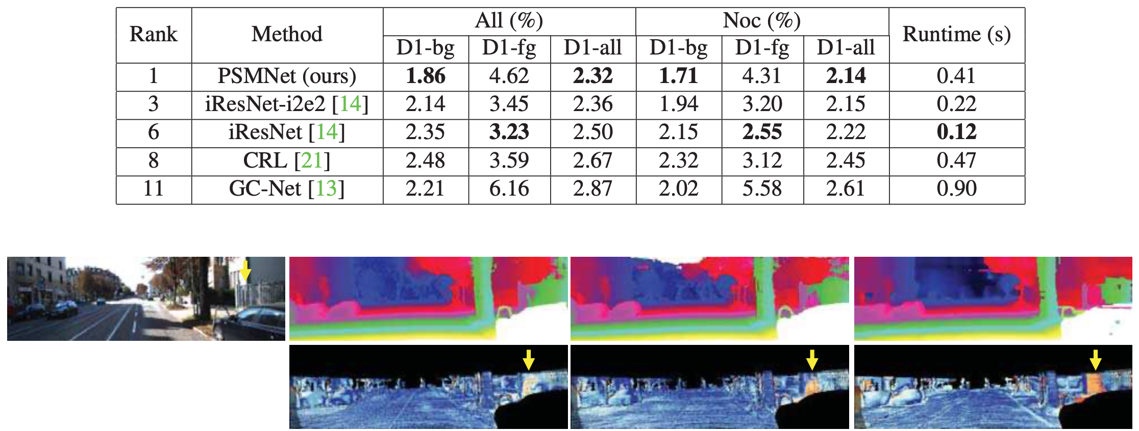
CVPR 2018
Architectural improvements: spatial pyramid pooling
Results on KITTI 2015, March 2018 leaderboard:

Slide 9
CVPR 2019
High-resolution for self-driving: Z=f B/Z, increase f !

Slide 10
Yang18cvpr architecture figure:

Slide 11
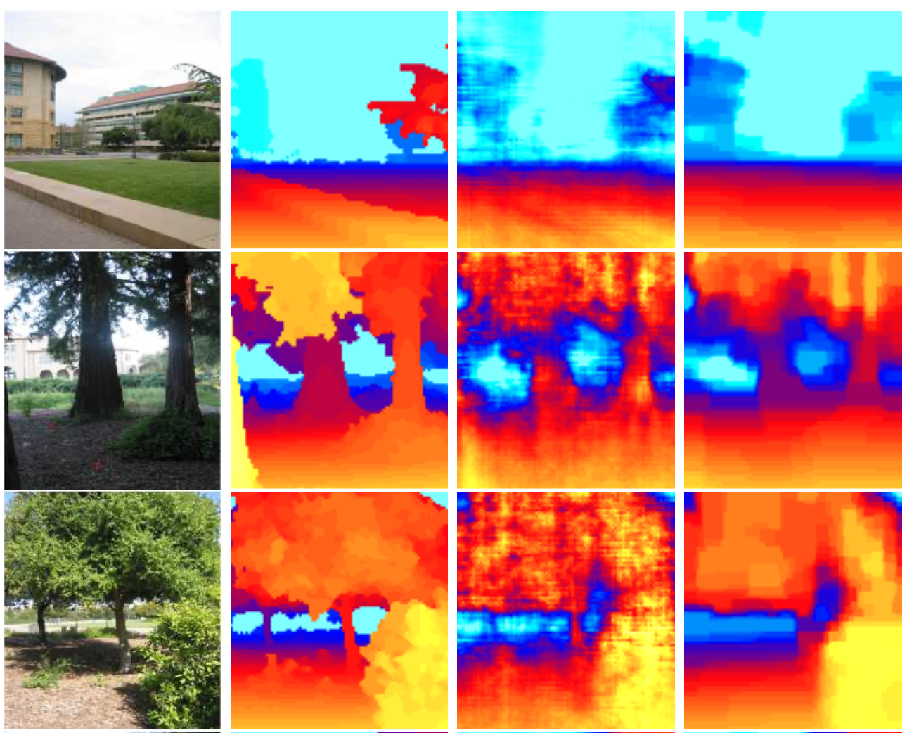
NIPS 2005 (!)
A whole different beast: monocular depth
Not deep: Markov random field (MRF)
Learns a relatively small number of parameters

Slide 12
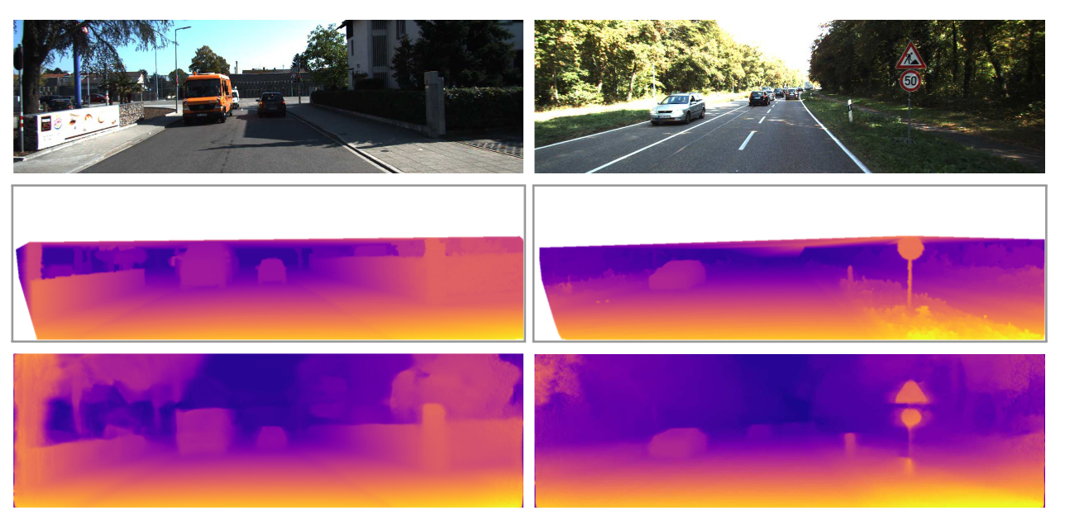
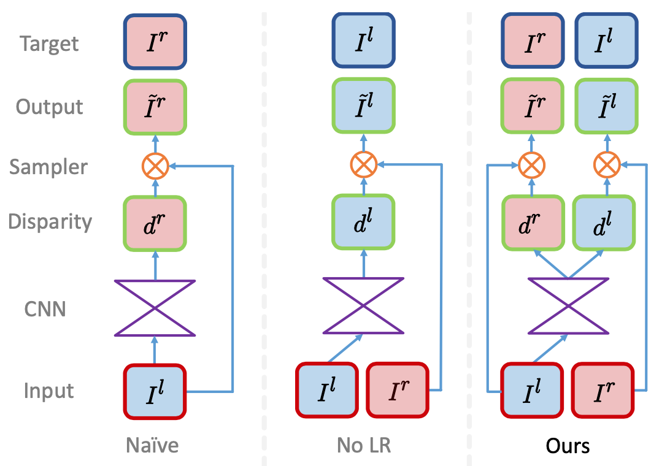
CVPR 2017
LR- consistency
Unsupervised monocular depth

