Slide 1
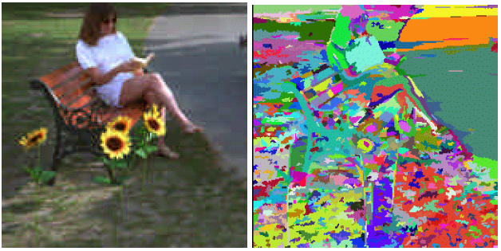
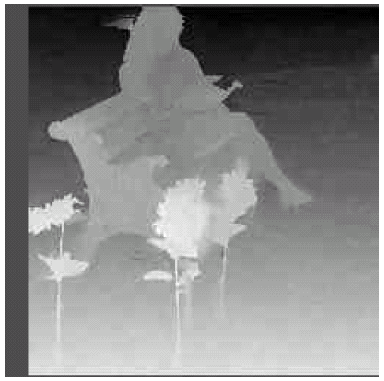
Dense Stereo
Some Slides by Forsyth & Ponce, Jim Rehg, Sing Bing Kang
(Does not line up well with Szeliski book)

Slide 2
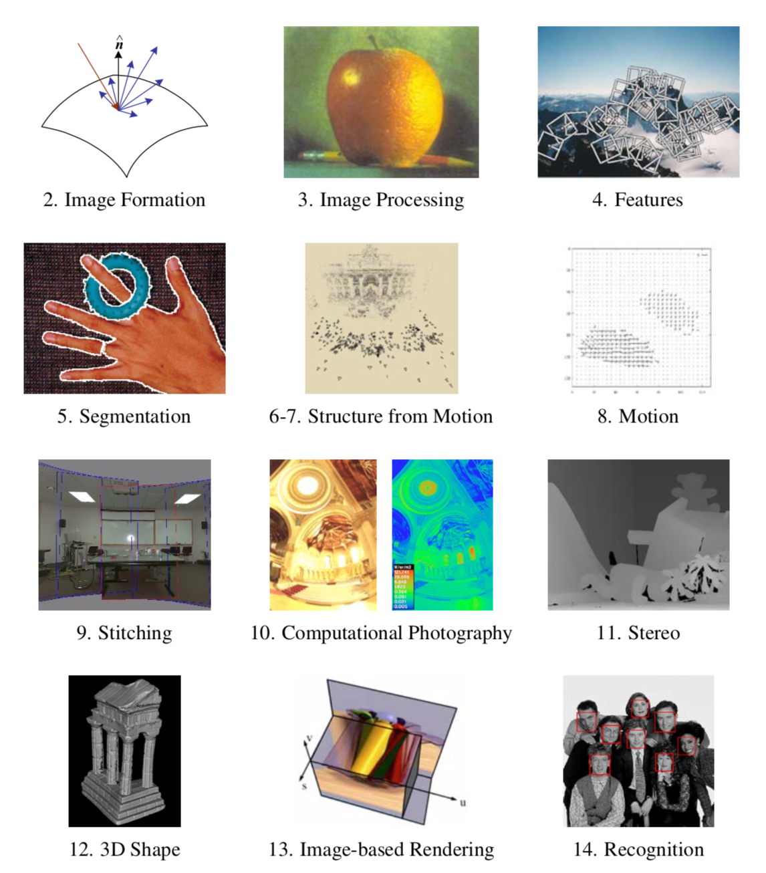

Slide 3
Etymology
Stereo comes from the Greek word for solid (στερεο), and the term can be applied to any system using more than one channel

Slide 4
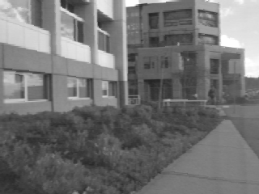
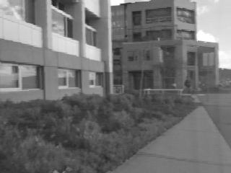
Effect of Moving Camera
3D point
As camera is shifted (viewpoint changed):
3D points are projected to different 2D locations
Amount of shift in projected 2D location depends on depth
2D shifts=Parallax

Slide 5
Basic Idea of Stereo
Triangulate on two images of the same point to recover depth.
Feature matching across views
Calibrated cameras
depth
baseline
Left
Right
Matching correlation
windows across scan lines

Slide 6
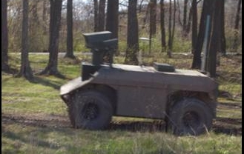
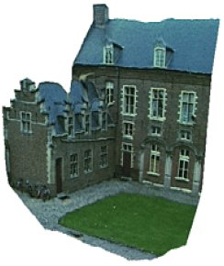
Why is Stereo Useful?
Passive and non-invasive
Robot navigation (path planning, obstacle detection)
3D modeling (shape analysis, reverse engineering, visualization)
Photorealistic rendering

Slide 7
Outline
Pinhole camera model
Basic (2-view) stereo algorithm
Equations
Window-based matching (SSD)
Dynamic programming
Multiple view stereo

Slide 8
Review: Pinhole Camera Model
3D scene point P is projected to a 2D point Q in the virtual image plane
Virtual image
P = (X,Y,Z)
Q
O
z
x
f
y
The 2D coordinates in the image are given by
(u,v)
(0,0)
Note: image center is (0,0)

Slide 9
Basic Stereo Derivations
baseline B
O_{L}
z
(u_{L},v_{L})
P_{L} = (X,Y,Z)
x
y
(u_{R},v_{R})
O_{R}
z
x
Important note:
Because the camera shifts along x, v_{L} = v_{R}
y

Slide 10
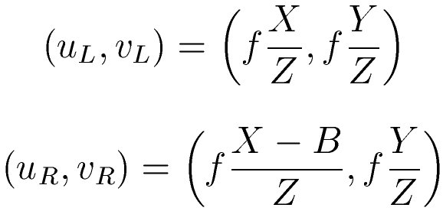
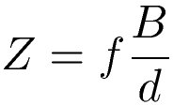
Basic Stereo Derivations
baseline B
O_{L}
z
(u_{L},v_{L})
P_{L} = (X,Y,Z)
x
y
(u_{R},v_{R})
O_{R}
z
x
Disparity:
y

Slide 11
Stereo Vision
Z(x, y) is depth at pixel (x, y)
d(x, y) is disparity
depth
baseline
Left
Right
Matching correlation
windows across scan lines

Slide 12
Components of Stereo
Matching criterion (error function)
Quantify similarity of pixels
Most common: direct intensity difference
Aggregation method
How error function is accumulated
Options: Pixel, edge, window, or segmented regions
Optimization and winner selection
Examples: Winner-take-all, dynamic programming, graph cuts, belief propagation

Slide 13
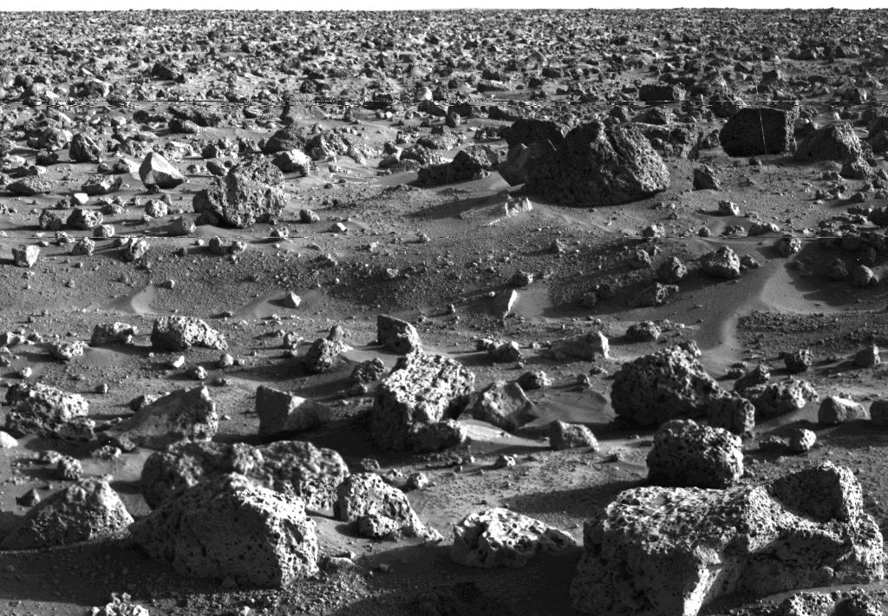
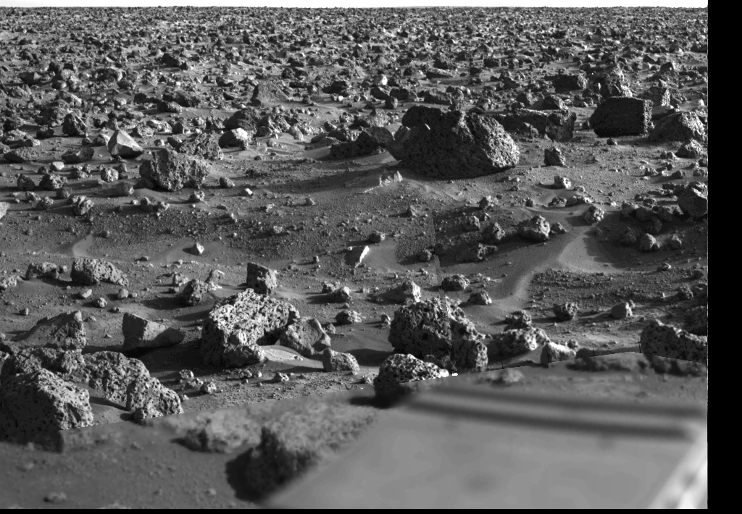
Stereo Correspondence
Search over disparity to find correspondences
Range of disparities can be large
virtually no shift
large shift

Slide 14
Correspondence Using Window-based Correlation
Left
Right
scanline
SSD error
Matching criterion = Sum-of-squared differences
disparity
Aggregation method = Fixed window size
“Winner-take-all”

Slide 15
Sum of Squared (Intensity) Differences
Left
Right

Slide 16
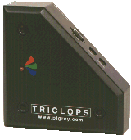
Correspondence Using Correlation
Left
Disparity Map
Images courtesy of Point Grey Research

Slide 17
Image Normalization
Images may be captured under different exposures (gain and aperture)
Cameras may have different radiometric characteristics
Surfaces may not be Lambertian
Hence, it is reasonable to normalize pixel intensity in each window (to remove bias and scale):

Slide 18
Images as Vectors
Left
Right
“Unwrap” image to form vector, using raster scan order
row 1
row 2
Each window is a vector in an m² dimensional vector space. Normalization makes them unit length.
row 3

Slide 19
Image Metrics
(Normalized) Sum of Squared Differences
θ
Normalized Correlation

Slide 20
Caveat
Image normalization should be used only when deemed necessary
The equivalence classes of things that look “similar” are substantially larger, leading to more matching ambiguities
I
I
I
I
x
x
x
x
Direct intensity
Normalized intensity

Slide 21
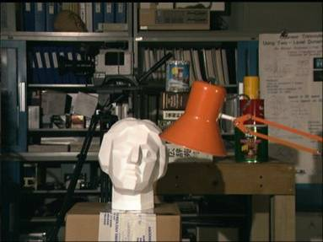
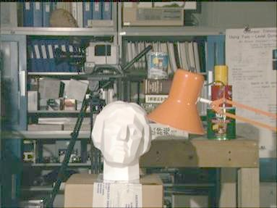
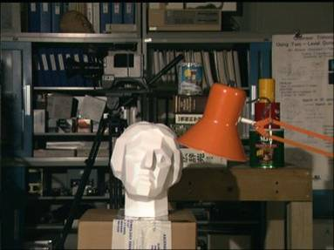
Alternative: Histogram Warping
(Assumes significant visual overlap between images)
freq
freq
I
Compare and warp towards each other
I
freq
freq
I
I
Cox, Roy, & Hingorani’95: “Dynamic Histogram Warping”

Slide 22
Two major roadblocks
Textureless regions create ambiguities
Occlusions result in missing data
Occluded regions
Textureless regions

Slide 23
Dealing with ambiguities and occlusion
Ordering constraint:
Impose same matching order along scanlines
Uniqueness constraint:
Each pixel in one image maps to unique pixel in other
Can encode these constraints easily in dynamic programming

Slide 24
Pixel-based Stereo
Center of left camera
Center of right camera
Left scanline
Right scanline
…
…
(NOTE: I’m using the actual, not virtual, image here.)

Slide 25
Stereo Correspondences
Right image is reference
Definition of occlusion/disocclusion depends on which image is considered the reference
Moving from left to right:
Pixels that “disappear” are occluded; pixels that “appear” are disoccluded
Left scanline
Right scanline
…
…
Match
Match
Occlusion
Match
Disocclusion

Slide 26
Search Over Correspondences
Occluded Pixels
Left scanline
Right scanline
Disoccluded Pixels
Three cases:
Sequential – cost of match
Occluded – cost of no match
Disoccluded – cost of no match

Slide 27
Stereo Matching with Dynamic Programming
Occluded Pixels
Start
Left scanline
Dynamic programming yields the optimal path through grid. This is the best set of matches that satisfy the ordering constraint
Dis-occluded Pixels
Right scanline
End

Slide 28
Ordering Constraint is not Generally Correct
Preserves matching order along scanlines, but cannot handle “double nail illusion”
A
Notes:
The ordering constraint is often used. It requires that the matching order along a scanline is unchanged.
However, this assumption is not true for scenes with thin objects or narrow holes.
In this example, the green background point A is to the left of the thin foreground in one image. However, this same point is to the right of the thin foreground in the other image. The ordering constraint is clearly violated here.
The ordering constraint is usually used in context of dynamic programming. It is not easy to explicitly enforce the smoothness between scanlines during the optimization. No ordering constraint based approach has state-of-the-art results for the Middlebury data set.

Slide 29
Uniqueness Constraint is not Generally Correct
Slanted plane: Matching between M pixels and N pixels
Notes:
The uniqueness constraint requires a one-to-one mapping between the two input images.
However, for a scene containing slanted planes, where the degrees of foreshortening are different in the two images, this constraint no longer holds.
For example, for the 3D scene shown at here, the foreground plane appears significantly wider in the left view than in the right view. If symmetric matching is enforced, the mapping must not be one-to-one.

Slide 30
Edge-based Stereo
Another approach is to match edges rather than windows of pixels:
Which method is better?
Edges tend to fail in dense texture (outdoors)
Correlation tends to fail in smooth featureless areas
Sparse correspondences

Slide 31
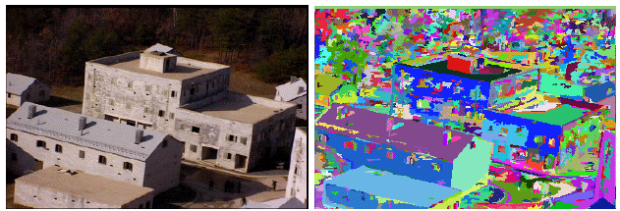
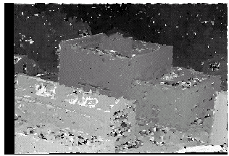
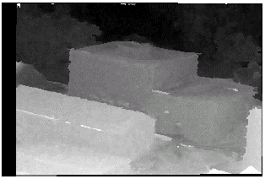
Segmentation-based Stereo
Hai Tao and Harpreet W. Sawhney

Slide 32
Another Example

Slide 33
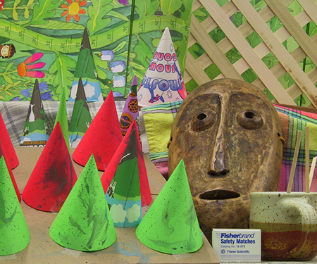
Hallmarks of A Good Stereo Technique
Should not rely on order and uniqueness constraints
Should account for occlusions
Should account for depth discontinuity
Should have reasonable shape priors to handle textureless regions (e.g., planar or smooth surfaces)
Should account for non-Lambertian surfaces
There is a database with ground truth for testing: http://cat.middlebury.edu/stereo/data.html

Slide 34
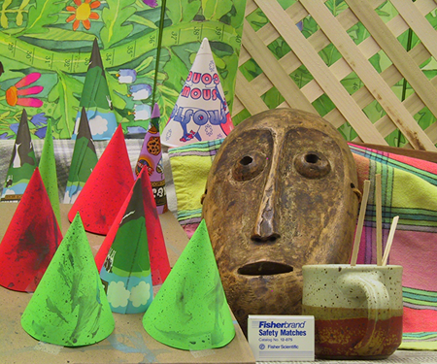
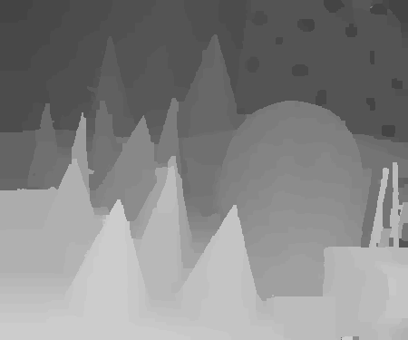
Left
Right
Result of using a more sophisticated stereo algorithm
Disparity Map
Notes:
Here we show more results. This is our result on the “Cone” data.

Slide 35
View Interpolation
Notes:
Once we know the disparity distribution, we can view interpolate, as shown in these movie clips.

Slide 36
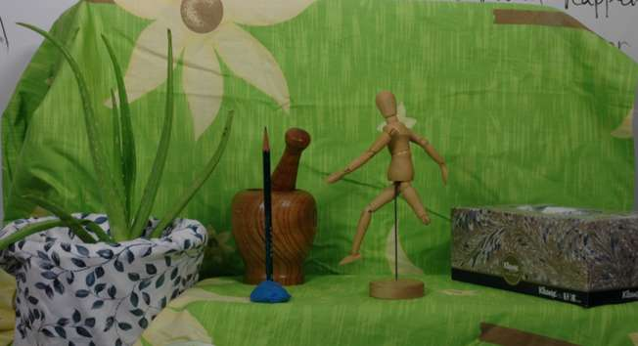
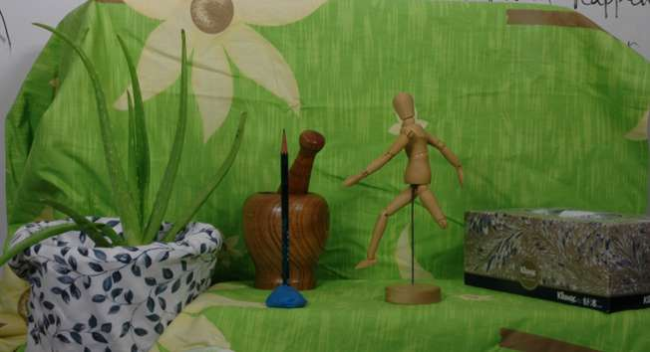
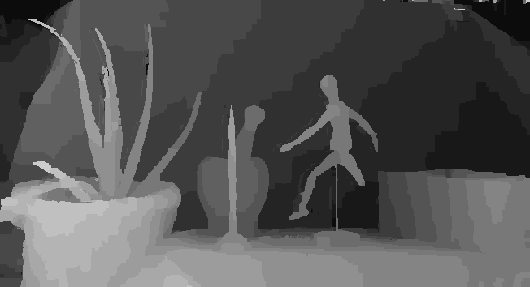
Result using a good technique
Right Image
Left Image
Disparity
Notes:
This is a stereo pair captured in our lab.
This is the disparity obtained by our approach.
Notice that the thin structures and narrow holes are accounted for.

Slide 37
View Interpolation
Notes:
This is the result of view interpolating using extracted depth information.

Slide 38
Bottom Line: Stereo is Still Difficult
Depth discontinuities
Lack of texture (depth ambiguity)
Non-rigid effects (highlights, reflection, translucency)

Slide 39
From 2 views to >2 views
More pixels voting for the right depth
Statistically more robust
However, occlusion reasoning is more complicated, since we have to account for partial occlusion:
Which subset of cameras sees the same 3D point?

