Slide 1
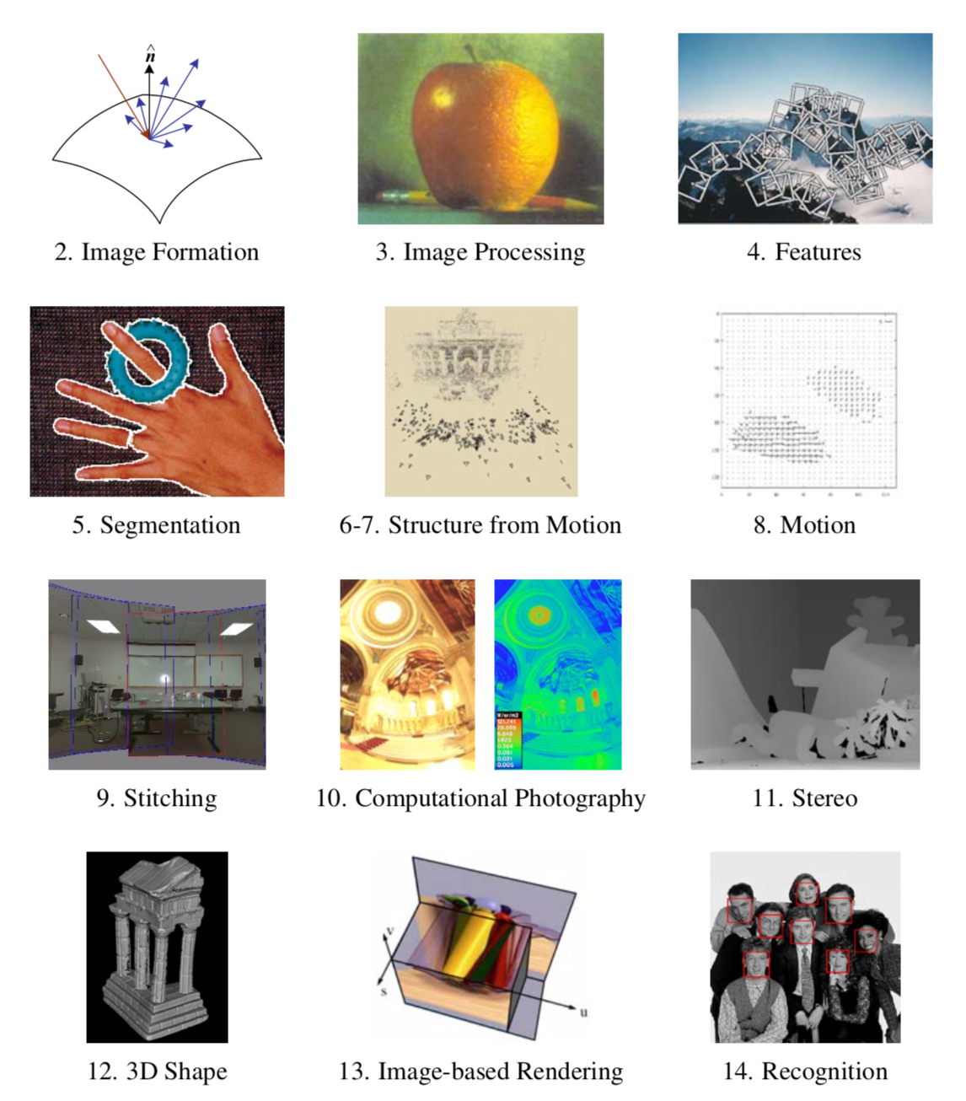

Slide 2
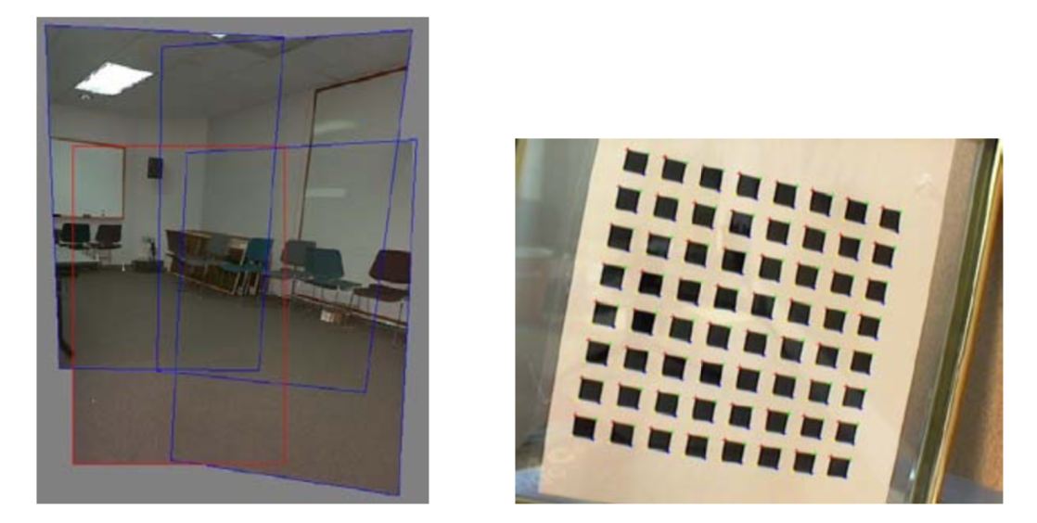
Feature-based Image Alignment
Geometric image registration
2D or 3D transforms between them
Special cases: pose estimation, calibration
Image credit Szeliski book

Slide 3
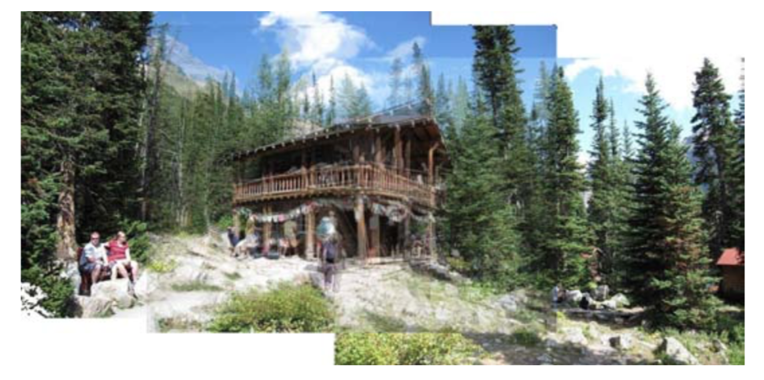
2D Alignment
3 photos
Translational model
Image credit Szeliski book

Slide 4
2D Alignment
Input:
A set of matches {(x_{i}, x_{i}’)}
A parametric model f(x; p)
Output:
Best model p*
How?
Image credit Szeliski book

Slide 5
2D translation estimation
Input:
Set of matches {(x₁, x₁’), (x₂, x₂’), (x₃, x₃’), (x₄, x₄’)}
Parametric model: f(x; t) = x + t
Parameters p == t, location of origin of A in B
Output:
Best model p*
Image credit Szeliski book

Slide 6
2D translation estimation
Input:
Set of matches {(x₁, x₁’), (x₂, x₂’), (x₃, x₃’), (x₄, x₄’)}
Parametric model: f(x; t) = x + t
Parameters p == t, location of origin of A in B
Question for class:
What is your best guess for model p* ??
Image credit Szeliski book
Notes:
What is your best guess? With one correspondence?
x1 = [600, 150], x1’ = [50, 50] -> x’ = x - t => t = x-x’ = [600-50, 150-50] = [550, 100]

Slide 7
2D translation estimation
How?
One correspondence x1 = [600, 150], x1’ = [50, 50]
Parametric model: x’ = f(x; t) = x + t
Image credit Szeliski book

Slide 8
2D translation estimation
[-550, -100]
How?
One correspondence x1 = [600, 150], x1’ = [50, 50]
Parametric model: x’ = f(x; t) = x + t => t = x’- x
=> t = [50-600, 40-150] = [-550, -100]
Image credit Szeliski book

Slide 9
2D translation via least-squares
How?
A set of matches {(x_{i}, x_{i}’)}
Parametric model: f(x; t) = x + t
Minimize sum of squared residuals:
Image credit Szeliski book

Slide 10
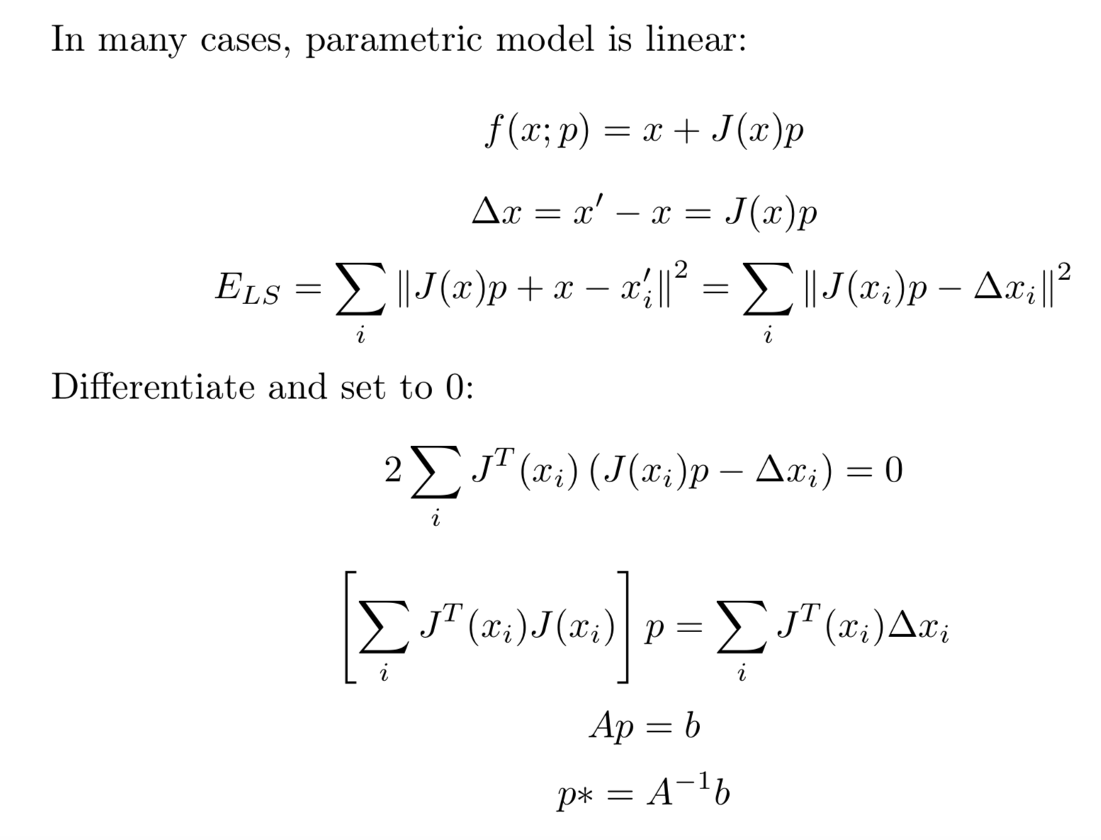
How to solve?
Jacobian
Normal equations
Hessian

Slide 11
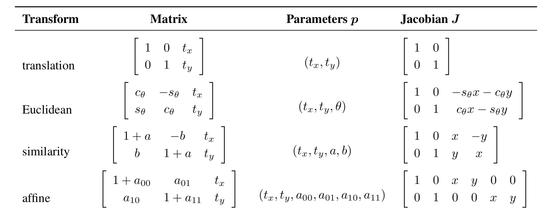
Linear models menagerie
All the simple 2D models are linear!
Exception: perspective transform
Figure credit Szeliski book

Slide 12
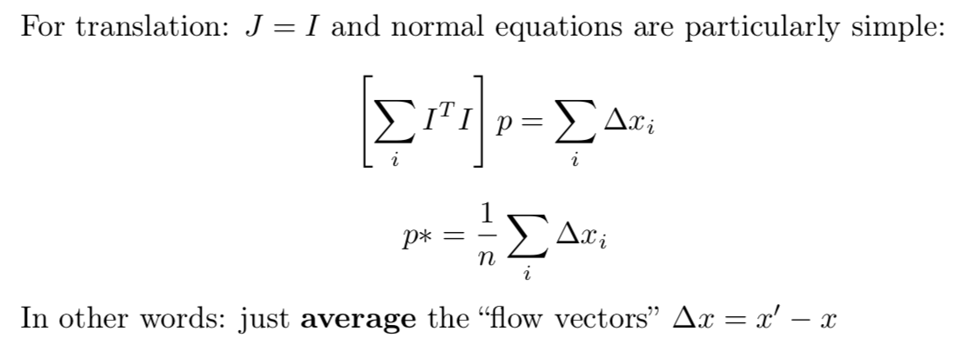
2D translation via least-squares
Image credit Szeliski book

Slide 13
Oops I lied !!! Euclidean is not linear!
All the simple 2D models are linear!
Euclidean Jacobians are a function of θ!
Figure credit Szeliski book

Slide 14
Nonlinear Least Squares

Slide 15
Projective/H
Jacobians a bit harder
Parameterization:
x’= f(x,p):
And Jacobian:
Image credit Graphics Mill
(educational Use)

Slide 16
Closed Form H
Taking x’=f(x,p):
Divide both sides by :
4 matches => system of 8 linear equations
Image credit Graphics Mill
(educational Use)

Slide 17
RANSAC

Slide 18
Motivation
Estimating motion models
Typically: points in two images
Candidates:
Translation
Homography
Fundamental matrix

Slide 19
Mosaicking: Homography
www.cs.cmu.edu/~dellaert/mosaicking

Slide 20
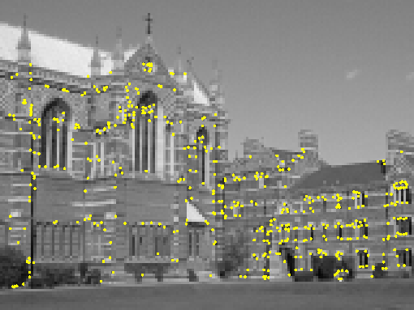
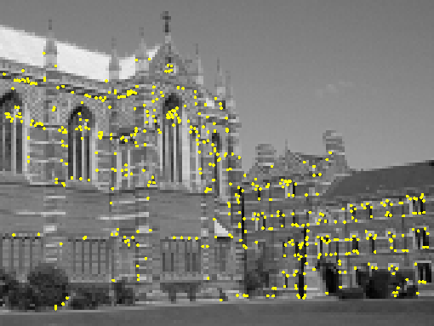
Two-view geometry (next lecture)
Notes:
Show two images
How can we match them up ?

Slide 21
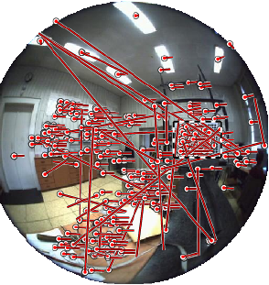
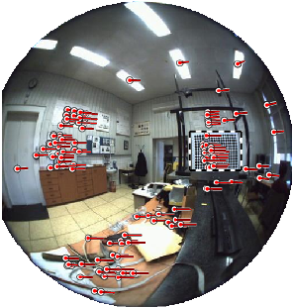
Omnidirectional example
Images by Branislav Micusik, Tomas Pajdla,
cmp.felk.cvut.cz/ demos/Fishepip/

Slide 22
Simpler Example
Fitting a straight line

Slide 23
Discard Outliers
No point with d>t
RANSAC:
RANdom SAmple Consensus
Fischler & Bolles 1981
Copes with a large proportion of outliers
Image credit Choi et al BMVC 2009

Slide 24
Main Idea
Select 2 points at random
Fit a line
“Support” = number of inliers
Line with most inliers wins
Image credit shutterstock, academic use

Slide 25
Why will this work ?

Slide 26
Best Line has most support
More support -> better fit
Image credit Wikipedia

Slide 27
RANSAC
Objective:
Robust fit of a model to data D
Algorithm
Randomly select s points
Instantiate a model
Get consensus set D_{i}
If |D_{i}|>T, terminate and return model
Repeat for N trials, return model with max |D_{i}|
Image credit Wikipedia

Slide 28
In General
Fit a more general model
Sample = minimal subset
Translation ?
Homography ?
Euclidean transorm ?

Slide 29
Example
Euclidean: needs 2 correspondences (2*2>=3)
Here correct hypothesis has support of 4 (out of 5)
Including red into minimal sample (of 2) would likely yield low support

Slide 30
How many samples ?
We want: at least one sample with all inliers
Can’t guarantee: probability P
E.g. P = 0.99
Image credit Wikipedia

Slide 31
Calculate N
If $ε$ = outlier probability $ε$=0.4
proportion of inliers p = 1- $ε$ p=0.6
P(sample with all inliers) = p^{s} s=2 -> p^{s}=0.36
P(sample with an outlier) = 1-p^{s} 0.64
P(N samples an outlier) = (1-p^{s})^{N} N=3 -> 0.26
We want P(N samples an outlier) < 1-P (e.g. 0.01)
(1-p^{s})^{N} < 1-P 0.64^{N} < 0.01
N > log(1-P)/log(1-p^{s}) N >10.3
Image credit Wikipedia

Slide 32
Example
P=0.99
s=2
$ε$= 5% => N=2
$ε$= 50% => N=17
s=4
$ε$= 5% => N=3
$ε$= 50% => N=72
s=8
$ε$= 5% => N=5
$ε$= 50% => N=1177
Image credit Wikipedia

Slide 33
Remarks
N = f($ε$), not the number of points
N increases steeply with s
Image credit Wikipedia

Slide 34
Distance Threshold
Requires noise distribution
Gaussian noise with σ
Chi-squared distribution with DOF m
95% cumulative:
Line, F: m=1, t²=3.84 σ²
Translation, homography: m=2, t²=5.99 σ²
I.e. -> 95% prob that d<t is inlier
Image credit Wikipedia

Slide 35
Threshold T
Terminate if |D_{i}|>T
Rule of thumb: T ≈ #inliers
So, T = (1- $ε$)n = pn
Image credit Wikipedia

Slide 36
Adaptive N
When $ε$ is unknown ?
Start with $ε$ = 50%, N=inf
Repeat:
Sample s, fit model
update $ε$ as |outliers|/n
set N=f($ε$, s, p)
Terminate when N samples seen
Image credit Wikipedia

Slide 37
Summary: RANSAC
Objective:
Robust fit of a model to data D
Algorithm
Randomly select s points
Instantiate a model
Get consensus set D_{i}
If |D_{i}|>T, terminate and return model
Repeat for N trials, return model with max |D_{i}|
Image credit Wikipedia

Slide 38
Pose Estimation in VR
https://youtu.be/nrj3JE-NHMw

Slide 39
Review: 2D Alignment
Input:
A set of matches {(x_{i}, x_{i}’)}
A parametric model f(x; p)
Output:
Best model p*
How?
Image credit Szeliski book

Slide 40
Now: 3D-2D Alignment
Input:
A set of 3D->2D matches {(X_{i}, x_{i})}
A parametric model f(X; p)
Output:
Best model p*
How?
Image credit Szeliski book

Slide 41
Pose Estimation
Input:
A set of 2D measurements x_{i} of known 3D points X_{i}
Parametric model is camera matrix P, i.e., x = f(X; P)
Output:
Best camera matrix P
How?
Image credit Szeliski book

Slide 42
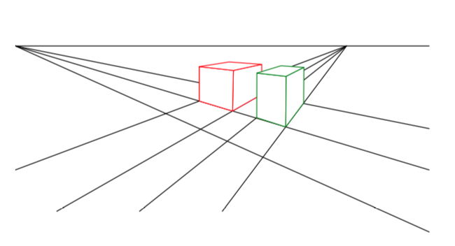
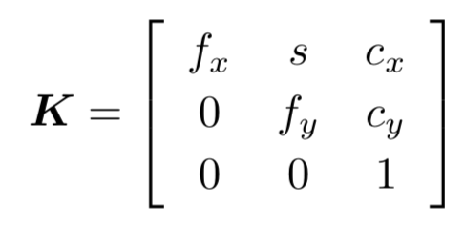
Review: Projective Camera Matrix
Chapter 2 in book
Homogeneous coord.
3D TO 2D projection: x = K[R|t]X = PX where P = 3x4 camera matrix and K the 3x3 calibration

Slide 43
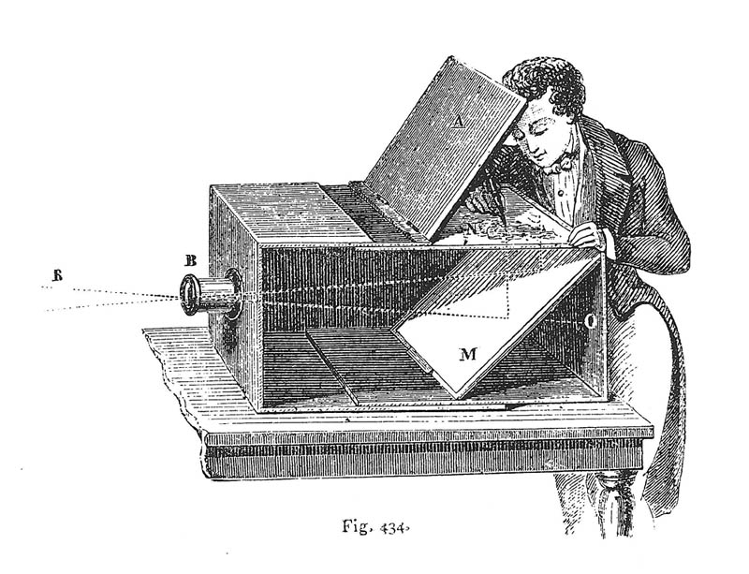
Camera Extrinsics: a Pose in 3D
What is the geometric meaning of R and t ??
Intuitive: camera is at a position _{w}t_{c} Indices say: camera in world coordinate frame
_{w}t_{c}

Slide 44
Camera Extrinsics: a Pose in 3D
What is the geometric meaning of R and t ??
Rotation is given by 3x3 matrix _{w}R_{c} whose columns are the camera axes _{w}x_{c}, _{w}y_{c}, _{w}z_{c}
_{w}x_{c}
_{w}z_{c}
_{w}y_{c}

Slide 45
Camera Extrinsics: a Pose in 3D
What is the geometric meaning of R and t ??
Transforming point X_{i} from world to camera coordinates: _{w}X_{i} – _{w}t_{c} = _{w}R_{c c}X_{i}
_{w}X_{i} - _{w}t_{c}
_{w}X_{i}

Slide 46
Camera Extrinsics: a Pose in 3D
Expressed in homogeneous coordinates:
_{c}X_{i} = _{w}R_{c}^{T} (_{w}X_{i} - _{w}t_{c}) = _{w}R_{c}^{T} [I| - _{w}t_{c}] _{w}X_{i} = [_{w}R_{c}^{T} | - _{w}R_{c}^{T} _{w}t_{c}] _{w}X_{i} = [_{c}R_{w} | _{c}t_{w}] _{w}X_{i} = [R|t] _{w}X_{i}
_{c}X_{i}
_{w}X_{i}

Slide 47
Camera Extrinsics: a Pose in 3D
Conclusion: when people write _{c}X_{i} = [R|t] _{w}X_{i} they are talking about (unintuitive) [_{c}R_{w} | _{c}t_{w}]
We like use (intuitive) _{c}X_{i} = _{w}R_{c}^{T} [I| - _{w}t_{c}] _{w}X_{i}
_{c}X_{i}
_{w}X_{i}

Slide 48
Revision: Projective Camera Matrix
Homogeneous coord.
3D TO 2D projection: Camera-centric: x = K[_{c}R_{w} | _{c}t_{w}] X = PX World-centric: x = K _{w}R_{c}^{T} [I | - _{w}t_{c}] X = PX P = same 3x4 camera matrix and K the 3x3 calibration

Slide 49
Looking at the (opaque) camera matrix
Can you interpret the columns of P with entities in the scene?
Answer:
P¹ == the image of [1 0 0 0]
P² == the image of [0 1 0 0]
P³ == the image of [0 0 1 0]
P⁴ == the image of [0 0 0 1]
What are those ?
[0 0 0 1] is easy…
Answer:
[0 0 0 1] is the origin, so P4 is the image of the origin.
[1 0 0 0] is a point at infinity in the X-direction, so it is the vanishing point of all lines parallel with the X direction!

Slide 50
Vanishing points, revisited
3
2
1
2
1
3
Columns of P !
P⁴ is arbitrary: wherever you defined the world origin.
https://www.artinstructionblog.com/perspective-drawing-tutorial-for-artists-part-2

Slide 51
Back to Pose Estimation!
Simple algorithm: just measure the coordinates of the origin and the three vanishing points?
Does not work ☹:
Columns are only measured up to a scale.
4 points * 2DOF = only 8 DOF! Missing 11-8=3
3 missing numbers are exactly those scales.

Slide 52
Least Squares Pose Estimation…
Input:
A set of 2D measurements x_{i} of known 3D points X_{i}
Parametric model is camera matrix P, i.e., x = f(X; P)
Output:
Best camera matrix P

Slide 53
Pose estimation = “Resectioning”
Opposite of triangulation.

Slide 54
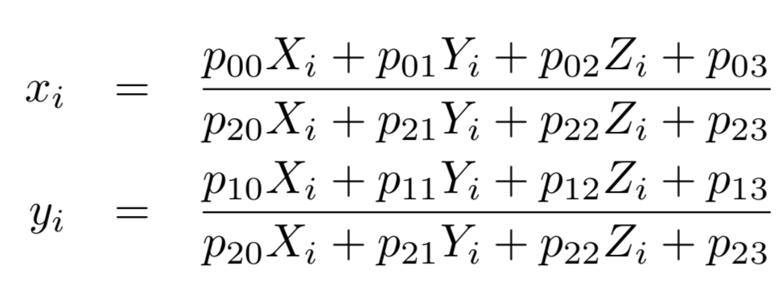
Pose estimation
In project 4, you will use scipy.optimize.least_squares to do exactly that. Working knowledge of 3D poses will be required.
Note before we compute the 2D reprojection error we need to convert back PX to non-homogeneous coordinates:
https://docs.scipy.org/doc/scipy/reference/generated/scipy.optimize.least_squares.html

