Slide 1
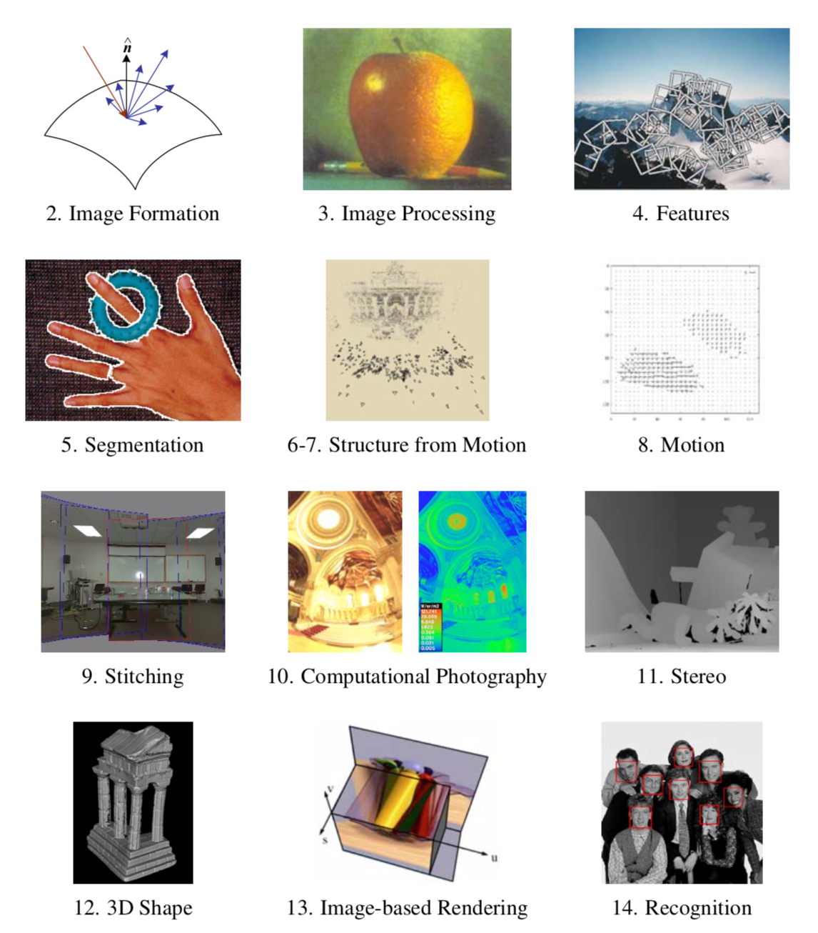

Slide 2
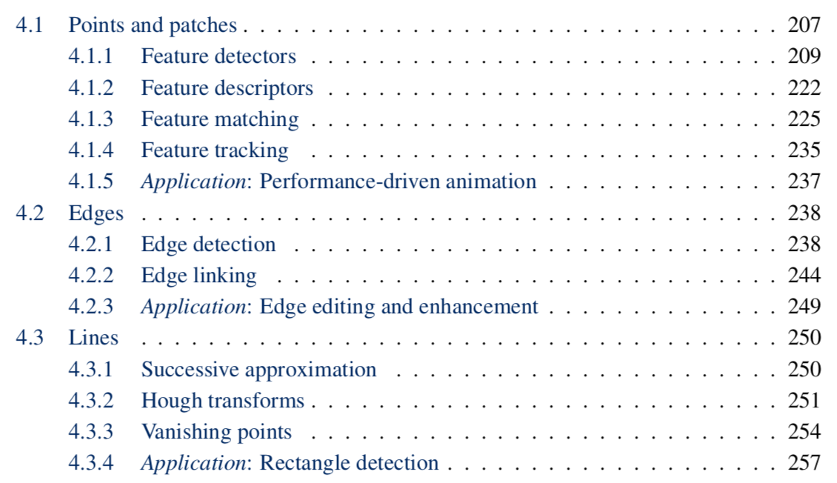

Slide 4
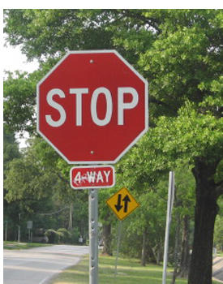
Correspondence across views
Correspondence: matching points, patches, edges, or regions across images
≈

Slide 5
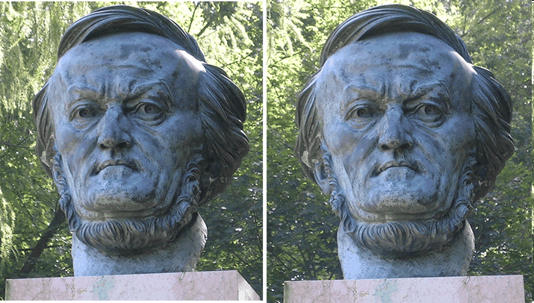
Example: estimating “fundamental matrix” that corresponds two views
Slide from Silvio Savarese

Slide 6
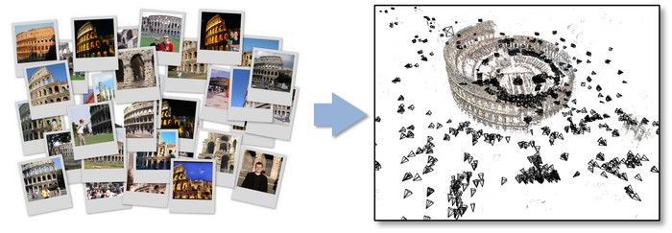
Example: structure from motion

Slide 7
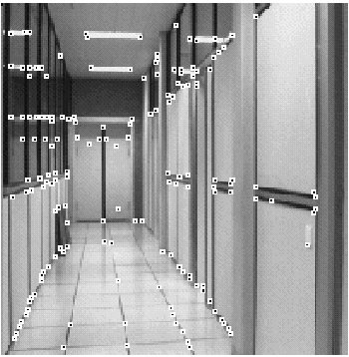
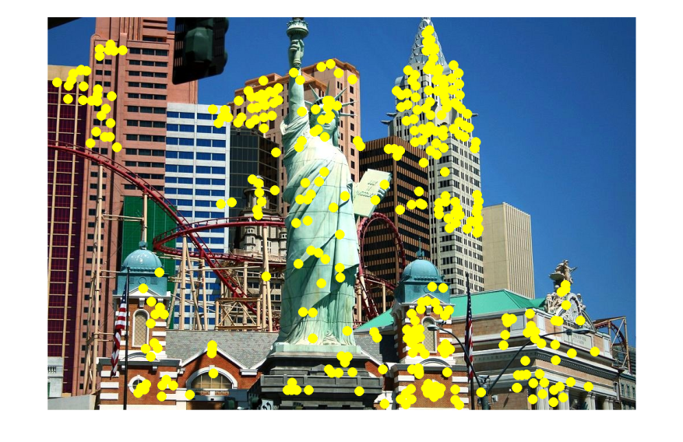
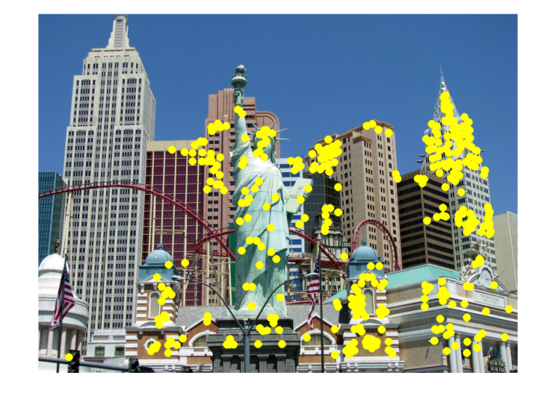
Applications
Feature points are used for:
Image alignment
3D reconstruction
Motion tracking
Robot navigation
Indexing and database retrieval
Object recognition

Slide 8
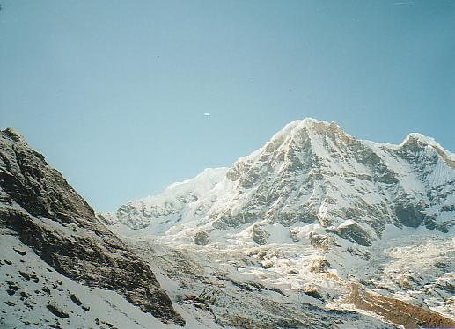
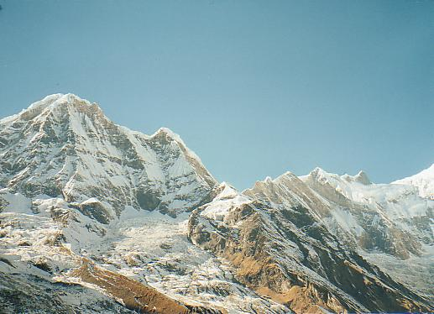
Example: Panorama stitching
We have two images – how do we combine them?

Slide 9
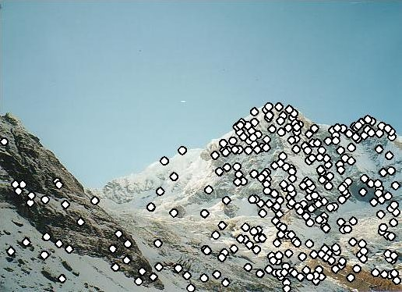
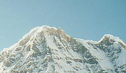
Local features: main components
Detection: Identify the interest points
Description: Extract vector feature descriptor surrounding each interest point.
Matching: Determine correspondence between descriptors in two views
Kristen Grauman

Slide 10
Detectors

Slide 11
Local features: main components
Detection: Identify the interest points
Description:Extract vector feature descriptor surrounding each interest point.
Matching: Determine correspondence between descriptors in two views

Slide 12
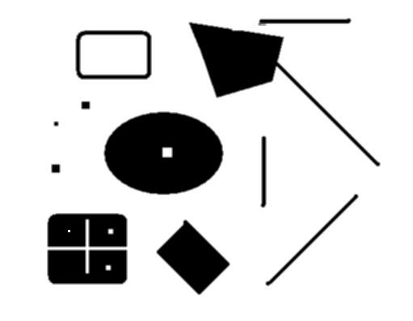
Interest points defined
original
Suppose you have to click on some point, go away and come back after I deform the image, and click on the same points again.
Which points would you choose?
deformed

Slide 13
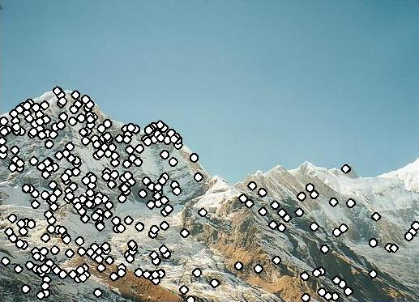
Characteristics of good features
Repeatability
The same feature can be found in several images despite geometric and photometric transformations
Saliency
Each feature is distinctive
Compactness and efficiency
Many fewer features than image pixels
Locality
A feature occupies a relatively small area of the image; robust to clutter and occlusion

Slide 14
Goal: interest operator repeatability
We want to detect (at least some of) the same points in both images.
Yet we have to be able to run the detection procedure independently per image.
No chance to find true matches!
Kristen Grauman
Notes:
14

Slide 15
History
Hans Moravec 1980
Harris Corners 1988
[Wolf & Platt 1993: FCN!]
SIFT (Lowe) 2004
FAST 2006 (learning!)
SURF 2006
ORB 2011

Slide 16
Corner Detection: Basic Idea
We should easily recognize the point by looking through a small window
Shifting a window in any direction should give a large change in intensity
“flat” region: no change in all directions
“edge”: no change along the edge direction
“corner”: significant change in all directions
Source: A. Efros

Slide 17
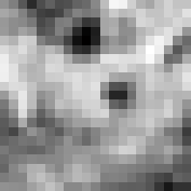
Corner Detection: Mathematics
Change in appearance of window w(x,y)
for the shift [u,v]:
I(x, y)
E(u, v)
E(3,2)
w(x, y)

Slide 18
Corner Detection: Mathematics
Change in appearance of window w(x,y)
for the shift [u,v]:
I(x, y)
E(u, v)
E(0,0)
w(x, y)

Slide 19
Corner Detection: Mathematics
Change in appearance of window w(x,y)
for the shift [u,v]:
Window function
Shifted intensity
Intensity
Window function w(x,y) =
or
1 in window, 0 outside
Gaussian
Source: R. Szeliski

Slide 20
Corner Detection: Mathematics
Change in appearance of window w(x,y)
for the shift [u,v]:
We want to find out how this function behaves for small shifts
E(u, v)

Slide 21
Corner Detection: Mathematics
Change in appearance of window w(x,y)
for the shift [u,v]:
We want to find out how this function behaves for small shifts
But this is very slow to compute naively.
O(window_width² * shift_range² * image_width²)
O( 11² * 11² * 600² ) = 5.2 billion of these
14.6 thousand per pixel in your image

Slide 22
Corner Detection: Mathematics
Change in appearance of window w(x,y)
for the shift [u,v]:
We want to find out how this function behaves for small shifts
Recall Taylor series expansion. A function f can be approximated around point a as

Slide 23
Corner Detection: Mathematics
Change in appearance of window w(x,y)
for the shift [u,v]:
We want to find out how this function behaves for small shifts
Local quadratic approximation of E(u,v) in the neighborhood of (0,0) is given by the second-order Taylor expansion:
Notes:
Technically a Maclaurin expansion, a special case of Taylor expansion centered at 0.
What is the point? Well, now we’re just extrapolating local measurements instead of doing 10s of thousands of computations.

Slide 24
Corner Detection: Mathematics
Local quadratic approximation of E(u,v) in the neighborhood of (0,0) is given by the second-order Taylor expansion:
E(u, v)
Always 0
First derivative is 0
Notes:
Technically a Maclaurin expansion, a special case of Taylor expansion centered at 0.

Slide 25
Corner Detection: Mathematics
The quadratic approximation simplifies to
where M is a second moment matrix computed from image derivatives:
M

Slide 26
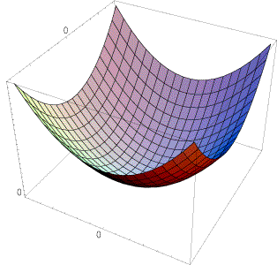
Interpreting the second moment matrix
The surface E(u,v) is locally approximated by a quadratic form. Let’s try to understand its shape.

Slide 27
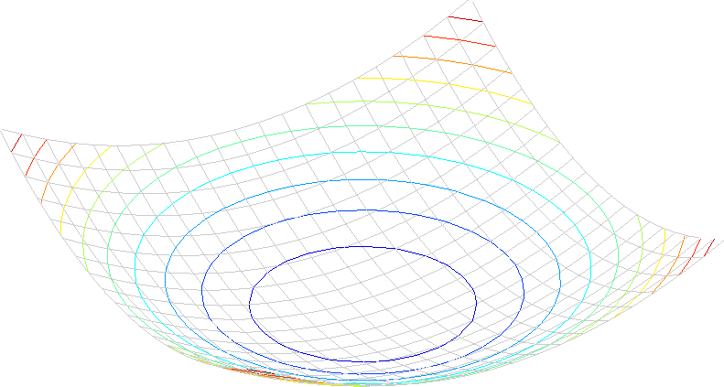
Interpreting the second moment matrix
Consider a horizontal “slice” of E(u, v):
This is the equation of an ellipse.

Slide 28
Interpreting the second moment matrix
Consider a horizontal “slice” of E(u, v):
This is the equation of an ellipse.
Diagonalization of M:
The axis lengths of the ellipse are determined by the eigenvalues and the orientation is determined by R
direction of the fastest change
direction of the slowest change
(λ_{max})^{-1/2}
(λ_{min})^{-1/2}

Slide 29
Interpreting the eigenvalues
Classification of image points using eigenvalues of M:
λ₂
“Edge” λ₂ >> λ₁
“Corner” λ₁ and λ₂ are large, λ₁ ~ λ₂; E increases in all directions
λ₁ and λ₂ are small; E is almost constant in all directions
“Flat” region
“Edge” λ₁ >> λ₂
λ₁

Slide 30
Corner response function
α: constant (0.04 to 0.06)
“Edge” R < 0
“Corner” R > 0
|R| small
“Flat” region
“Edge” R < 0

Slide 31
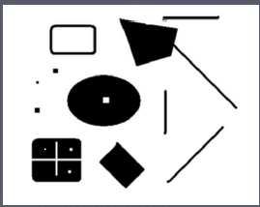
Corners as distinctive interest points
2 x 2 matrix of image derivatives (averaged in neighborhood of a point).
Notation:

Slide 32
Harris corner detector
Compute M matrix for each image window to get their cornerness scores.
Find points whose surrounding window gave large corner response (f> threshold)
Take the points of local maxima, i.e., perform non-maximum suppression
C.Harris and M.Stephens. “A Combined Corner and Edge Detector.” Proceedings of the 4th Alvey Vision Conference: pages 147—151, 1988.
Notes:
32

Slide 33
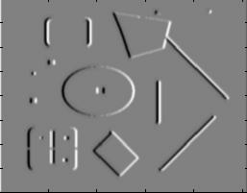
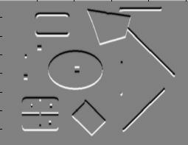
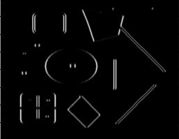
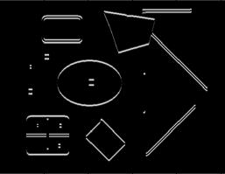
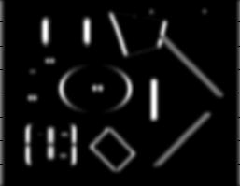
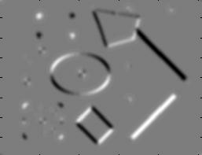
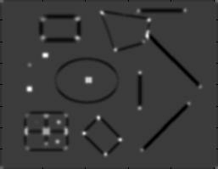
Harris Detector [Harris88]
Second moment matrix
1. Image derivatives
I_{x}
I_{y}
(optionally, blur first)
I_{x}²
I_{y}²
I_{x}I_{y}
2. Square of derivatives
3. Gaussian filter g(σ_{I})
g(I_{x}²)
g(I_{y}²)
g(I_{x}I_{y})
4. Cornerness function – both eigenvalues are strong
5. Non-maxima suppression
har

Slide 34
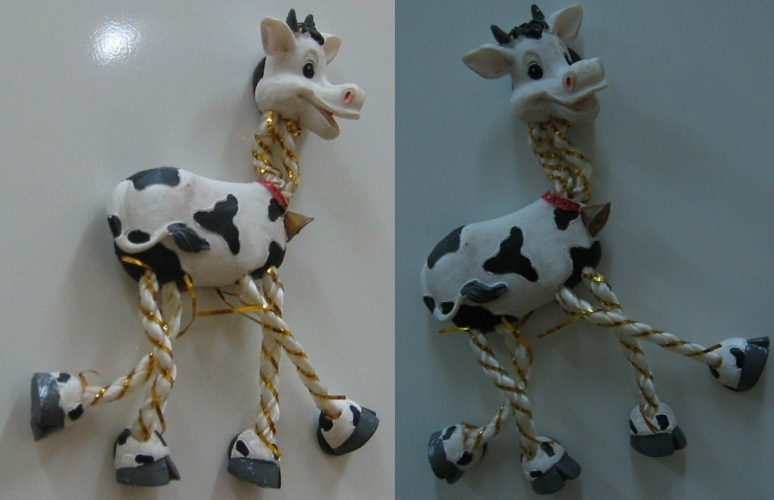
Harris Detector: Steps

Slide 35
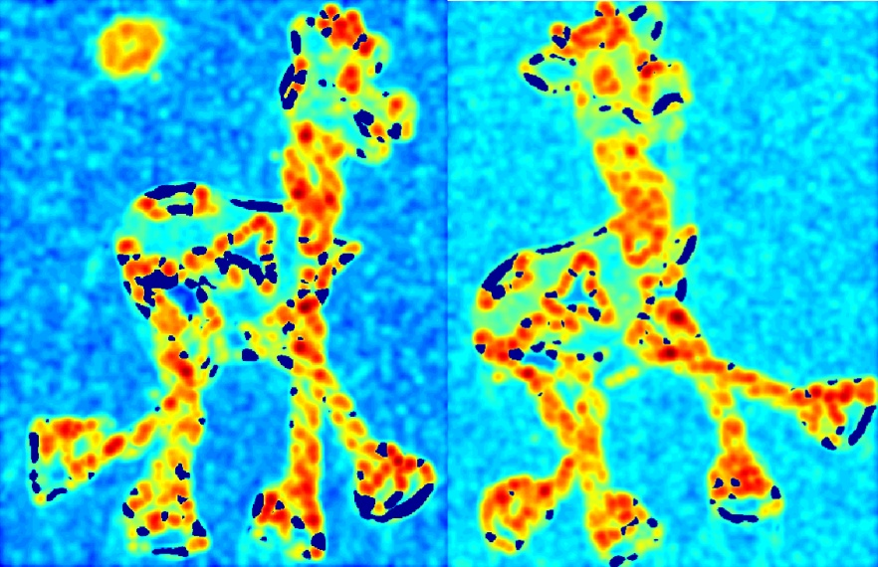
Harris Detector: Steps
Compute corner response R

Slide 36
Harris Detector: Steps
Find points with large corner response: R>threshold

Slide 37
Harris Detector: Steps
Take only the points of local maxima of R

Slide 38
Harris Detector: Steps

Slide 39
Deep Detectors

Slide 40
Many “Classical” Detectors Available
Hessian & Harris [Beaudet ‘78], [Harris ‘88]
Laplacian, DoG [Lindeberg ‘98], [Lowe 1999]
Harris-/Hessian-Laplace [Mikolajczyk & Schmid ‘01]
Harris-/Hessian-Affine [Mikolajczyk & Schmid ‘04]
EBR and IBR [Tuytelaars & Van Gool ‘04]
MSER [Matas ‘02]
Salient Regions [Kadir & Brady ‘01]
Others…

Slide 41
CVPR 2015
Train on images from webcams: fixed view, different times
Learn CNN-like regressor
Loss = repeatability

