Slide 1
Deep Object Recognition
Frank Dellaert
CS 6476 Computer Vision at Georgia Tech
Several Slides by Dhruv Bathra, James Hays, Kaiming He, and others

Slide 2
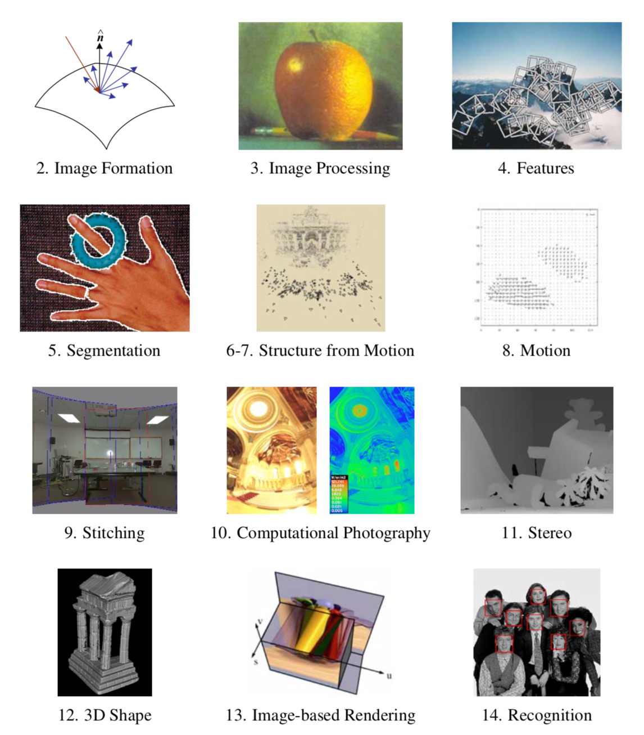

Slide 5
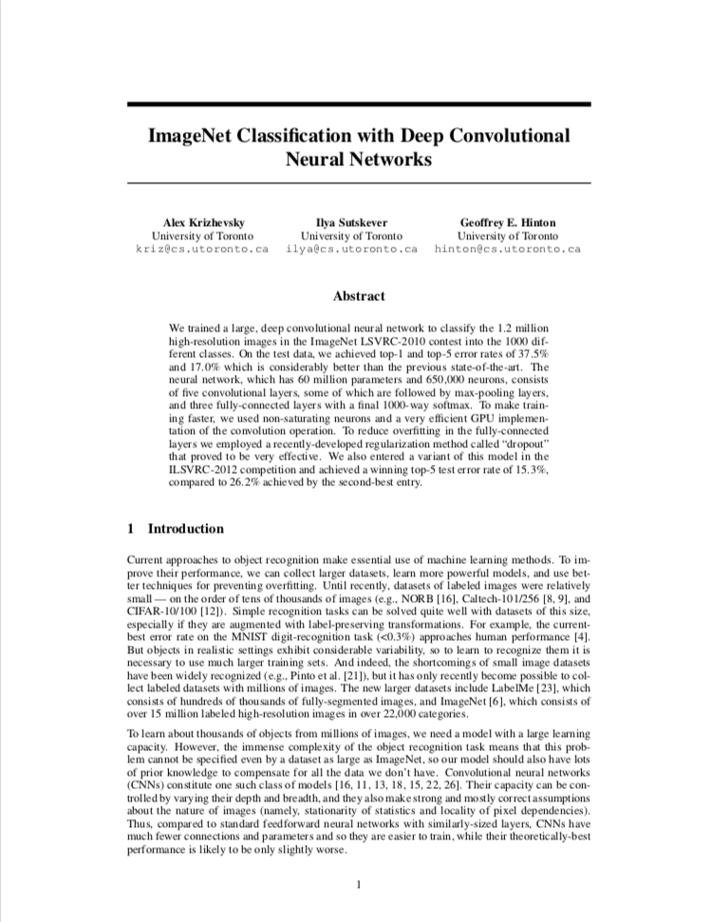
AlexNet
CNN by Alex Krizhevsky, Ilya Sutskever and Geoffrey Hinton
Competed in the ImageNet Large Scale Visual Recognition Challenge on September 30, 2012. Achieved a top-5 error of 15.3%, beating SOTA by 10%.
Seen by many as the start of the DL revolution in CV.
That claim is contested by Jürgen Schmidhuber, whose postdoc Dan Ciresan published a similar result in IJCAI 2011 (but on easier datasets).
Both owe a debt to Fukushima, who invented CNNs in 1980, and Yann LeCun, who applied backprop to CNNs in 89.

Slide 7
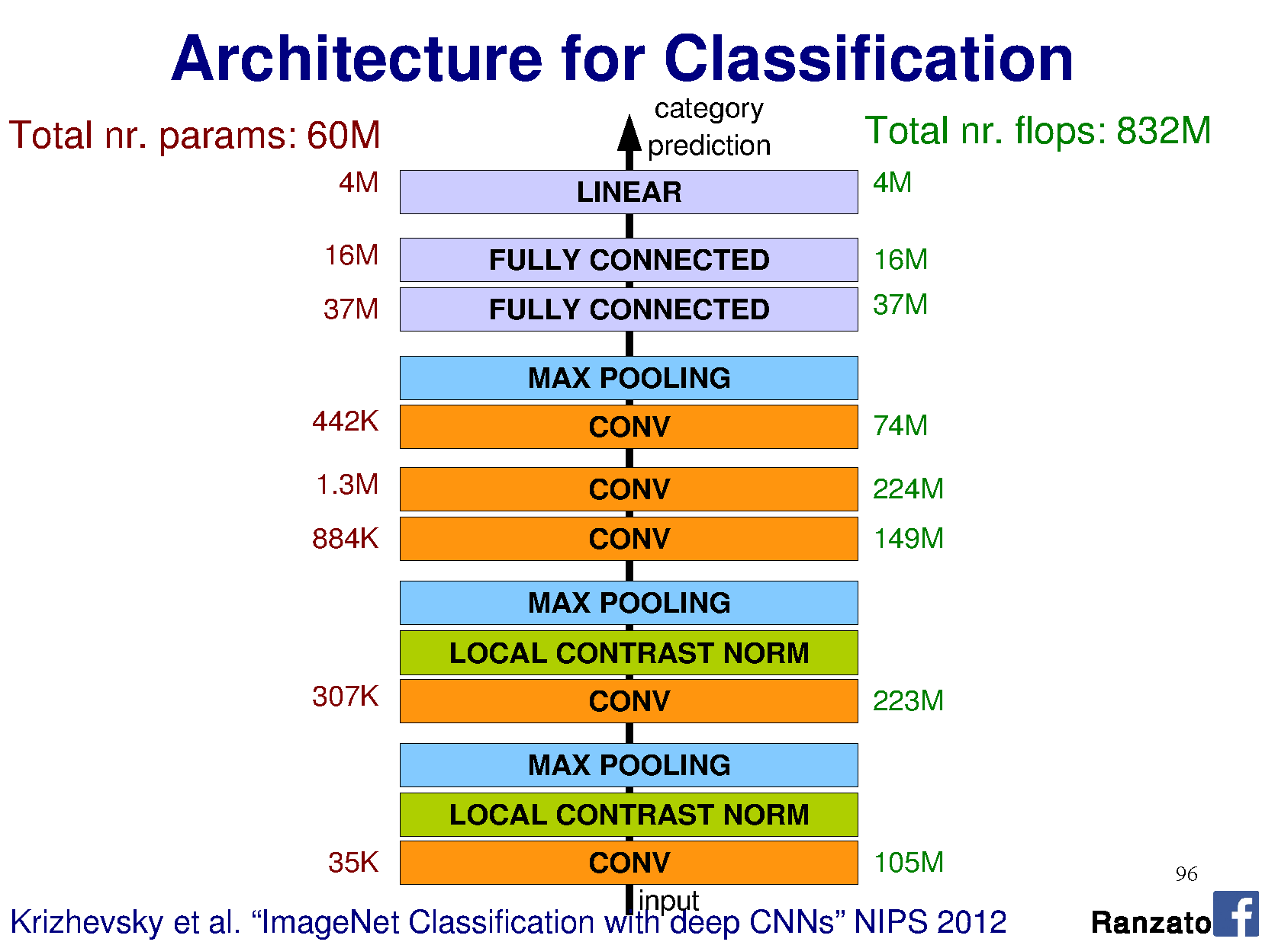

Slide 9
Notes:
This is top 5 error

Slide 10
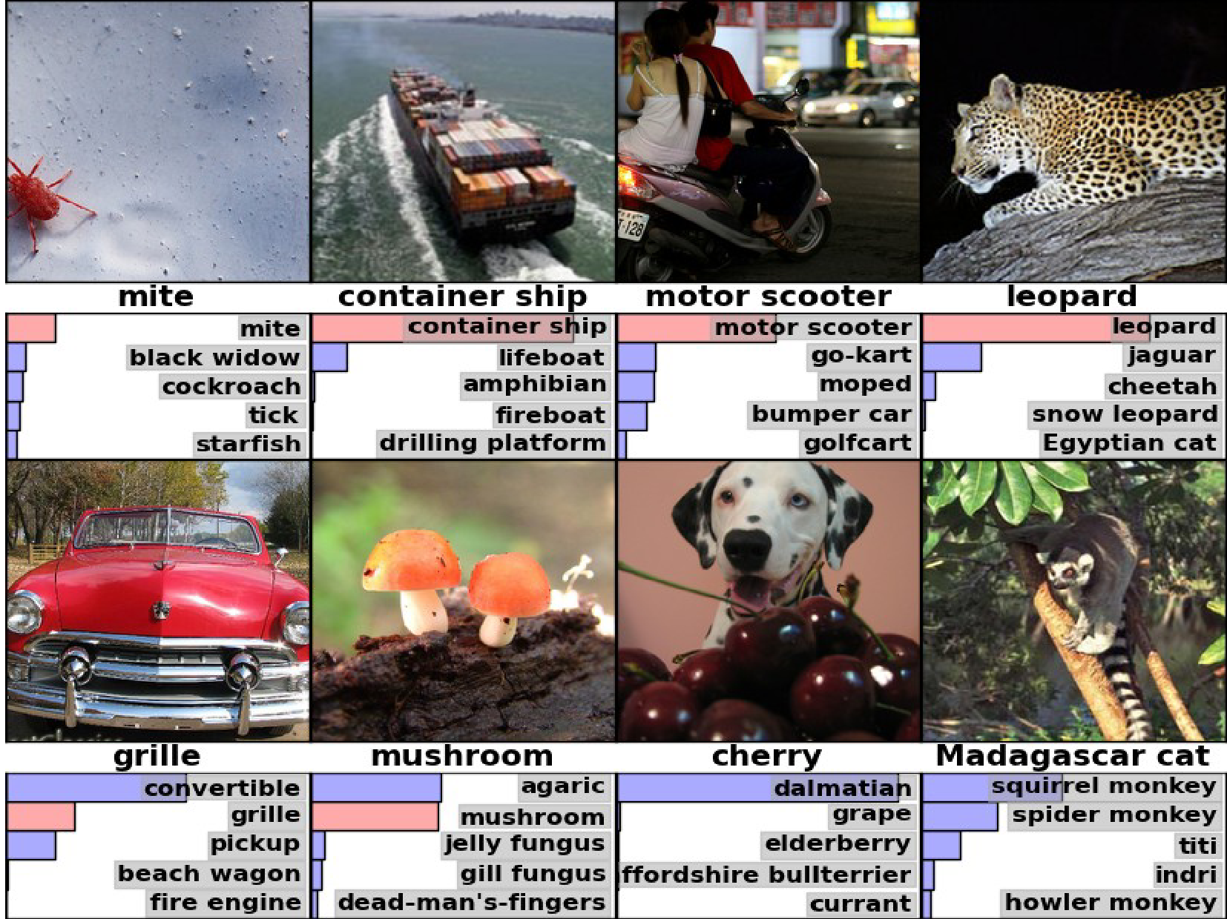

Slide 11
Beyond AlexNet

Slide 12
VERY DEEP CONVOLUTIONAL NETWORKS FOR LARGE-SCALE IMAGE RECOGNITION
Karen Simonyan & Andrew Zisserman 2015
These are the “VGG” networks.

Slide 13
VGG
Notes:
Compared to Alex-Net – Deeper, smaller convolutions, more parameters

Slide 14
Notes:
Compared to Alex-Net – Deeper, smaller convolutions, more parameters

Slide 15
Going Deeper with Convolutions
Christian Szegedy, Wei Liu, Yangqing Jia, Pierre Sermanet, Scott Reed,
Dragomir Anguelov, Dumitru Erhan, Vincent Vanhoucke, Andrew Rabinovich 2015
This is the “Inception” architecture or “GoogLeNet”
*The architecture blocks are called “Inception” modules and the collection of them into a particular net is “GoogLeNet”

Slide 17
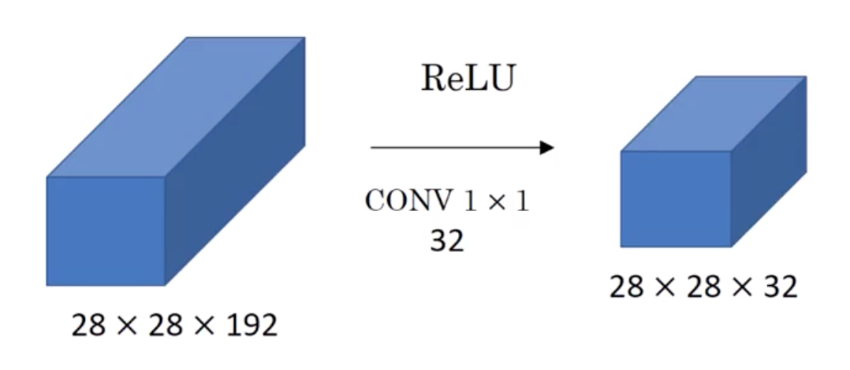
1x1 Convolutions
Linearly reduce a set of n features to a set of m features. Example: 192 -> 32
I.e., matrix multiplication with m x n matrix, at each location (32x192 in example: 32 “bases”)
Typically followed by ReLU

Slide 18
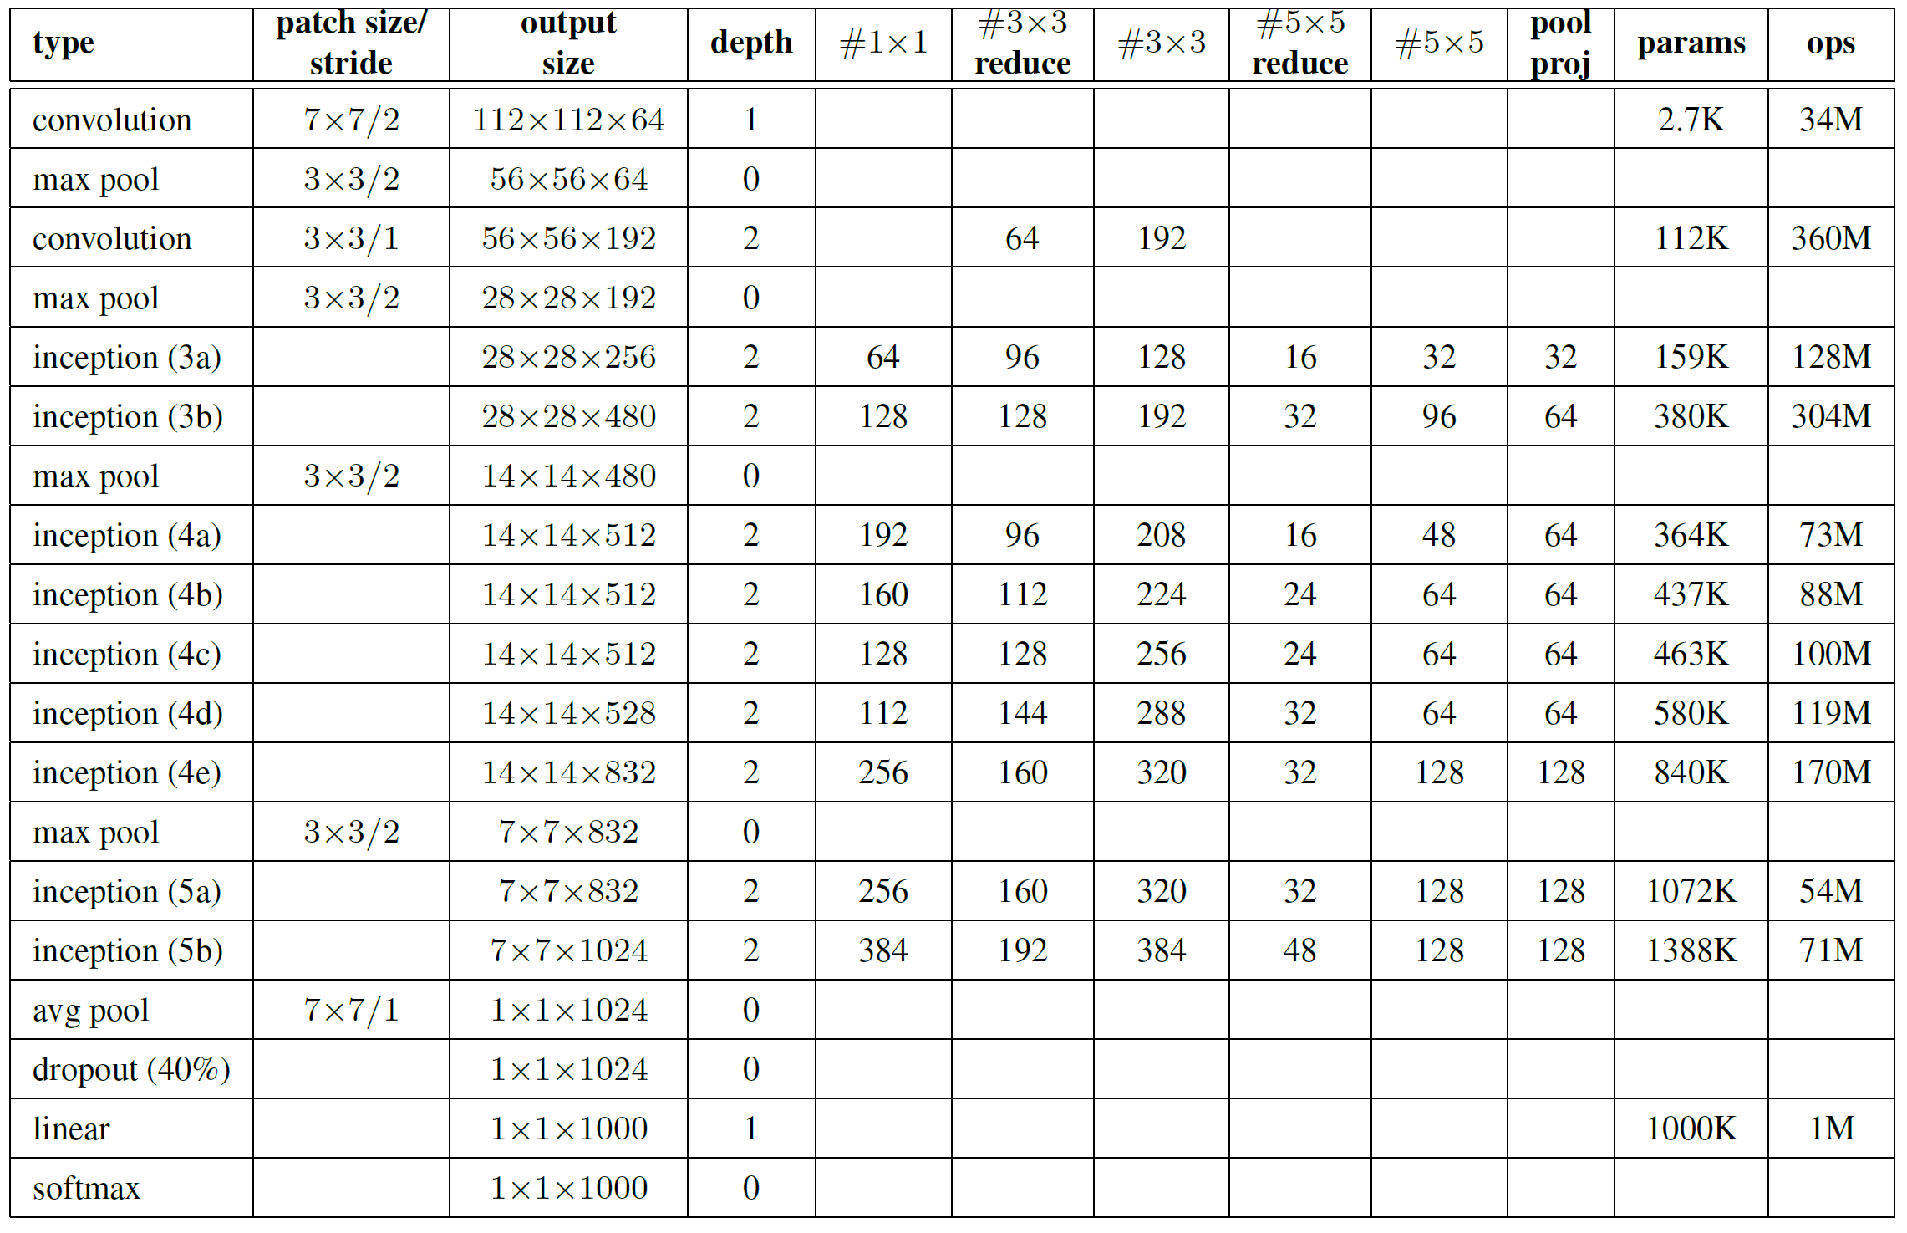
GoogLeNet: Only 6.8 million parameters. AlexNet ~60 million, VGG up to 138 million

Slide 20
Results
ILSVRC 2014:

Slide 21
Revolution of Depth
soft max2
Soft maxAct ivat ion
FC
AlexNet, 8 layers
(ILSVRC 2012)
11x11 conv, 96, /4, pool/2
VGG, 19 layers
(ILSVRC 2014)
3x3 conv, 64
GoogleNet, 22 layers
(ILSVRC 2014)
AveragePool 7x7 + 1 (V)
Dept hConcat
5x5 conv, 256, pool/2
3x3 conv, 64, pool/2
Conv Conv Conv Conv 1x1 + 1 (S) 3x3 + 1 (S) 5x5 + 1 (S) 1x1 + 1 (S)
Conv Conv MaxPool 1x1 + 1 (S) 1x1 + 1 (S) 3x3 + 1 (S)
3x3 conv, 384
3x3 conv, 128
Dept hConcat
Conv Conv Conv Conv 1x1 + 1 (S) 3x3 + 1 (S) 5x5 + 1 (S) 1x1 + 1 (S)
soft max1
3x3 conv, 384
3x3 conv, 128, pool/2
Conv Conv MaxPool 1x1 + 1 (S) 1x1 + 1 (S) 3x3 + 1 (S)
Soft maxAct ivat ion
MaxPool 3x3 + 2 (S)
FC
3x3 conv, 256, pool/2
3x3 conv, 256
Dept hConcat
FC
Conv Conv Conv Conv Conv 1x1 + 1 (S) 3x3 + 1 (S) 5x5 + 1 (S) 1x1 + 1 (S) 1x1 + 1 (S)
fc, 4096
3x3 conv, 256
Conv Conv MaxPool AveragePool 1x1 + 1 (S) 1x1 + 1 (S) 3x3 + 1 (S) 5x5 + 3 (V)
Dept hConcat
fc, 4096
3x3 conv, 256
Conv Conv Conv Conv 1x1 + 1 (S) 3x3 + 1 (S) 5x5 + 1 (S) 1x1 + 1 (S)
Conv Conv MaxPool 1x1 + 1 (S) 1x1 + 1 (S) 3x3 + 1 (S)
fc, 1000
3x3 conv, 256, pool/2
Dept hConcat
soft max0
Conv Conv Conv Conv 1x1 + 1 (S) 3x3 + 1 (S) 5x5 + 1 (S) 1x1 + 1 (S)
Soft maxAct ivat ion
3x3 conv, 512
Conv Conv MaxPool 1x1 + 1 (S) 1x1 + 1 (S) 3x3 + 1 (S)
FC
Dept hConcat
FC
3x3 conv, 512
Conv Conv Conv Conv Conv 1x1 + 1 (S) 3x3 + 1 (S) 5x5 + 1 (S) 1x1 + 1 (S) 1x1 + 1 (S)
Conv Conv MaxPool AveragePool 1x1 + 1 (S) 1x1 + 1 (S) 3x3 + 1 (S) 5x5 + 3 (V)
3x3 conv, 512
Dept hConcat
Conv Conv Conv Conv 1x1 + 1 (S) 3x3 + 1 (S) 5x5 + 1 (S) 1x1 + 1 (S)
3x3 conv, 512, pool/2
Conv Conv MaxPool 1x1 + 1 (S) 1x1 + 1 (S) 3x3 + 1 (S)
MaxPool 3x3 + 2 (S)
3x3 conv, 512
Dept hConcat
Conv Conv Conv Conv 1x1 + 1 (S) 3x3 + 1 (S) 5x5 + 1 (S) 1x1 + 1 (S)
3x3 conv, 512
Conv Conv MaxPool 1x1 + 1 (S) 1x1 + 1 (S) 3x3 + 1 (S)
Dept hConcat
3x3 conv, 512
Conv Conv Conv Conv 1x1 + 1 (S) 3x3 + 1 (S) 5x5 + 1 (S) 1x1 + 1 (S)
Conv Conv MaxPool 1x1 + 1 (S) 1x1 + 1 (S) 3x3 + 1 (S)
3x3 conv, 512, pool/2
MaxPool 3x3 + 2 (S)
LocalRespNorm
fc, 4096
Conv 3x3 + 1 (S)
Conv 1x1 + 1 (V)
fc, 4096
LocalRespNorm
MaxPool 3x3 + 2 (S)
fc, 1000
Conv 7x7 + 2 (S)
input
Kaiming He, Xiangyu Zhang, Shaoqing Ren, & Jian Sun. “Deep Residual Learning for Image Recognition”. CVPR 2016.

Slide 22
Surely it would be ridiculous to go any deeper…
Introducing: ResNet
11x11 conv, 96, /4, pool/2
7x7 conv, 64, /2, pool/2
1x1 conv, 64
3x3 conv, 64 1x1 conv, 256 1x1 conv, 64 3x3 conv, 64
1x1 conv, 256 1x1 conv, 64 3x3 conv, 64 1x1 conv, 256
1x1 conv, 128, /2
3x3 conv, 128
1x1 conv, 512
1x1 conv, 128
3x3 conv, 128
1x1 conv, 512
1x1 conv, 128
3x3 conv, 128
1x1 conv, 512
1x1 conv, 128
3x3 conv, 128
1x1 conv, 512
1x1 conv, 128
3x3 conv, 128
1x1 conv, 512
1x1 conv, 128
3x3 conv, 128
1x1 conv, 512
1x1 conv, 128
3x3 conv, 128
1x1 conv, 512
1x1 conv, 128
3x3 conv, 128
1x1 conv, 512
1x1 conv, 256, /2
3x3 conv, 256
1x1 conv, 1024
AlexNet, 8 layers
(ILSVRC 2012)
5x5 conv, 256, pool/2
3x3 conv, 384
3x3 conv, 384 3x3 conv, 256, pool/2
fc, 4096
fc, 4096
fc, 1000
VGG, 19 layers
(ILSVRC 2014)
3x3 conv, 64
3x3 conv, 64, pool/2 3x3 conv, 128
3x3 conv, 128, pool/2 3x3 conv, 256
3x3 conv, 256
3x3 conv, 256 3x3 conv, 256, pool/2
3x3 conv, 512
3x3 conv, 512
3x3 conv, 512 3x3 conv, 512, pool/2
3x3 conv, 512
3x3 conv, 512
3x3 conv, 512 3x3 conv, 512, pool/2
fc, 4096
fc, 4096
fc, 1000
ResNet, 152 layers
(ILSVRC 2015)
1x1 conv, 256
3x3 conv, 256
1x1 conv, 1024
1x1 conv, 256
3x3 conv, 256
1x1 conv, 1024
1x1 conv, 256
3x3 conv, 256
1x1 conv, 1024
1x1 conv, 256
3x3 conv, 256
1x1 conv, 1024
1x1 conv, 256
3x3 conv, 256
1x1 conv, 1024
1x1 conv, 256
3x3 conv, 256
1x1 conv, 1024
1x1 conv, 256
3x3 conv, 256
1x1 conv, 1024
1x1 conv, 256
3x3 conv, 256
1x1 conv, 1024
1x1 conv, 256
3x3 conv, 256
1x1 conv, 1024
1x1 conv, 256
3x3 conv, 256
1x1 conv, 1024
1x1 conv, 256
3x3 conv, 256
1x1 conv, 1024
1x1 conv, 256
3x3 conv, 256
1x1 conv, 1024
1x1 conv, 256
3x3 conv, 256
1x1 conv, 1024
1x1 conv, 256
3x3 conv, 256
1x1 conv, 1024
1x1 conv, 256
3x3 conv, 256
1x1 conv, 1024
1x1 conv, 256
3x3 conv, 256
1x1 conv, 1024
1x1 conv, 256
3x3 conv, 256
1x1 conv, 1024
1x1 conv, 256
3x3 conv, 256
1x1 conv, 1024
1x1 conv, 256
3x3 conv, 256
1x1 conv, 1024
1x1 conv, 256
3x3 conv, 256
1x1 conv, 1024
1x1 conv, 256
3x3 conv, 256
1x1 conv, 1024
1x1 conv, 256
3x3 conv, 256
1x1 conv, 1024
1x1 conv, 256
3x3 conv, 256
1x1 conv, 1024
1x1 conv, 256
3x3 conv, 256
1x1 conv, 1024
1x1 conv, 256
3x3 conv, 256
1x1 conv, 1024
1x1 conv, 256
3x3 conv, 256
1x1 conv, 1024
1x1 conv, 256
3x3 conv, 256
1x1 conv, 1024
1x1 conv, 256
3x3 conv, 256
1x1 conv, 1024
1x1 conv, 256
3x3 conv, 256
1x1 conv, 1024
1x1 conv, 256
3x3 conv, 256
1x1 conv, 1024
1x1 conv, 256
3x3 conv, 256
1x1 conv, 1024
1x1 conv, 256
3x3 conv, 256
1x1 conv, 1024
1x1 conv, 256
3x3 conv, 256
1x1 conv, 1024
1x1 conv, 256
3x3 conv, 256
1x1 conv, 1024
1x1 conv, 256
3x3 conv, 256
1x1 conv, 1024
1x1 conv, 512, /2
3x3 conv, 512
1x1 conv, 2048
1x1 conv, 512
3x3 conv, 512
1x1 conv, 2048
1x1 conv, 512
3x3 conv, 512
1x1 conv, 2048
ave pool, fc 1000
Kaiming He, Xiangyu Zhang, Shaoqing Ren, & Jian Sun. “Deep Residual Learning for Image Recognition”. CVPR 2016.

Slide 23
Revolution of Depth
28.2
25.8
152 layers
16.4
22 layers
6.7
11.7
19 layers
7.3
3.57
8 layers
8 layers
shallow
ILSVRC'15 | ILSVRC'14 | ILSVRC'14 | ILSVRC'13 | ILSVRC'12 | ILSVRC'11 | ILSVRC'10
ResNet | GoogleNet | VGG |  | AlexNet
ImageNet Classification top-5 error (%)
Kaiming He, Xiangyu Zhang, Shaoqing Ren, & Jian Sun. “Deep Residual Learning for Image Recognition”. CVPR 2016.

Slide 24
Revolution of Depth
101 layers
86
Engines of
visual recognition
66
58
34
16 layers
8 layers
shallow
HOG, DPM
AlexNet (RCNN)
VGG (RCNN)
ResNet (Faster RCNN)*
PASCAL VOC 2007 Object Detection mAP (%)
*w/ other improvements & more data
Kaiming He, Xiangyu Zhang, Shaoqing Ren, & Jian Sun. “Deep Residual Learning for Image Recognition”. CVPR 2016.

Slide 25
Deep Residual Learning
𝐹 𝑥 is a residual mapping w.r.t. identity
𝑥
weight layer
If identity were optimal, easy to set weights as 0
If optimal mapping is closer to identity, easier to find small fluctuations
𝐹(𝑥)
relu
identity
𝑥
weight layer
𝐻 𝑥 = 𝐹 𝑥 + 𝑥
relu
Kaiming He, Xiangyu Zhang, Shaoqing Ren, & Jian Sun. “Deep Residual Learning for Image Recognition”. CVPR 2016.

Slide 26
CIFAR-10 experiments
CIFAR-10 plain nets
CIFAR-10 ResNets
20
56-layer 44-layer 32-layer 20-layer
20
ResNet-20 ResNet-32 ResNet-44 ResNet-56
ResNet-110
20-layer 32-layer 44-layer 56-layer 110-layer
error (%)
error (%)
10
10
5
plain-20 plain-32 plain-44 plain-56
5
solid: test dashed: train
0
0
1
2
3
iter. (1e4)
4
5
6
0
0
1
2
3
iter. (1e4)
4
5
6
Deep ResNets can be trained without difficulties
Deeper ResNets have lower training error, and also lower test error
Kaiming He, Xiangyu Zhang, Shaoqing Ren, & Jian Sun. “Deep Residual Learning for Image Recognition”. CVPR 2016.

Slide 27
ResNets @ ILSVRC & COCO 2015 Competitions
1st places in all five main tracks
ImageNet Classification: “Ultra-deep” 152-layer nets
ImageNet Detection: 16% better than 2nd
ImageNet Localization: 27% better than 2nd
COCO Detection: 11% better than 2nd
COCO Segmentation: 12% better than 2nd
57K citations (in 6 years)
*improvements are relative numbers
Kaiming He, Xiangyu Zhang, Shaoqing Ren, & Jian Sun. “Deep Residual Learning for Image Recognition”. CVPR 2016.

Slide 28
Object Detection Architectures
boat
person
Image Classification (what?)
Object Detection (what + where?)

Slide 29
Object Detection: Early Work

Slide 30
Object Detection: R-CNN
figure credit: R. Girshick et al.
warped region
aeroplane? no.
.
CNN
person? yes.
..
tvmonitor? no.
input image
region proposals
~2,000
1 CNN for each region
-> 4096 feature vector
classify regions
Region-based CNN pipeline
Proposals by “Selective search” algorithm (2013)
Two “heads”:
classifier
BB regressor
Nice post: https://towardsdatascience.com/r-cnn-fast-r-cnn-faster-r-cnn-yolo-object-detection-algorithms-36d53571365e
Girshick, Donahue, Darrell, Malik. Rich Feature Hierarchies for Accurate Object Detection and Semantic Segmentation. CVPR 2014

Slide 31
Object Detection: R-CNN
R-CNN
feature
feature
feature
feature
End-to-End training
CNN
CNN
CNN
CNN
pre-computed Regions-of-Interest (RoIs)
image
Girshick, Donahue, Darrell, Malik. Rich Feature Hierarchies for Accurate Object Detection and Semantic Segmentation. CVPR 2014

Slide 32
Object Detection: Fast R-CNN
Fast R-CNN
feature
feature
feature
pre-computed Regions-of-Interest (RoIs)
RoI pooling
End-to-End training
shared conv layers
CNN
image
Girshick. Fast R-CNN. ICCV 2015

Slide 33
Object Detection: Fast R-CNN
Fast R-CNN
Girshick. Fast R-CNN. ICCV 2015

Slide 34
Object Detection: Faster R-CNN
features
Introduces “Region Proposal Networks” (RPNs)
Solely based on CNN: use for classification and regions
Each step is end-to-end
RoI pooling
proposals
Region Proposal Net
feature map
CNN
End-to-End training
Shaoqing Ren, Kaiming He, Ross Girshick, & Jian Sun. “Faster R-CNN: Towards Real-Time Object Detection with Region Proposal Networks”. NIPS 2015.

Slide 35
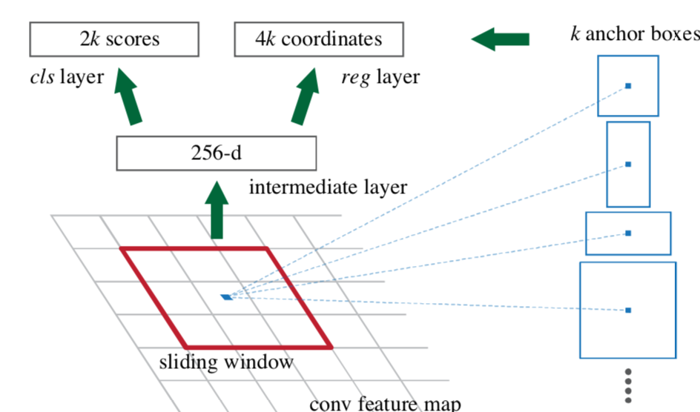
Region Proposal Nets in Faster R-CNN
In paper: k=9 (3 scales, 3 aspect ratios)
Sibling objectness (2k) and BB regression(4k) outputs
Shaoqing Ren, Kaiming He, Ross Girshick, & Jian Sun. “Faster R-CNN: Towards Real-Time Object Detection with Region Proposal Networks”. NIPS 2015.

Slide 36
Object Detection
ImageNet data
detection data
backbone structure
classification network
detection network
pre-train
features
fine-tune
AlexNet
VGG-16
GoogleNet
ResNet-101
…
“plug-in” features
R-CNN
Fast R-CNN
Faster R-CNN
MultiBox
SSD
…
independently developed
detectors
Slide by Kaiming He,

Slide 37
Faster R-CNN w Resnet
classifier
RoI pooling
Simply “Faster R-CNN + ResNet”
proposals
CNN | mAP@.5 | mAP@.5:.95
VGG-16 | 41.5 | 21.5
ResNet-101 | 48.4 | 27.2
Region Proposal Net
feature map
CNN
COCO detection results
ResNet-101 has 28% relative gain vs VGG-16
image
Kaiming He, Xiangyu Zhang, Shaoqing Ren, & Jian Sun. “Deep Residual Learning for Image Recognition”. CVPR 2016. Shaoqing Ren, Kaiming He, Ross Girshick, & Jian Sun. “Faster R-CNN: Towards Real-Time Object Detection with Region Proposal Networks”. NIPS 2015.

Slide 38
Faster R-CNN Efficiency
Expensive “Selective Search” is gone

Slide 39
Object Detection
RPN learns proposals by extremely deep nets
Uses only 300 proposals (no hand-designed proposals)
Add components:
Iterative localization
Context modeling
Multi-scale testing
All are based on CNN features; all are end-to-end
All benefit more from deeper features – cumulative gains!
Kaiming He, Xiangyu Zhang, Shaoqing Ren, & Jian Sun. “Deep Residual Learning for Image Recognition”. CVPR 2016. Shaoqing Ren, Kaiming He, Ross Girshick, & Jian Sun. “Faster R-CNN: Towards Real-Time Object Detection with Region Proposal Networks”. NIPS 2015.

Slide 40
ResNet’s object detection result on COCO
Kaiming He, Xiangyu Zhang, Shaoqing Ren, & Jian Sun. “Deep Residual Learning for Image Recognition”. CVPR 2016. Shaoqing Ren, Kaiming He, Ross Girshick, & Jian Sun. “Faster R-CNN: Towards Real-Time Object Detection with Region Proposal Networks”. NIPS 2015.

Slide 41
Kaiming He, Xiangyu Zhang, Shaoqing Ren, & Jian Sun. “Deep Residual Learning for Image Recognition”. CVPR 2016. Shaoqing Ren, Kaiming He, Ross Girshick, & Jian Sun. “Faster R-CNN: Towards Real-Time Object Detection with Region Proposal Networks”. NIPS 2015.

Slide 42
Kaiming He, Xiangyu Zhang, Shaoqing Ren, & Jian Sun. “Deep Residual Learning for Image Recognition”. CVPR 2016. Shaoqing Ren, Kaiming He, Ross Girshick, & Jian Sun. “Faster R-CNN: Towards Real-Time Object Detection with Region Proposal Networks”. NIPS 2015.

Slide 43
this video is available online: https://youtu.be/WZmSMkK9VuA
Results on real video. Models trained on MS COCO (80 categories). (frame-by-frame; no temporal processing)
Kaiming He, Xiangyu Zhang, Shaoqing Ren, & Jian Sun. “Deep Residual Learning for Image Recognition”. CVPR 2016. Shaoqing Ren, Kaiming He, Ross Girshick, & Jian Sun. “Faster R-CNN: Towards Real-Time Object Detection with Region Proposal Networks”. NIPS 2015.

Slide 44
More Visual Recognition Tasks
ResNet-based methods lead on these benchmarks (incomplete list):
ImageNet classification, detection, localization
MS COCO detection, segmentation
PASCAL VOC detection, segmentation
ResNet-101
Human pose estimation [Newell et al 2016]
Depth estimation [Laina et al 2016]
Segment proposal [Pinheiro et al 2016]
…
PASCAL segmentation leaderboard
ResNet-101
PASCAL detection leaderboard
Slide by Kaiming He,

Slide 45
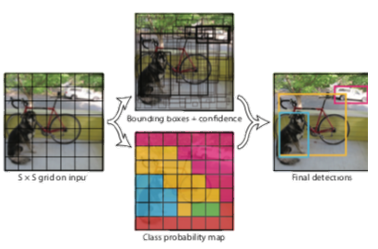
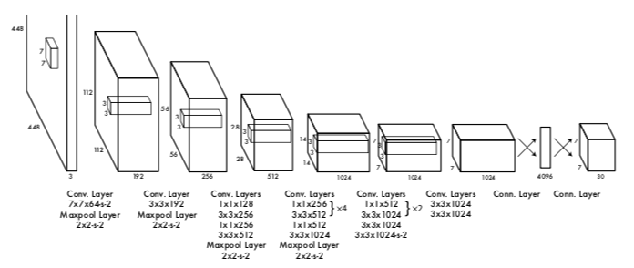
Yolo: You Only Look Once Jospeh Redmom et.al (resumé)
7x7 grid of cells
Each grid cell predicts
2 bounding boxes (x, y, w, h, confidence) = 10 reals
Probabilities over 20 classes
Final output: 7x7x30 tensor (30 = 5+5+20)
“the fastest extant object detector” at CVPR 2016

Slide 46
Yolo 1,2,3…
YOLO: CVPR 2016
YOLO9000 (YOLOv2) = CVPR 2017
YOLOv3: Arxiv 2018
Quotes from “YOLOv3: An Incremental Improvement”:
Sometimes you just kinda phone it in for a year, you know? … Spent a lot of time on Twitter. Played around with GANs a little.

Slide 47
Detectron

