Slide 1
Object Detection: Perceptrons, Boosting, and SVMs
Frank Dellaert
CS 4476 Computer Vision at Georgia Tech
Several Slides by Lana Lazebnik and others

Slide 2
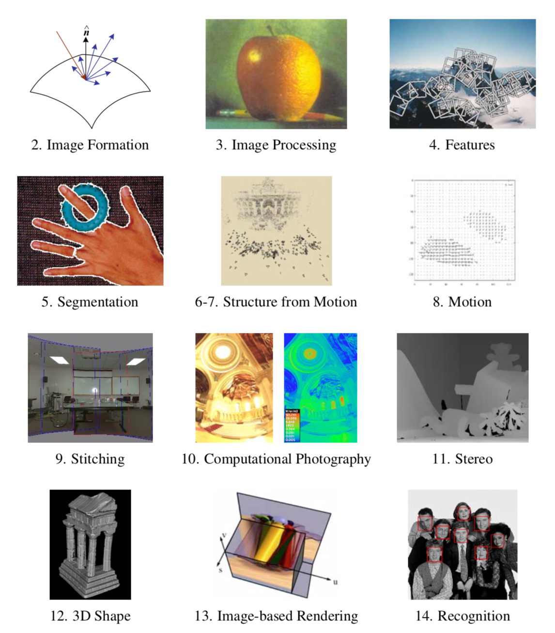

Slide 4
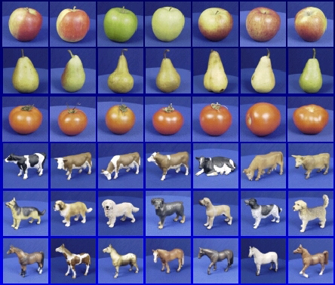
Image classification

Slide 5
The statistical learning framework
Apply a prediction function to a feature representation of the image to get the desired output:
f( ) = “apple”
f( ) = “tomato”
f( ) = “cow”

Slide 6
The statistical learning framework
y = f(x)
Training: given a training set of labeled examples {(x₁,y₁), …, (x_{N},y_{N})}, estimate the prediction function f by minimizing the prediction error on the training set
Testing: apply f to a never before seen test example x and output the predicted value y = f(x)
output
prediction function
feature representation

Slide 7
Steps
Training
Training Labels
Training Images
Image Features
Training
Learned model
Learned model
Testing
Image Features
Prediction
Test Image
Slide credit: D. Hoiem

Slide 8
“Classic” recognition pipeline
Feature representation
Trainable classifier
Image
Pixels
Class label
Hand-crafted feature representation
Off-the-shelf trainable classifier

Slide 9
Very brief tour of some classifiers
K-nearest neighbor
Perceptron
Boosting
SVM
Naïve Bayes
Bayesian network
Randomized Forests
Convolutional Neural networks

Slide 10
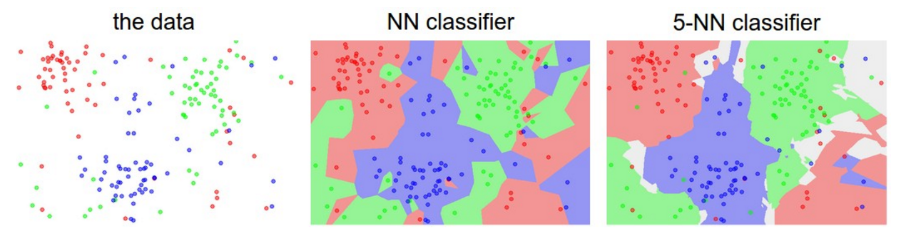
K-nearest neighbor classifier
Credit: Andrej Karpathy, http://cs231n.github.io/classification/

Slide 12
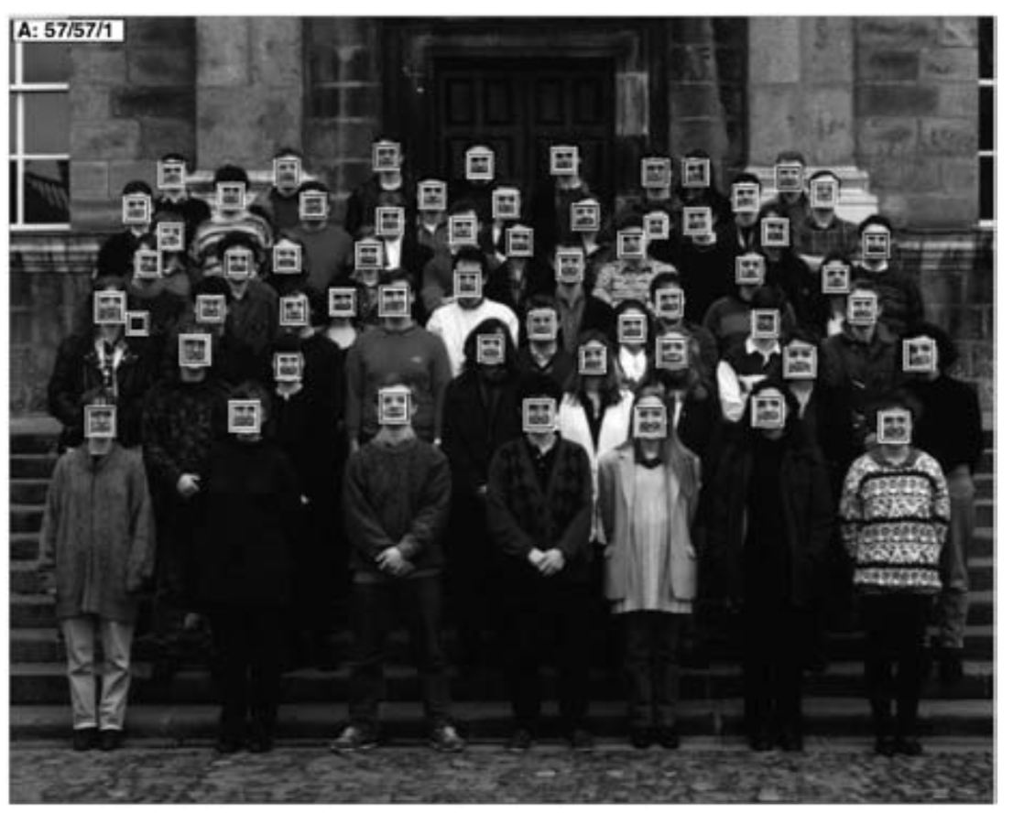
Face Detection: the problem

Slide 13
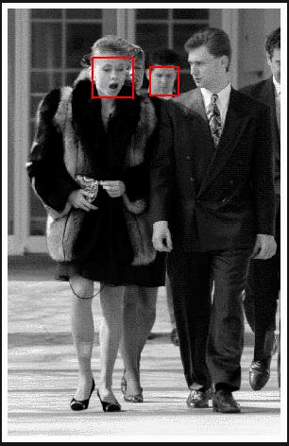
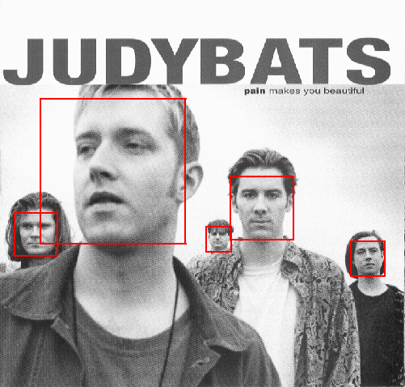
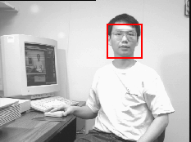
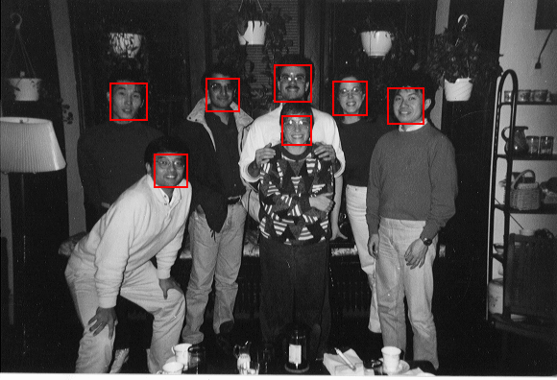
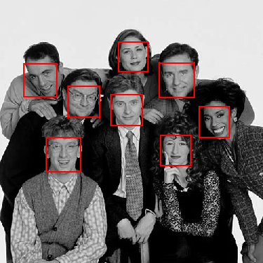
Output of Face Detector on Test Images

Slide 14
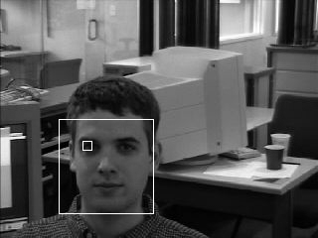
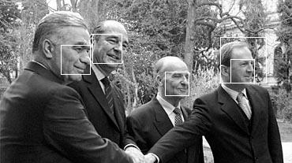
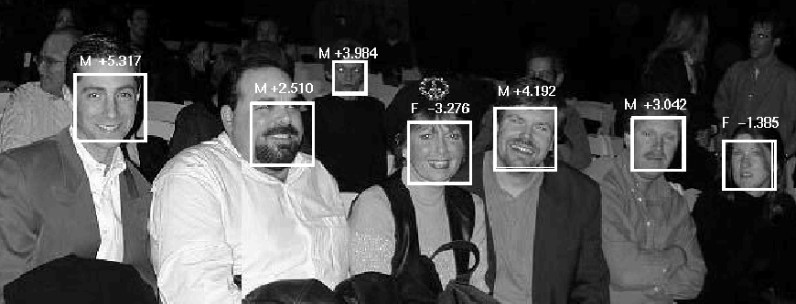
Solving other “Face” Tasks
Facial Feature Localization
Profile Detection
Demographic
Analysis

Slide 15
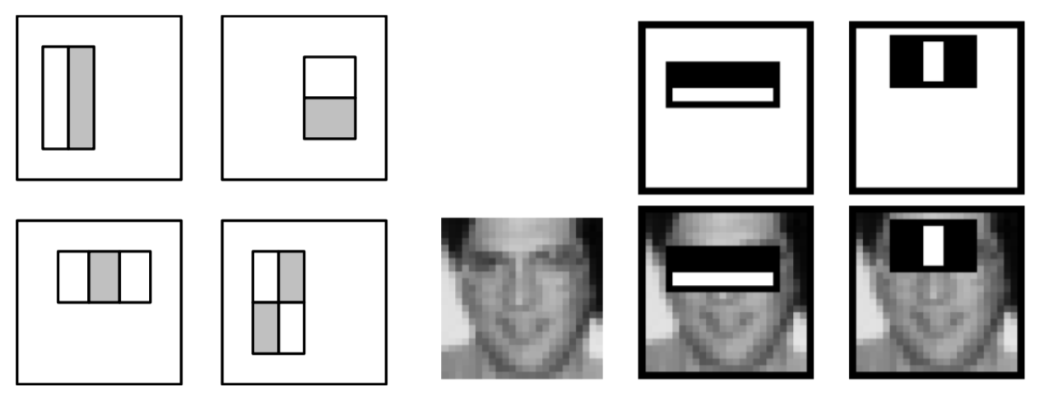
Haar Wavelet Features
Can be computed very efficiently using “integral transform”.
Introduced by Viola & Jones, CVPR 2001
“Rapid object detection using a boosted cascade of simple features”
One of the most influential CV papers
25K citations (SIFT: 54K)
384 by 288 pixel images
15 fps on 700 MHz Intel Pentium III ☺
24x24 detector windows
180K possible features
Scanned at multiple locations/scales
Notes:
For real problems results are only as good as the features used...
This is the main piece of ad-hoc (or domain) knowledge
Rather than the pixels, we have selected a very large set of simple functions
Sensitive to edges and other critcal features of the image
** At multiple scales
Since the final classifier is a perceptron it is important that the features be non-linear… otherwise the final classifier will be a simple perceptron.
We introduce a threshold to yield binary features

Slide 16
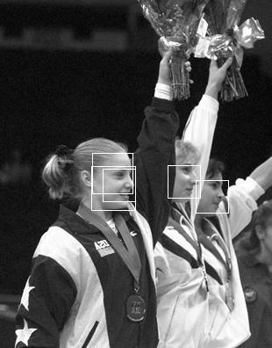
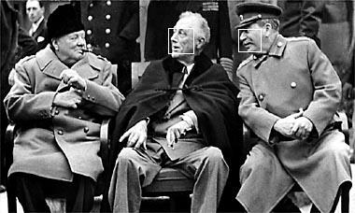
Profile Detection

Slide 18
Linear classifiers aka Perceptrons
Find a linear function to separate the classes:
f(x) = sgn(w ⋅ x + b)
Notes:
“Parametric” classifier: model defined by a small number of parameters (w, b)
Pros:
Very fast at test time
Cons:
Slow at training time: need to estimate the parameters
Only works for two classes
Data may not be linearly separable

Slide 19
Linear classifiers aka Perceptrons
When the data is linearly separable, there may be more than one separator (hyperplane)
Which separator is best?

Slide 20
Perceptron Learning
Start with w=0, b=0
R=max |x_{i}|
For i=1:N
if y_{i}(<wx_{i}>+b)<=0
w += f y_{i} x_{i}
b += f y_{i} R²
Terminate if all examples correctly classified

Slide 21
Nearest neighbor vs. linear classifiers
NN pros:
Simple to implement
Decision boundaries not necessarily linear
Works for any number of classes
Nonparametric method
NN cons:
Need good distance function
Slow at test time
Linear pros:
Low-dimensional parametric representation
Very fast at test time
Linear cons:
Works for two classes
How to train the linear function?
What if data is not linearly separable?

Slide 22
Szeliski, Chapter 14, Section 14.1.1

Slide 23
Weak learners
Accurate learners = hard
“so-so” learners = easy
Example:
if “buy” occurs in email, classify as SPAM
Weak learner = “rule of thumb”

Slide 24
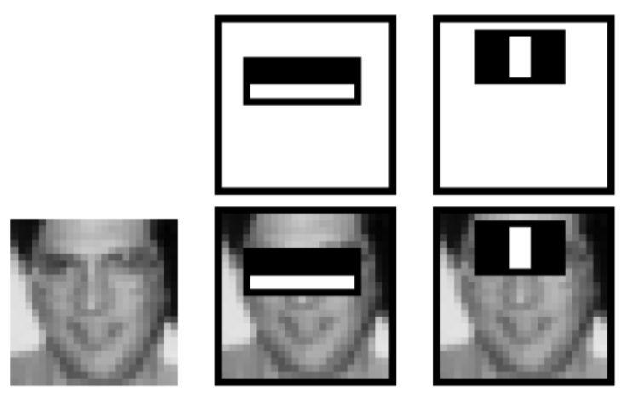
More Weak Learners
Perceptron
Decision stumps
Haar wavelets:

Slide 25
A Super Efficient Feature Selector
Adaboost Algorithm
Features = Weak Classifiers
Each round selects the optimal feature given:
Previous selected features
Exponential Loss

Slide 26
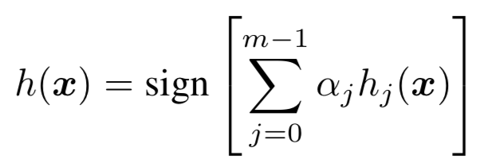
AdaBoost
Given a set of weak classifiers
None much better than random
Iteratively combine classifiers
Form a linear combination
Training error converges to 0 quickly
Test error is related to training margin

Slide 27
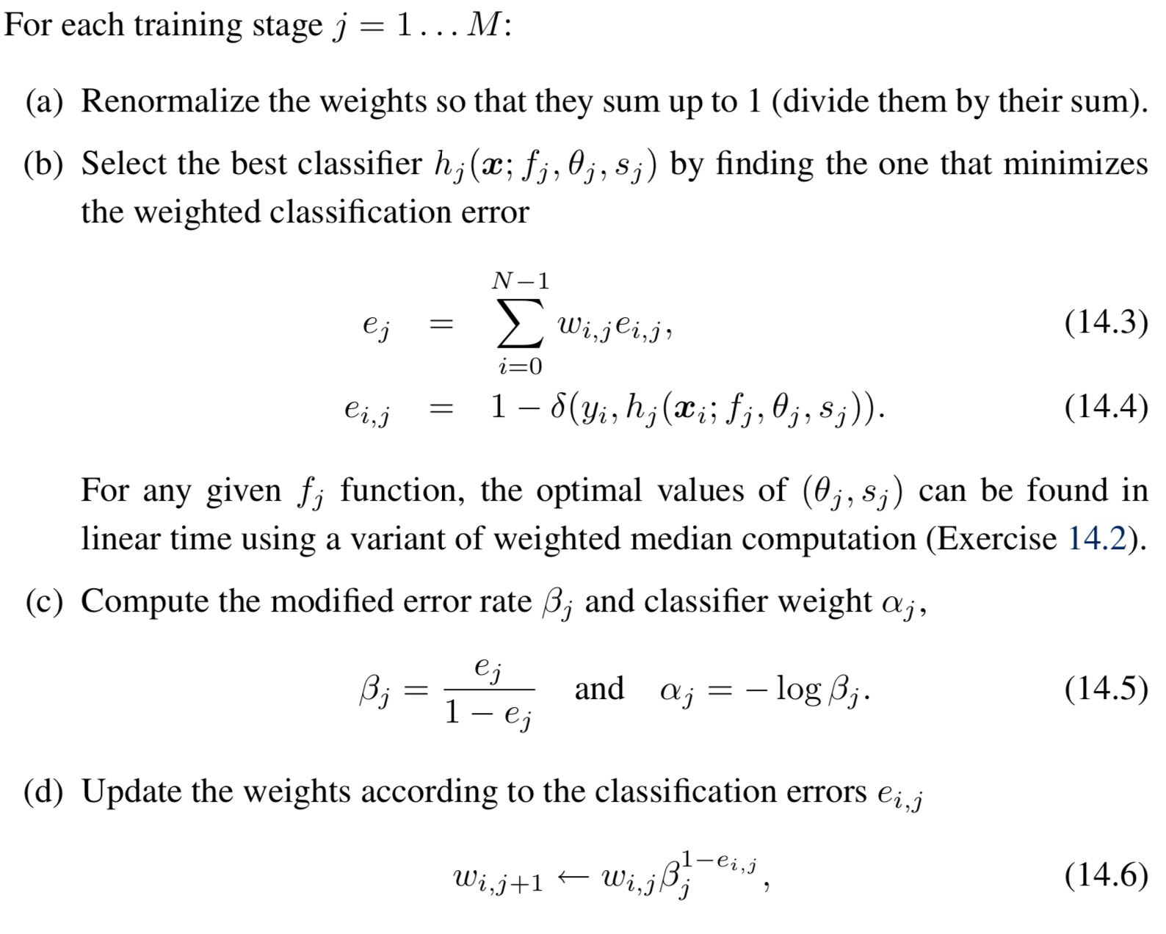
Adaboost Algorithm

Slide 28
AdaBoost at work…
Weak
Classifier 1
Final classifier is
linear combination of weak classifiers:
Weights
Increased
Weak
Classifier 2
Surprising Phenomenon:
Weak
classifier 3
After all examples are classified:
Test error keeps decreasing !
Connection with SVM: Margin increases

Slide 30
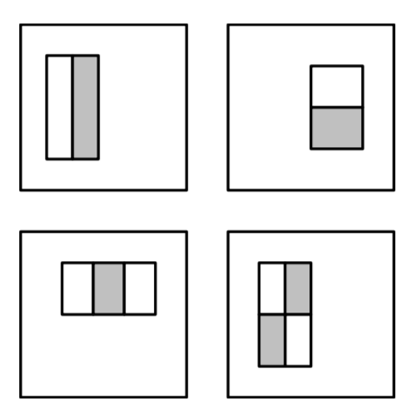
Recap: Haar Wavelet Features
“Rectangle filters”
Notes:
For real problems results are only as good as the features used...
This is the main piece of ad-hoc (or domain) knowledge
Rather than the pixels, we have selected a very large set of simple functions
Sensitive to edges and other critcal features of the image
** At multiple scales
Since the final classifier is a perceptron it is important that the features be non-linear… otherwise the final classifier will be a simple perceptron.
We introduce a threshold to yield binary features

Slide 31
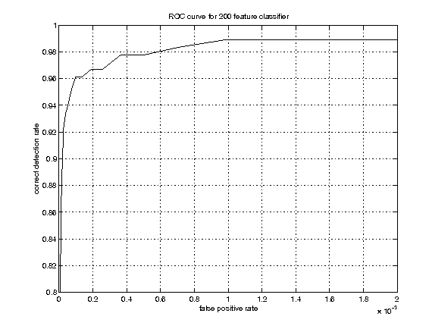
Example Classifier for Face Detection
A classifier with 200 rectangle features was learned using AdaBoost
95% correct detection on test set with 1 in 14084
false positives.
Not quite competitive...
ROC curve for 200 feature classifier

Slide 32
Building better (and faster) classifiers
Given a nested set of classifier hypothesis classes
% False Pos
0
50
vs
false
neg
determined by
50 100
% Detection
T
T
T
IMAGE
SUB-WINDOW
T
Classifier 1
Classifier 2
Classifier 3
FACE
F
F
F
F
NON-FACE
NON-FACE
NON-FACE
NON-FACE
Notes:
In general simple classifiers, while they are more efficient, they are also weaker.
We could define a computational risk hierarchy (in analogy with structural risk minimization)…
A nested set of classifier classes
The training process is reminiscent of boosting…
- previous classifiers reweight the examples used to train subsequent classifiers
The goal of the training process is different
- instead of minimizing errors minimize false positives

Slide 33
Cascaded Classifier
IMAGE
SUB-WINDOW
50%
20%
2%
1 Feature
5 Features
20 Features
FACE
F
F
F
NON-FACE
NON-FACE
NON-FACE
A 1 feature classifier achieves 100% detection rate and about 50% false positive rate.
A 5 feature classifier achieves 100% detection rate and 40% false positive rate (20% cumulative)
using data from previous stage.
A 20 feature classifier achieve 100% detection rate with 10% false positive rate (2% cumulative)

Slide 34
Output of Face Detector on Test Images

Slide 35
Feature Localization Features
Learned features reflect the task

Slide 36
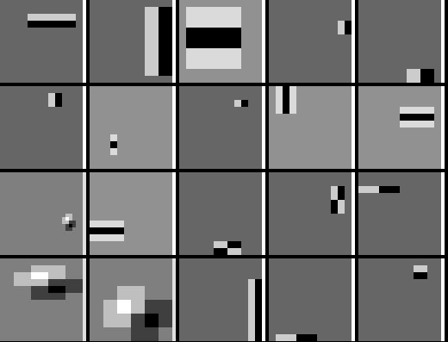
Profile Features

Slide 38
The problem
Seminal paper for machine learning in CV:
Dalal and Triggs, CVPR 2005
Found MIT pedestrian test set too easy
Introduces new ‘INRIA’ dataset
Tiny datasets by today’s standards
MIT: 500 train, 200 test
New: 1239 train, 566 test

Slide 39
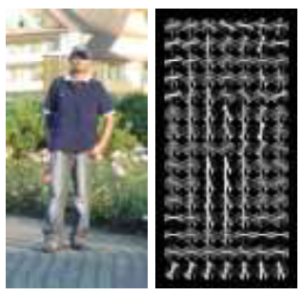
Hand-coded Features: HOG
HOG = histogram of oriented gradients
Very similar to SIFT
Evaluated on regular (overlapping) grid
Single scale
8x8 pixel cells
9 orientation bins
See also:
https://mccormickml.com/2013/05/09/hog-person-detector-tutorial/

Slide 41
Classifier
Two class example
Linear hyperplane classifier, f(x) = <w, x>

Slide 42
Margin
Margin of an example
Margin of a classifier

Slide 43
Learning SVMs
Intuitive maximization problem:

Slide 44
Nonlinear SVMs
Datasets that are linearly separable work out great:
But what if the dataset is just too hard?
We can map it to a higher-dimensional space:
0
x
0
x
x²
0
x
Slide credit: Andrew Moore

Slide 45
Nonlinear SVMs
General idea: the original input space can always be mapped to some higher-dimensional feature space where the training set is separable:
Φ: x → φ(x)
Slide credit: Andrew Moore

Slide 46
Nonlinear SVMs
The kernel trick: instead of explicitly computing the lifting transformation φ(x), define a kernel function K such that K(x_{i} , x_{j}) = φ(x_{i} ) · φ(x_{j})
This gives a nonlinear decision boundary in the original feature space:
C. Burges, A Tutorial on Support Vector Machines for Pattern Recognition, Data Mining and Knowledge Discovery, 1998
Notes:
The kernel must be equivalent to a dot product in some space.

Slide 47
Nonlinear kernel: Example
Consider the mapping
x²

Slide 48
Kernels for bags of features
Histogram intersection kernel:
Generalized Gaussian kernel:
D can be (inverse) L1 distance, Euclidean distance, χ² distance, etc.
J. Zhang, M. Marszalek, S. Lazebnik, and C. Schmid, Local Features and Kernels for Classifcation of Texture and Object Categories: A Comprehensive Study, IJCV 2007

Slide 49
Summary: SVMs for image classification
Pick an image representation (in our case, HOG)
Pick a kernel function for that representation
Compute the matrix of kernel values between every pair of training examples
Feed the kernel matrix into your favorite SVM solver to obtain support vectors and weights
At test time: compute kernel values for your test example and each support vector, and combine them with the learned weights to get the value of the decision function
Slide credit: L. Lazebnik

Slide 50
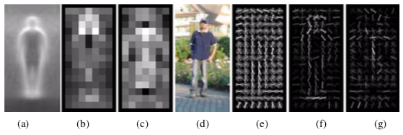
Pedestrian Detection Example
(f) weighted by the positive SVM weights
(g) weighted by the negative SVM weights
Figure from Dalal and Triggs 2005

Slide 51
SVMs: Pros and cons
Pros
Many publicly available SVM packages: http://www.kernel-machines.org/software
Kernel-based framework is very powerful, flexible
SVMs work very well in practice, even with very small training sample sizes
Cons
No “direct” multi-class SVM, must combine two-class SVMs
Computation, memory
During training time, must compute matrix of kernel values for every pair of examples
Learning can take a very long time for large-scale problems

Slide 52
Bonus Slides
Integral Images

Slide 53
Fast computation with integral images
The integral image computes a value at each pixel (x,y) that is the sum of the pixel values above and to the left of (x,y), inclusive
This can quickly be computed in one pass through the image
(x,y)

Slide 54
Computing the integral image

Slide 55
Computing the integral image
ii(x, y-1)
s(x-1, y)
i(x, y)
Cumulative row sum: s(x, y) = s(x–1, y) + i(x, y)
Integral image: ii(x, y) = ii(x, y−1) + s(x, y)
MATLAB: ii = cumsum(cumsum(double(i)), 2);

Slide 56
Computing sum within a rectangle
Let A,B,C,D be the values of the integral image at the corners of a rectangle
Then the sum of original image values within the rectangle can be computed as:
sum = A – B – C + D
Only 3 additions are required for any size of rectangle!
D
B
C
A

Slide 57
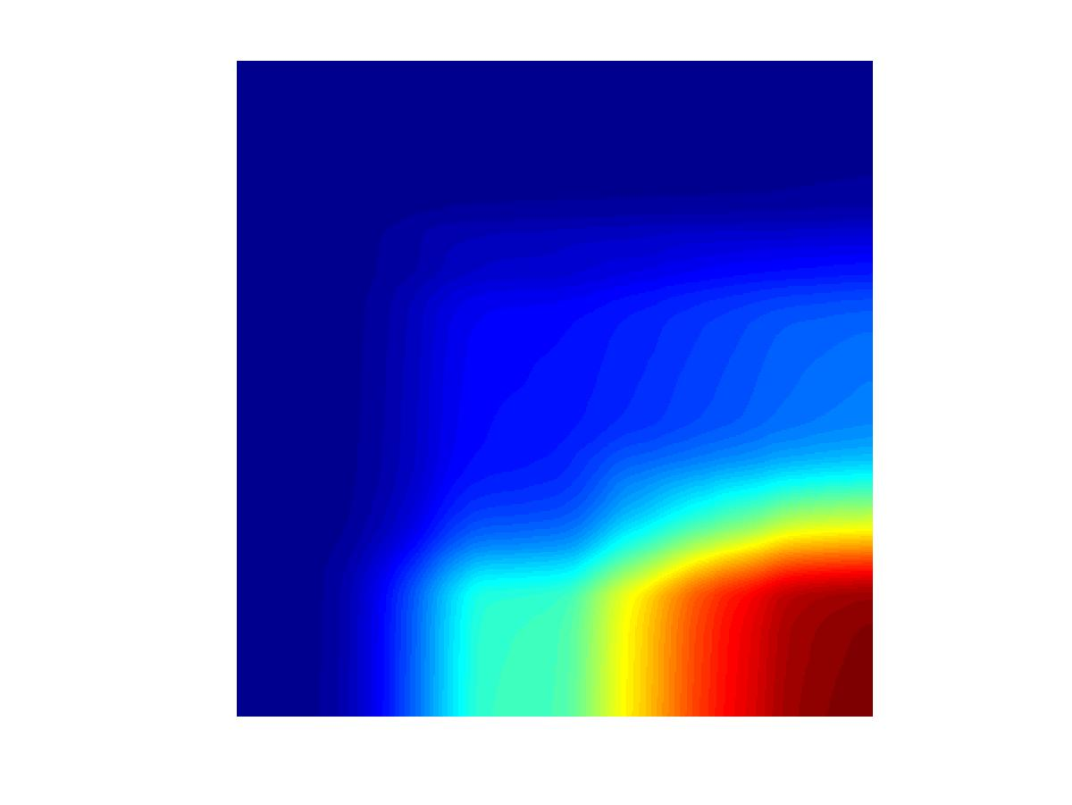
Computing a rectangle feature
Integral Image
-1
+1
+2
-2
-1
+1

