Slide 1
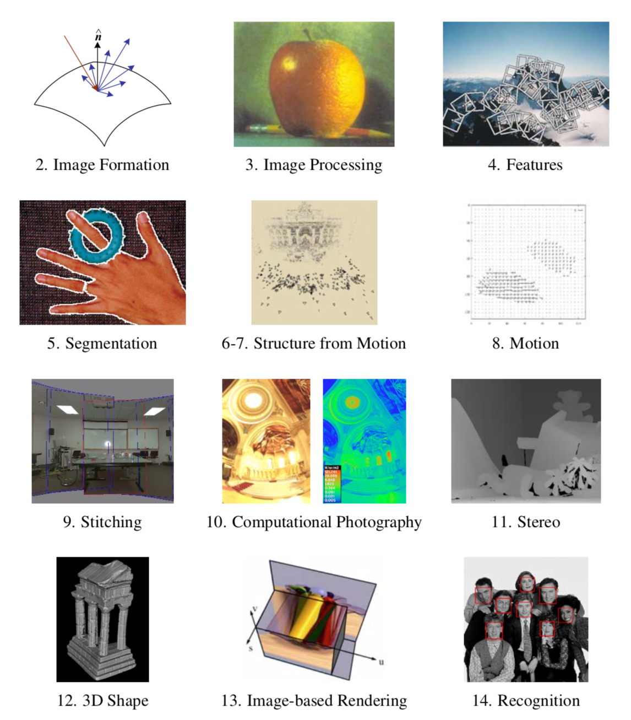

Slide 2
Stitching and HDR,
Stitching a Series of Images to construct a Wide FOV Panorama.
(Lords Cricket Ground, London, UK, by I. Essa)
Slides by Irfan Essa
Adapted for CS 4476 by Frank Dellaert
More detailsin Szeliski Ch. 9, Ch 10.

Slide 3
5 Steps to Make a Panorama
(Lords Cricket Ground, London, UK, by I. Essa)
Capture Images
Detection and Matching
Warping ➔ Aligning Images
Blending, Fading, Cutting
Cropping (Optional)

Slide 4
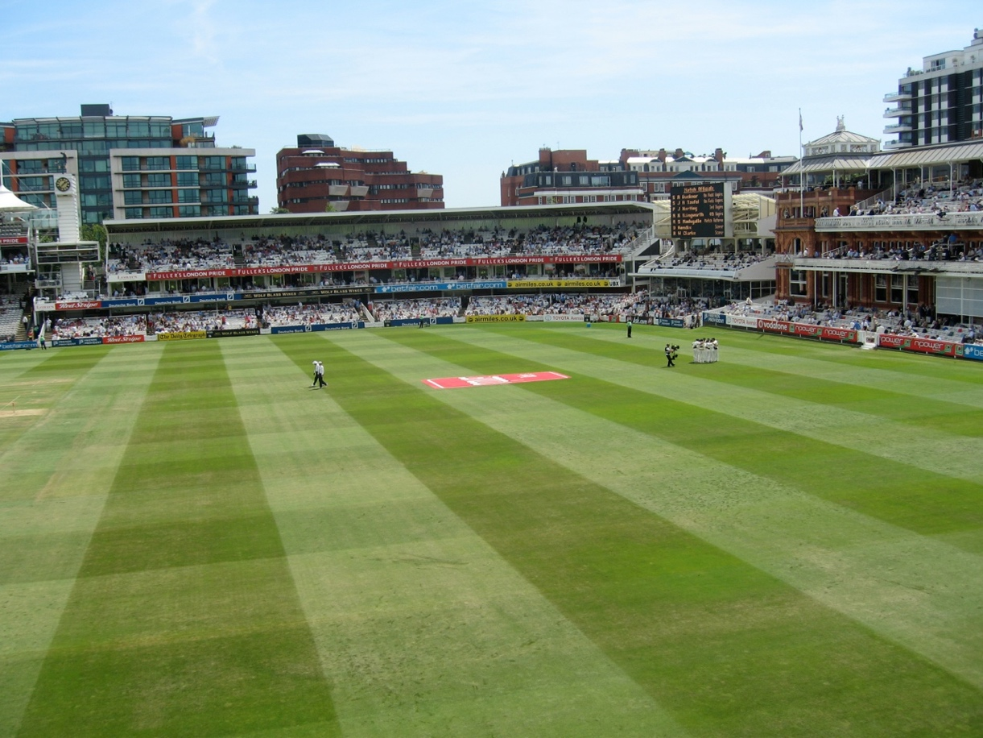
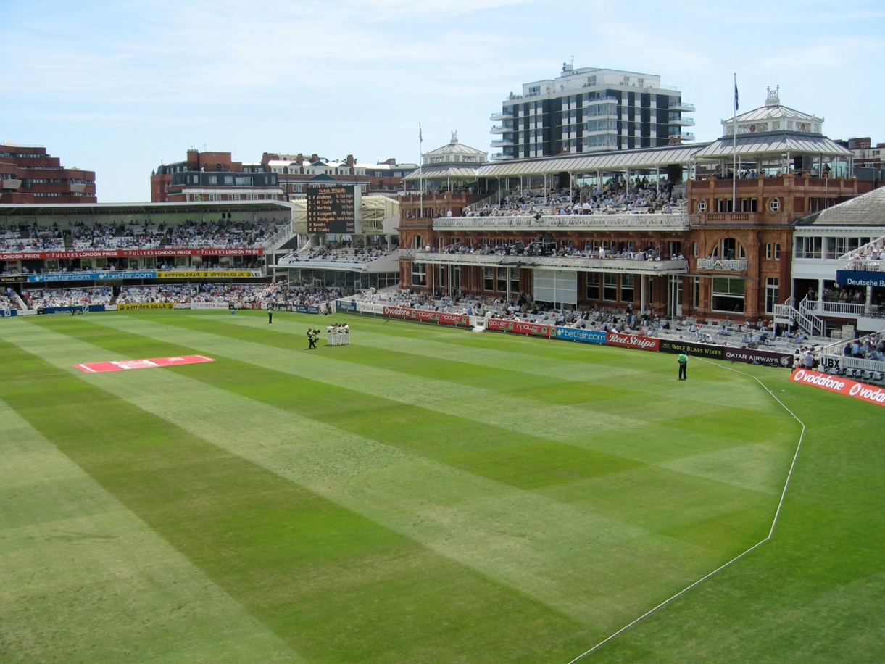
Align Images: Translate??
L
R
L on top
R on top

Slide 5
Better: Warp

Slide 6
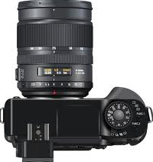
A Bundle of Rays Contains all Views
Synthetic
View
View 2
Possible to generate any synthetic camera view as long as it has
the same center of projection!
View 1
Slide motivated by James Hays

Slide 7
Image Re-projection to Panorama Projection Plane
The panorama mosaic has a natural interpretation in 3D
Images are reprojected onto a common plane
The mosaic is formed on this plane
Mosaic is a synthetic wide-angle camera
Projection
Plane

Slide 8
Image Re-Projection (1)
To relate two images from the same camera center and map a pixel from ^{PP1} to ^{PP2}:
Cast a ray through each pixel in ^{PP1}
Draw the pixel where that ray intersects ^{PP2}
PP2
PP1

Slide 9
Image Re-Projection (2)
To relate two images from the same camera center and map a pixel from ^{PP1} to ^{PP2}:
Rather than a 3D re-projection,
Think of it as a 2D image warp from one image to another
Do not need to know the geometry of the two planes with respect to the eye?
PP2
PP1

Slide 10
Recall: Image Transforms
Which transform is the right one for warping ^{PP1} into ^{PP2}?
E.g. translation, Euclidean, affine, projective
Translation: 2 unknowns, Euclidean: 3 unknowns
Affine: 6 unknowns, Projective: 8 unknowns
Y
perspective
scale
translation
rotation
affine
X

Slide 11
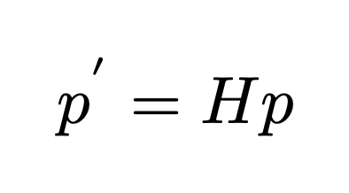
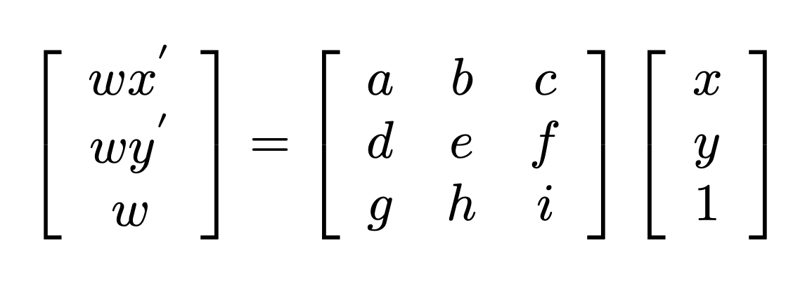
Homography Recap
Relates two images from the same camera center
Rectangle should map to arbitrary quadrilateral
Parallel lines aren’t parallel
Straight lines must be straight
PP2
PP1
http://en.wikipedia.org/wiki/Homography
Notes:
Relate two images from the same camera center and map a pixel from PP1 to PP2
rectangle should map to arbitrary quadrilateral
parallel lines aren’t parallel
straight lines must be straight
Referred to as Homography
To apply a homography H
Compute p’ = Hp (regular matrix multiply)
Convert p’ from homogeneous to image coordinates

Slide 12
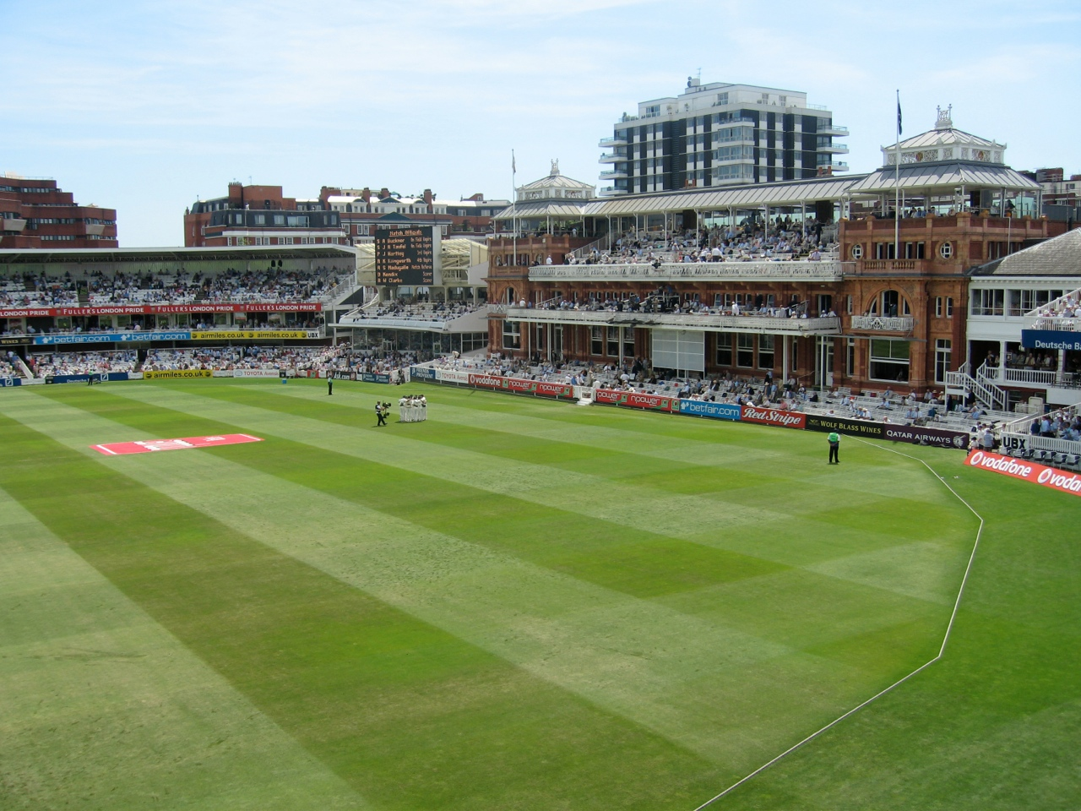
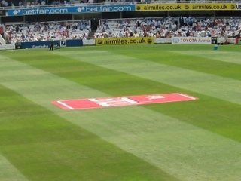
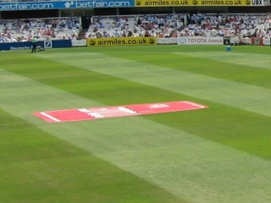
Computing Homographies Nonlinear Least-Squares (Ch. 6)
Notes:
To apply a given homography H
Compute p’ = Hp (regular matrix multiply)
Convert p’ from homogeneous to image coordinates

Slide 13
Warp into a Shared Coordinate Space

Slide 14
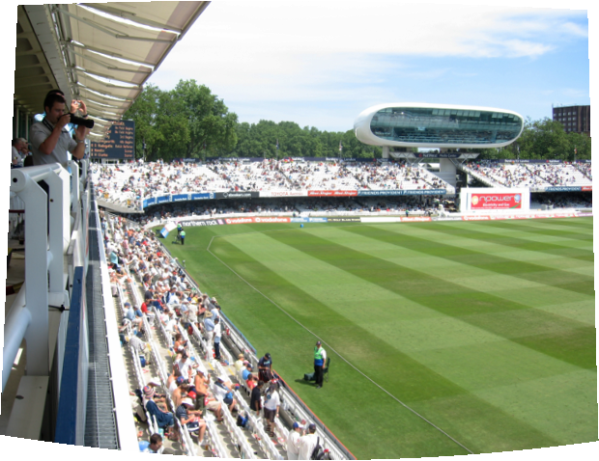
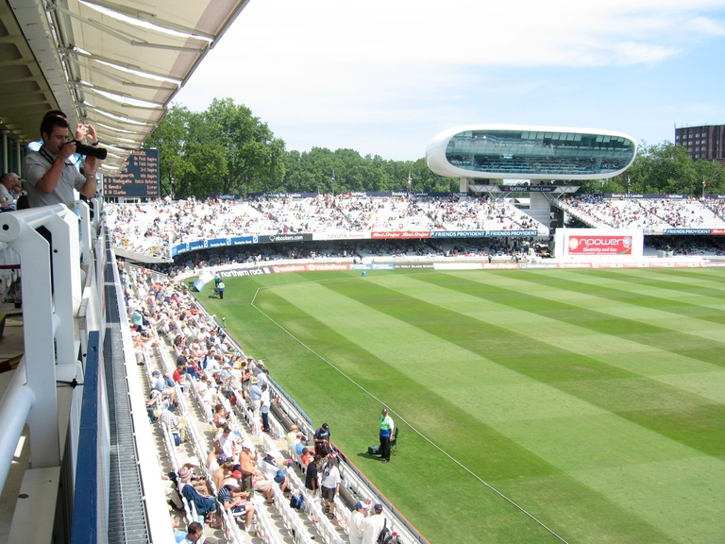
Warping and Interpolation

Slide 15
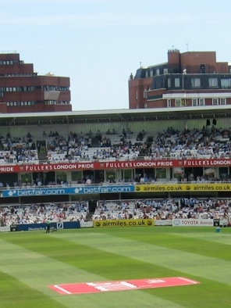
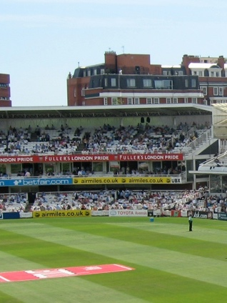
Dealing with BAD Matches
L
R

Slide 16
RANdom SAmple Consensus (RANSAC)
Select ONE match, Count INLIERS
Find “average” translation vector
L
R

Slide 17
RANdom SAmple Consensus (RANSAC)
Loop till find a convergence/popular ^{H} :
Select four feature pairs (at random)
Compute homography ^{H} (exact)
Compute inliers where: ^{SSD(p}in^{', H p}in^{) <} ^{ε}
Keep largest set of inliers
Re-compute least-squares ^{H} estimate on all of the inliers
Key idea: Not that there are more inliers than outliers, but that the outliers are wrong in different ways.
Notes:
SSD: Sum of Squared Differences

Slide 18
Not Just a Plane
Projection Plane
Cylinder
Sphere
Plain
Cylinder
Sphere

Slide 19
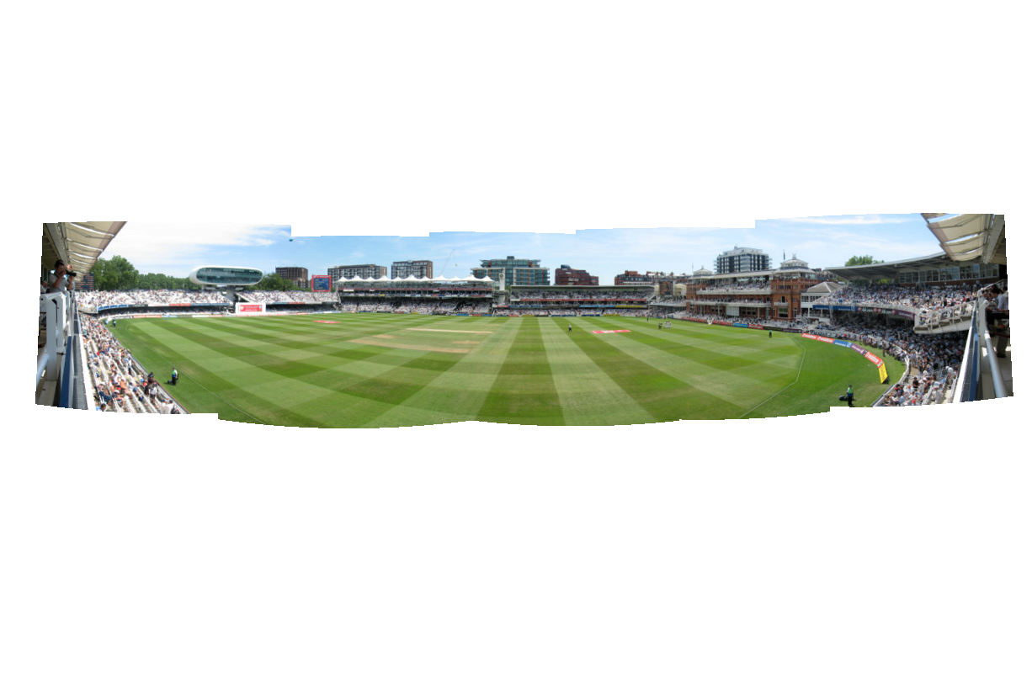
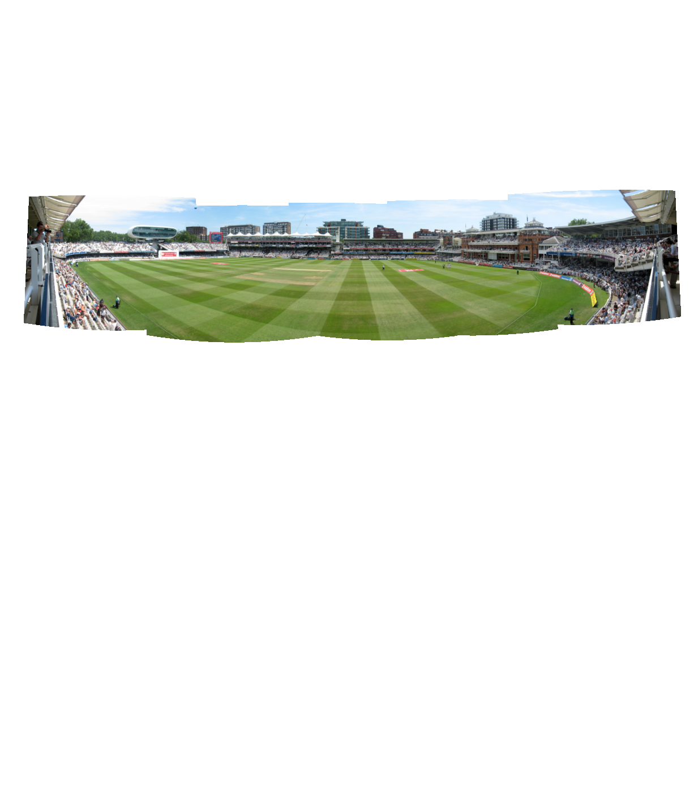
Planar,
Spherical,
Cylindrical Panoramas

Slide 20
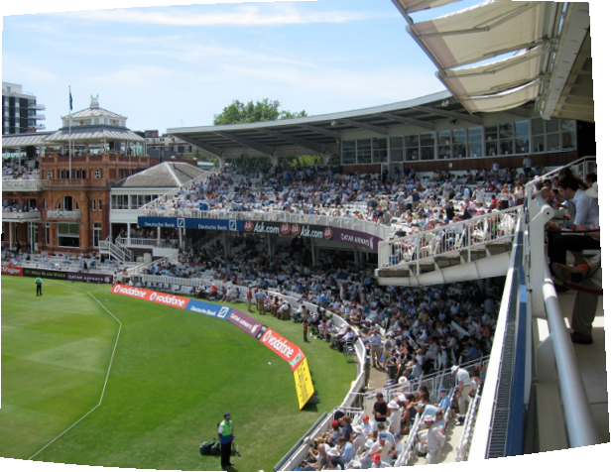
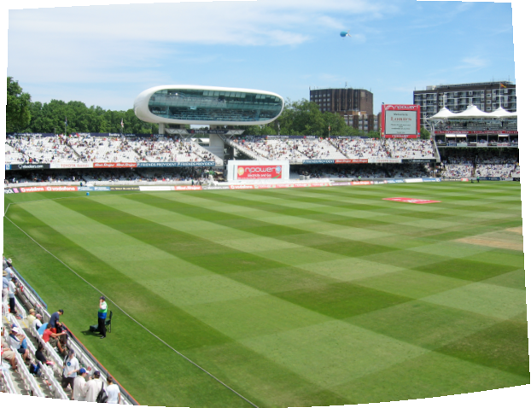
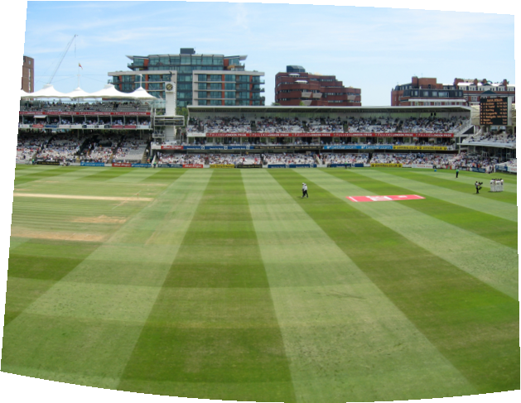
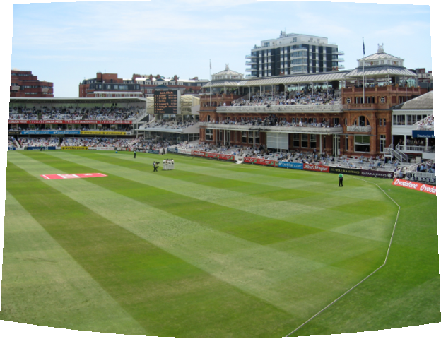
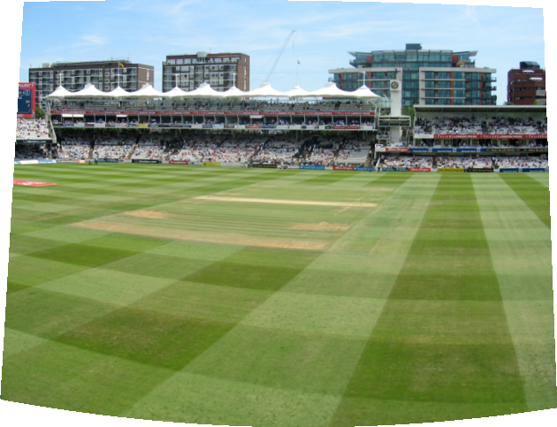
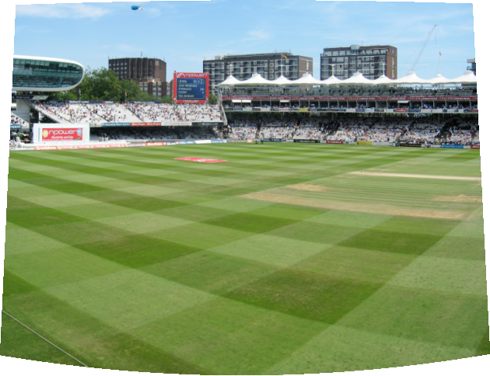
“Finding Panoramas”
Using RANSAC and related matching techniques, we can find images next to each other that form a panorama. So we don’t have to take pictures in a sequence.
Brown and Lowe (2003).

Slide 21
Further Reading
Brown and Lowe (2003). “Recognising Panoramas.” International Conference on Computer Vision (ICCV2003) (pdf | bib | ppt)
Microsoft Research Image Composite Editior (ICE)
Panorama Tools Graphical User Interface (PTGui)
Hugin Panorama Photo Stitcher

Slide 22
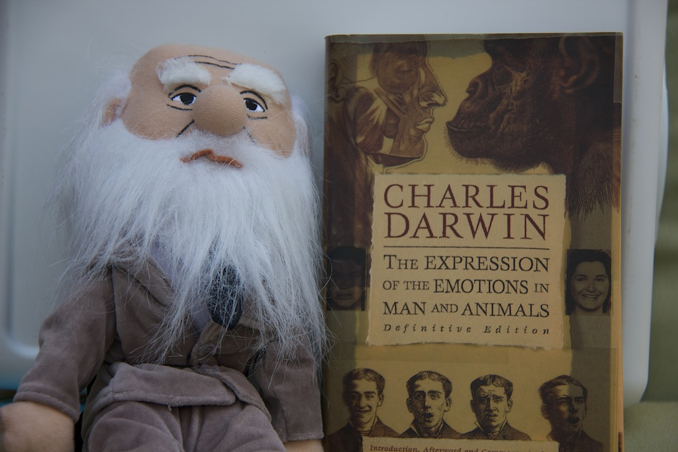
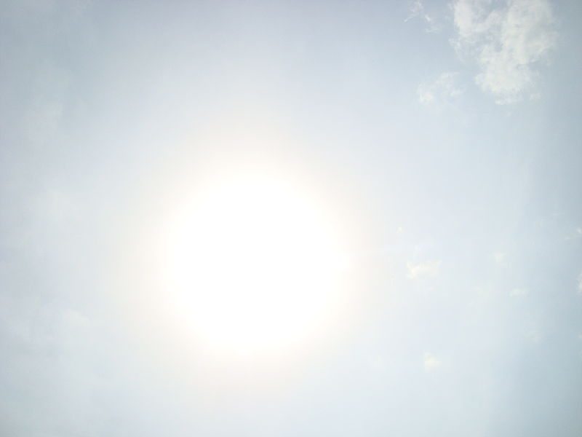
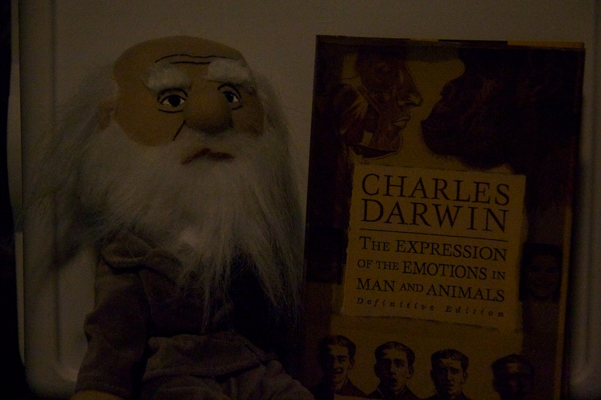
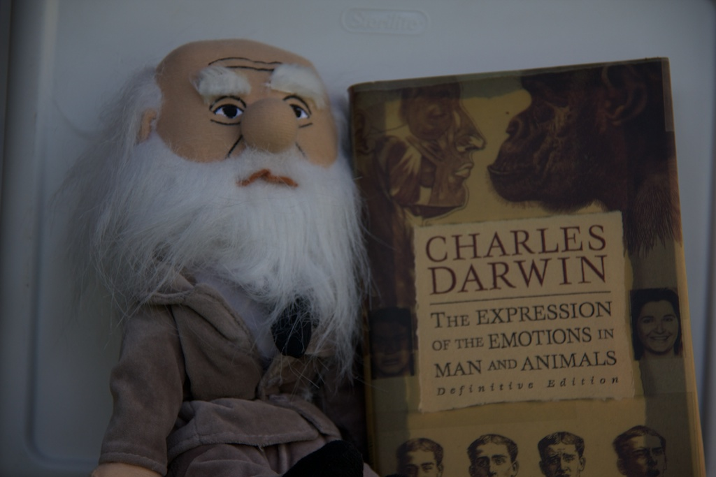
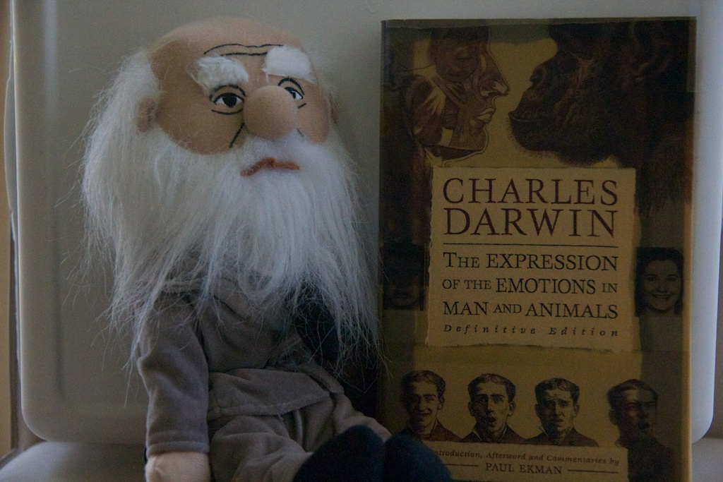
High Dynamic Range
Inside, No Lights
Long Exposure
Outside,
in the Sun
Into the Sun
Inside,
Incandescent Light
Outside,
Under Shade
Inside, Near Window
(Natural Light)
http://commons.wikimedia.org/wiki/File:%22Sun%22.JPG

Slide 23
Dynamic Range
Luminance: A photometric measure of the luminous intensity per unit area of light traveling in a given direction. Measured in candela per square meter (cd/m²).
Luminance
(log cd/m²)
-6
-4
-2
0
2
4
6
8
starlight
moonlight
indoor
sunlight
Human Static Contrast Ratio: 100:1 (10²:1) ➔ about 6.5 f-stops
Human Dynamic Contrast Ratio: 1,000,000:1 (10⁶:1) ➔ about 20 f-stops

Slide 24
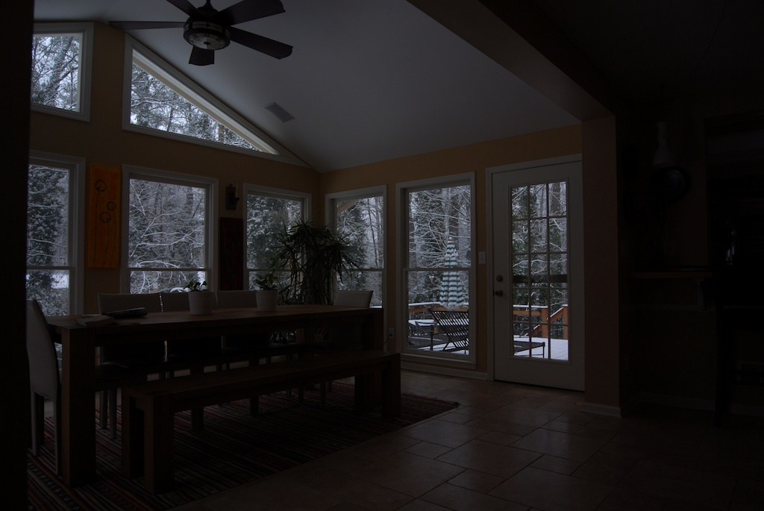
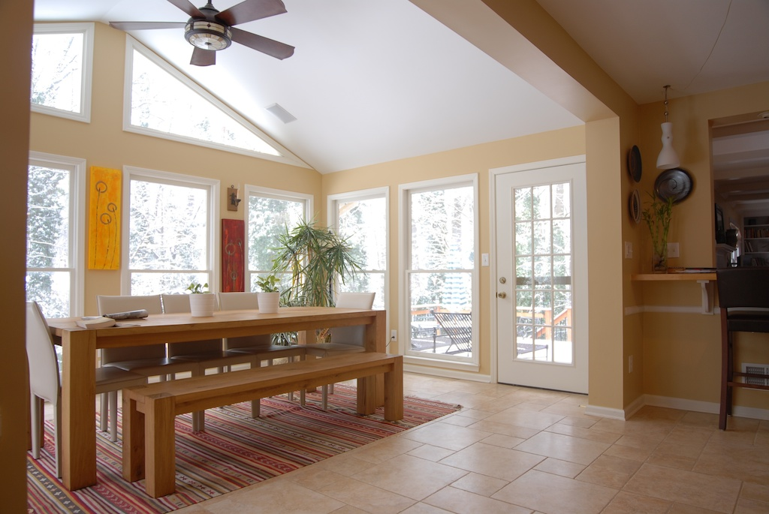
Limited Dynamic Range of Current Cameras
Short Exposure: Snow and Outside Visible
Long Exposure: Inside Visible
Need about 5-10 million values to store all brightnesses around us
8-bit images provide only 256 values!!

Slide 25
Limited Dynamic Range of Current Cameras
High dynamic range
10⁻⁶
10⁶
Real world
10⁻⁶
10⁶
Photograph
0 to 255
Short Exposure: Snow and Outside Visible
Need about 5-10 million values to store all brightnesses around us.
8-bit images provide only 256 values!!

Slide 26
Limited Dynamic Range of Current Cameras
High dynamic range
10⁻⁶
10⁶
Real world
10⁻⁶
10⁶
Photograph
0 to 255
Long Exposure: Inside Visible
Need about 5-10 million values to store all brightnesses around us.
8-bit images provide only 256 values!!

Slide 27
Relationship Between Image and Scene Brightness
The Image Acquisition Pipeline
3D
Scene
Scene
Radiance
(L)
[W/sr/m²]
Lens/Optics
Sensor
Irradiance
(E)
[W/m²]
Shutter
Sensor
Exposure
(H)
W/m²/s
Linear
Linear
EΔt
CCD
ADC
Digital
Values
*RAW IMAGE*
Remapping
-45
Pixel Values (I)
*COMPRESSED*
Non-Linear
Voltages
Notes:
Sr: steradian

Slide 28
Relationship Between Image and Scene Brightness
g: L ➔ E ➔ H ➔ I
g⁻¹: I ➔ H ➔ E ➔ L
3D
Scene
Scene
Radiance
(L)
[W/sr/m²]
Lens/Optics
Sensor
Irradiance
(E)
[W/m²]
Shutter
Sensor
Exposure
(H)
W/m²/s
Linear
Linear
EΔt
CCD
ADC
Digital
Values
*RAW IMAGE*
Remapping
-45
Pixel Values (I)
*COMPRESSED*
Non-Linear
Voltages
Notes:
Sr: steradian

Slide 29
Summary
Discussed issues of Dynamic Range.
Discussed why digital cameras do no encode it very well.
Presented the Image Acquisition Pipeline for Capturing Scene Radiance to Pixel Values.
Discussed the linear and non-linear aspects of the Image Acquisition Pipeline for Capturing Scene Radiance to Pixel Values.

Slide 30
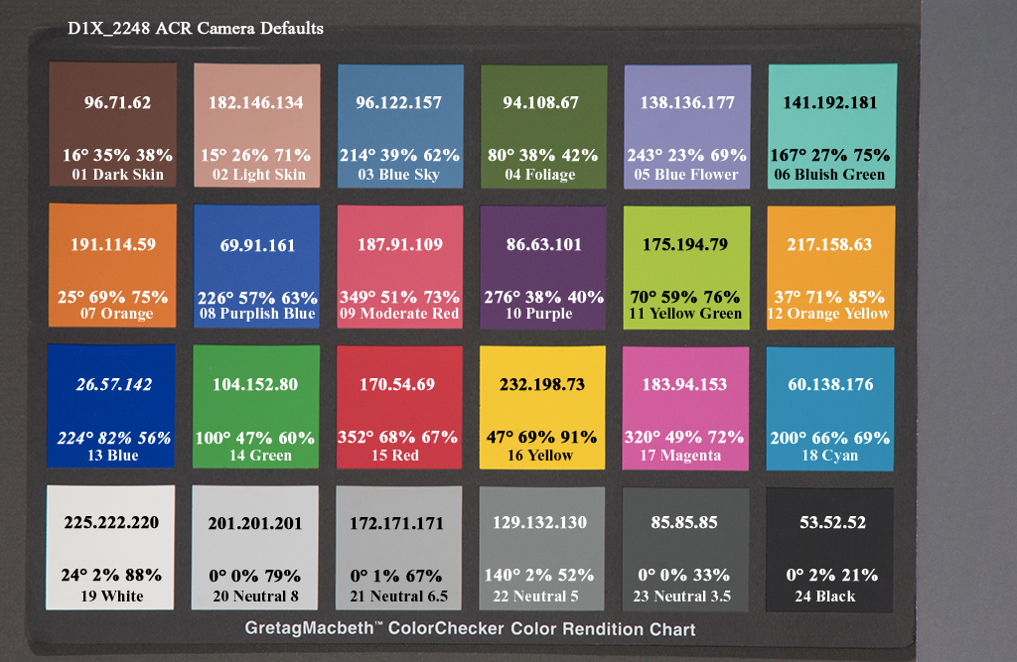
Camera Calibration
Geometric
How pixel coordinates relate to directions in the world
Radiometric / Photometric
How pixel values relate to radiance amounts in the world

Slide 31
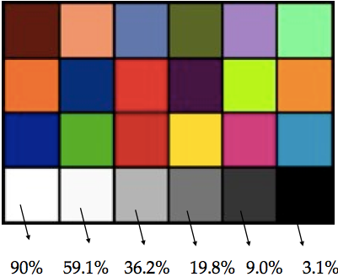
Radiometric Calibration
g: L ➔ E ➔ H ➔ I
g⁻¹: I ➔ H ➔ E ➔ L
A Color Chart with know reflectances
Multiple camera exposures to fill up the curve
Method assumes constant lighting on all patches and works best when source is far away (example sunlight)
Unique inverse exists because g is monotonic and smooth for all cameras
255
Pixel
Values
?
0
(Grossberg and Nayar 2003)
0
Irradiance
1
Notes:
Use a Color Chart with precisely know reflectances
Multiple camera exposures to fill up the curve.
Method assumes constant lighting on all patches and works best when source is far away (example sunlight).
Unique inverse exists because g is monotonic and smooth for all cameras.

Slide 32
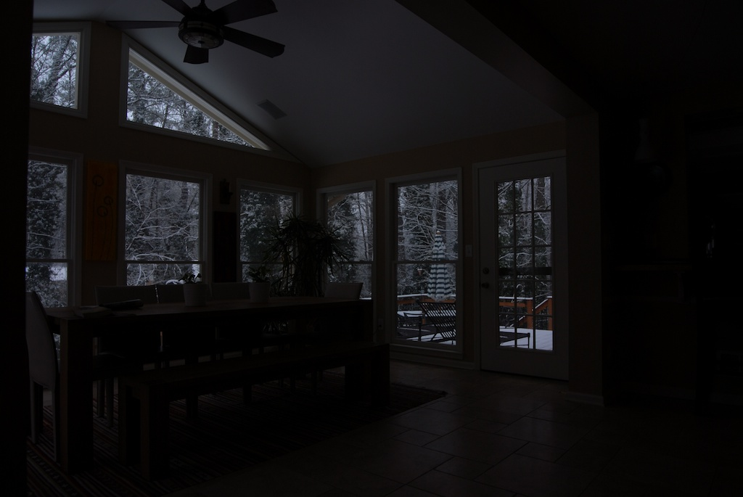
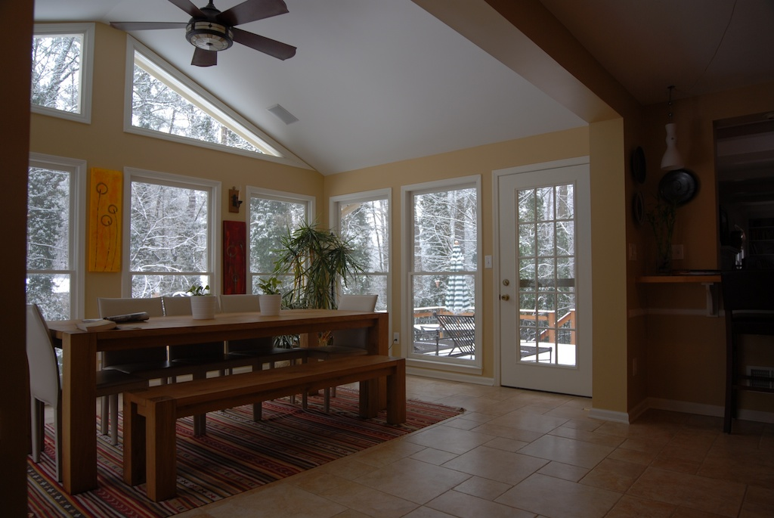
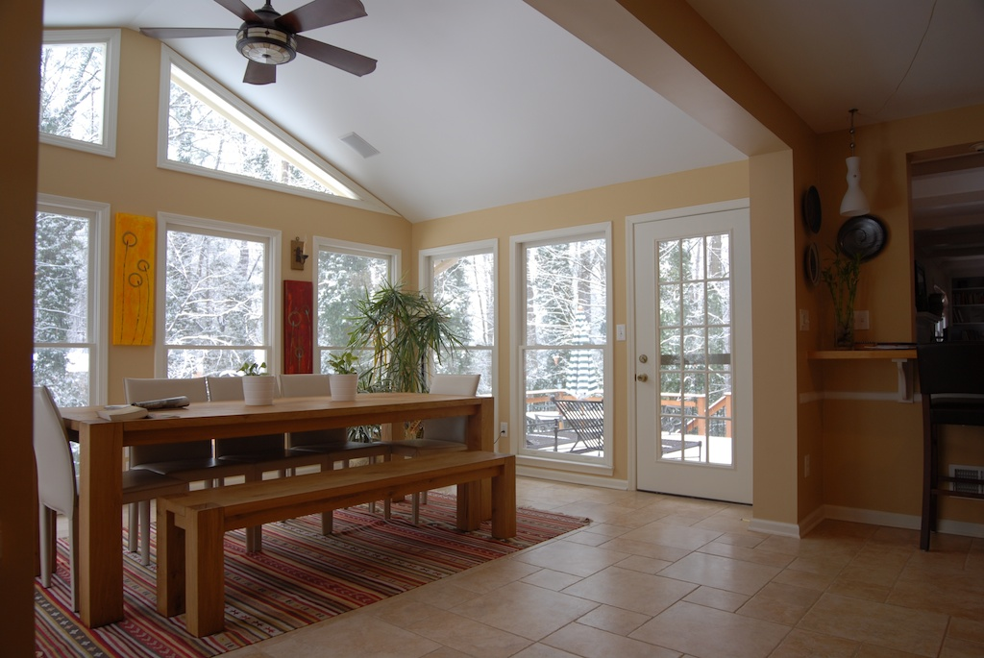
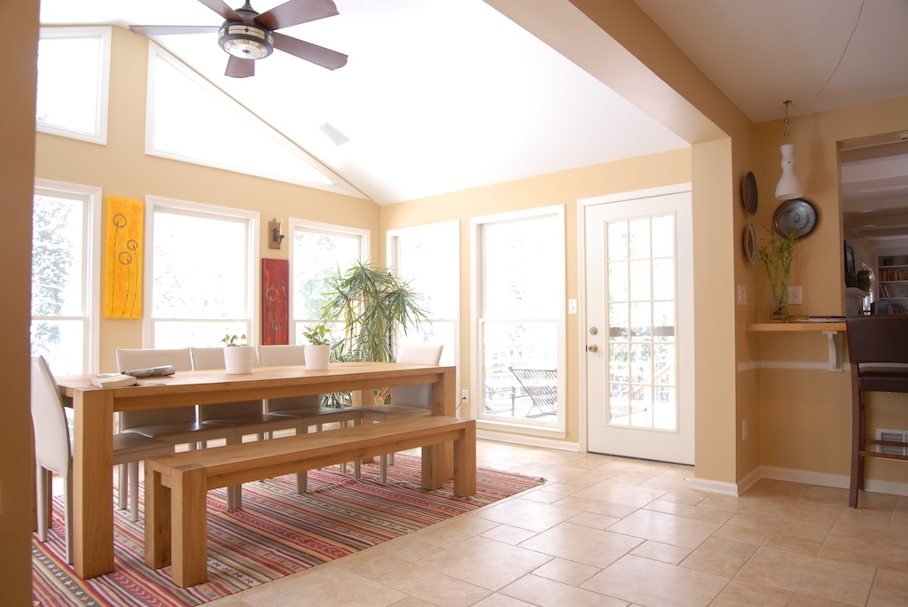

Slide 33
A Sequence of Images of Different Exposures

Slide 34
Series of Images
Pixel Values (I)
• 1
• 1
• 1
• 1
• 1
3
• 2
• 2
• 2
• 2
• 2
2
• 3
• 3
• 3
• 3
• 3
x
1
Δt =1/64 sec
Δt = 1/16 sec
Δt = 1/4 sec
Δt = 1 sec
Δt = 4 sec
log Exposure (H)
Pixel Values (I) = g(Exposure)
Exposure (H) = Irradiance (E)∗ Δt
log Exposure (H) = log Irradiance (E) + log Δt
Debevec and Malik 1997

Slide 35
Response Curves
Pixel
Values (I)
Pixel
Values (I)
3
2
x
1
log Exposure (H)
log Exposure (H)
Assuming unit radiance for each pixel
After adjusting radiances to obtain a smooth response curve

Slide 36
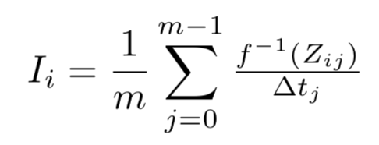
Iterative Method
For each pixel site i in each image j, we have
So, if have f, we can estimate the irradiance image I as
Note f⁻¹ is a lookup table.
We can re-estimate as:
Iterate (2) and (3), until convergence.
(1)
(2)
(3)

Slide 37
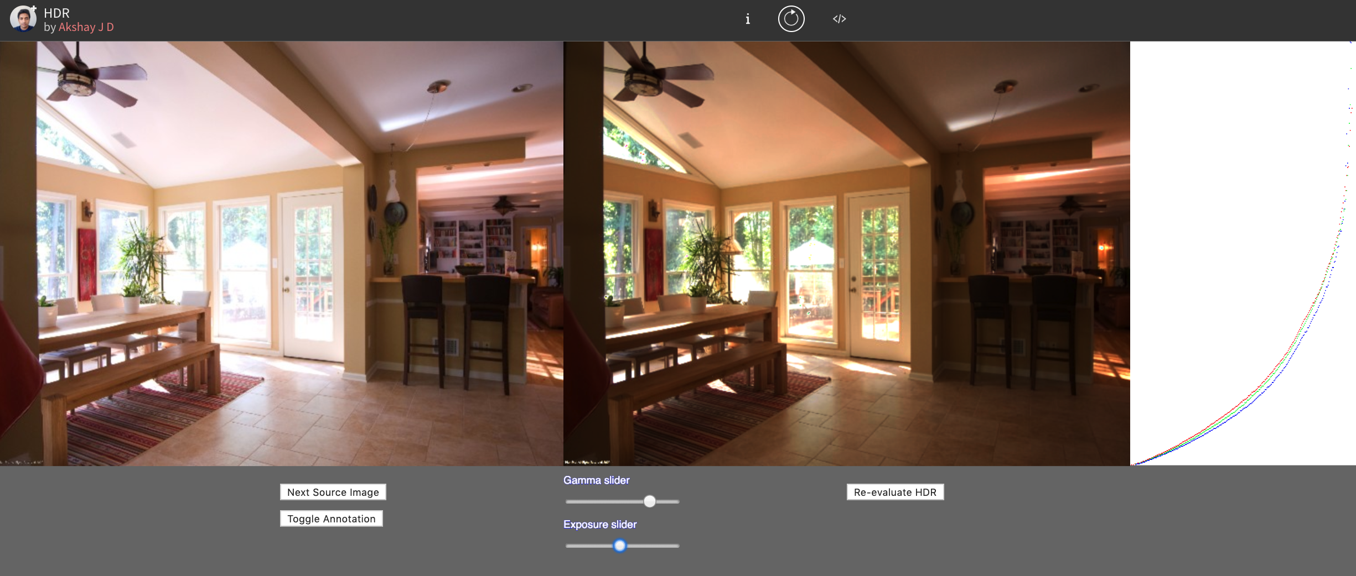
Demo-time!

Slide 38
How to Compute: Debevec 99
Let g(z) be the discrete inverse response function
For each pixel site i in each image j, compute
Solve the overdetermined linear system for N pixels over P different exposure images:
Fitting Term
Smoothness Term
See Debevec and Malik (1997) for more details

Slide 39
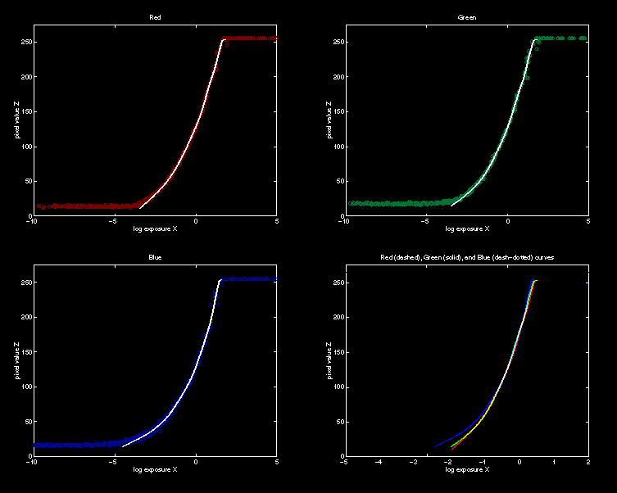
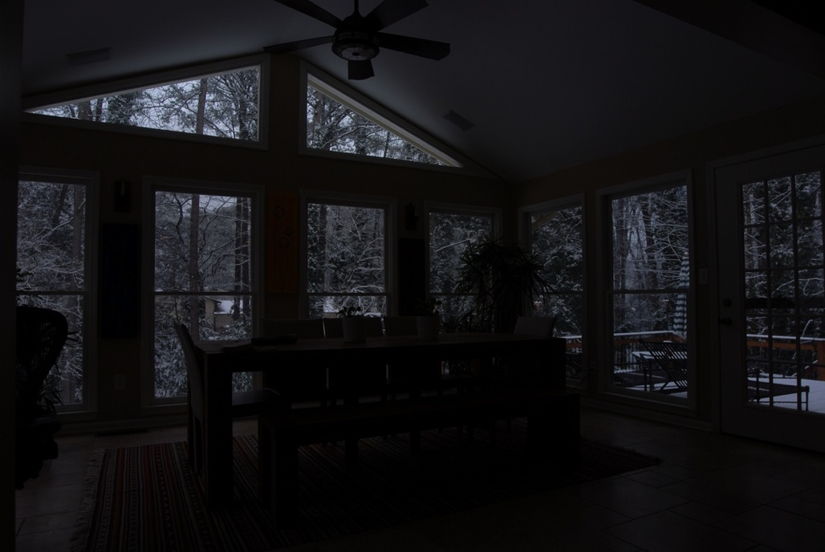
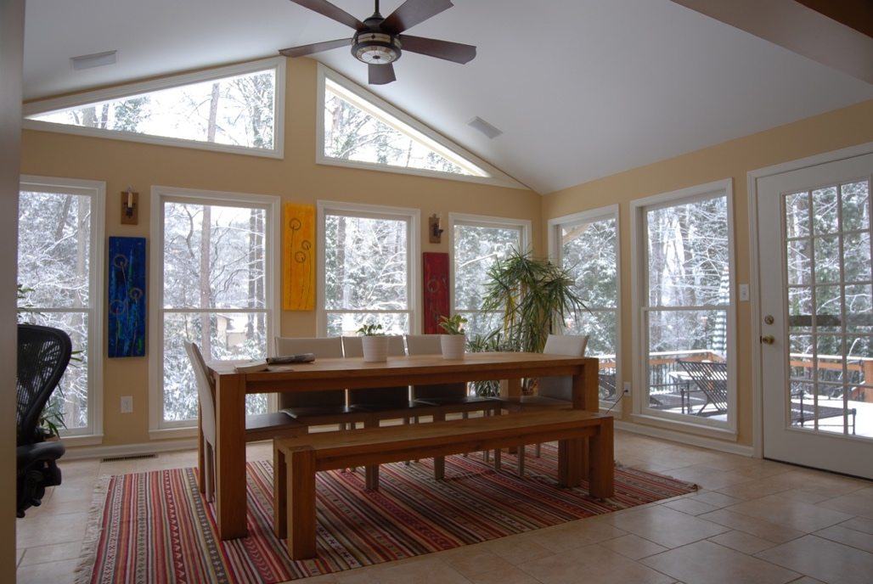
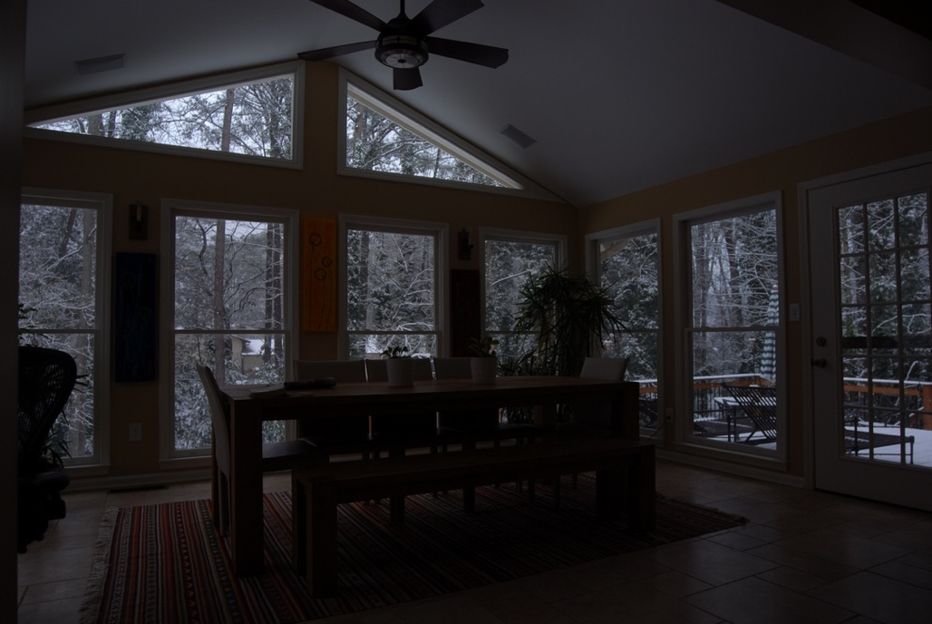
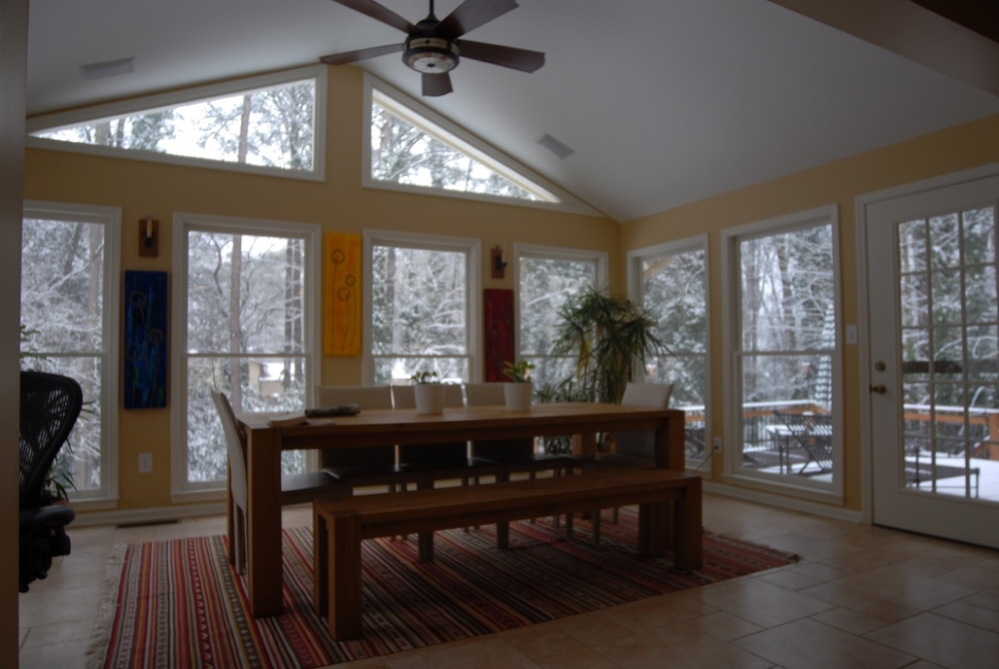
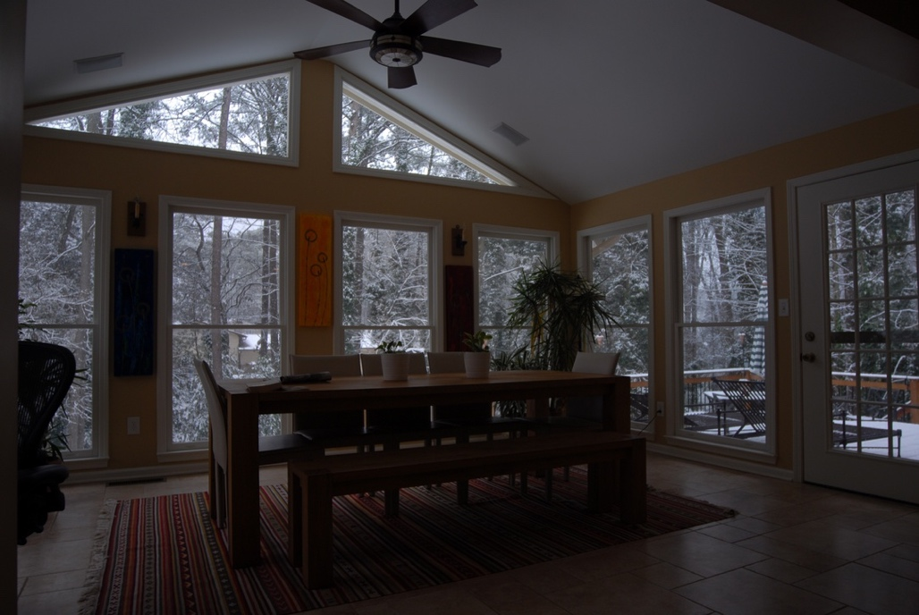
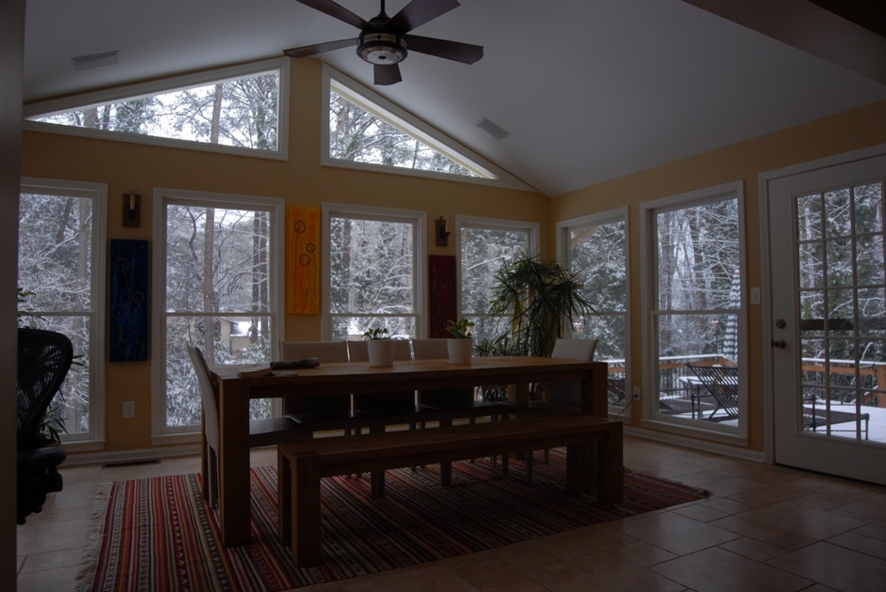
Response Curves
Red
Green
Blue
RGB
(Not actual curves for these images, used
here just for demonstration)

Slide 40
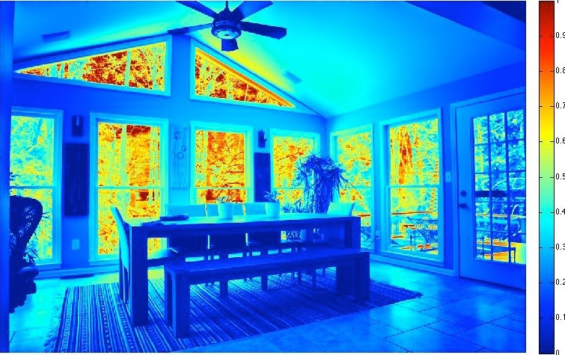
Radiance Map
12,871.00
0.6215

Slide 41
Need a New File Format
Radiance Format
32 bits / pixel
Red
Green
Blue
Exponent
(145, 215, 87, 149) =
(145, 215, 87) * 2^(149-128) =
(1190000, 1760000, 713000)
(145, 215, 87, 103) =
(145, 215, 87) * 2^(103-128) =
(0.00000432, 0.00000641, 0.00000259)
Ward (2001), There are many other formats too

Slide 42
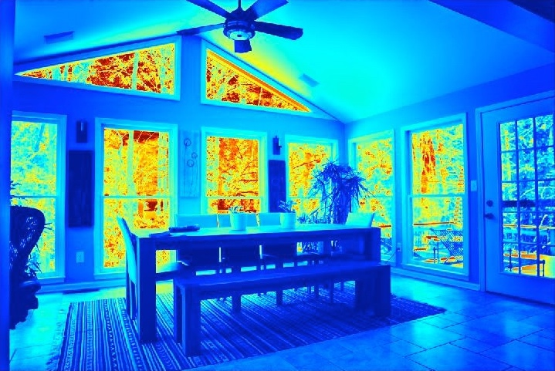
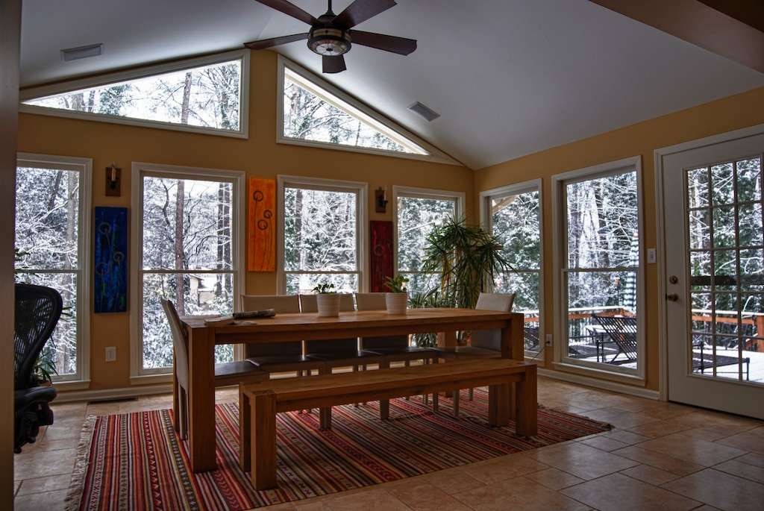
Now to Display it!

Slide 43
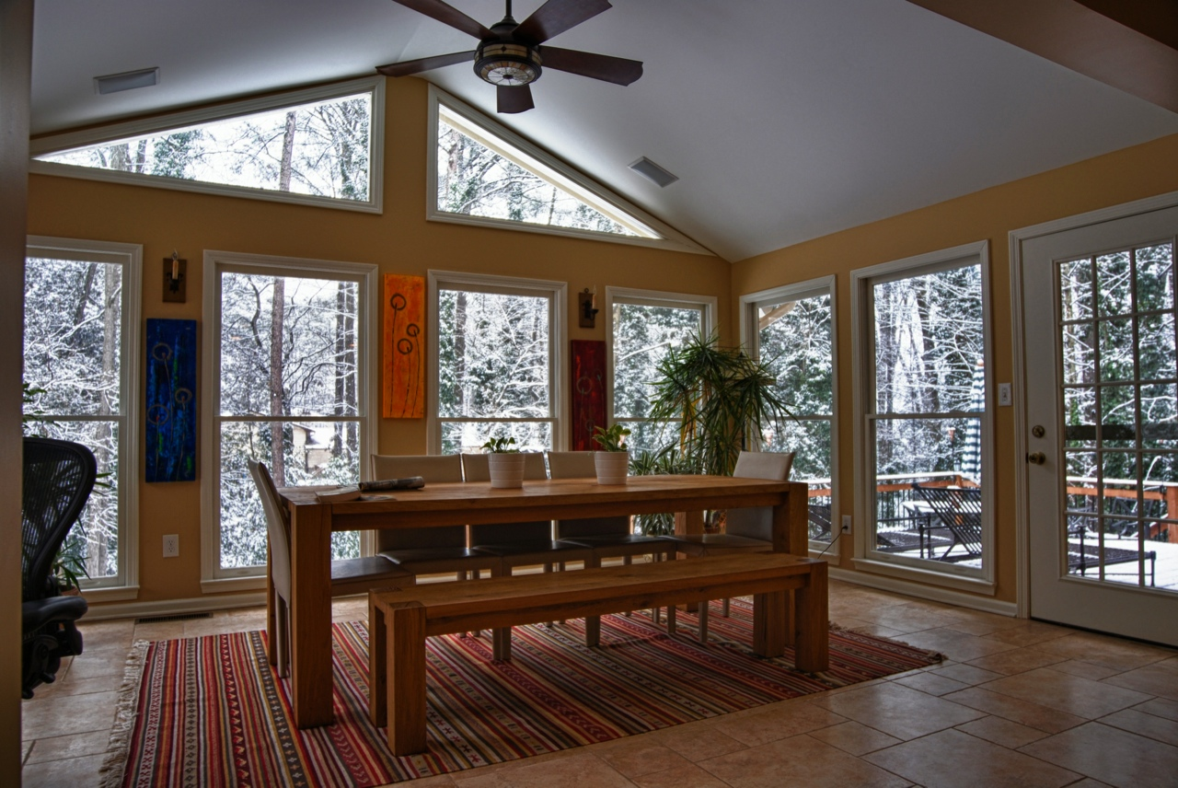

Slide 44
Tone Mapping
Map one set of colors to another
Displaying on a medium that has limited dynamic range
Printers, monitors, and projectors all have a limited dynamic range
Inadequate to reproduce the full range of light intensities present in natural scenes
http://commons.wikimedia.org/wiki/File:Kanitz-Kyawsche_Gruft_in_Hainewalde_HDR.jpg
Notes:
Map one set of colors to another in order to approximate the appearance of high dynamic range images
For displaying on a medium that has limited dynamic range.
Printers, monitors, and projectors all have a limited dynamic range that is inadequate to reproduce the full range of light intensities present in natural scenes.
Addresses the problem of strong contrast reduction from the scene radiance to the displayable range while preserving the image details and color appearance important to appreciate the original scene content.
Many well-known Algorithms exist for this.
See Banterle, et al. (2011), Reinhard et al. (2002) and Durand and Dorsey (2002)

Slide 45
Tone Mapping
Addresses the problem of
strong contrast reduction from the scene radiance to the displayable range
preservs the image details and color appearance
Many well-known Algorithms exist for this
See Banterle, et al. (2011), Reinhard et al. (2002) and Durand and Dorsey (2002)
http://commons.wikimedia.org/wiki/File:Kanitz-Kyawsche_Gruft_in_Hainewalde_HDR.jpg
Notes:
Map one set of colors to another in order to approximate the appearance of high dynamic range images
For displaying on a medium that has limited dynamic range.
Printers, monitors, and projectors all have a limited dynamic range that is inadequate to reproduce the full range of light intensities present in natural scenes.
Addresses the problem of strong contrast reduction from the scene radiance to the displayable range while preserving the image details and color appearance important to appreciate the original scene content.
Many well-known Algorithms exist for this.
See Banterle, et al. (2011), Reinhard et al. (2002) and Durand and Dorsey (2002)

Slide 46
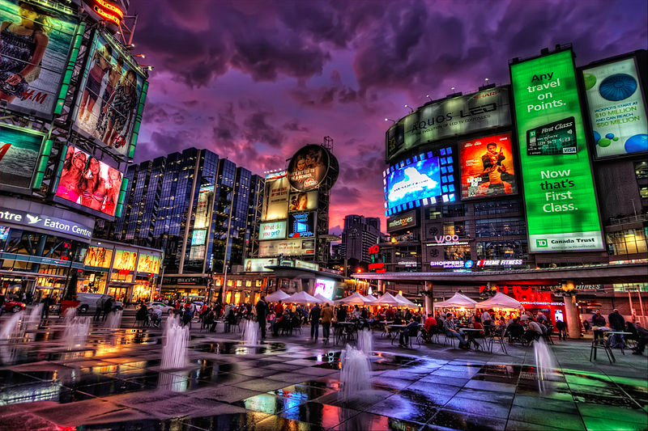
Tone Mapping
High dynamic range
10⁻⁶
10⁶
Real world
10⁻⁶
10⁶
Photograph
0 to 255
http://en.wikipedia.org/wiki/File:Dundus_Square.jpg
Match limited contrast of the medium
Preserve details
Use filtering approaches to “compress” locally and globally

Slide 47
Further Information
Grossberg and Nayar (2003), “Determining the Camera Response from Images: What is Knowable?,” IEEE Transactions on Pattern Analysis and Machine Intelligence,
Debevec and Malik (1997). “Recovering High Dynamic Range Radiance Maps from Photographs.” In SIGGRAPH 1997
Ward (2001), “High Dynamic Range Imaging,” Proceedings of the Ninth Color Imaging Conference, November 2001.

Slide 48
Further Information
Durand and Dorsey (2002), “Fast Bilateral Filtering for the Display of High-Dynamic-Range Images” In SIGGRAPH 2002.
Reinhard, Stark, Shirley and Ferwerda (2002), “Photographic Tone Reproduction for Digital Images”, In SIGGRAPH 2002.
Banterle, Artusi, Debattista, and Chalmers (2011) Advanced High Dynamic Range Imaging CRC Press. (with Matlab Code)
Many Software suites on the Internet.
Also, look for “Exposure Fusion”

Slide 49
Credits
Softwares used
Matlab by Mathwork's Inc.
For more information, see
Richard Szeliski (2010) Computer Vision: Algorithms and Applications, Springer.
Some concepts in slides motivated by similar slides by J. Hays.
Photographs by Irfan Essa

