Slide 1
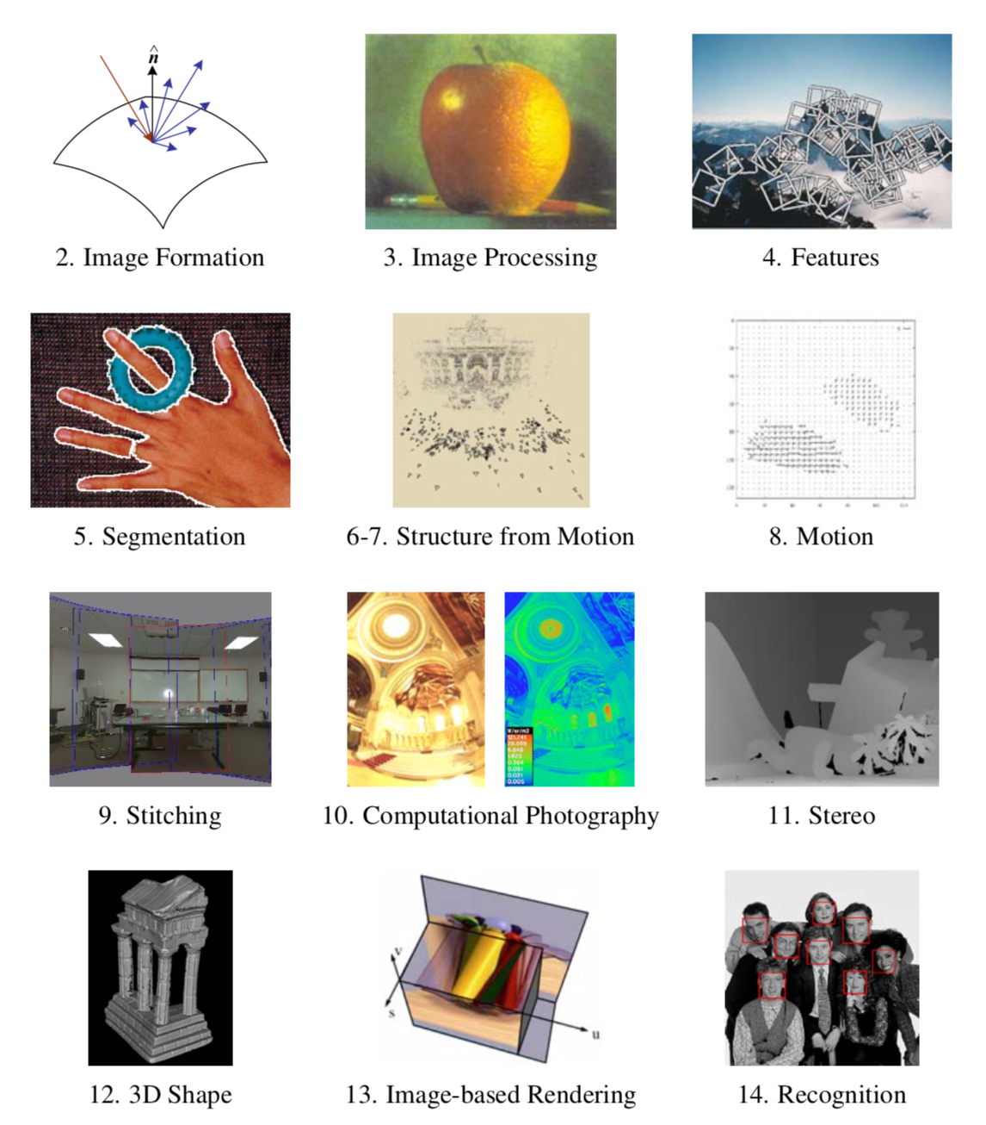

Slide 2
Credits
Images and formulas from Szeliski
Second half from CVPR talk by Zhaoyang Lv
Taking a Deeper Look at the Inverse Compositional Algorithm, Zhaoyang Lv , Frank Dellaert, James M. Rehg, Andreas Geiger, CVPR 2019

Slide 3
Motivating problem: Video Stabilization
Stabilized
Original

Slide 4
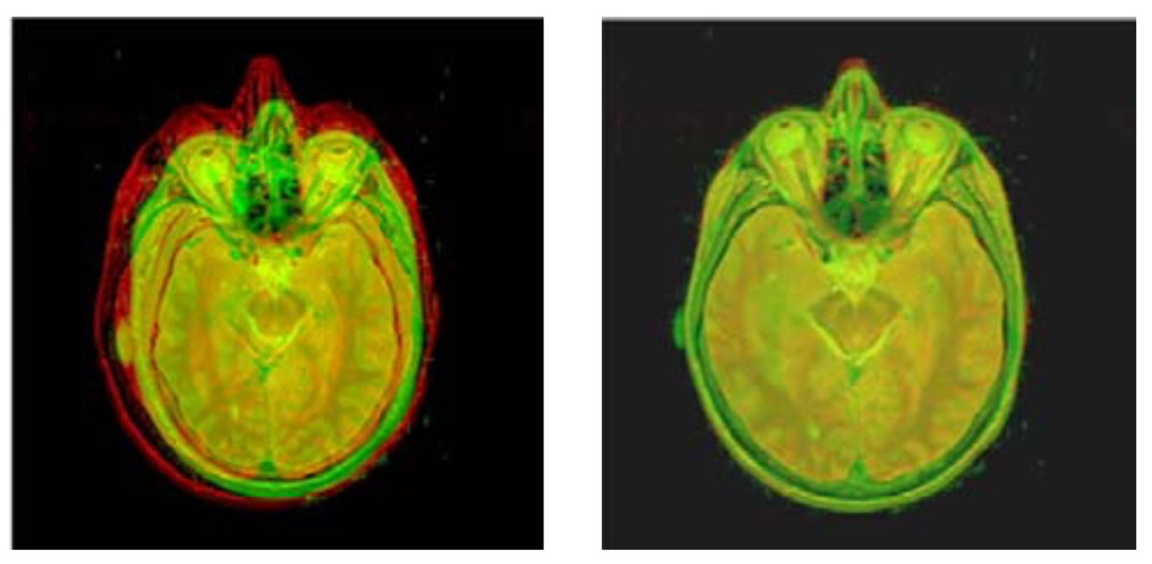
Dense Motion Estimation
Widely used!
Aligning images
Motion in video
Video Stabilization
We need:
Error metric
Search technique
Full search
Hierarchical
Incremental
Image credit: Kybic and Unser © 2003 IEEE

Slide 5
Outline
Error metric/full search
Hierarchical search
Incremental refinement

Slide 6
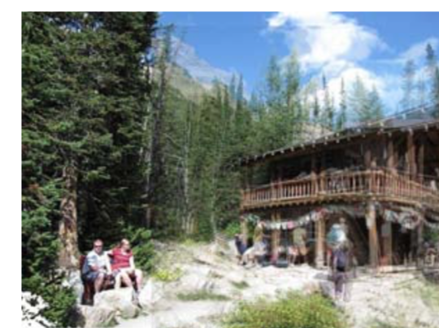
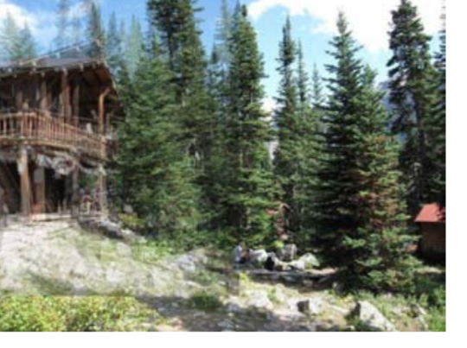
Translational Alignment
Shift image I₁ with respect to template I₀
Before, feature-based error:

Slide 7
Translational Alignment
Shift image I₁ with respect to template I₀
Before, feature-based error:
Now, image-based error:

Slide 8
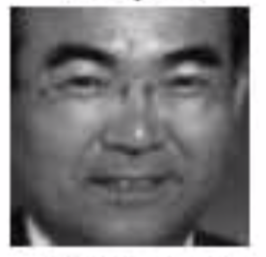
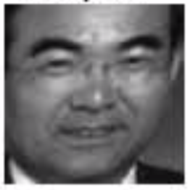
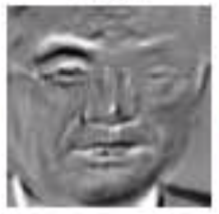
SSD
Sum of Squared Differences
Assumes: brightness constancy
If u fractional: interpolation needed
Bilinear (fast, good)
Bicubic (slower, slightly better)

Slide 9
Robust Error Metrics
Quadratic error is unforgiving!
Absolute error (SAD): allows for outliers
Differentiable robust error metrics exist

Slide 10
Dealing with Boundary Conditions
Should not count pixels outside
Add two “window” functions
Windowed SSD metric:
Invariant to overlap: Root mean square:

Slide 11
Violations of Brightness Constancy
Estimate Bias and Gain
Normalized Cross-Correlation

Slide 12
Hierarchical Motion Estimation
Build an image pyramid:
Low-pass
Decimate
Recursively estimate motion:
Estimate motion at highest level
Use result as initial estimate at lower level

Slide 13
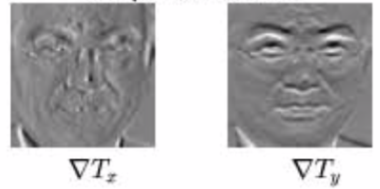
Sub-pixel Refinement
Taylor expansion of SSD in sub-pixel update Δu:
J is the Jacobian, i.e., gradients at x_{i}+u:

Slide 14
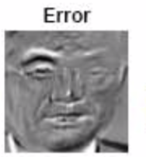
Solve using Normal Equations
A is Hessian or ”information matrix”, same as Harris uses!
RHS b is just dot product of gradient images with error ->
Remember: feature-based translation: just mean of flow vectors !

Slide 15
Aperture Problems and Harris

Slide 16
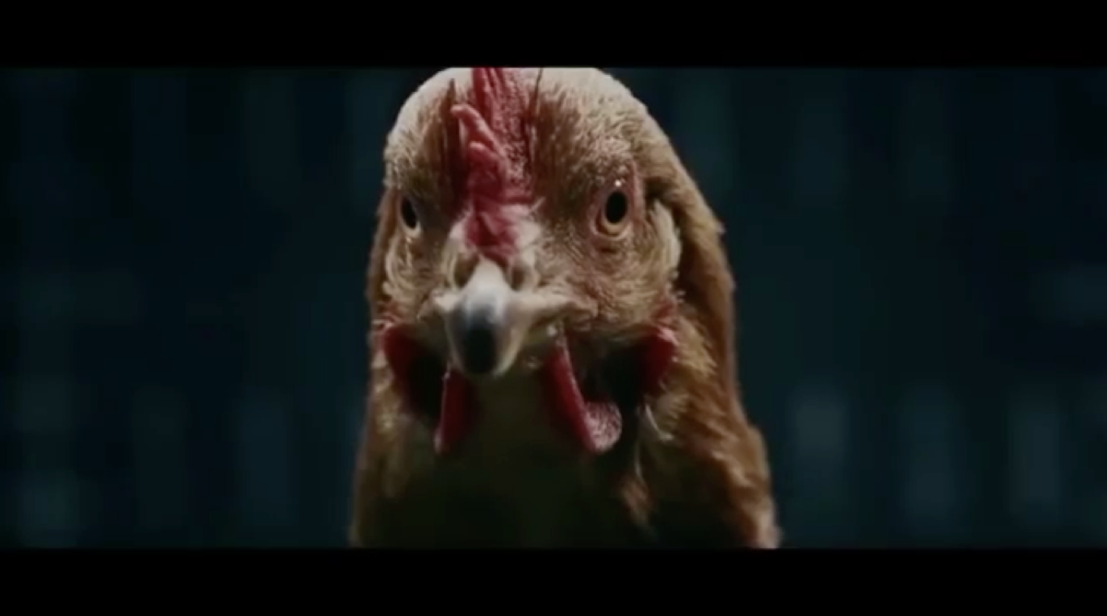
Revisiting Video Stabilization

Slide 17
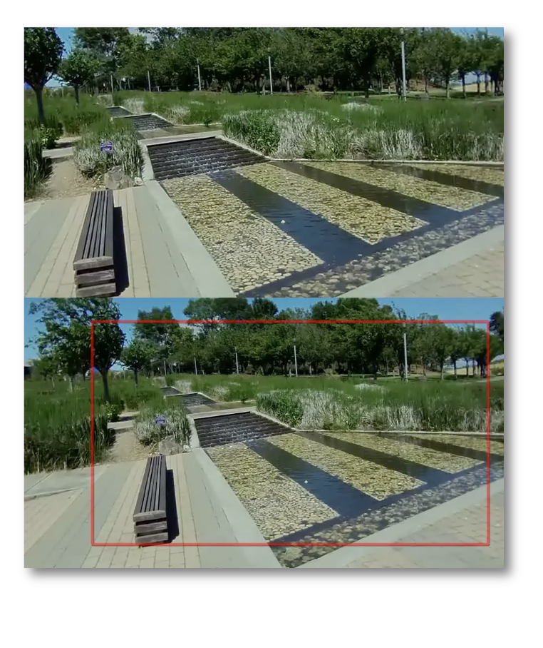
Motion Models: Translation
Translation in x and y
2 DOF
Still very shaky

Slide 18
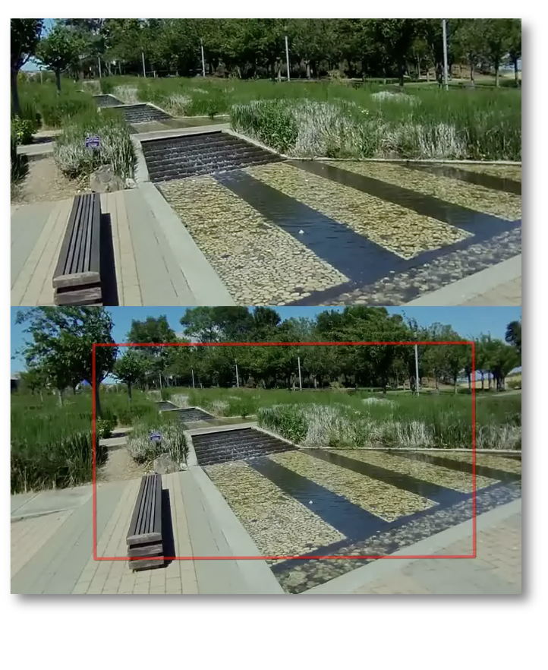
Motion Models: Similarity
Translation in x and y
Uniform scale and rotation
4 DOF
Not shaky, but wobbly
Notes:
say: uniform scale and rotation

Slide 19
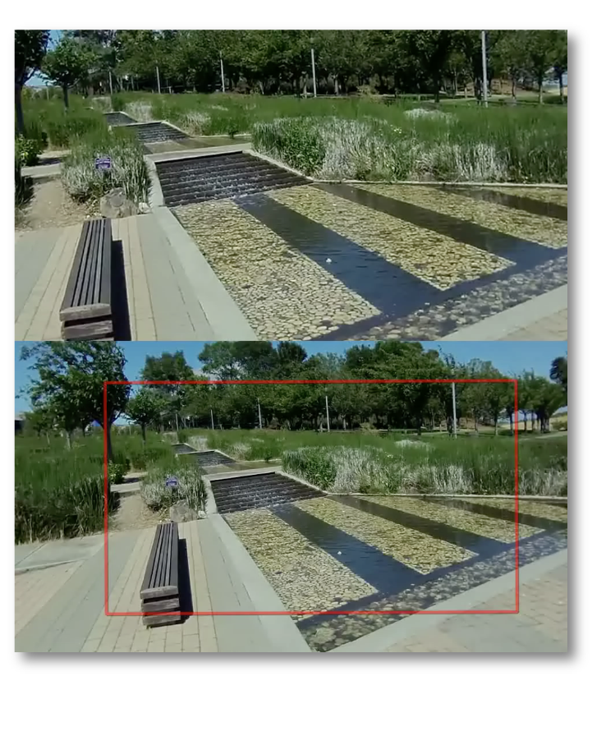
Motion Models: Homography
Translation in x and y, scale and rotation
Skew and perspective
8 DOF
Stable

Slide 20
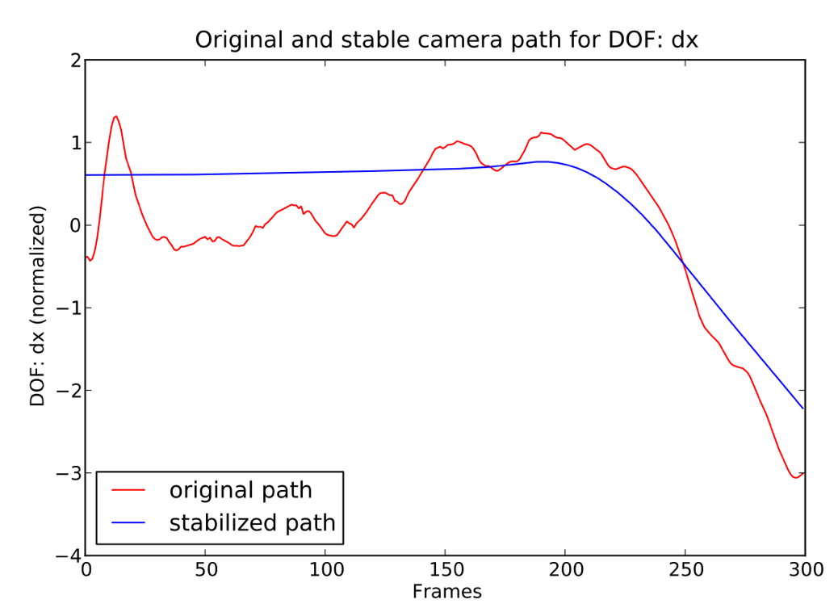
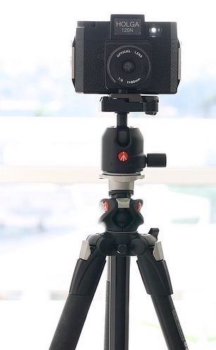
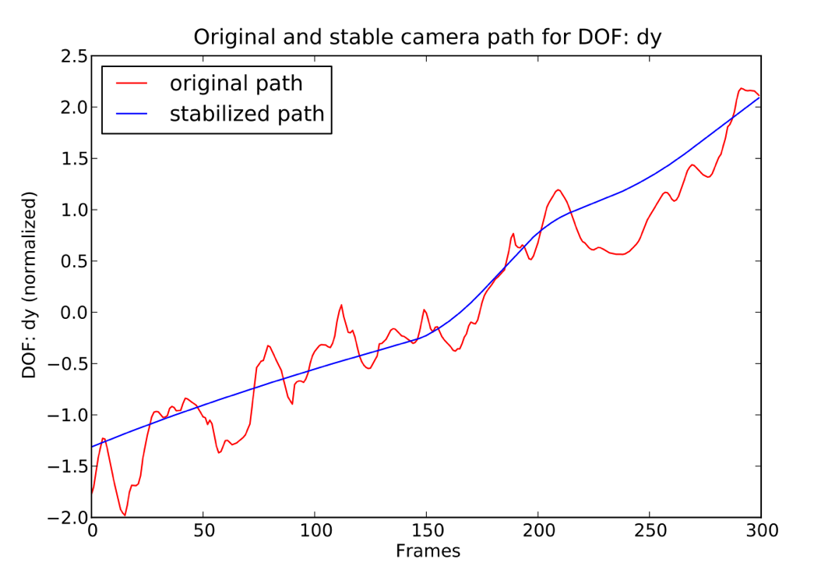
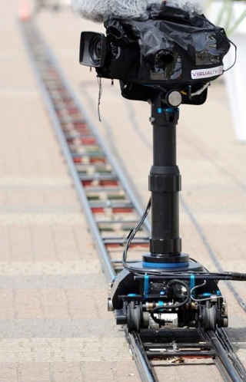
Path Smoothing
Goal: Approximate original path with stable one
Cinematography inspired: Properties of a stable path?
Tripod → Constant segment
Dolly or pan → Linear segment
Ease in and out transitions → Parabolic segment
Notes:
We asked us, what would be properties of stable path if cinematographer would have taken it
would have employed stabilization equipment. We wanted our optimized path to reflect this. Specifically it should be composed of three types of segment. Linear segments, ...

Slide 21
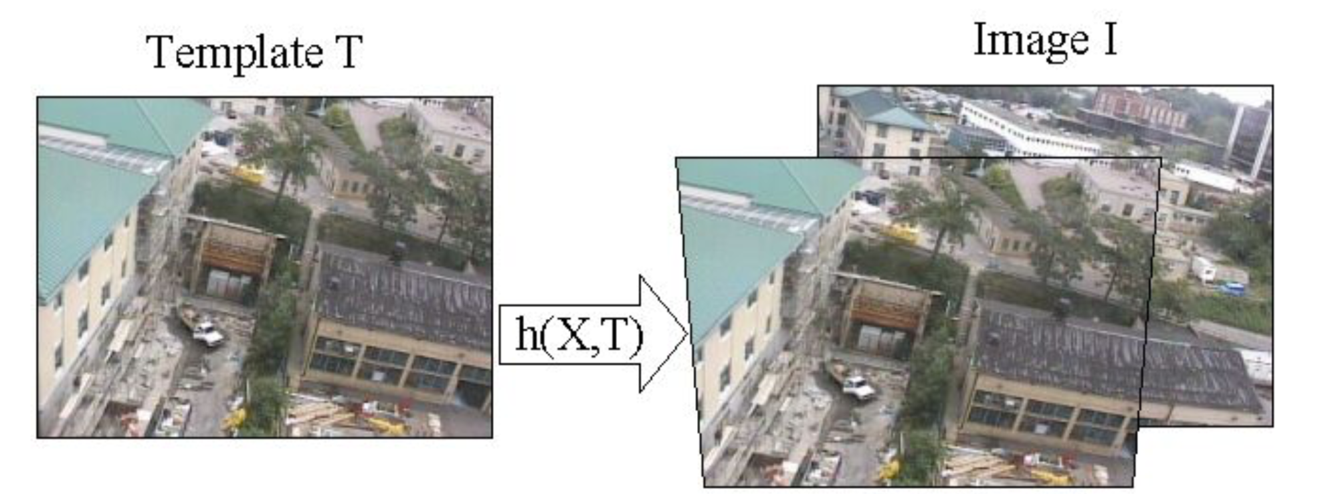
Parametric Motion
E.g., image-based homography estimation
Dellaert & Collins, 1999, Fast Image-Based Tracking by Selective Pixel Integration

Slide 22
”Jacobian Images”
Dellaert & Collins, 1999, Fast Image-Based Tracking by Selective Pixel Integration

Slide 23
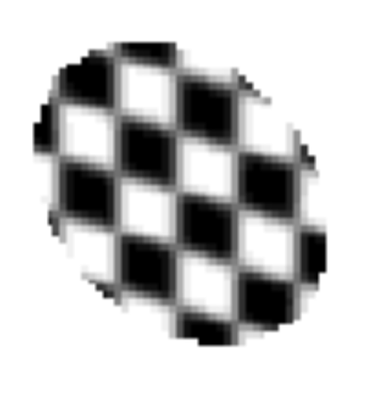
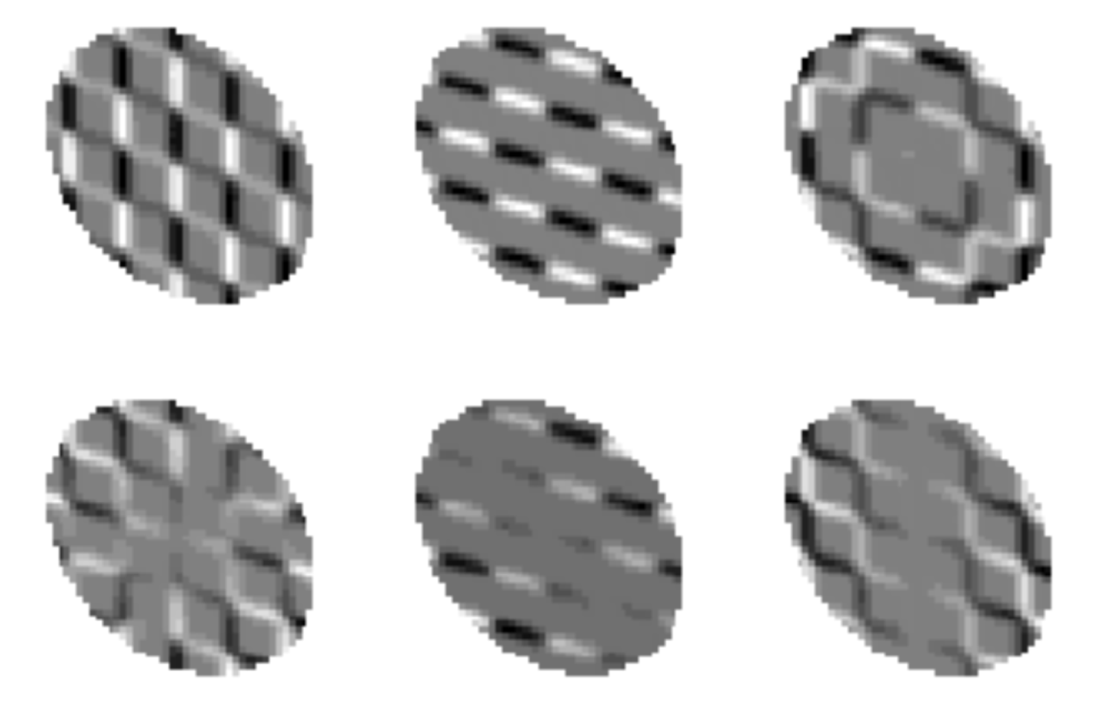
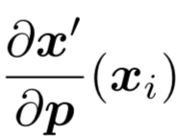
Computing Jacobian Images
template
dot-product
Dellaert & Collins, 1999, Fast Image-Based Tracking by Selective Pixel Integration

Slide 24
Compositional and Inverse Compositional
Compare three variants:
Original:
Compositional:
Inverse Comp:
In compositional approach we warp the image I₁ and solve for an incremental update.
Inverse compositional: search for incremental update to template instead
Jacobians and Hessian can now be precomputed

Slide 25
The Inverse Compositional Algorithm
[S. Baker and I. Matthews, 04]
Weight matrix
Damping: very frequently used in non-linear optimization to make sure gradients are valid;
“Levenberg-Marquardt”
Notes:
Need to explain the regularizer

Slide 26
Inverse Compositional Approach

Slide 27
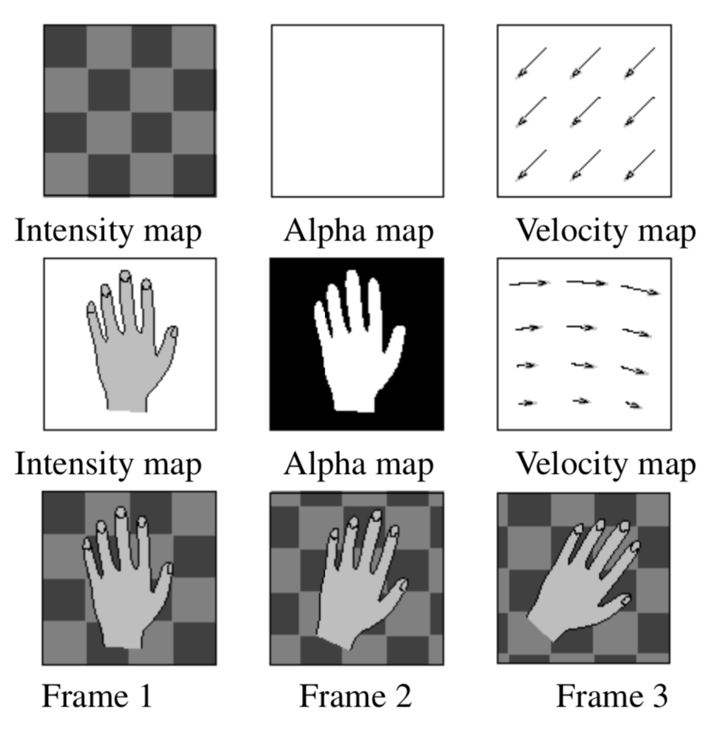
Layered Motion
One type of assumption to “regularize” optical flow
Estimate FG and BG layers

Slide 28
Layered Motion Results

Slide 29
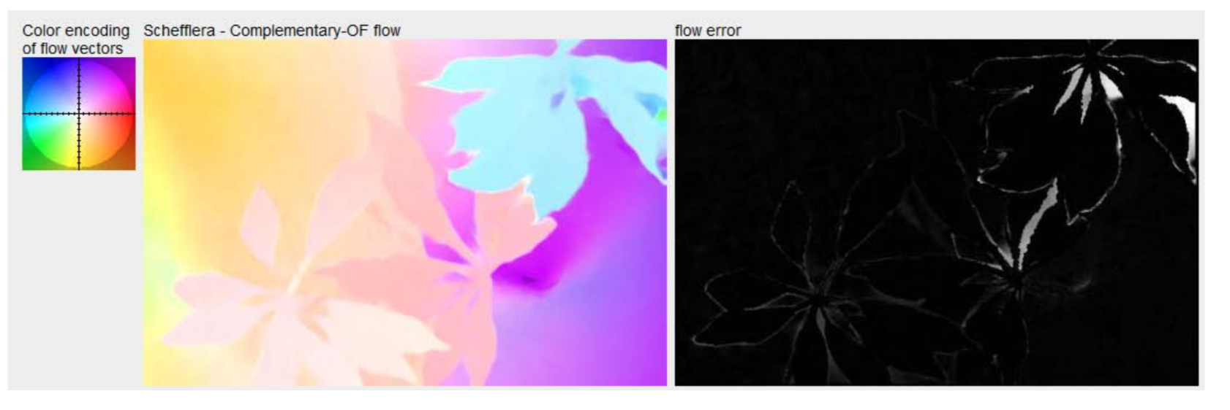
Optical Flow: fully non-parametric
Fully non-parametric model of motion
N pixels -> N flow vectors -> 2N parameters
Need some smoothness assumptions!
Hard to deal with occlusion

Slide 30
Taking a Deeper Look at the Inverse Compositional Algorithm
Zhaoyang Lv¹ , Frank Dellaert¹, James M. Rehg¹, Andreas Geiger²
¹Georgia Institute of Technology
²Autonomous Vision Group, MPI-IS and University of Tübingen

Slide 31
The Inverse Compositional Algorithm
[S. Baker and I. Matthews, 04]
We propose to take a deeper look at the Inverse Compositional algorithm from a learning perspective.
Notes:
Need to explain the regularizer

Slide 32
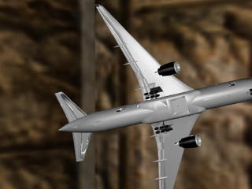
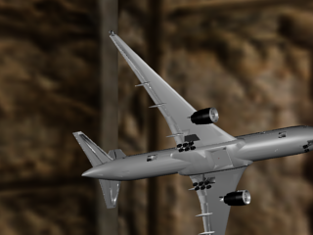
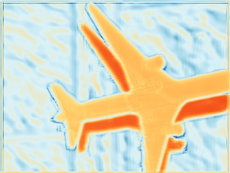
Take a Deeper Look at the Inverse Compositional algorithm
Contribution (A): Two-view Feature Encoder
(A) Two-View Feature Encoder

Slide 33
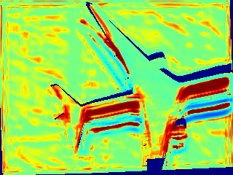
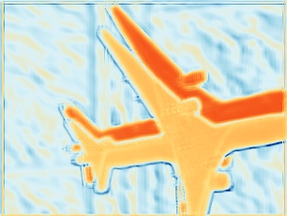
Take a Deeper Look at the Inverse Compositional algorithm
Contribution (B): Convolutional M-estimator
(B) Convolutional M-estimator

Slide 34
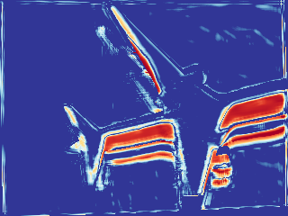
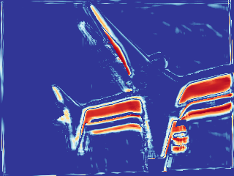
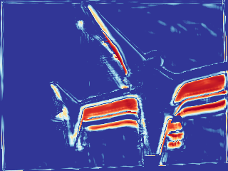
Take a Deeper Look at the Inverse Compositional algorithm
Contribution (C): Trust Region Network
(C) Trust Region Network

Slide 35
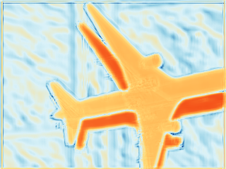
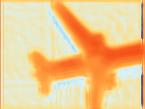
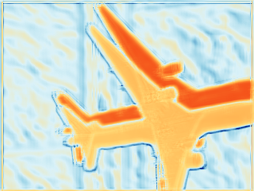
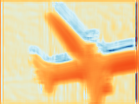
Coarse-to-Fine Inverse Compositional Algorithm
Feature Pyramid
(A) Two-View Feature Encoder
(A) Two-View Feature Encoder
(A) Two-View Feature Encoder
(A) Two-View Feature Encoder
$$∑$$
$$∑$$
$$∑$$
$$∑$$
$K$Inverse- Composition
$K$Inverse- Composition
$K$Inverse- Composition
$K$Inverse- Composition
Notes:
Emphasize all the components are end-to-end learned

Slide 36
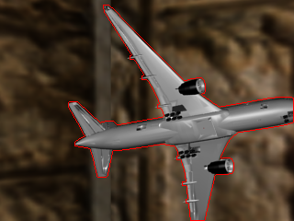
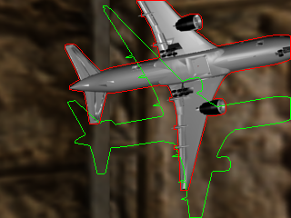
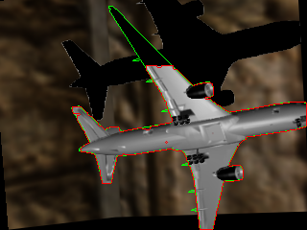
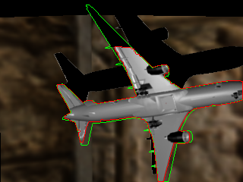
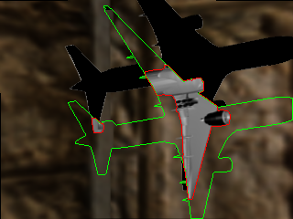
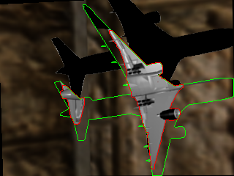
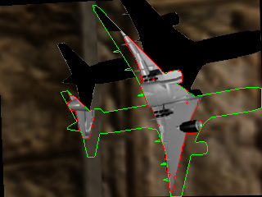
Visualization of Iterative 3D Rigid Motion Alignment
$$T$$
$$I$$
$$I(ξ^{GT})$$
Ours (A)+(B)+(C)
DeepLK
[Wang et al. ICRA, 2018]
Ours (A)
Ours (A)+(B)

Slide 37
Conclusion
We have taken a deeper look at the inverse compositional algorithm by reformulating it with
Two-view Feature Encoder
(B) Convolutional M-estimator
(C) Trust Region Network
The proposed solution is learnable, accurate, small, and fast in inference.

