Slide 1
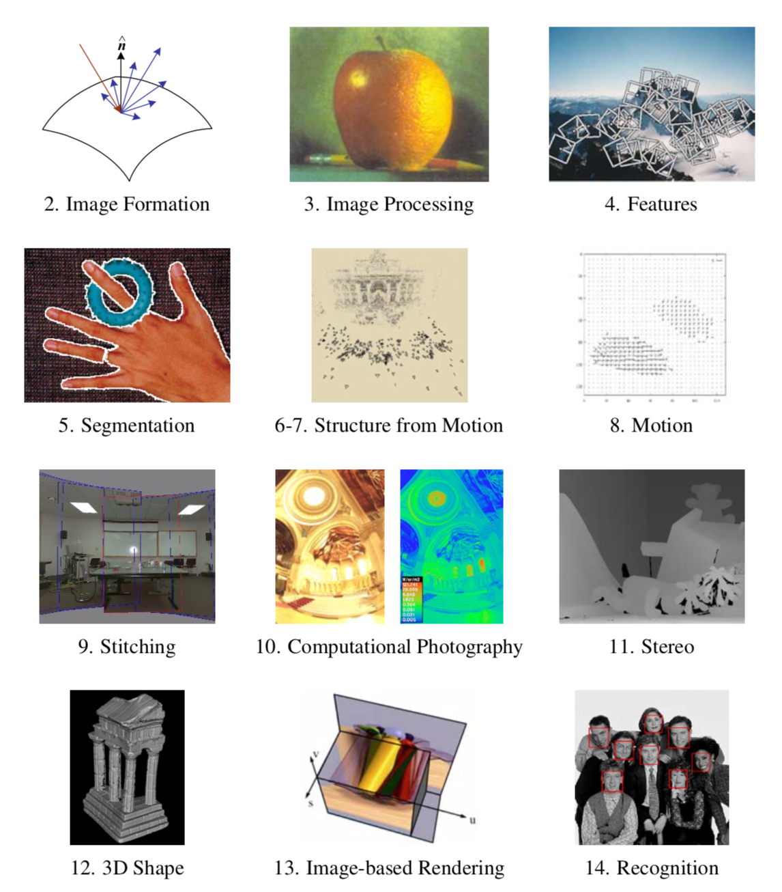

Slide 2
Recap: Two views and Fundamental Matrix F
P
l
l=F p’
p
p’
C
C’
Notes:
Illustrate by stepping through

Slide 3
Rank 2 Constraint
Why is F rank 2?
F
F^{T}
C
e=t
e’
C’
Not invertible! Collection of points is mapped to a pencil of lines. Epipoles map to zero.
What would it mean to be rank 1?

Slide 4
The Eight-Point Algorithm (Longuet-Higgins, 1981)
Minimize:
under the constraint
2
|F | =1.

Slide 5
The Normalized Eight-Point Algorithm
(Hartley, 1995)
Center the image data at the origin, and scale it so the mean squared distance between the origin and the data points is 2 pixels:
q_{i} = T p_{i} q_{i}’ = T’ p_{i}’.
Use the eight-point algorithm to compute F from the points q_{i} and q’_{i}.
Enforce the rank-2 constraint.
Output T⁻¹F T’.

Slide 6
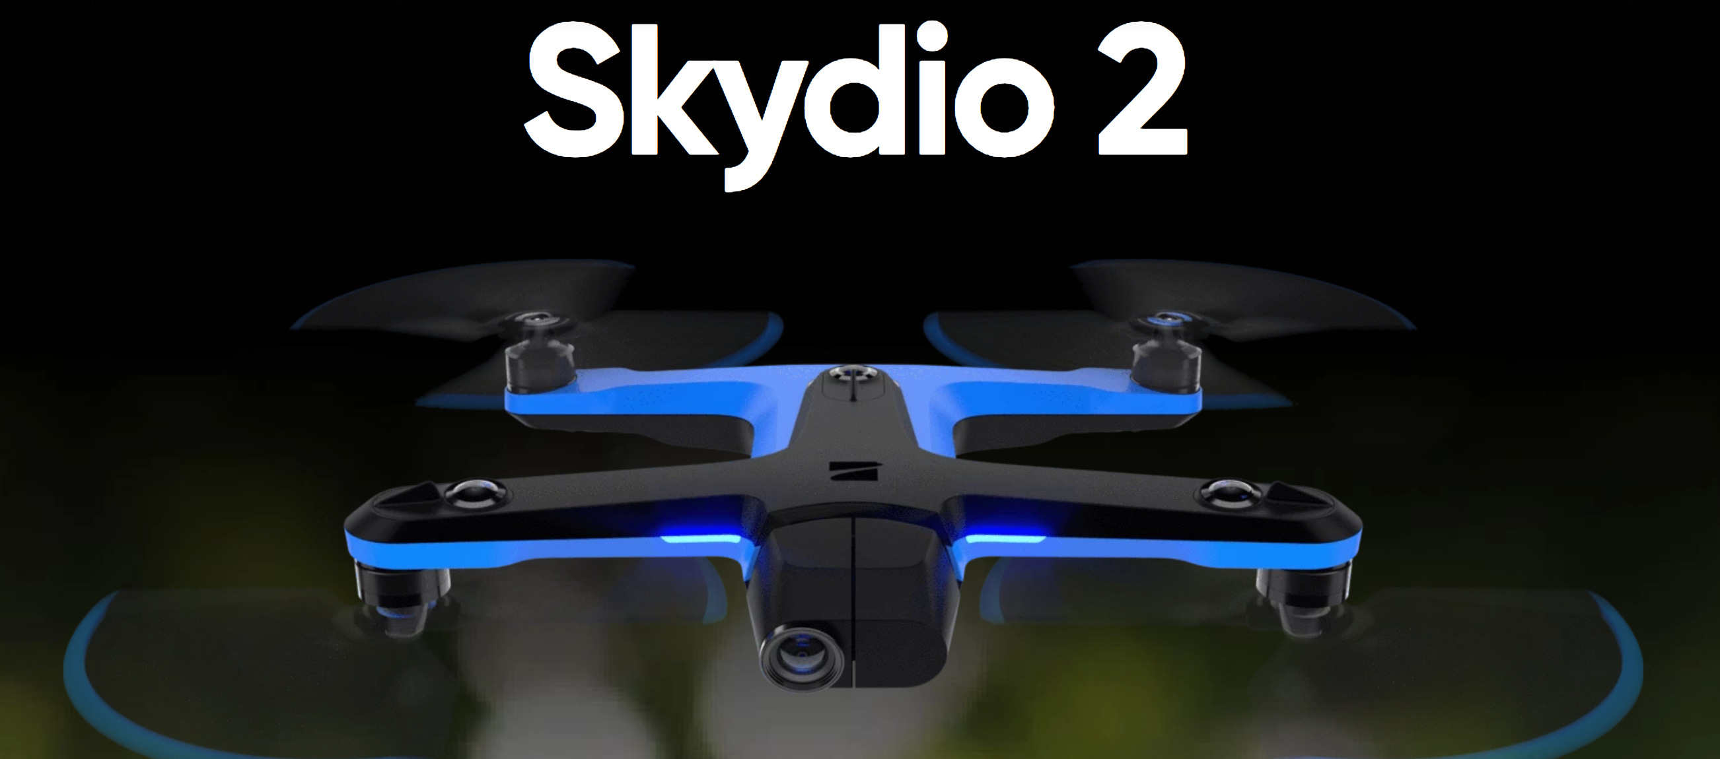
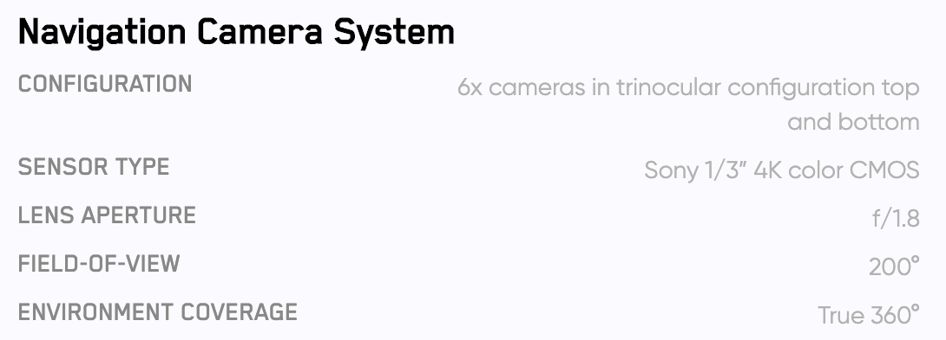
Trinocular Camera rigs
https://www.skydio.com/

Slide 7
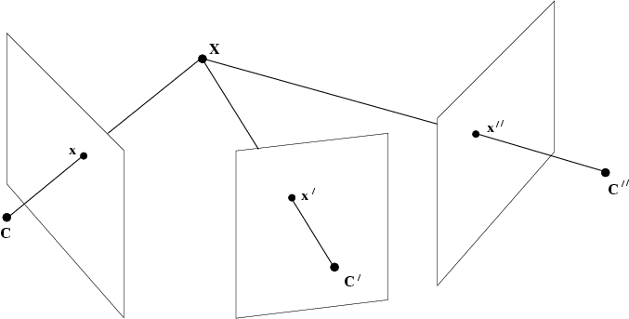
Trifocal Geometry

Slide 8
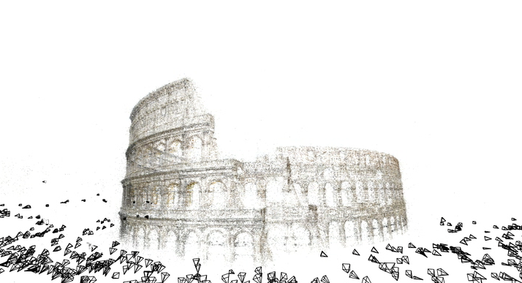
Structure from Motion
Building Rome in a Day
Agarwal et al

Slide 9
Motivation
Photo Tourism
Photosynth
Multi-view stereo
Building Rome in a Day
Rome on a Cloudless Day

Slide 10
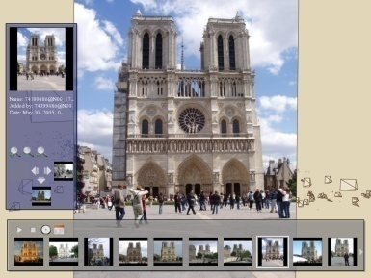
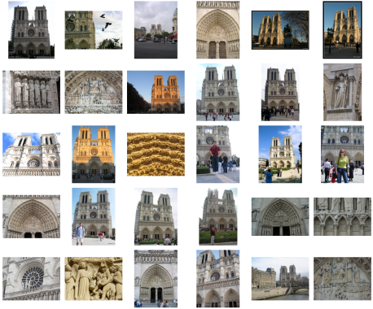
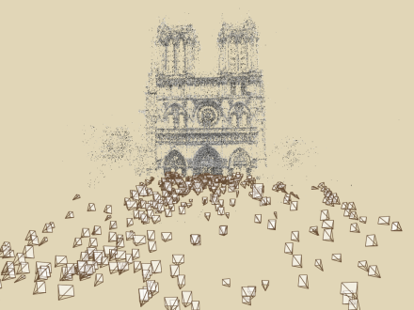
Photo Tourism
Noah Snavely, Steven M. Seitz, Richard Szeliski, Photo tourism: Exploring photo collections in 3D," ACM Transactions on Graphics (SIGGRAPH Proceedings), 25(3), 2006, 835-846.
Photo Explorer
Scene reconstruction
Input photographs
http://phototour.cs.washington.edu/
[Note: change to Trevi for consistency]

Slide 11
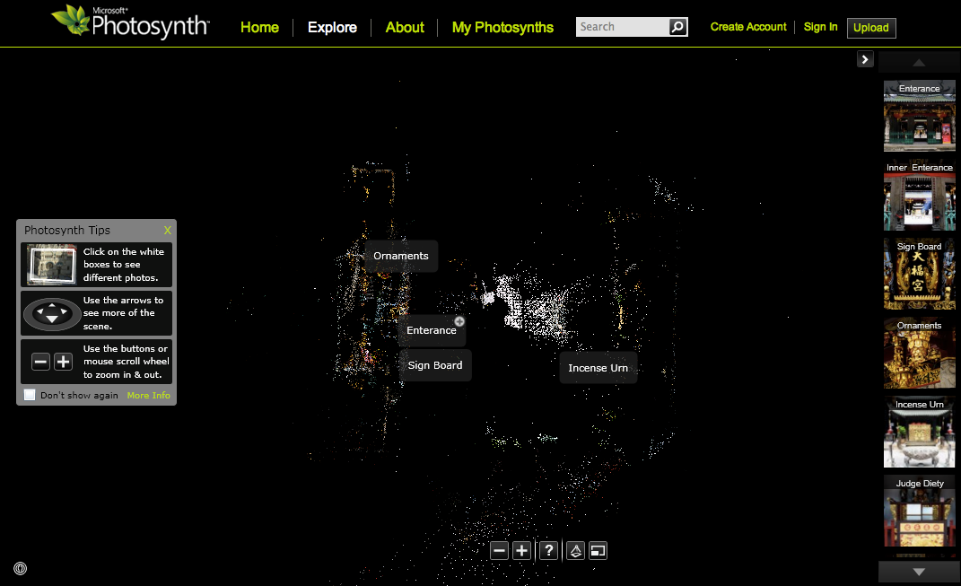
Photosynth
photosynth.net
http://photosynth.net/view.aspx?cid=29aa8616-a43a-43e4-9d6e-b8ad9b50483e

Slide 12
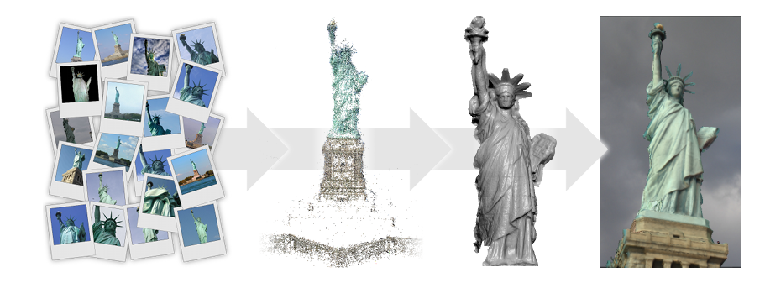
Multi-view Stereo
Multi-View Stereo for Community Photo Collections
Michael Goesele, Noah Snavely, Brian Curless, Hugues Hoppe, and Steven M. Seitz
ICCV 2007

Slide 13
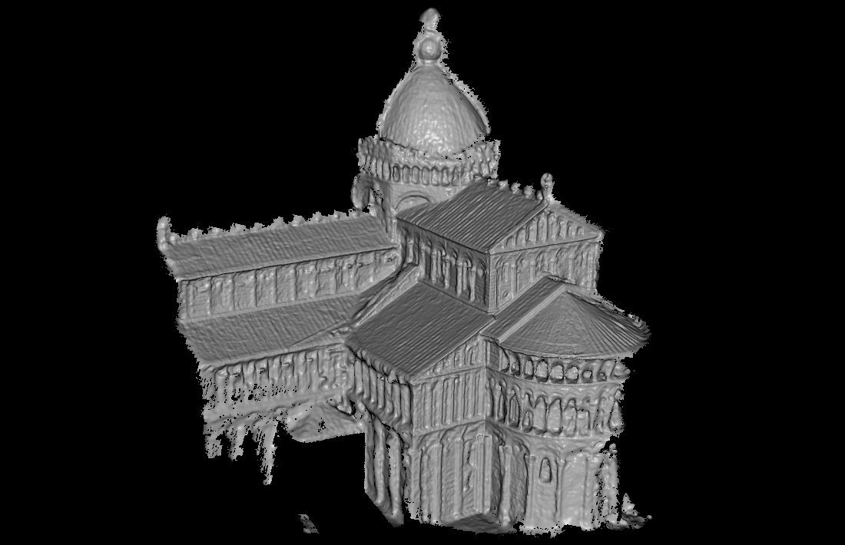
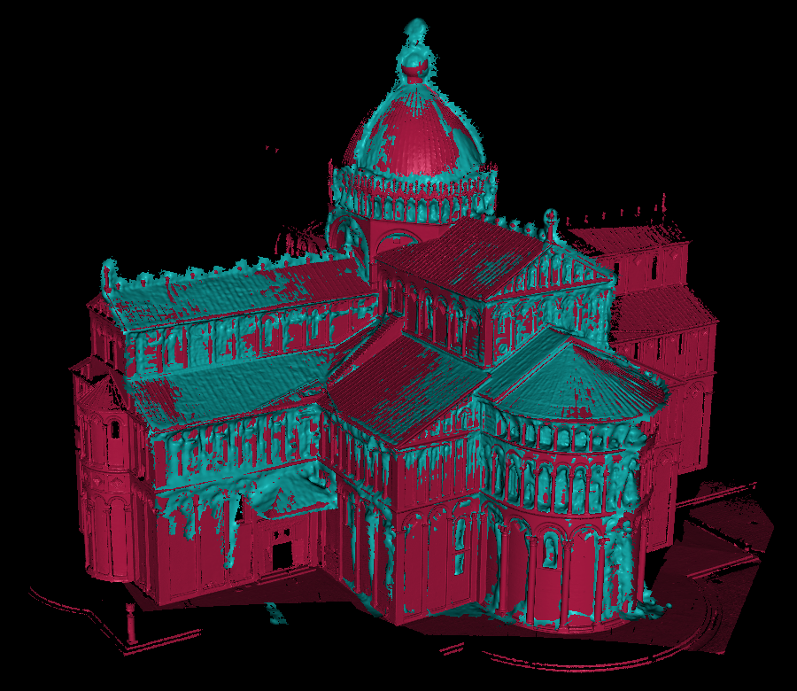
Multi-view Stereo
Compared with Laser-Scanner

Slide 14
Building Rome in a Day
Building Rome in a Day Sameer Agarwal, Noah Snavely, Ian Simon, Steven M. Seitz and Richard Szeliski International Conference on Computer Vision, 2009, Kyoto, Japan.
http://grail.cs.washington.edu/rome/

Slide 15
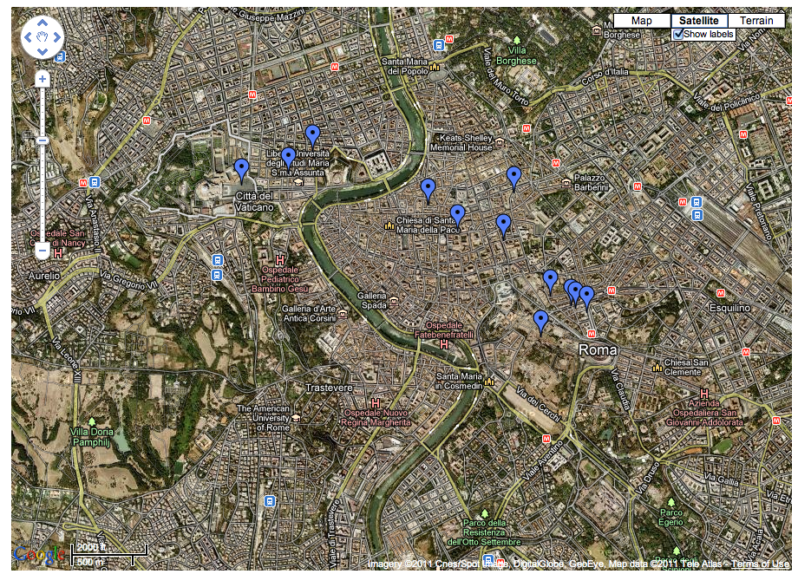
Rome on a Cloudless Day
Jan-Michael Frahm, Pierre Georgel, David Gallup, Tim Johnson, Rahul Raguram, Changchang Wu, Yi-Hung Jen, Enrique Dunn, Brian Clipp, Svetlana Lazebnik, Marc Pollefeys, ECCV 2010
http://www.cs.unc.edu/~jmf/rome_on_a_cloudless_day/

Slide 16
2 Problems !
Correspondence
Optimization

Slide 17
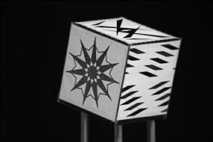
A Correspondence Problem

Slide 18
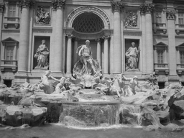
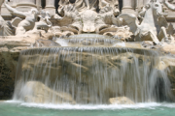
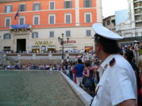
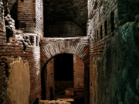
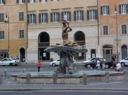
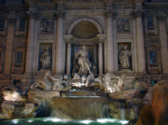
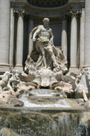
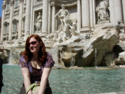
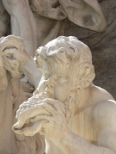
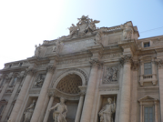
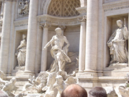
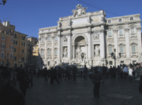
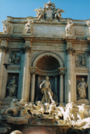
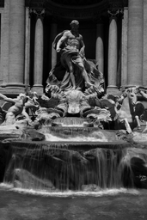
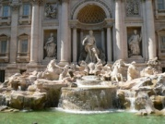
Feature detection
Detect features using SIFT [Lowe, IJCV 2004]

Slide 19
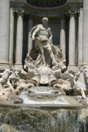
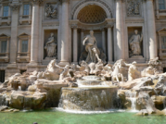
Feature matching
Refine matching using RANSAC [Fischler & Bolles 1987] to estimate fundamental matrices between pairs
Notes:
The matches are refined by using RANSAC, which is a robust model-fitting technique, to estimate a fundamental matrix between each pair of matching images and keeping only matches consistent with that fundamental matrix.
We then link connected components of pairwise feature matches together to form correspondences across multiple images.
Once we have correspondences, we run structure from motion to recover the camera and scene geometry. Structure from motion solves the following problem:

Slide 20
2 Problems !
Correspondence
Optimization

Slide 21
An Optimization Problem
Find the most likely structure and motion Θ

Slide 22
Optimization
=Non-linear Least-Squares !
=
m_{i}
Image i’
m_{i’}
Image i
u_{ik}
j_{ik}
x_{j}

Slide 23
Recall: Nonlinear Least Squares
Jacobian
Normal equations
Hessian

Slide 24
Sparse nonlinear least squares
Simple 1-Dimensional Example
p = 2 cameras and 4 points {c1 c2 l1 l2 l3 l4}
f(u_{ik};p) = difference in x position = l_{j(ik)} – c_{i}
0
10
15
20
l₁
l₂
l₃
l₄
c₁
c₂
5
15

Slide 25
Sparse Jacobian and Hessian
l₁
l₂
l₃
l₄
c₁
c₂
A =
1 0 0 0 0 0
-1 0 1 0 0 0
-1 0 0 1 0 0
-1 0 0 0 1 0
0 -1 1 0 0 0
0 -1 0 1 0 0
0 -1 0 0 1 0
0 -1 0 0 0 1
b =
5
-5
5
10
-15
-5
0
5
c1 c2 l1 l2 l3 l4
A'*A = inv(Sigma)
4 0 -1 -1 -1 0
0 4 -1 -1 -1 -1
-1 -1 2 0 0 0
-1 -1 0 2 0 0
-1 -1 0 0 2 0
0 -1 0 0 0 1
(A'*A)\A'*b =
5.0000
15.0000
0.0000
10.0000
15.0000
20.0000
c1 c2 l1 l2 l3 l4

Slide 26
A general formalism: Factor Graphs
Bipartite graph
Two types of nodes:
Unknowns
Factors: correspond to squared errors
Connectivity = sparsity! Factor is function of small set.
0
10
15
20
l₁
l₂
l₃
l₄
c₁
c₂
5
15

Slide 27
SLAM: Simultaneous Localization and Mapping

Slide 28
SLAM Factor Graph
x₀
x₁
x₂
...
x_{M}
- Trajectory of Robot
...
- Landmark Measurements
l₁
l₂
...
- “Landmarks”
l_{N}
P(X,M) = k*
Notes:
Factor graph is a graphical model representation…
Leads to a linear least squares problem.

Slide 29
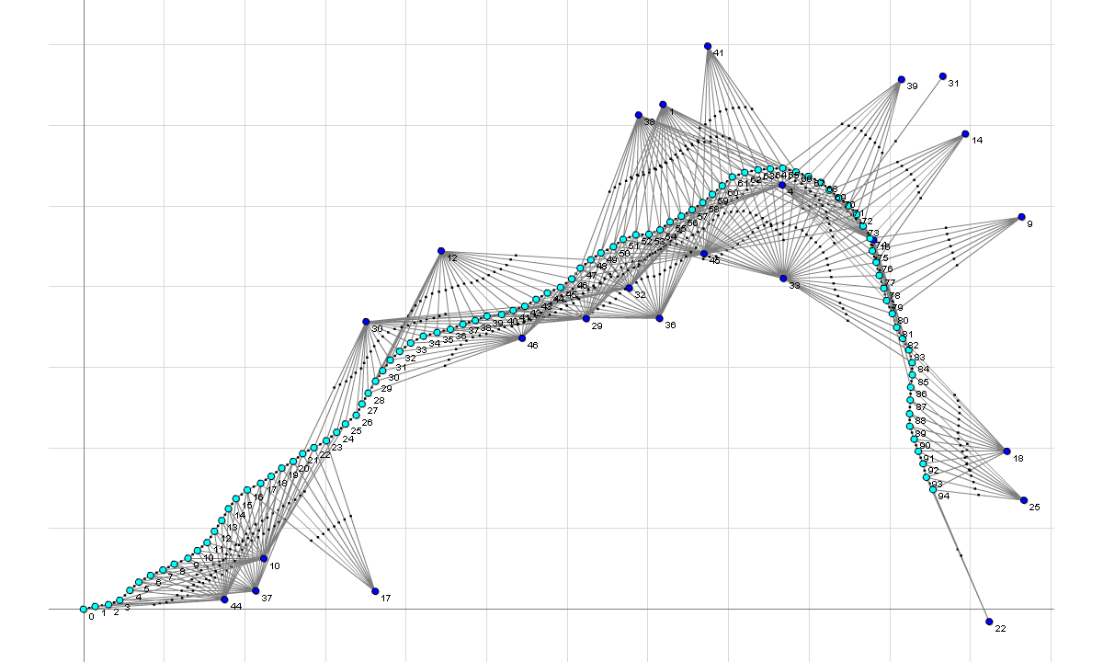
SLAM Factor Graph
A
Notes:
The associated factor graph, as imported in mfqr

Slide 30
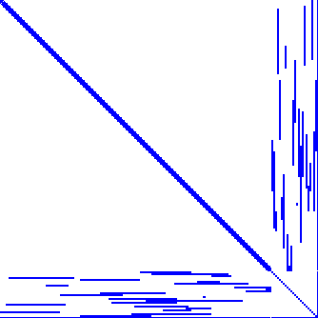
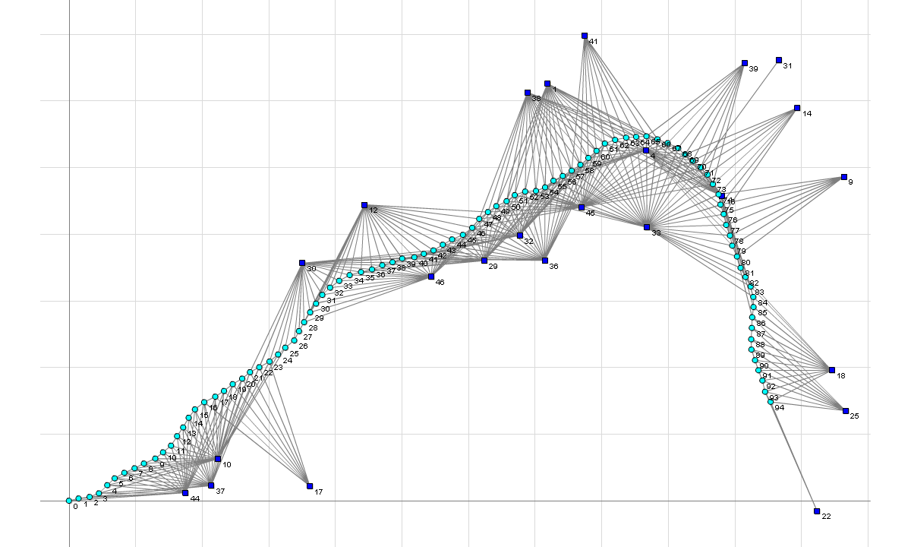
Hessian
A^{T}A
Notes:
The associated factor graph, as imported in mfqr

Slide 31
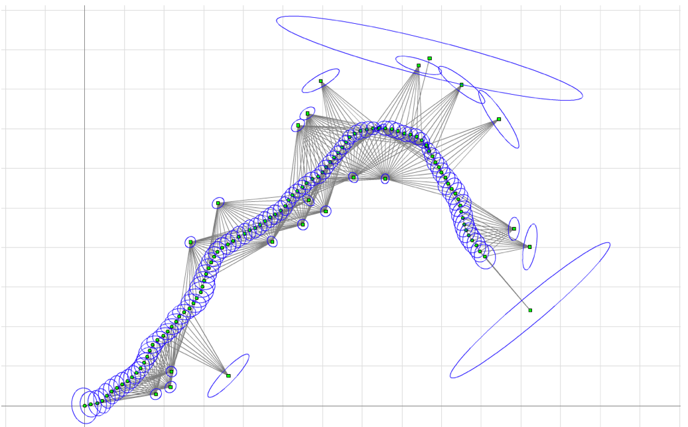
End result: Solution + Sigma

Slide 32
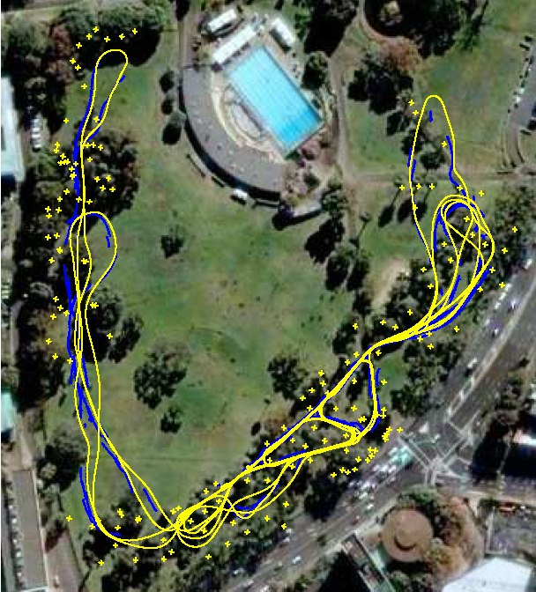
Example: Victoria Park, Sidney

Slide 33
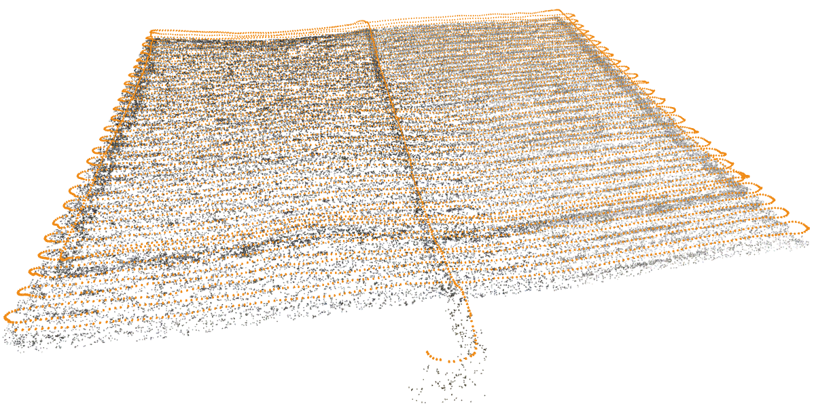
Example: Underwater SLAM
9831 camera poses, 185261 landmarks, and 350988 factors

Slide 34
Structure from Motion (Chicago, movie by Yong Dian Jian)

Slide 35
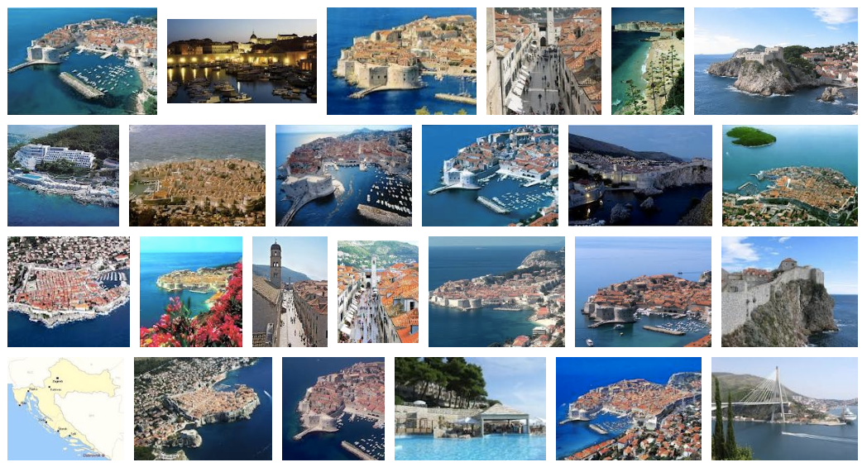
3D Models from Community Databases
E.g., Google image search on “Dubrovnik”
Figure by Aggarwal et al.

Slide 36
3D Models from Community Databases
Agarwal, Snavely, Seitz et al. at UW http://grail.cs.washington.edu/rome/
5K images, 3.5M points, >10M factors
Movie by Aggarwal et al.

Slide 37
Hyper-SFM: Efficient Multi-core
Kai now leads an autonomous driving startup in China
Kai Ni, and Frank Dellaert, HyperSfM, IEEE International Conference on 3D Imaging, Modeling, Processing, Visualization and Transmission (3DIMPVT), 2012.

Slide 38
4D Reconstruction

Slide 39
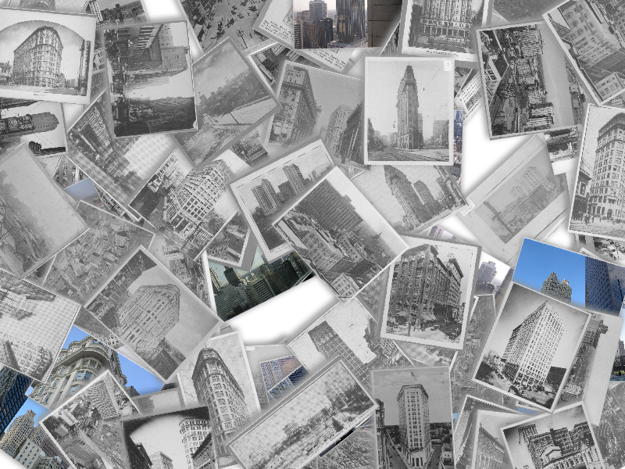
Spatiotemporal Reconstruction
4D Cities: 3D + Time
4D City Model
Historical Image Collection
Supported by NSF CAREER, Microsoft
Recent revival: NSF NRI award on 4D crops for precision agriculture…
Grant Schindler
Notes:
Video File:time_loop.mov
We include a date for every photograph and a time interval for every 3d structure.
So our problem is that we have a stack of historical photos of a city from the past 100 years…

Slide 40
4D Reconstruction of Lower Manhattan
Probabilistic Temporal Inference on Reconstructed 3D Scenes, G. Schindler and F. Dellaert, IEEE Computer Society Conference on Computer Vision and Pattern Recognition (CVPR), 2010.
Notes:
Video File: nyc_points_buildings_rotate.mov

Slide 41
4D Structure over Time
Notes:
Video File: nyc_pointcloud_upclose.mov

Slide 42
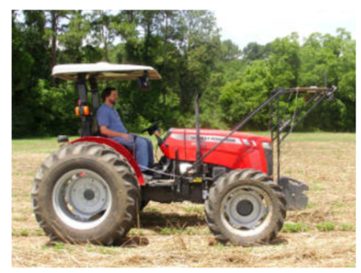
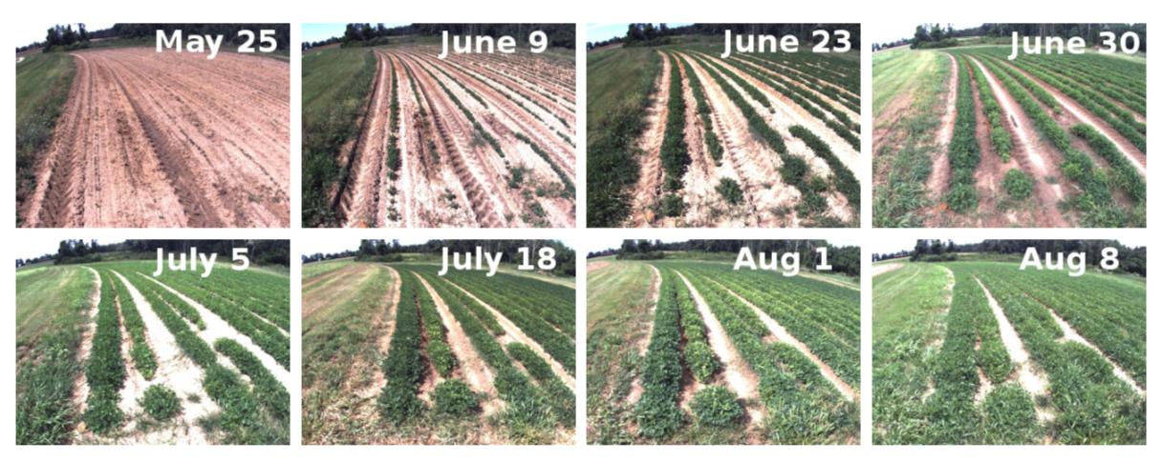
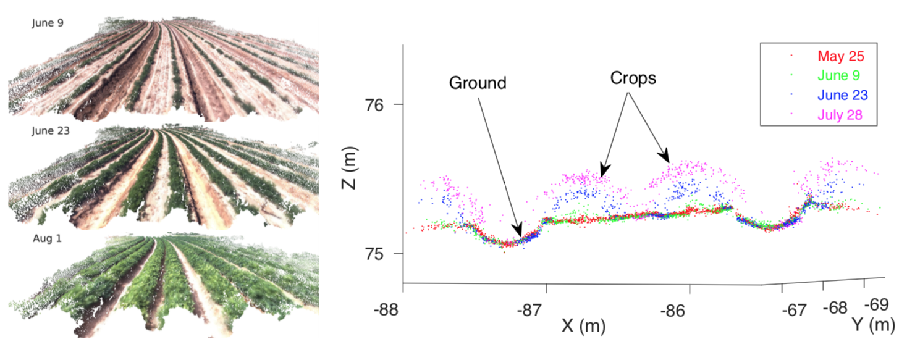
4D crop monitoring (Jing Dong)

Slide 43
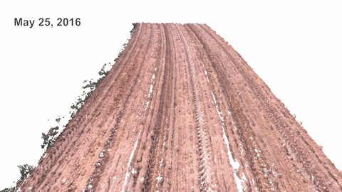
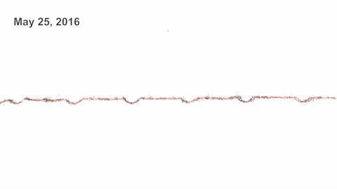
Results: video (by Jing Dong)
4D reconstruction results (by PMVS) and its cross section

