Slide 1
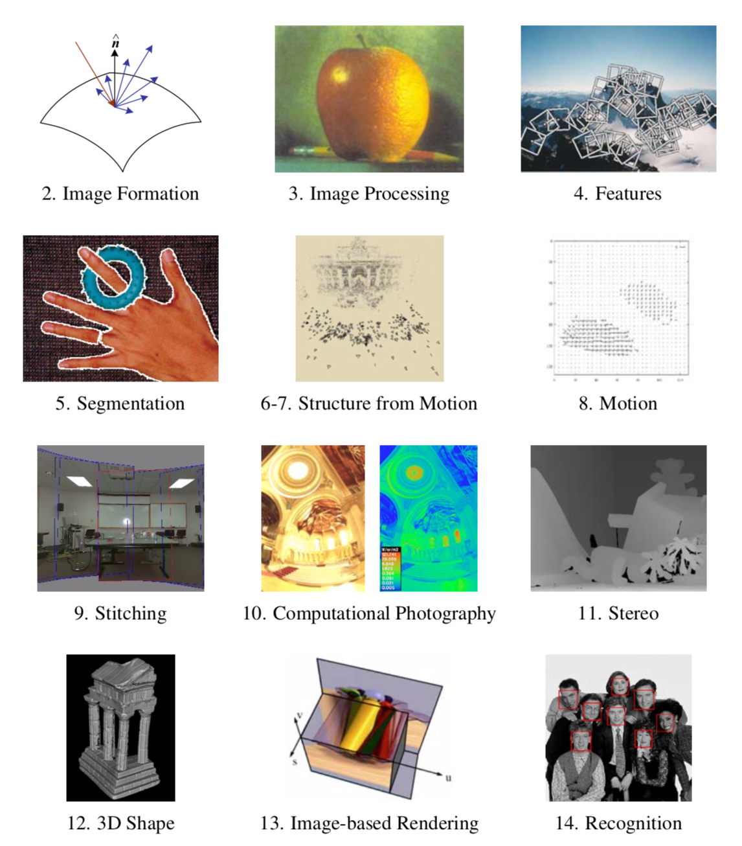

Slide 2
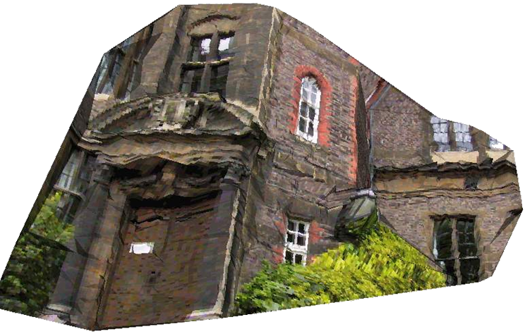
Multiple View Geometry
Frank Dellaert

Slide 3
Outline
Intro
Camera Review
Stereo triangulation
Geometry of 2 views
Essential Matrix
Fundamental Matrix
Estimating E/F from point-matches
Notes:
Triangulation: take two images and get 3D structure
What if we
Structure from motion: Multiple cameras: more accurate

Slide 4
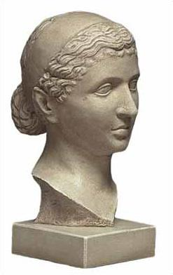
Why Consider Multiple Views?
P
P'
X
x'
x
Answer: To extract 3D structure via triangulation.

Slide 5
Stereo Rig
Top View
Matches on Scanlines
Convenient when searching for correspondences.

Slide 6
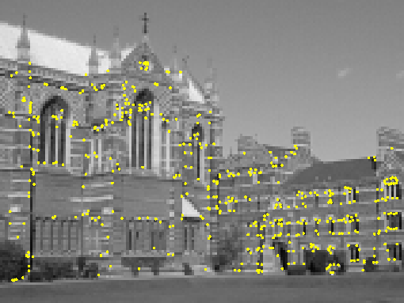
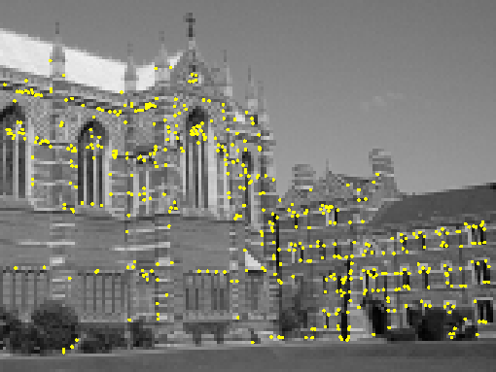
Feature Matching !
Notes:
Show two images
How can we match them up ?

Slide 7
Real World Challenges
Bad News: Good correspondences are hard to find
Good news: Geometry constrains possible correspondences.
4 DOF between x and x'; only 3 DOF in X.
Constraint is manifest in the Fundamental matrix
F can be calculated either from camera matrices or a set of good correspondences.

Slide 8
Geometry of 2 views ?
What if we do not know R,t ?
Caveat:
My exposition uses different R, t
but more intuitive (IMHO)
I use [R^{T}|-R^{T}t] = R^{T} [I|-t] camera matrices
Szeliski uses [R|t]
Notes:
Very cool, but now, suppose we don’t know where images were taken from
Now what ?

Slide 9
Epipolar Geometry
P
Where can p appear ?
p
?
p’
t
C
C’
M=[I|0]
M’= R^{T}[I|-t]
Notes:
Very handy to know something about geometry
For example, if I have 2 views, one point, where could it be in other view ?
Suppose for now we know the geometry…
Picture: two views, question mark

Slide 10
Image of Camera Center
epipole
M=[I|0]
M’= R^{T}[I|-t]
Notes:
Let’s ask a simpler question: two views, where is image of other camera in view 1 ?
We call this the epipole

Slide 11
Example: Cameras Point at Each Other
Top View
Epipolar Lines

Slide 12
Epipoles
Epipoles inside the image: zoom-like setup.

Slide 13
Epipoles
Epipoles in near-stereo config.

Slide 14
Epipoles
Camera Center C’ in first view:
Origin C in second view:

Slide 15
Image of Camera Ray ?
epipole
M’= R^{T}[I|-t]
M=[I|0]
Notes:
Now, slightly more thinking. What is image of a ray ?

Slide 16
Point at infinity
Given p’, what is corresponding point at infinity [x 0] ?
Answer for any camera M’=[A|a]:
A⁻¹ = Infinite homography
In our case M’=[R^{T}|-R^{T}t]:
Notes:
How to calculate them ?

Slide 17
Sidebar: Infinite Homographies
Homography between
image plane
plane at infinity
Navigation by the stars:
Image of stars = function of rotation R only !
Traveling on a sphere rotates viewer

Slide 18
Epipolar Line Calculation
1) Point 1 = epipole e=t
2) Point 2 = point at infinity
3) Epipolar line = join of points 1 and 2
Notes:
How to calculate them ?

Slide 19
Epipolar Lines
P∞
P
p∞=Rp’
p
p’
C
e=t
e’
C’
M=[I|0]
M’= R^{T}[I|-t]
Notes:
Illustrate by stepping through

Slide 20
Epipolar lines
p∞=Rp’
e=t
Notes:
Now, slightly more thinking. What is image of a ray ?

Slide 21
Epipolar Plane
P
p
p’
C’
e’
e=t
C
M’= R^{T}[I|-t]
M=[I|0]
Notes:
Other way to see it: Plane formed by C, C’, and P

Slide 22
Essential Matrix
mapping from p’ to l
E = 3*3 matrix
Because p is on l, we have

Slide 23
Essential Matrix E
P∞
R,t = 6 DOF
However, scale !
=> 5 DOF
P
p∞=Rp’
p
p’
C
e=t
e’
C’
M=[I|0]
M’= R^{T}[I|-t]
Notes:
Illustrate by stepping through

Slide 24
Fundamental Matrix
FUNDAMENTAL

Slide 25
Uncalibrated Case
P∞
P
p∞=A⁻¹p’
p
p’
C
e’=a
e=-A⁻¹a
C’
M=K[I|0]
M’=K’[R^{T}|-R^{T}t]
M’= [A|a]
M’=K⁻¹K’[R^{T}|-R^{T}t]
M=[I|0]
M=[I|0]
Notes:
Illustrate by stepping through

Slide 26
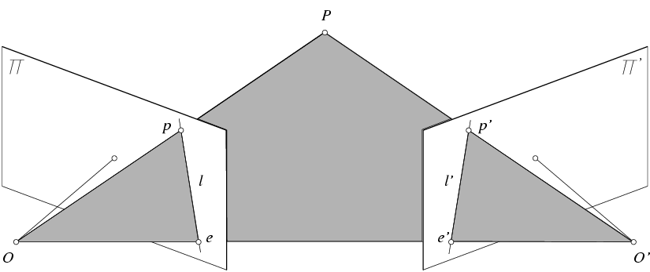
Uncalibrated Case, Forsyth & Ponce Version
Fundamental Matrix
(Faugeras and Luong, 1992)

Slide 27
Fundamental Matrix
mapping from p’ to l
F = 3*3 matrix
Because p is on l, we have

Slide 28
Fundamental Matrix F
P∞
3x3 = 9 DOF
However, scale, rank 2 !
=> 7 DOF
P
p∞=A⁻¹p’
p
p’
C
e=t
e’
C’
M=[I|0]
M’= [A|a]
Notes:
Illustrate by stepping through

Slide 29
Properties of the Fundamental Matrix
Fp’ is the epipolar line associated with p’.
F^{T}p is the epipolar line associated with p.
F^{T}e=0 and Fe’=0.
F is singular.

Slide 30
Non-Linear Least-Squares Approach
(Luong et al., 1993)
Minimize
with respect to the coefficients of F , using an
appropriate rank-2 parameterization.
d(p, l) = point to line distance = (ax + by + cw)/sqrt(a² + b²)
d² (p, l) = |ax + by + cw|²/(a² + b²)

Slide 31
The Eight-Point Algorithm (Longuet-Higgins, 1981)
Minimize:
under the constraint
2
|F | =1.

Slide 32
The Normalized Eight-Point Algorithm (Hartley, 1995)
Center the image data at the origin, and scale it so the mean squared distance between the origin and the data points is 2 pixels:
q_{i} = T p_{i} q_{i}’ = T’ p_{i}’.
Use the eight-point algorithm to compute F from the points q_{i} and q’_{i}.
Enforce the rank-2 constraint.
Output T⁻¹F T’.

