Slide 1
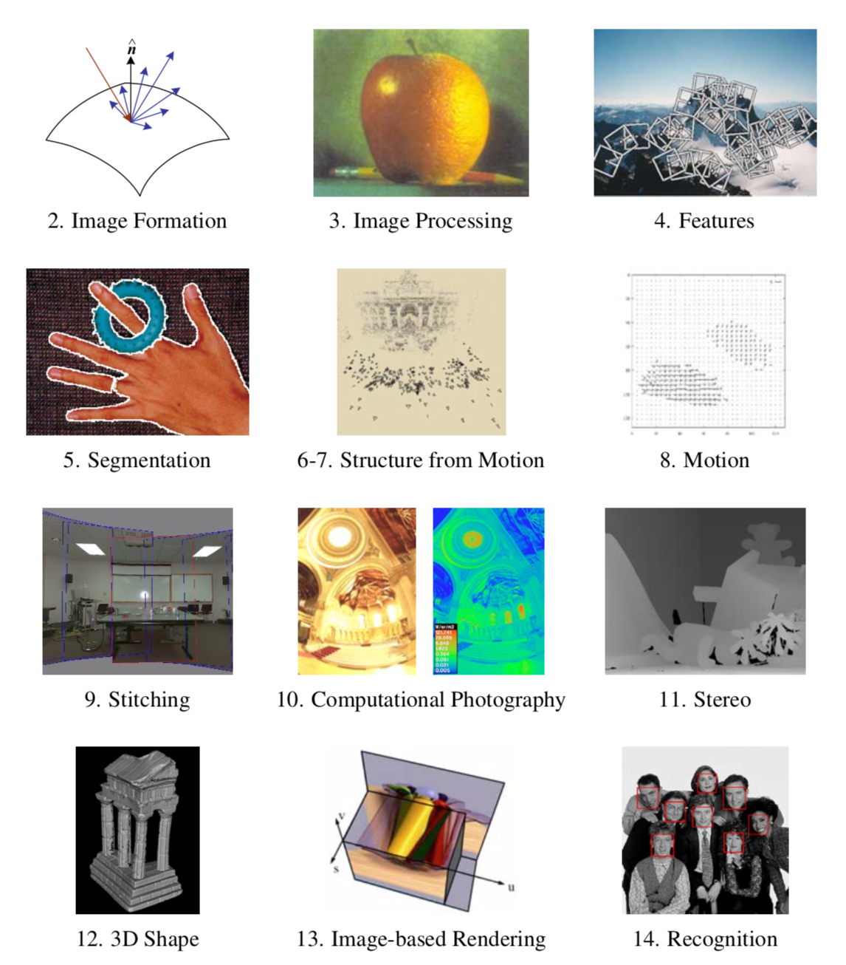

Slide 2
Review: RANSAC
Objective:
Robust fit of a model to data D
Algorithm
Randomly select s points
Instantiate a model
Get consensus set D_{i}
If |D_{i}|>T, terminate and return model
Repeat for N trials, return model with max |D_{i}|
Image credit Wikipedia

Slide 3
Adaptive N
When etha is unknown ?
Start with etha = 50%, N=inf
Repeat:
Sample s, fit model
-> update etha as |outliers|/n
-> set N=f(etha, s, p)
Terminate when N samples seen
Image credit Wikipedia

Slide 4
Review: 2D Alignment
Input:
A set of matches {(x_{i}, x_{i}’)}
A parametric model f(x; p)
Output:
Best model p*
How?
Image credit Szeliski book

Slide 5
Now: 3D-2D Alignment
Input:
A set of 3D->2D matches {(X_{i}, x_{i})}
A parametric model f(X; p)
Output:
Best model p*
How?
Image credit Szeliski book

Slide 6
Pose Estimation
Input:
A set of 2D measurements x_{i} of known 3D points3D X_{i}
Parametric model is camera matrix P, i.e., x = f(X; P)
Output:
Best camera matrix P
How?
Image credit Szeliski book

Slide 7
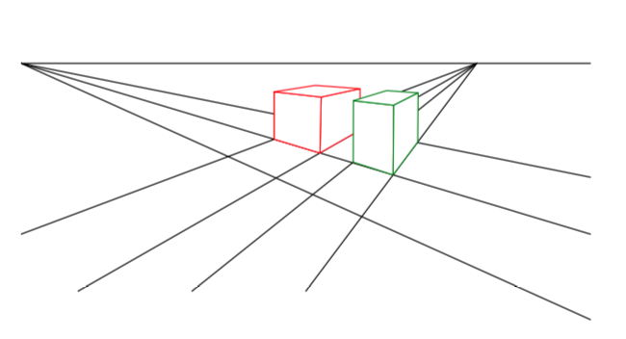
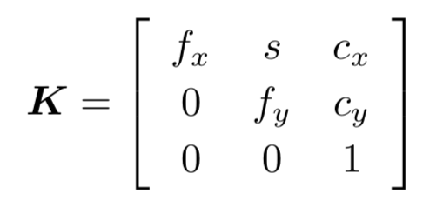
Review: Projective Camera Matrix
Chapter 2 in book
Homogeneous coord.
3D TO 2D projection: x = K[R|t]X = PX where P = 3x4 camera matrix and K the 3x3 calibration

Slide 8
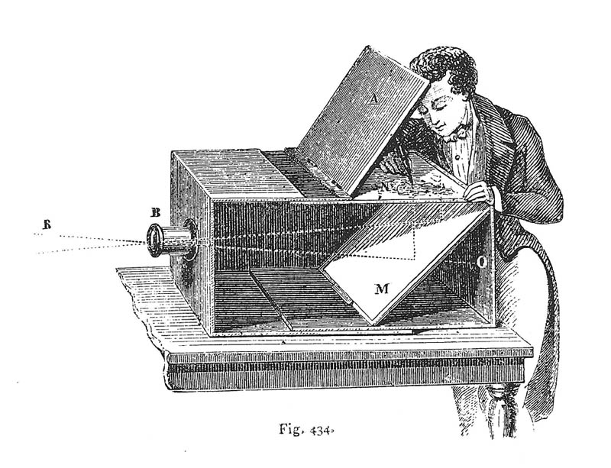
Camera Extrinsics: a Pose in 3D
What is the geometric meaning of R and t ??
Intuitive: camera is at a position _{w}t_{c} Indices say: camera in world coordinate frame
_{w}t_{c}

Slide 9
Camera Extrinsics: a Pose in 3D
What is the geometric meaning of R and t ??
Rotation is given by 3x3 matrix _{w}R_{c} whose columns are the camera axes _{w}x_{c}, _{w}y_{c}, _{w}z_{c}
_{w}x_{c}
_{w}z_{c}
_{w}y_{c}

Slide 10
Camera Extrinsics: a Pose in 3D
What is the geometric meaning of R and t ??
Transforming point X_{i} from world to camera coordinates: _{w}X_{i} – _{w}t_{c} = _{w}R_{c c}X_{i}
_{w}X_{i} - _{w}t_{c}
_{w}X_{i}

Slide 11
Camera Extrinsics: a Pose in 3D
Expressed in homogeneous coordinates:
_{c}X_{i} = _{w}R_{c}^{T} (_{w}X_{i} - _{w}t_{c}) = _{w}R_{c}^{T} [I| - _{w}t_{c}] _{w}X_{i} = [_{w}R_{c}^{T} | - _{w}R_{c}^{T} _{w}t_{c}] _{w}X_{i} = [_{c}R_{w} | _{c}t_{w}] _{w}X_{i} = [R|t] _{w}X_{i}
_{c}X_{i}
_{w}X_{i}

Slide 12
Camera Extrinsics: a Pose in 3D
Conclusion: when people write _{c}X_{i} = [R|t] _{w}X_{i} they are talking about (unintuitive) [_{c}R_{w} | _{c}t_{w}]
We like use (intuitive) _{c}X_{i} = _{w}R_{c}^{T} [I| - _{w}t_{c}] _{w}X_{i}
_{c}X_{i}
_{w}X_{i}

Slide 13
Revision: Projective Camera Matrix
Homogeneous coord.
3D TO 2D projection: Camera-centric: x = K[_{c}R_{w} | _{c}t_{w}] X = PX World-centric: x = K _{w}R_{c}^{T} [I | - _{w}t_{c}] X = PX P = same 3x4 camera matrix and K the 3x3 calibration

Slide 14
Looking at the (opaque) camera matrix
Can you interpret the columns of P with entities in the scene?
Answer:
P¹ == the image of [1 0 0 0]
P² == the image of [0 1 0 0]
P³ == the image of [0 0 1 0]
P⁴ == the image of [0 0 0 1]
What are those ?
[0 0 0 1] is easy…
Answer:
[0 0 0 1] is the origin, so P4 is the image of the origin.
[1 0 0 0] is a point at infinity in the X-direction, so it is the vanishing point of all lines parallel with the X direction!

Slide 15
Vanishing points, revisited
3
2
1
2
1
3
Columns of P !
P⁴ is arbitrary: wherever you defined the world origin.
https://www.artinstructionblog.com/perspective-drawing-tutorial-for-artists-part-2

Slide 16
Back to Pose Estimation!
Simple algorithm: just measure the coordinates of the origin and the three vanishing points?
Does not work ☹:
Columns are only measured up to a scale.
4 points * 2DOF = only 8 DOF! Missing 11-8=3
3 missing numbers are exactly those scales.

Slide 17
Least Squares Pose Estimation…
Input:
A set of 2D measurements x_{i} of known 3D points3D X_{i}
Parametric model is camera matrix P, i.e., x = f(X; P)
Output:
Best camera matrix P

Slide 18
Pose estimation = “Resectioning”
Opposite of triangulation.

Slide 19
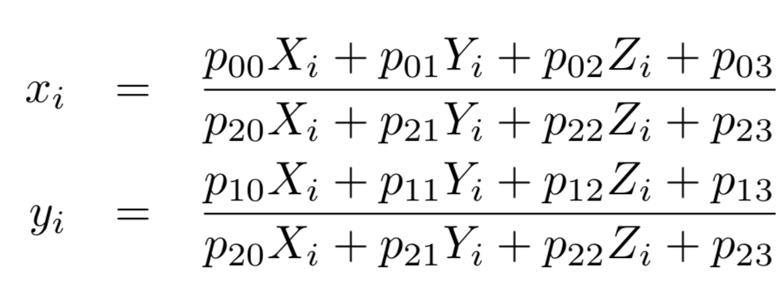
Pose estimation
In project 3, you will use scipy.optimize.least_squares to do exactly that. Working knowledge of 3D poses will be required.
Note before we compute the 2D reprojection error we need to convert back PX to non-homogeneous coordinates:
https://docs.scipy.org/doc/scipy/reference/generated/scipy.optimize.least_squares.html

Slide 20
Application: VR
https://youtu.be/nrj3JE-NHMw

