Slide 1
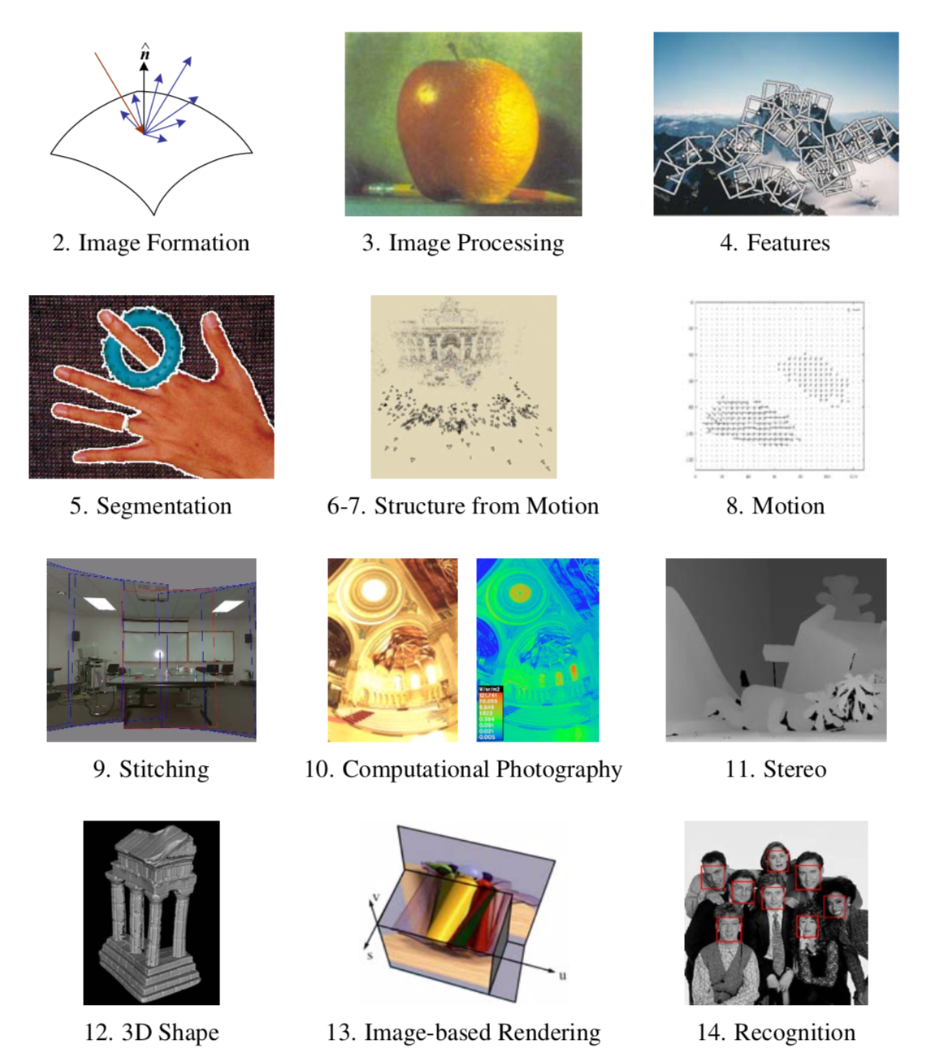

Slide 2
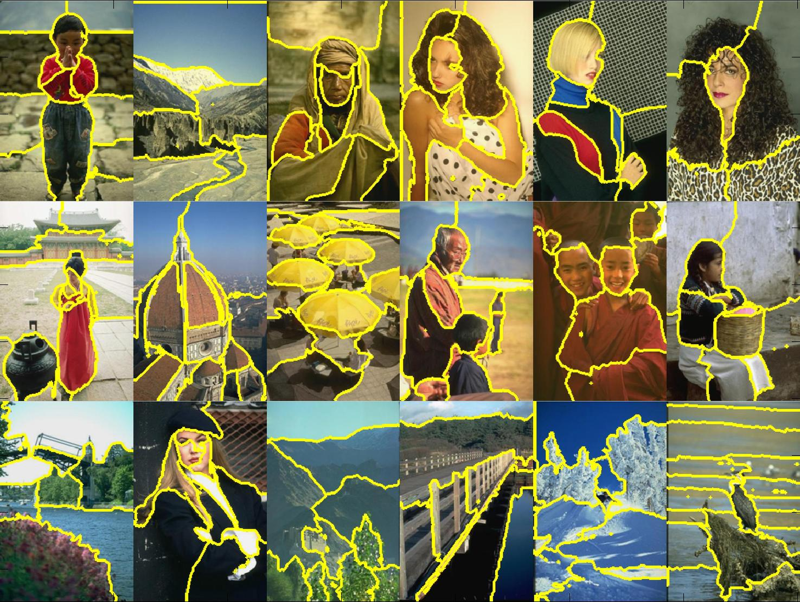
Segmentation & Custering
Disclaimer: Many slides have been borrowed from Devi Parikh and Kristen Grauman, who may have borrowed some of them from others. Any time a slide did not already have a credit on it, I have credited it to Kristen. So there is a chance some of these credits are inaccurate.
Notes:
2

Slide 5
Grouping in vision
Goals:
  Gather features that belong together
  Obtain an intermediate representation that compactly describes key image or video parts
Slide credit: Kristen Grauman

Slide 6
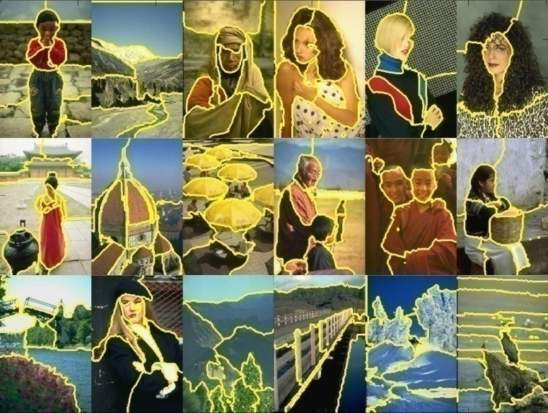
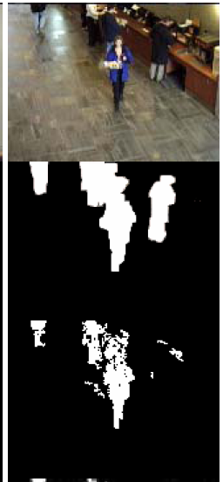
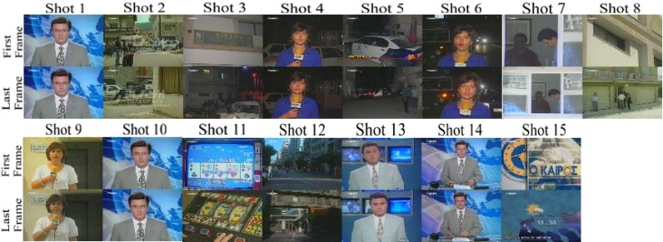
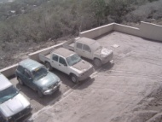
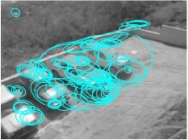
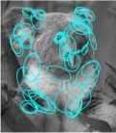
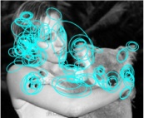

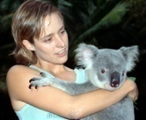
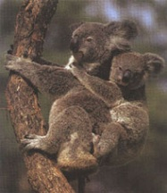
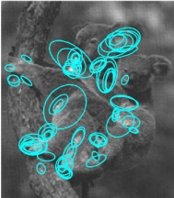
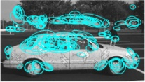

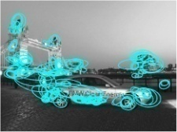




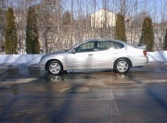
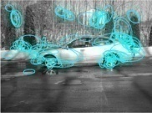

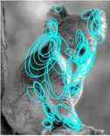
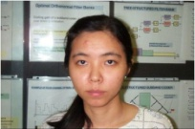
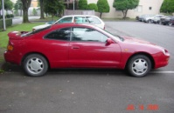
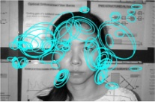
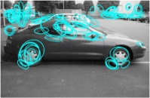
Examples of grouping in vision
[http://poseidon.csd.auth.gr/LAB_RESEARCH/Latest/imgs/SpeakDepVidIndex_img2.jpg]
Group video frames into shots
[Figure by J. Shi]
Determine image regions
Fg / Bg
[Figure by Wang & Suter]
Figure-ground
[Figure by Grauman & Darrell]
Object-level grouping
Slide credit: Kristen Grauman
Notes:
6

Slide 7
Grouping in vision
Goals:
  Gather features that belong together
  Obtain an intermediate representation that compactly describes key image (video) parts
Top down vs. bottom up segmentation
  Top down: pixels belong together because they are from the same object
  Bottom up: pixels belong together because they look similar
Hard to measure success
  What is interesting depends on the application.
Slide credit: Kristen Grauman

Slide 8
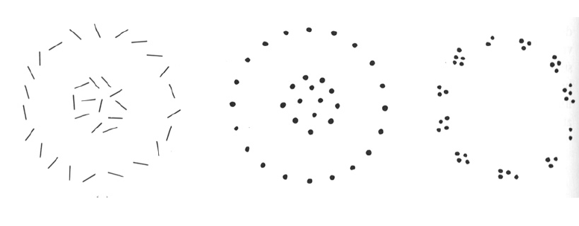
Slide credit: Kristen Grauman

Slide 9
Gestalt
A key feature of the human visual system is that context affects how things are perceived
Gestalt: whole or group
  Whole is something other than sum of its parts
  Relationships among parts can yield new properties/features
Slide credit: Kristen Grauman
Notes:
9

Slide 10
Example: Muller-Lyer illusion
Notes:
10

Slide 11
Example: Muller-Lyer illusion
Notes:
11

Slide 12
Example: Muller-Lyer illusion
The effect only arises because we perceive each shape as something other than the sum of it’s parts…
What things should be grouped?
What cues indicate groups?
Notes:
12

Slide 13
Gestalt
Gestalt: whole or group
  Whole is something other than sum of its parts
  Relationships among parts can yield new properties/features
Psychologists identified series of factors that predispose set of elements to be grouped (by human visual system)
Slide credit: Kristen Grauman
Notes:
13

Slide 14
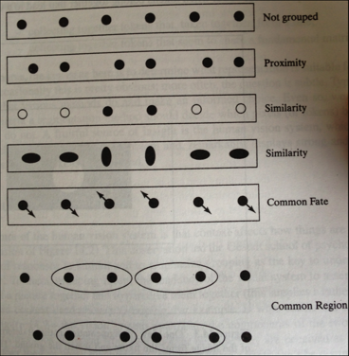
Gestalt
Figure 14.4 from Forsyth and Ponce
Slide credit: Devi Parikh

Slide 15
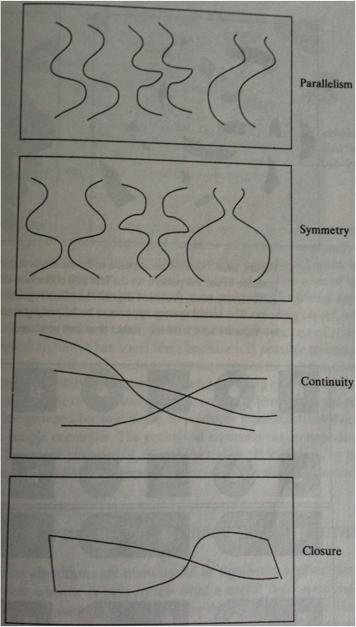
Gestalt
Slide credit: Devi Parikh

Slide 16
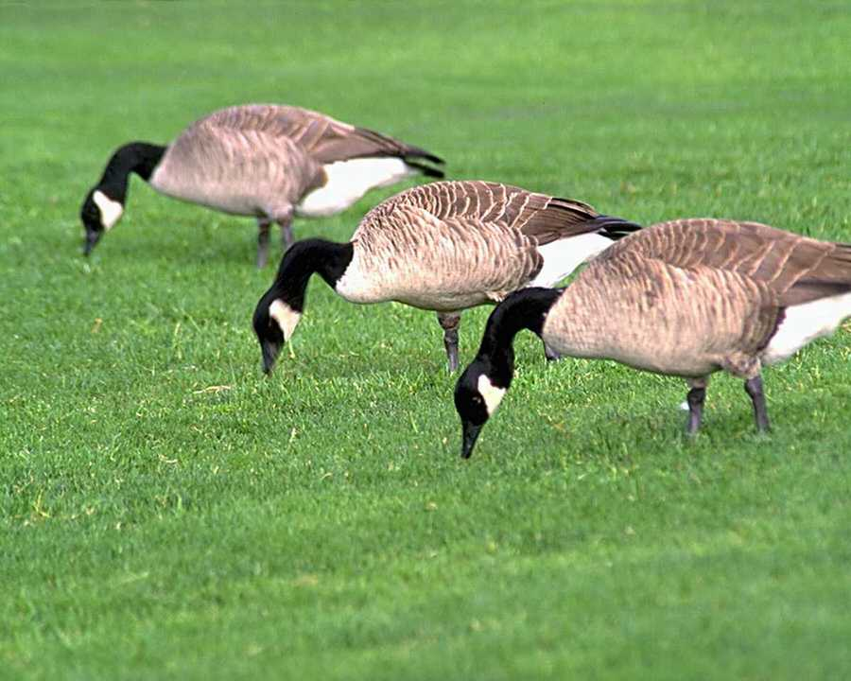
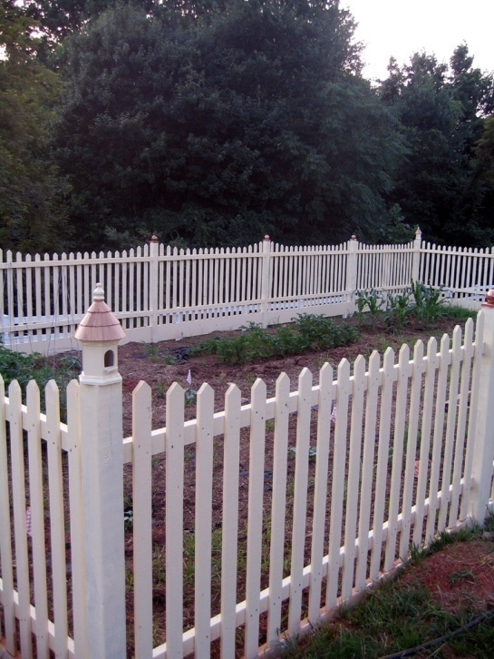
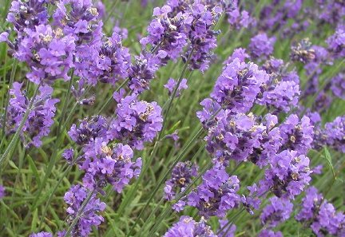
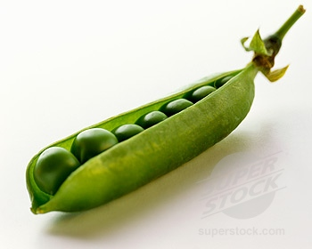
Similarity
Kristen Grauman
http://chicagoist.com/attachments/chicagoist_alicia/GEESE.jpg, http://wwwdelivery.superstock.com/WI/223/1532/PreviewComp/SuperStock_1532R-0831.jpg

Slide 17
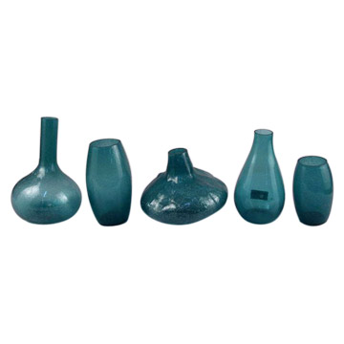
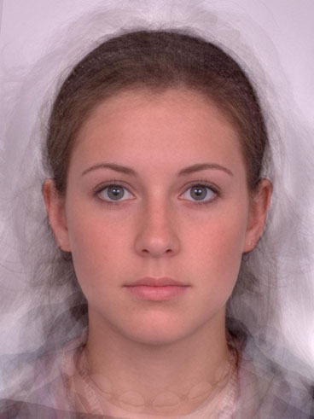
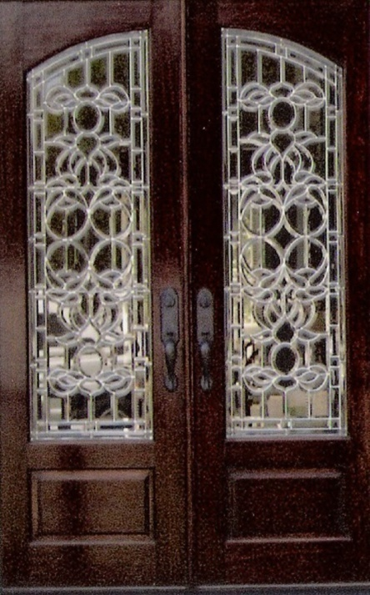
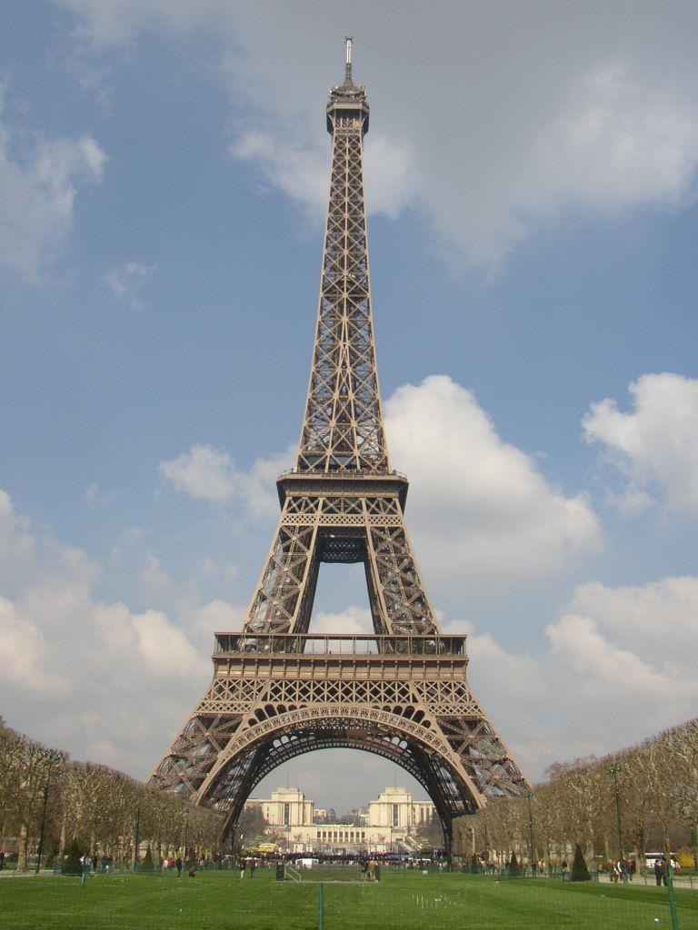
Symmetry
Slide credit: Kristen Grauman
http://seedmagazine.com/news/2006/10/beauty_is_in_the_processingtim.php

Slide 18
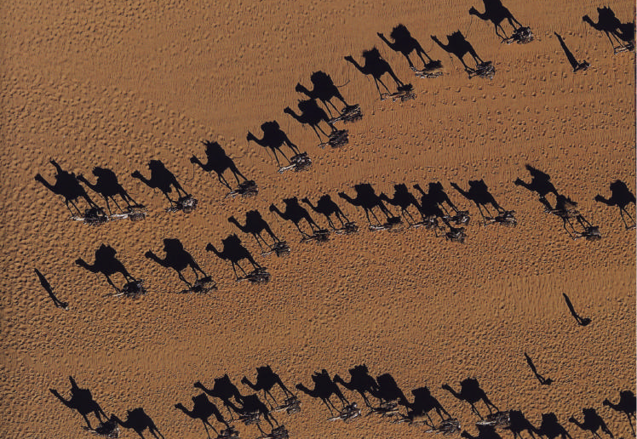
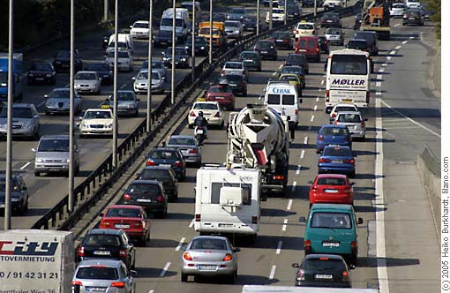
Common fate
Image credit: Arthus-Bertrand (via F. Durand)
(coherent motion)
Slide credit: Kristen Grauman

Slide 19
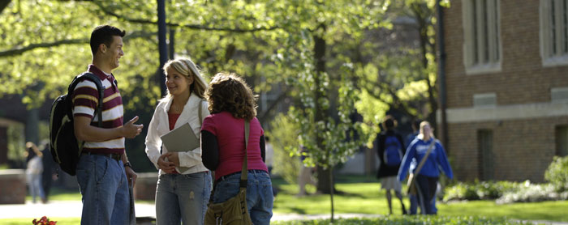
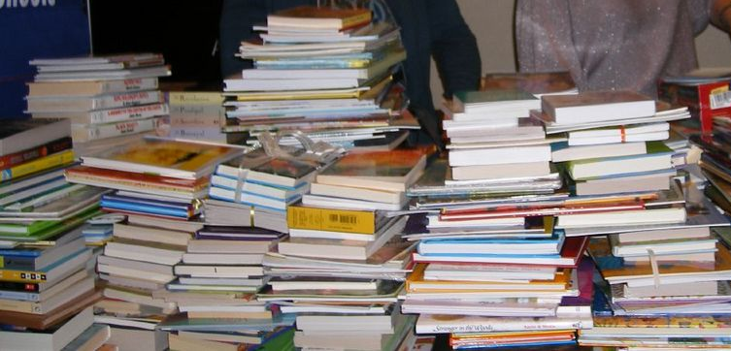
Proximity
Slide credit: Kristen Grauman
http://www.capital.edu/Resources/Images/outside6_035.jpg

Slide 20
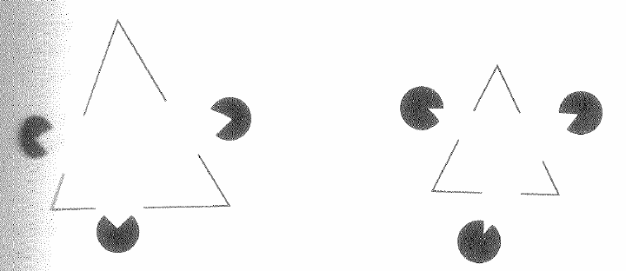
Illusory/subjective contours
Interesting tendency to explain by occlusion
Slide credit: Kristen Grauman
In Vision, D. Marr, 1982
Notes:
20

Slide 21
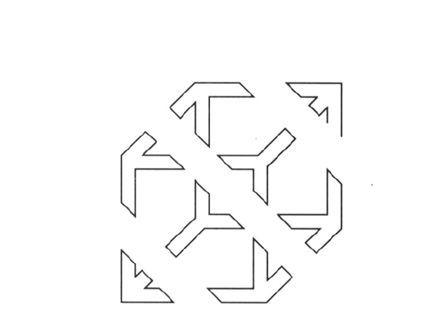
Slide credit: Kristen Grauman

Slide 22
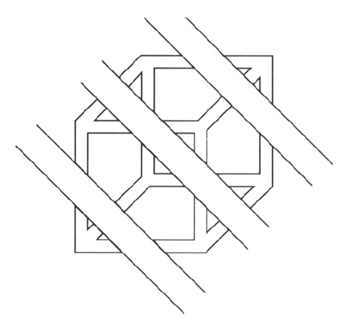
Continuity, explanation by occlusion
Slide credit: Kristen Grauman

Slide 23
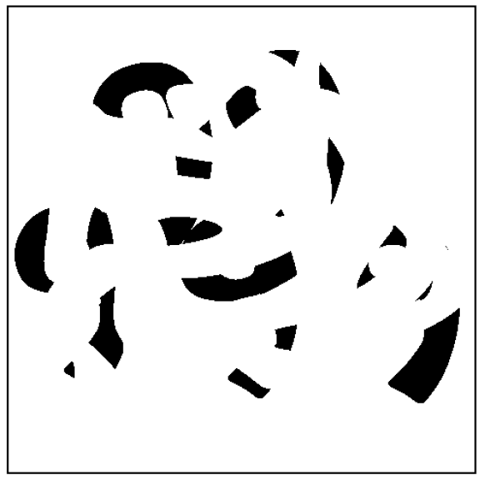
D. Forsyth

Slide 24
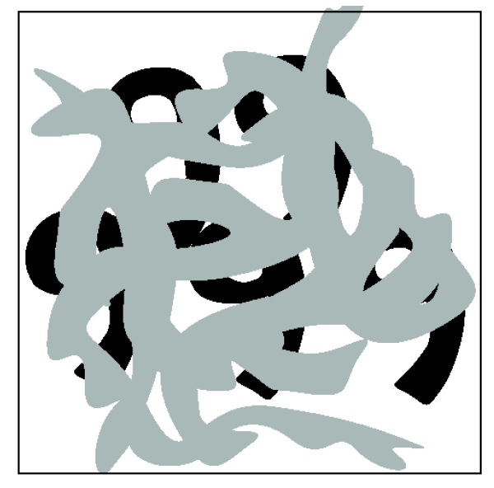
Slide credit: Kristen Grauman

Slide 25
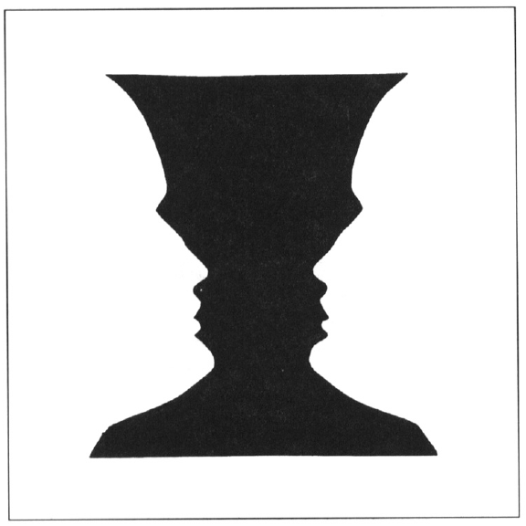
Figure-ground
Slide credit: Kristen Grauman

Slide 26
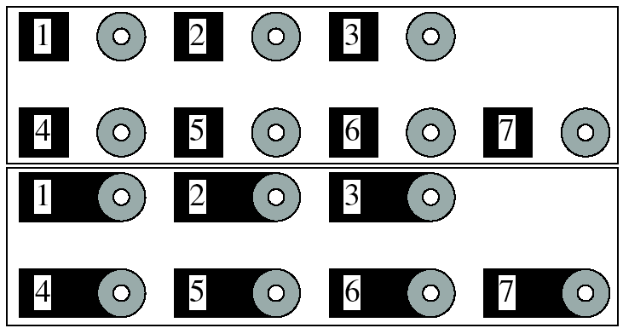
Grouping phenomena in real life
Forsyth & Ponce, Figure 14.7
Slide credit: Kristen Grauman

Slide 27
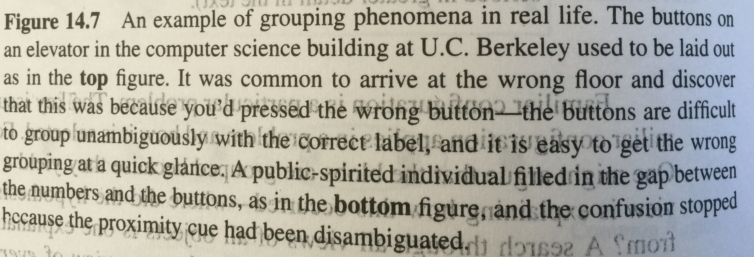
Grouping phenomena in real life
Forsyth & Ponce, Figure 14.7
Slide credit: Kristen Grauman

Slide 28
Grouping phenomena in real life
Forsyth & Ponce, Figure 14.7
Slide credit: Kristen Grauman

Slide 29
Gestalt
Gestalt: whole or group
  Whole is other than sum of its parts
  Relationships among parts can yield new properties/features
Psychologists identified series of factors that predispose set of elements to be grouped (by human visual system)
Inspiring observations/explanations; challenge remains how to best map to algorithms.
Slide credit: Kristen Grauman
Notes:
29

Slide 31


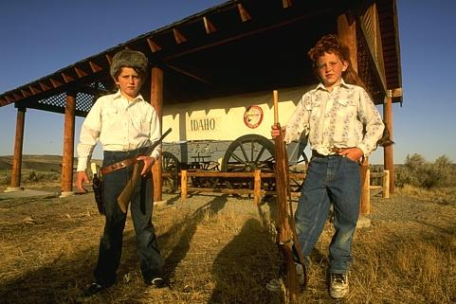

The goals of segmentation
Separate image into coherent “objects”
image
human segmentation
Source: Lana Lazebnik

Slide 32
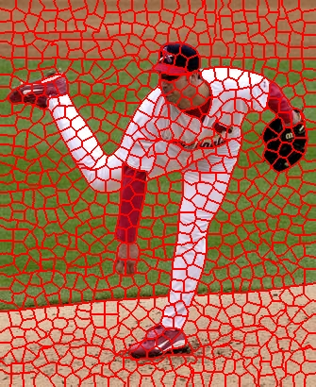
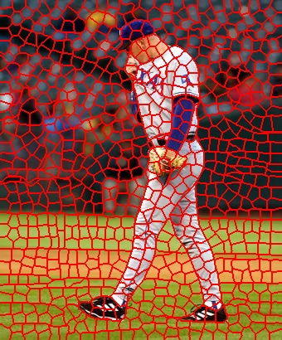
The goals of segmentation
Separate image into coherent “objects”
Group together similar-looking pixels for efficiency of further processing
“superpixels”
X. Ren and J. Malik. Learning a classification model for segmentation. ICCV 2003.
Source: Lana Lazebnik

Slide 33
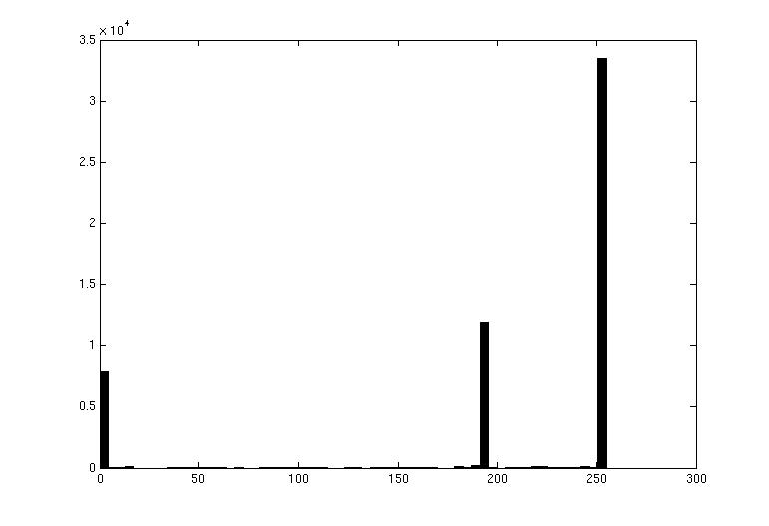

Image segmentation: toy example
white pixels
pixel count
3
black pixels
gray pixels
1
2
input image
intensity
These intensities define the three groups.
We could label every pixel in the image according to which of these primary intensities it is.
  i.e., segment the image based on the intensity feature.
What if the image isn’t quite so simple?
Kristen Grauman

Slide 34
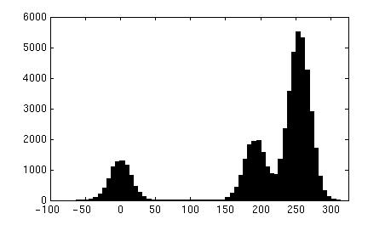
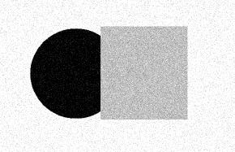
pixel count
input image
intensity
pixel count
input image
intensity
Kristen Grauman

Slide 35
pixel count
input image
intensity
Now how to determine the three main intensities that define our groups?
We need to cluster.
Kristen Grauman

Slide 36

0
190
255
intensity
3
1
2
Goal: choose three “centers” as the representative intensities, and label every pixel according to which of these centers it is nearest to.
Best cluster centers are those that minimize SSD between all points and their nearest cluster center ci:
Kristen Grauman

Slide 37
Clustering
With this objective, it is a “chicken and egg” problem:
  If we knew the cluster centers, we could allocate points to groups by assigning each to its closest center.
  If we knew the group memberships, we could get the centers by computing the mean per group.
Kristen Grauman

Slide 38
K-means clustering
Basic idea: randomly initialize the k cluster centers, and iterate between the two steps we just saw.
  Randomly initialize the cluster centers, c₁, ..., c_{K}
  Given cluster centers, determine points in each cluster
    For each point p, find the closest c_{i}. Put p into cluster i
  Given points in each cluster, solve for c_{i}
    Set c_{i} to be the mean of points in cluster i
  If c_{i} have changed, repeat Step 2
Properties
  Will always converge to some solution
  Can be a “local minimum”
    does not always find the global minimum of objective function:
Source: Steve Seitz

Slide 39


K-means: pros and cons
Pros
Simple, fast to compute
Converges to local minimum of within-cluster squared error
Cons/issues
Setting k?
Sensitive to initial centers
Sensitive to outliers
Detects spherical clusters
Assuming means can be computed
Slide credit: Kristen Grauman
Notes:
39

Slide 40

An aside: Smoothing out cluster assignments
Assigning a cluster label per pixel may yield outliers:
original
labeled by cluster center’s intensity
?
How to ensure they are spatially smooth?
3
1
2
Kristen Grauman

Slide 41

Segmentation as clustering
Depending on what we choose as the feature space, we can group pixels in different ways.
Grouping pixels based on intensity similarity
Feature space: intensity value (1-d)
Slide credit: Kristen Grauman
Notes:
41

Slide 42


K=2
K=3
quantization of the feature space; segmentation label map
Slide credit: Kristen Grauman

Slide 43

Segmentation as clustering
Depending on what we choose as the feature space, we can group pixels in different ways.
R=255
G=200
B=250
Grouping pixels based on color similarity
B
R=245
G=220
B=248
G
R=15
G=189
B=2
R=3
G=12
B=2
R
Feature space: color value (3-d)
Kristen Grauman
Notes:
43

Slide 44
Segmentation as clustering
Depending on what we choose as the feature space, we can group pixels in different ways.
Grouping pixels based on intensity similarity
Clusters based on intensity similarity don’t have to be spatially coherent.
Kristen Grauman
Notes:
44

Slide 45
Segmentation as clustering
Depending on what we choose as the feature space, we can group pixels in different ways.
Grouping pixels based on intensity+position similarity
Intensity
Y
X
Both regions are black, but if we also include position (x,y), then we could group the two into distinct segments; way to encode both similarity & proximity.
Kristen Grauman
Notes:
45

Slide 46



Segmentation as clustering
Color, brightness, position alone are not enough to distinguish all regions…
Slide credit: Kristen Grauman

Slide 47

Segmentation as clustering
Depending on what we choose as the feature space, we can group pixels in different ways.
Grouping pixels based on texture similarity
F₁
F₂
Filter bank of 24 filters
…
F₂₄
Feature space: filter bank responses (e.g., 24-d)
Slide credit: Kristen Grauman
Notes:
47

Slide 48


Segmentation with texture features
Find “textons” by clustering vectors of filter bank outputs
Describe texture in a window based on texton histogram
Count
Image
Texton map
Texton index
Count
Count
Texton index
Texton index
Malik, Belongie, Leung and Shi. IJCV 2001.
Adapted from Lana Lazebnik

Slide 49

Image segmentation example
Kristen Grauman

Slide 50


Pixel properties vs. neighborhood properties
These look very similar in terms of their color distributions (histograms).
How would their texture distributions compare?
Kristen Grauman

Slide 52
K-means: pros and cons
Pros
Simple, fast to compute
Converges to local minimum of within-cluster squared error
Cons/issues
Setting k?
Sensitive to initial centers
Sensitive to outliers
Detects spherical clusters
Assuming means can be computed
Slide credit: Kristen Grauman
Notes:
52

Slide 53

Mean shift algorithm
The mean shift algorithm seeks modes or local maxima of density in the feature space
Feature space
(L*u*v* color values)
image
Slide credit: Kristen Grauman

Slide 54
Mean shift
Search
window
Center of
mass
Mean Shift
vector
Slide by Y. Ukrainitz & B. Sarel

Slide 55
Mean shift
Search
window
Center of
mass
Mean Shift
vector
Slide by Y. Ukrainitz & B. Sarel

Slide 56
Mean shift
Search
window
Center of
mass
Mean Shift
vector
Slide by Y. Ukrainitz & B. Sarel

Slide 57
Mean shift
Search
window
Center of
mass
Mean Shift
vector
Slide by Y. Ukrainitz & B. Sarel

Slide 58
Mean shift
Search
window
Center of
mass
Mean Shift
vector
Slide by Y. Ukrainitz & B. Sarel

Slide 59
Mean shift
Search
window
Center of
mass
Mean Shift
vector
Slide by Y. Ukrainitz & B. Sarel

Slide 60
Mean shift
Search
window
Center of
mass
Slide by Y. Ukrainitz & B. Sarel

Slide 61

Mean shift clustering
Cluster: all data points in the attraction basin of a mode
Attraction basin: the region for which all trajectories lead to the same mode
Slide by Y. Ukrainitz & B. Sarel

Slide 62

Mean shift clustering/segmentation
Find features (color, gradients, texture, etc)
Initialize windows at individual feature points
Perform mean shift for each window until convergence
Merge windows that end up near the same “peak” or mode
Slide credit: Kristen Grauman

Slide 63




Mean shift segmentation results
http://www.caip.rutgers.edu/~comanici/MSPAMI/msPamiResults.html
Slide credit: Kristen Grauman

Slide 64

Mean shift segmentation results
Slide credit: Kristen Grauman

Slide 65
Mean shift
Pros:
  Does not assume shape on clusters
  One parameter choice (window size)
  Generic technique
  Find multiple modes
Cons:
  Selection of window size
  Does not scale well with dimension of feature space
Kristen Grauman

Slide 67

Images as graphs
q
w_{pq}
w
p
Fully-connected graph
  node (vertex) for every pixel
  link between every pair of pixels, p,q
  affinity weight w_{pq} for each link (edge)
    w_{pq} measures similarity
      similarity is inversely proportional to difference (color+position…)
Source: Steve Seitz

Slide 68


Measuring affinity
One possibility:
Small sigma: group only nearby points
Large sigma: group distant points
Kristen Grauman

Slide 69

Example: weighted graphs
Suppose we have a 4-pixel image
(i.e., a 2 x 2 matrix)
Each pixel described by 2 features
Feature dimension 2
Feature dimension 1
Dimension of data points : d = 2
Number of data points : N = 4
Kristen Grauman

Slide 70


Example: weighted graphs
Computing the distance matrix:
D(:,1)=
0.01
D(1,:)=
(0)
0.24
0.01
0.47
0.24
0.47
for i=1:N
for j=1:N
D(i,j) = ||x_{i}- x_{j}||²
end
end
Kristen Grauman

Slide 71

Example: weighted graphs
Computing the distance matrix:
D(:,1)=
D(1,:)=
(0)
0.24
0.01
0.47
0.29
0.24
(0)
0.29
0.15
0.24
0.15
for i=1:N
for j=1:N
D(i,j) = ||x_{i}- x_{j}||²
end
end
Kristen Grauman

Slide 72

Example: weighted graphs
Computing the distance matrix:
for i=1:N
for j=1:N
D(i,j) = ||x_{i}- x_{j}||²
end
end
N x N matrix
Kristen Grauman

Slide 73

Distances→affinities
Example: weighted graphs
D
A
for i=1:N
for j=i+1:N
A(i,j) = exp(-1/(2*σ^2)*||x_{i}- x_{j}||²);
A(j,i) = A(i,j);
end
end
for i=1:N
for j=1:N
D(i,j) = ||x_{i}- x_{j}||²
end
end
Kristen Grauman

Slide 74



Scale parameter σ affects affinity
Distance matrix
D=
Affinity matrix with increasing σ:
Kristen Grauman

Slide 75



Visualizing a shuffled affinity matrix
If we permute the order of the vertices as they are referred to in the affinity matrix, we see different patterns:
Kristen Grauman

Slide 76

Measuring affinity
σ=.2
Data points
Affinity matrices
σ=.1 σ=.2 σ=1
Slide credit: Kristen Grauman

Slide 77
Measuring affinity
Points x₁…x₁₀
40 data points
40 x 40 affinity matrix A
x₁
.
.
.
x₄₀
Points x₃₁…x₄₀
x_{1 . . .} x₄₀
$A\left(i,j\right)=exp⁡\{−\left(1/{2σ\text{2}}\right)\left\|xi−xj\right\|$²}
What do the blocks signify?
What does the symmetry of the matrix signify?
How would the matrix change with larger value of σ?
Slide credit: Kristen Grauman

Slide 78
Putting it together
Points x₁…x₁₀
Data points
Points x₃₁…x₄₀
σ=.1 σ=.2 σ=1
Affinity matrices
$A\left(i,j\right)=exp⁡\{−\left(1/{2σ\text{2}}\right)\left\|xi−xj\right\|$²}
Kristen Grauman

Slide 79
Segmentation by Graph Cuts
q
w_{pq}
w
p
A
B
C
Break Graph into Segments
  Want to delete links that cross between segments
  Easiest to break links that have low similarity (low weight)
    similar pixels should be in the same segments
    dissimilar pixels should be in different segments
Source: Steve Seitz

Slide 80
Cuts in a graph: Min cut
B
A
Link Cut
  set of links whose removal makes a graph disconnected
  cost of a cut:
Find minimum cut
  gives you a segmentation
  fast algorithms exist for doing this
Source: Steve Seitz

Slide 81

Minimum cut
Problem with minimum cut:
Weight of cut proportional to number of edges in the cut; tends to produce small, isolated components.
[Shi & Malik, 2000 PAMI]
Slide credit: Kristen Grauman

Slide 82

Cuts in a graph: Normalized cut
B
A
Normalized Cut
  fix bias of Min Cut by normalizing for size of segments:
  assoc(A,V) = sum of weights of all edges that touch A
  Ncut value small when we get two clusters with many edges with high weights, and few edges of low weight between them
  Approximate solution for minimizing the Ncut value : generalized eigenvalue problem.
      J. Shi and J. Malik, Normalized Cuts and Image Segmentation, CVPR, 1997
Source: Steve Seitz

Slide 83









Example results
Slide credit: Kristen Grauman

Slide 84









Results: Berkeley Segmentation Engine
http://www.cs.berkeley.edu/~fowlkes/BSE/
Slide credit: Kristen Grauman

Slide 85
Normalized cuts: pros and cons
Pros:
Generic framework, flexible to choice of function that computes weights (“affinities”) between nodes
Does not require model of the data distribution
Cons:
Time complexity can be high
  Dense, highly connected graphs → many affinity computations
  Solving eigenvalue problem
Preference for balanced partitions
Kristen Grauman

Slide 87

Segments as primitives for recognition
Multiple segmentations
B. Russell et al., “Using Multiple Segmentations to Discover Objects and their Extent in Image Collections,” CVPR 2006
Slide credit: Lana Lazebnik

Slide 88






Top-down segmentation
E. Borenstein and S. Ullman, “Class-specific, top-down segmentation,” ECCV 2002
A. Levin and Y. Weiss, “Learning to Combine Bottom-Up and Top-Down Segmentation,” ECCV 2006.
Slide credit: Lana Lazebnik

Slide 89

Top-down segmentation
Normalized cuts
Top-down segmentation
E. Borenstein and S. Ullman, “Class-specific, top-down segmentation,” ECCV 2002
A. Levin and Y. Weiss, “Learning to Combine Bottom-Up and Top-Down Segmentation,” ECCV 2006.
Slide credit: Lana Lazebnik

Slide 90
Summary
Segmentation to find object boundaries or mid-level regions, tokens.
Bottom-up segmentation via clustering
  General choices -- features, affinity functions, and clustering algorithms
Grouping also useful for quantization, can create new feature summaries
  Texton histograms for texture within local region
Example clustering methods
  K-means
  Mean shift
  Graph cut, normalized cuts
Slide credit: Kristen Grauman

Slide 92
More recently…
Neural networks to learn both local feature affinities and top-down context
He et al., “Mask R-CNN,” ICCV 2017 (Best paper)

Slide 93

More recently…
Segmenting both classes and instances
He et al., “Mask R-CNN,” ICCV 2017 (Best paper)

