Slide 1
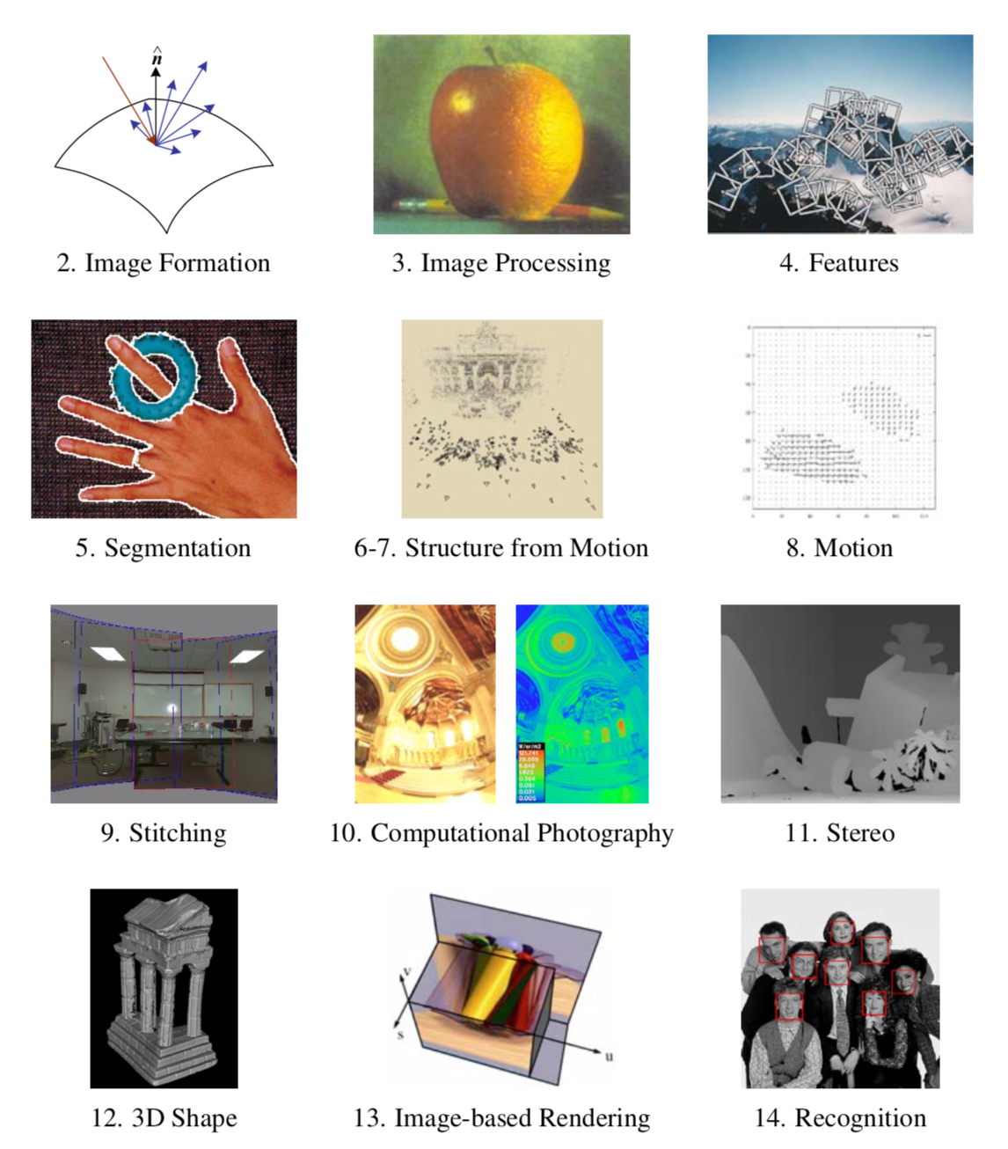

Slide 2
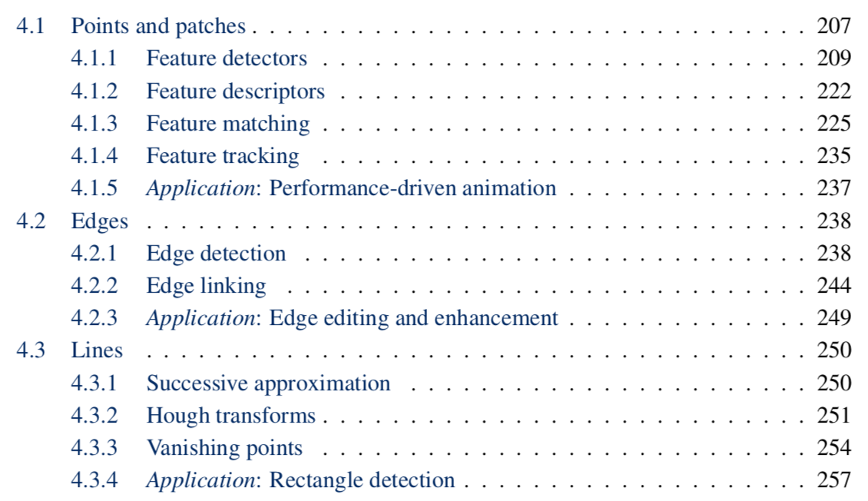

Slide 4
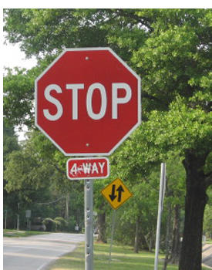
Correspondence across views
Correspondence: matching points, patches, edges, or regions across images
≈

Slide 5
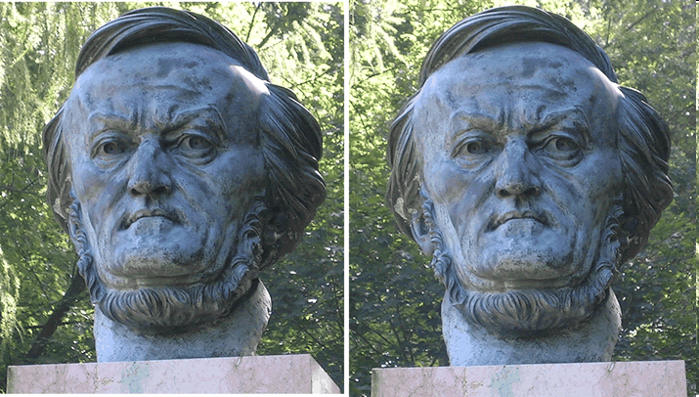
Example: estimating “fundamental matrix” that corresponds two views
Slide from Silvio Savarese

Slide 6
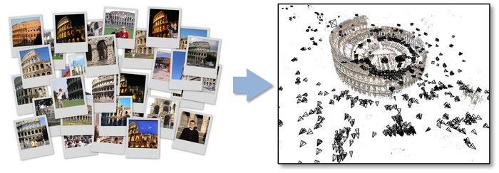
Example: structure from motion

Slide 7
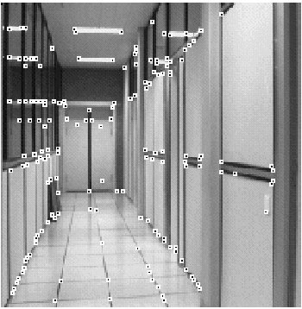
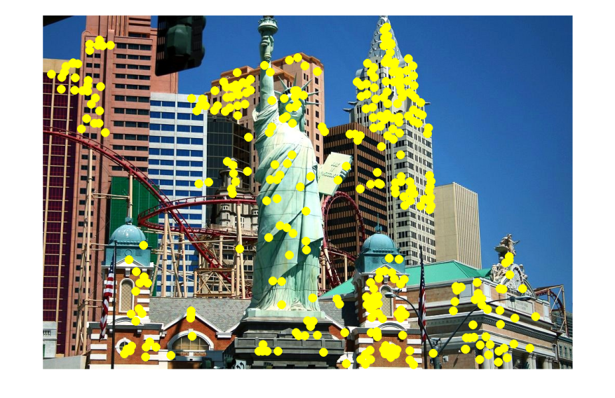
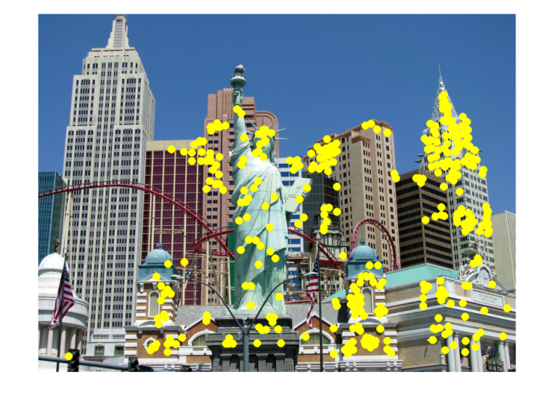
Applications
Feature points are used for:
Image alignment
3D reconstruction
Motion tracking
Robot navigation
Indexing and database retrieval
Object recognition

Slide 8
Project 2: interest points and local features
Note: “interest points” = “keypoints”, also sometimes called “features”

Slide 9
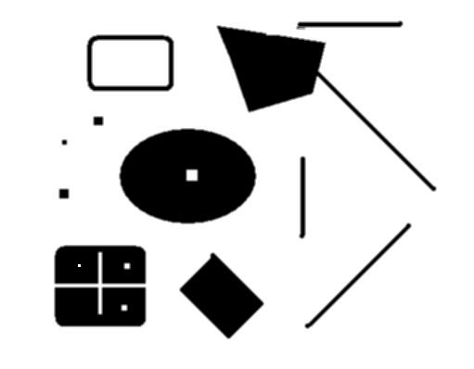
Interest points defined
original
Suppose you have to click on some point, go away and come back after I deform the image, and click on the same points again.
Which points would you choose?
deformed

Slide 10
Overview of Keypoint Matching
1. Find a set of distinctive key- points
A₁
B₃
2. Define a region around each keypoint
A₂
A₃
B₁
B₂
3. Compute a local descriptor from the normalized region
4. Match local descriptors

Slide 11
Goals for Keypoints
Detect points that are repeatable and distinctive

Slide 12
Invariant Local Features
Image content is transformed into local feature coordinates that are invariant to translation, rotation, scale, and other imaging parameters
Features Descriptors

Slide 13
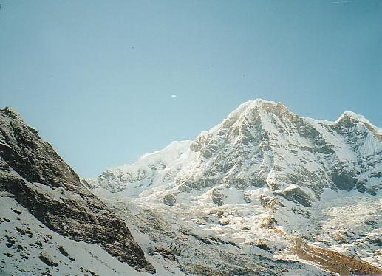
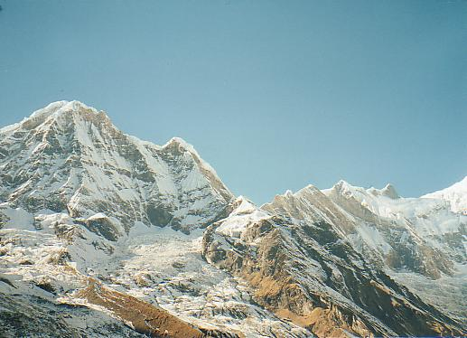
Why extract features?
Motivation: panorama stitching
We have two images – how do we combine them?

Slide 14
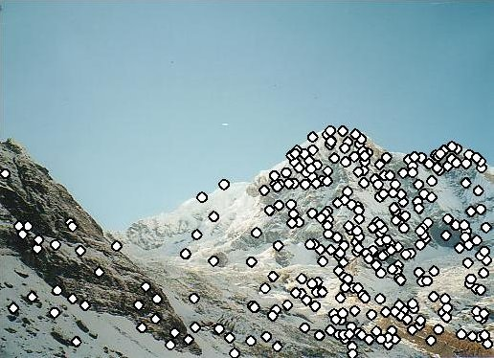
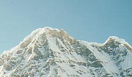
Local features: main components
Detection: Identify the interest points
Description: Extract vector feature descriptor surrounding each interest point.
Matching: Determine correspondence between descriptors in two views
Kristen Grauman

Slide 15
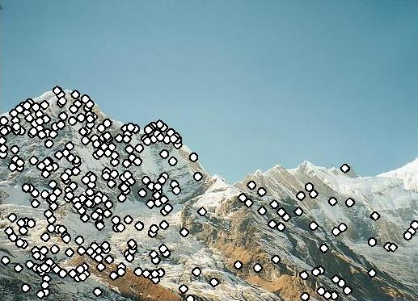
Characteristics of good features
Repeatability
The same feature can be found in several images despite geometric and photometric transformations
Saliency
Each feature is distinctive
Compactness and efficiency
Many fewer features than image pixels
Locality
A feature occupies a relatively small area of the image; robust to clutter and occlusion

Slide 16
Goal: interest operator repeatability
We want to detect (at least some of) the same points in both images.
Yet we have to be able to run the detection procedure independently per image.
No chance to find true matches!
Kristen Grauman
Notes:
16

Slide 17
Goal: descriptor distinctiveness
We want to be able to reliably determine which point goes with which.
Must provide some invariance to geometric and photometric differences between the two views.
?
Kristen Grauman

Slide 18
Local features: main components
Detection: Identify the interest points
Description:Extract vector feature descriptor surrounding each interest point.
Matching: Determine correspondence between descriptors in two views

Slide 19
Many Existing Detectors Available
Hessian & Harris [Beaudet ‘78], [Harris ‘88]
Laplacian, DoG [Lindeberg ‘98], [Lowe 1999]
Harris-/Hessian-Laplace [Mikolajczyk & Schmid ‘01]
Harris-/Hessian-Affine [Mikolajczyk & Schmid ‘04]
EBR and IBR [Tuytelaars & Van Gool ‘04]
MSER [Matas ‘02]
Salient Regions [Kadir & Brady ‘01]
Others…

Slide 20
Corner Detection: Basic Idea
We should easily recognize the point by looking through a small window
Shifting a window in any direction should give a large change in intensity
“flat” region: no change in all directions
“edge”: no change along the edge direction
“corner”: significant change in all directions
Source: A. Efros

Slide 21
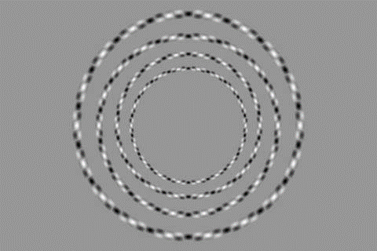

Slide 22
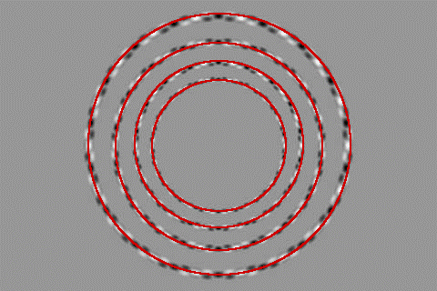

Slide 23
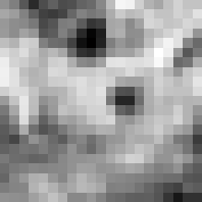
Corner Detection: Mathematics
Change in appearance of window w(x,y)
for the shift [u,v]:
I(x, y)
E(u, v)
E(3,2)
w(x, y)

Slide 24
Corner Detection: Mathematics
Change in appearance of window w(x,y)
for the shift [u,v]:
I(x, y)
E(u, v)
E(0,0)
w(x, y)

Slide 25
Corner Detection: Mathematics
Change in appearance of window w(x,y)
for the shift [u,v]:
Window function
Shifted intensity
Intensity
Window function w(x,y) =
or
1 in window, 0 outside
Gaussian
Source: R. Szeliski

Slide 26
Corner Detection: Mathematics
Change in appearance of window w(x,y)
for the shift [u,v]:
We want to find out how this function behaves for small shifts
E(u, v)

Slide 27
Corner Detection: Mathematics
Change in appearance of window w(x,y)
for the shift [u,v]:
We want to find out how this function behaves for small shifts
But this is very slow to compute naively.
O(window_width² * shift_range² * image_width²)
O( 11² * 11² * 600² ) = 5.2 billion of these
14.6 thousand per pixel in your image

Slide 28
Corner Detection: Mathematics
Change in appearance of window w(x,y)
for the shift [u,v]:
We want to find out how this function behaves for small shifts
Recall Taylor series expansion. A function f can be approximated around point a as

Slide 29
Corner Detection: Mathematics
Change in appearance of window w(x,y)
for the shift [u,v]:
We want to find out how this function behaves for small shifts
Local quadratic approximation of E(u,v) in the neighborhood of (0,0) is given by the second-order Taylor expansion:
Notes:
Technically a Maclaurin expansion, a special case of Taylor expansion centered at 0.
What is the point? Well, now we’re just extrapolating local measurements instead of doing 10s of thousands of computations.

Slide 30
Corner Detection: Mathematics
Local quadratic approximation of E(u,v) in the neighborhood of (0,0) is given by the second-order Taylor expansion:
E(u, v)
Always 0
First derivative is 0
Notes:
Technically a Maclaurin expansion, a special case of Taylor expansion centered at 0.

Slide 31
Corner Detection: Mathematics
The quadratic approximation simplifies to
where M is a second moment matrix computed from image derivatives:
M

Slide 32
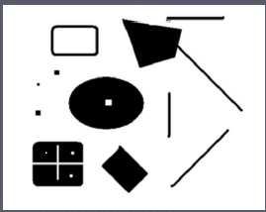
Corners as distinctive interest points
2 x 2 matrix of image derivatives (averaged in neighborhood of a point).
Notation:

Slide 33
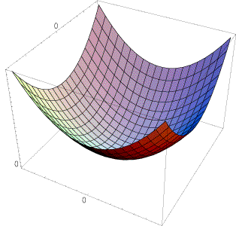
Interpreting the second moment matrix
The surface E(u,v) is locally approximated by a quadratic form. Let’s try to understand its shape.

Slide 34
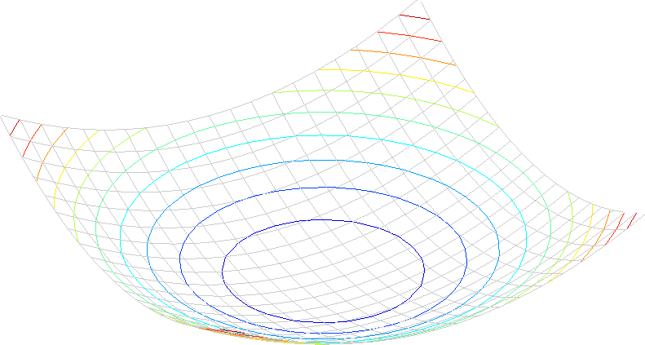
Interpreting the second moment matrix
Consider a horizontal “slice” of E(u, v):
This is the equation of an ellipse.

Slide 35
Interpreting the second moment matrix
First, consider the axis-aligned case (gradients are either horizontal or vertical)
If either λ is close to 0, then this is not a corner, so look for locations where both are large.

Slide 36
Interpreting the second moment matrix
Consider a horizontal “slice” of E(u, v):
This is the equation of an ellipse.
Diagonalization of M:
The axis lengths of the ellipse are determined by the eigenvalues and the orientation is determined by R
direction of the fastest change
direction of the slowest change
(λ_{max})^{-1/2}
(λ_{min})^{-1/2}

Slide 37
Interpreting the eigenvalues
Classification of image points using eigenvalues of M:
λ₂
“Edge” λ₂ >> λ₁
“Corner” λ₁ and λ₂ are large, λ₁ ~ λ₂; E increases in all directions
λ₁ and λ₂ are small; E is almost constant in all directions
“Flat” region
“Edge” λ₁ >> λ₂
λ₁

Slide 38
Corner response function
α: constant (0.04 to 0.06)
“Edge” R < 0
“Corner” R > 0
|R| small
“Flat” region
“Edge” R < 0

Slide 39
Harris corner detector
Compute M matrix for each image window to get their cornerness scores.
Find points whose surrounding window gave large corner response (f> threshold)
Take the points of local maxima, i.e., perform non-maximum suppression
C.Harris and M.Stephens. “A Combined Corner and Edge Detector.” Proceedings of the 4th Alvey Vision Conference: pages 147—151, 1988.
Notes:
39

Slide 40
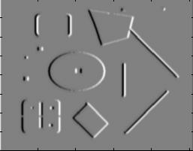
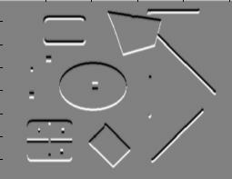
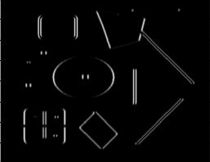
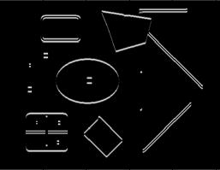
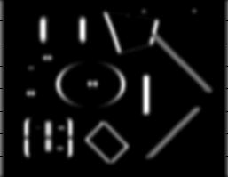
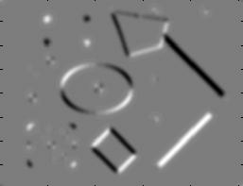
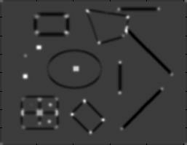
Harris Detector [Harris88]
Second moment matrix
1. Image derivatives
I_{x}
I_{y}
(optionally, blur first)
I_{x}²
I_{y}²
I_{x}I_{y}
2. Square of derivatives
3. Gaussian filter g(σ_{I})
g(I_{x}²)
g(I_{y}²)
g(I_{x}I_{y})
4. Cornerness function – both eigenvalues are strong
5. Non-maxima suppression
har

Slide 41
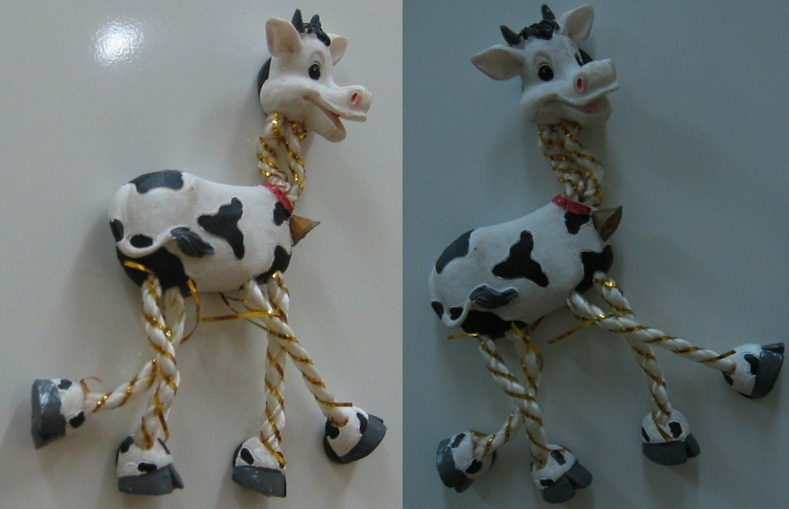
Harris Detector: Steps

Slide 42
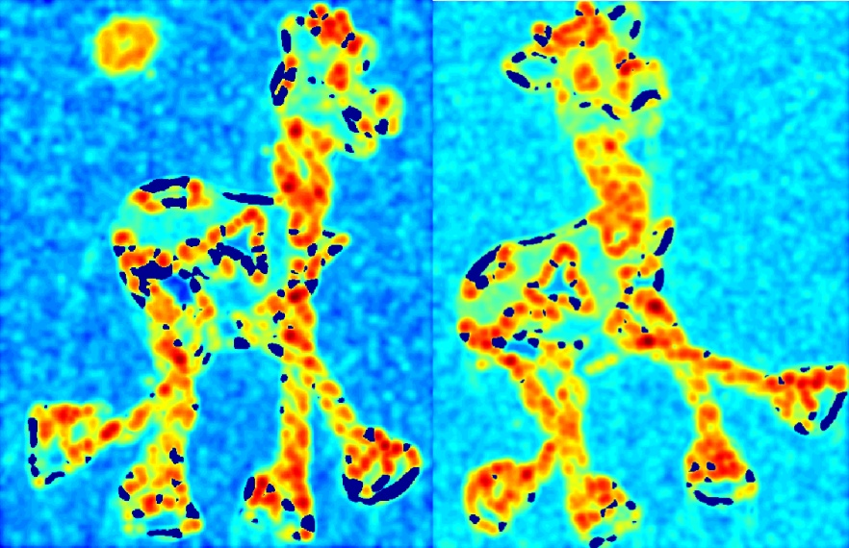
Harris Detector: Steps
Compute corner response R

Slide 43
Harris Detector: Steps
Find points with large corner response: R>threshold

Slide 44
Harris Detector: Steps
Take only the points of local maxima of R

Slide 45
Harris Detector: Steps

