Slide 1
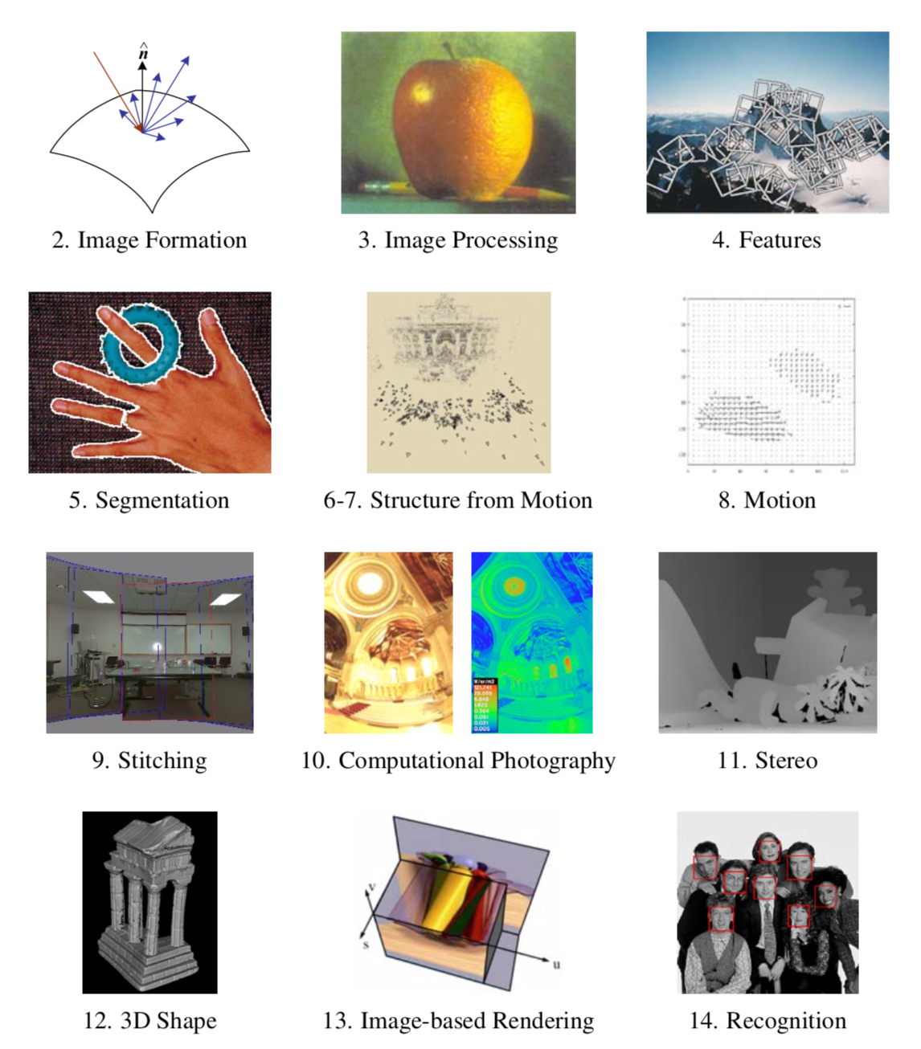

Slide 2
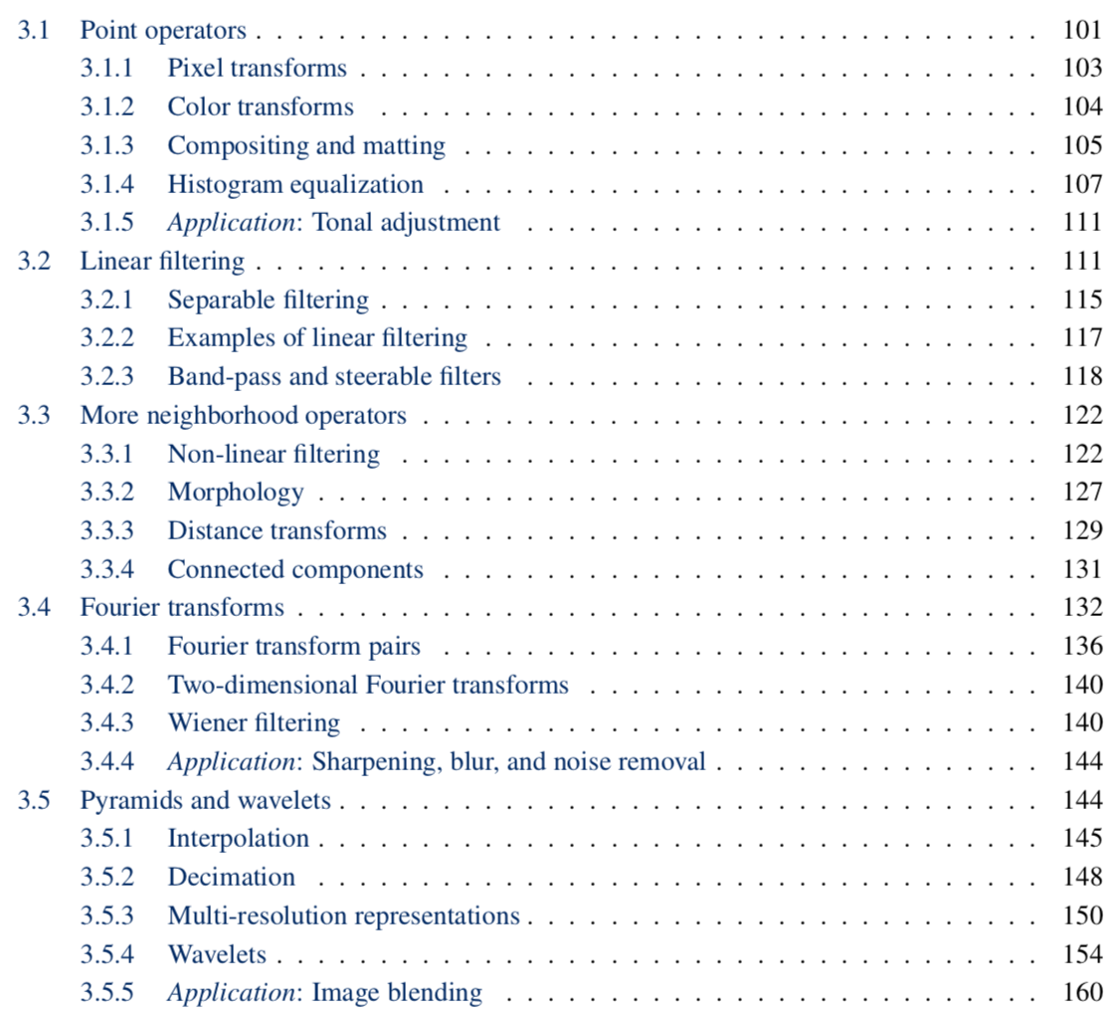

Slide 3
3.1.1 Pixel transforms
Contrast
Brightness
Gamma
Histogram equalization
Arithmetic
Compositing

Slide 4
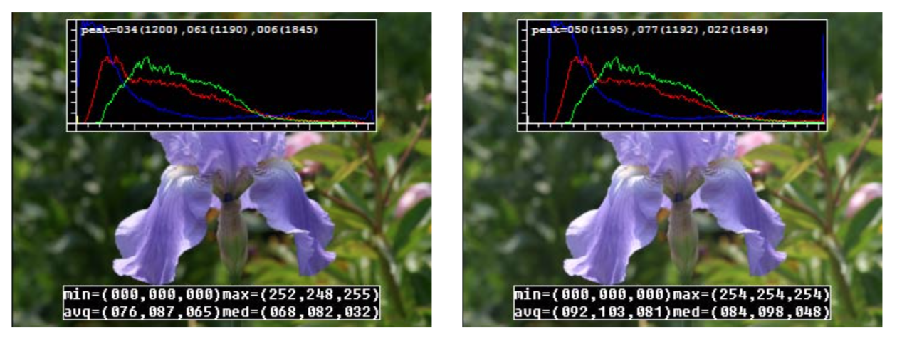
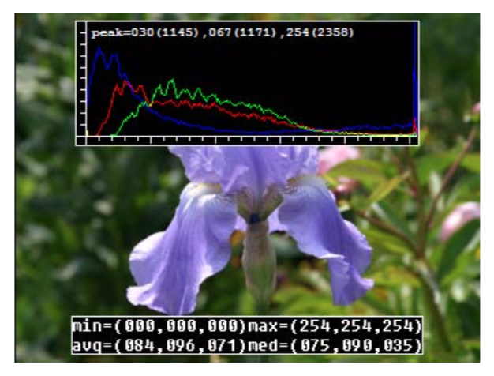
Contrast
g(x) = a f(x), a=1.1

Slide 5
Brightness
g(x) = f(x) + b, b=16

Slide 6
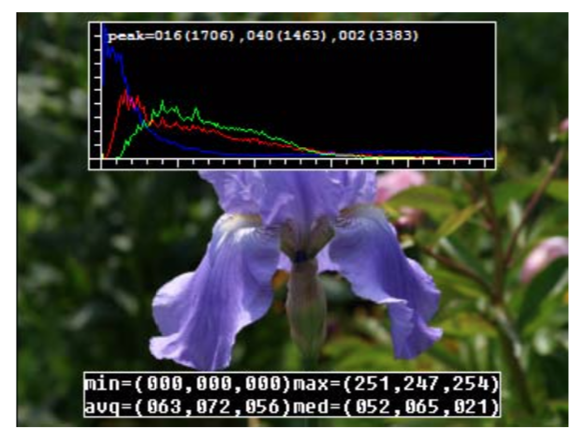
Gamma correction
gamma = 1.2

Slide 7
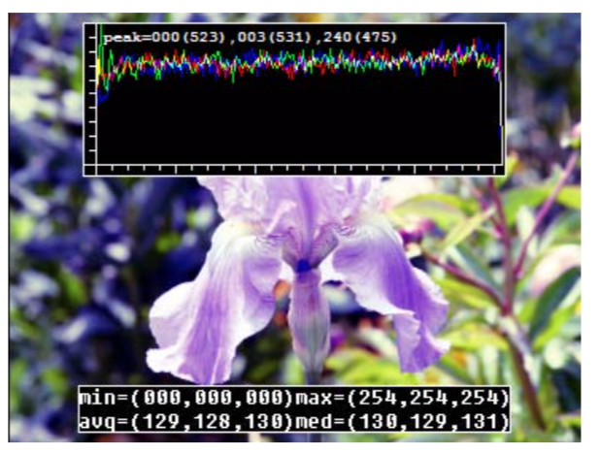
Histogram Equalization
Non-linear transform to make histogram flat
Still a per-pixel operation g(x) = h(f(x))

Slide 8
Point-Process: Pixel/Point Arithmetic
120 | 122 | 140 | 142 | 143
121 | 120 | 141 | 144 | 147
122 | 121 | 144 | 146 | 11
125 | 121 | 144 | 145 | 10
126 | 121 | 145 | 147 | 13
120 | 122 | 140 | 142 | 143
121 | 80 | 40 | 144 | 10
122 | 81 | 40 | 0 | 151
125 | 80 | 40 | 0 | 152
126 | 70 | 40 | 0 | 153
240 | 244 | 280 | 284 | 286
121 | 200 | 181 | 288 | 157
122 | 202 | 184 | 146 | 162
125 | 201 | 184 | 145 | 164
126 | 191 | 185 | 147 | 166
+
=
120 | 122 | 140 | 142 | 143
121 | 120 | 141 | 144 | 147
122 | 121 | 144 | 146 | 11
125 | 121 | 144 | 145 | 10
126 | 121 | 145 | 147 | 13
120 | 122 | 140 | 142 | 143
121 | 80 | 40 | 144 | 10
122 | 81 | 40 | 0 | 151
125 | 80 | 40 | 0 | 152
126 | 70 | 40 | 0 | 153
0 | 0 | 0 | 0 | 0
0 | 40 | 101 | 0 | 137
0 | 40 | 104 | 146 | -140
0 | 40 | 104 | 145 | -142
0 | 191 | 185 | 147 | -140
-
=

Slide 9
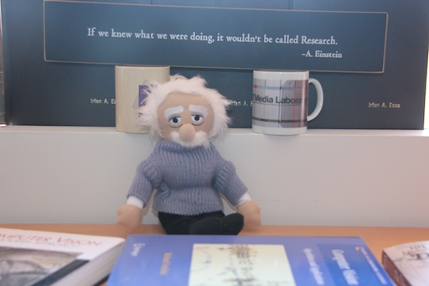
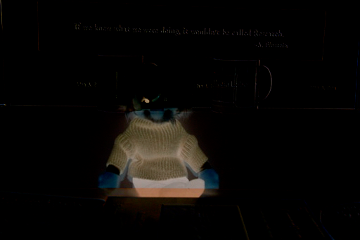
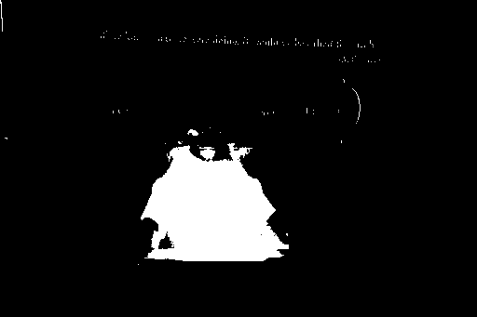
Pixel/Point Arithmetic: An Example
-
Image 1
Image 2
Image 1 - Image 2
=
Binary(Image 1 - Image 2)

Slide 10
Matte: an alpha image

Slide 11
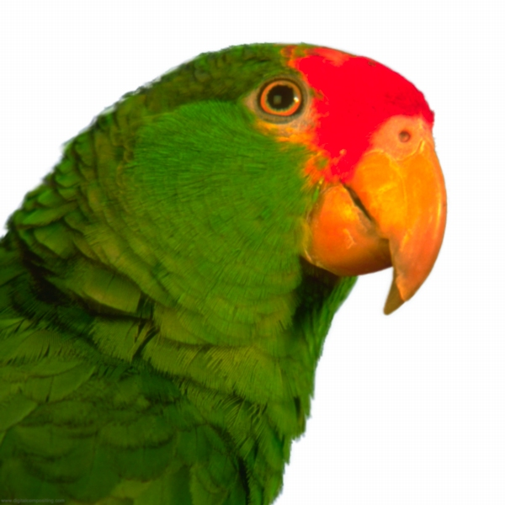
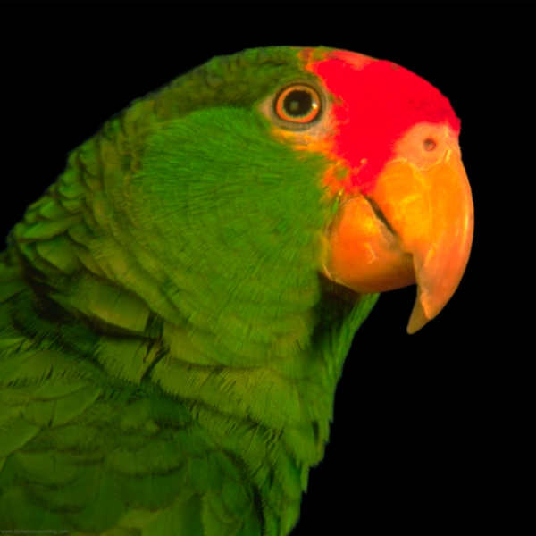
aF
Notes:
The definition of a premultiplied image is simple—an image that has its RGB channels
multiplied by its alpha channel.

Slide 12
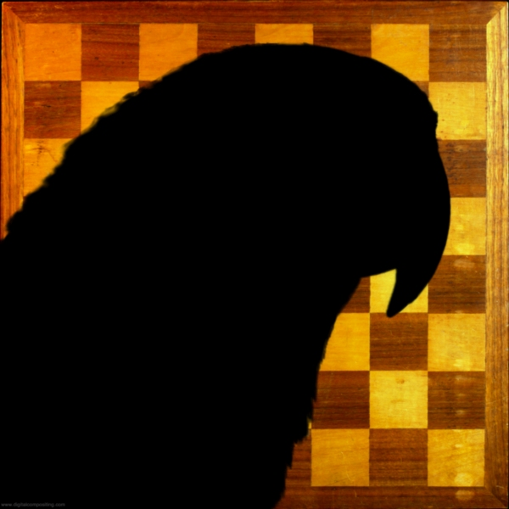
(1-a)B

Slide 13
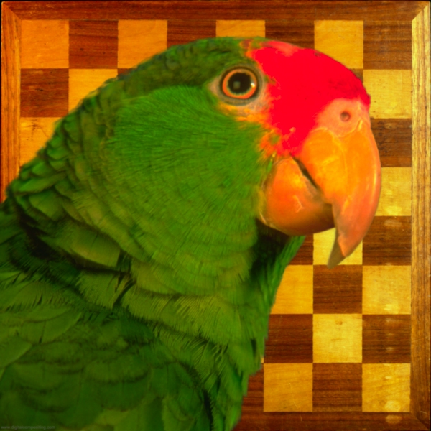
KeyMix: aF + (1-a)B

Slide 14
Premultiplied RGBA Images
Notes:
The definition of a premultiplied image is simple—an image that has its RGB channels
multiplied by its alpha channel.

Slide 15
Over: F + (1-a)B

Slide 17
Image filtering
Image filtering: compute function of local neighborhood at each position
Really important!
Enhance images
Denoise, resize, increase contrast, etc.
Extract information from images
Texture, edges, distinctive points, etc.
Detect patterns
Template matching
Deep Convolutional Networks

Slide 18
Example: box filter
1
1
1
1
1
1
1
1
1
Slide credit: David Lowe (UBC)

Slide 19
Image filtering
1
1
1
1
1
1
1
1
1
0 | 0 | 0 | 0 | 0 | 0 | 0 | 0 | 0 | 0
0 | 0 | 0 | 0 | 0 | 0 | 0 | 0 | 0 | 0
0 | 0 | 0 | 90 | 90 | 90 | 90 | 90 | 0 | 0
0 | 0 | 0 | 90 | 90 | 90 | 90 | 90 | 0 | 0
0 | 0 | 0 | 90 | 90 | 90 | 90 | 90 | 0 | 0
0 | 0 | 0 | 90 | 0 | 90 | 90 | 90 | 0 | 0
0 | 0 | 0 | 90 | 90 | 90 | 90 | 90 | 0 | 0
0 | 0 | 0 | 0 | 0 | 0 | 0 | 0 | 0 | 0
0 | 0 | 90 | 0 | 0 | 0 | 0 | 0 | 0 | 0
0 | 0 | 0 | 0 | 0 | 0 | 0 | 0 | 0 | 0
 | 0
0 | 0 | 0 | 0 | 0 | 0 | 0 | 0 | 0 | 0
0 | 0 | 0 | 0 | 0 | 0 | 0 | 0 | 0 | 0
0 | 0 | 0 | 90 | 90 | 90 | 90 | 90 | 0 | 0
0 | 0 | 0 | 90 | 90 | 90 | 90 | 90 | 0 | 0
0 | 0 | 0 | 90 | 90 | 90 | 90 | 90 | 0 | 0
0 | 0 | 0 | 90 | 0 | 90 | 90 | 90 | 0 | 0
0 | 0 | 0 | 90 | 90 | 90 | 90 | 90 | 0 | 0
0 | 0 | 0 | 0 | 0 | 0 | 0 | 0 | 0 | 0
0 | 0 | 90 | 0 | 0 | 0 | 0 | 0 | 0 | 0
0 | 0 | 0 | 0 | 0 | 0 | 0 | 0 | 0 | 0
Credit: S. Seitz
Notes:
ones, divide by 9

Slide 20
Image filtering
1
1
1
1
1
1
1
1
1
0 | 0 | 0 | 0 | 0 | 0 | 0 | 0 | 0 | 0
0 | 0 | 0 | 0 | 0 | 0 | 0 | 0 | 0 | 0
0 | 0 | 0 | 90 | 90 | 90 | 90 | 90 | 0 | 0
0 | 0 | 0 | 90 | 90 | 90 | 90 | 90 | 0 | 0
0 | 0 | 0 | 90 | 90 | 90 | 90 | 90 | 0 | 0
0 | 0 | 0 | 90 | 0 | 90 | 90 | 90 | 0 | 0
0 | 0 | 0 | 90 | 90 | 90 | 90 | 90 | 0 | 0
0 | 0 | 0 | 0 | 0 | 0 | 0 | 0 | 0 | 0
0 | 0 | 90 | 0 | 0 | 0 | 0 | 0 | 0 | 0
0 | 0 | 0 | 0 | 0 | 0 | 0 | 0 | 0 | 0
 | 0 | 10
0 | 0 | 0 | 0 | 0 | 0 | 0 | 0 | 0 | 0
0 | 0 | 0 | 0 | 0 | 0 | 0 | 0 | 0 | 0
0 | 0 | 0 | 90 | 90 | 90 | 90 | 90 | 0 | 0
0 | 0 | 0 | 90 | 90 | 90 | 90 | 90 | 0 | 0
0 | 0 | 0 | 90 | 90 | 90 | 90 | 90 | 0 | 0
0 | 0 | 0 | 90 | 0 | 90 | 90 | 90 | 0 | 0
0 | 0 | 0 | 90 | 90 | 90 | 90 | 90 | 0 | 0
0 | 0 | 0 | 0 | 0 | 0 | 0 | 0 | 0 | 0
0 | 0 | 90 | 0 | 0 | 0 | 0 | 0 | 0 | 0
0 | 0 | 0 | 0 | 0 | 0 | 0 | 0 | 0 | 0
Credit: S. Seitz
Notes:
ones, divide by 9

Slide 21
Image filtering
1
1
1
1
1
1
1
1
1
0 | 0 | 0 | 0 | 0 | 0 | 0 | 0 | 0 | 0
0 | 0 | 0 | 0 | 0 | 0 | 0 | 0 | 0 | 0
0 | 0 | 0 | 90 | 90 | 90 | 90 | 90 | 0 | 0
0 | 0 | 0 | 90 | 90 | 90 | 90 | 90 | 0 | 0
0 | 0 | 0 | 90 | 90 | 90 | 90 | 90 | 0 | 0
0 | 0 | 0 | 90 | 0 | 90 | 90 | 90 | 0 | 0
0 | 0 | 0 | 90 | 90 | 90 | 90 | 90 | 0 | 0
0 | 0 | 0 | 0 | 0 | 0 | 0 | 0 | 0 | 0
0 | 0 | 90 | 0 | 0 | 0 | 0 | 0 | 0 | 0
0 | 0 | 0 | 0 | 0 | 0 | 0 | 0 | 0 | 0
 | 0 | 10 | 20
0 | 0 | 0 | 0 | 0 | 0 | 0 | 0 | 0 | 0
0 | 0 | 0 | 0 | 0 | 0 | 0 | 0 | 0 | 0
0 | 0 | 0 | 90 | 90 | 90 | 90 | 90 | 0 | 0
0 | 0 | 0 | 90 | 90 | 90 | 90 | 90 | 0 | 0
0 | 0 | 0 | 90 | 90 | 90 | 90 | 90 | 0 | 0
0 | 0 | 0 | 90 | 0 | 90 | 90 | 90 | 0 | 0
0 | 0 | 0 | 90 | 90 | 90 | 90 | 90 | 0 | 0
0 | 0 | 0 | 0 | 0 | 0 | 0 | 0 | 0 | 0
0 | 0 | 90 | 0 | 0 | 0 | 0 | 0 | 0 | 0
0 | 0 | 0 | 0 | 0 | 0 | 0 | 0 | 0 | 0
Credit: S. Seitz
Notes:
ones, divide by 9

Slide 22
Image filtering
1
1
1
1
1
1
1
1
1
0 | 0 | 0 | 0 | 0 | 0 | 0 | 0 | 0 | 0
0 | 0 | 0 | 0 | 0 | 0 | 0 | 0 | 0 | 0
0 | 0 | 0 | 90 | 90 | 90 | 90 | 90 | 0 | 0
0 | 0 | 0 | 90 | 90 | 90 | 90 | 90 | 0 | 0
0 | 0 | 0 | 90 | 90 | 90 | 90 | 90 | 0 | 0
0 | 0 | 0 | 90 | 0 | 90 | 90 | 90 | 0 | 0
0 | 0 | 0 | 90 | 90 | 90 | 90 | 90 | 0 | 0
0 | 0 | 0 | 0 | 0 | 0 | 0 | 0 | 0 | 0
0 | 0 | 90 | 0 | 0 | 0 | 0 | 0 | 0 | 0
0 | 0 | 0 | 0 | 0 | 0 | 0 | 0 | 0 | 0
 | 0 | 10 | 20 | 30
0 | 0 | 0 | 0 | 0 | 0 | 0 | 0 | 0 | 0
0 | 0 | 0 | 0 | 0 | 0 | 0 | 0 | 0 | 0
0 | 0 | 0 | 90 | 90 | 90 | 90 | 90 | 0 | 0
0 | 0 | 0 | 90 | 90 | 90 | 90 | 90 | 0 | 0
0 | 0 | 0 | 90 | 90 | 90 | 90 | 90 | 0 | 0
0 | 0 | 0 | 90 | 0 | 90 | 90 | 90 | 0 | 0
0 | 0 | 0 | 90 | 90 | 90 | 90 | 90 | 0 | 0
0 | 0 | 0 | 0 | 0 | 0 | 0 | 0 | 0 | 0
0 | 0 | 90 | 0 | 0 | 0 | 0 | 0 | 0 | 0
0 | 0 | 0 | 0 | 0 | 0 | 0 | 0 | 0 | 0
Credit: S. Seitz
Notes:
ones, divide by 9

Slide 23
Image filtering
1
1
1
1
1
1
1
1
1
0 | 0 | 0 | 0 | 0 | 0 | 0 | 0 | 0 | 0
0 | 0 | 0 | 0 | 0 | 0 | 0 | 0 | 0 | 0
0 | 0 | 0 | 90 | 90 | 90 | 90 | 90 | 0 | 0
0 | 0 | 0 | 90 | 90 | 90 | 90 | 90 | 0 | 0
0 | 0 | 0 | 90 | 90 | 90 | 90 | 90 | 0 | 0
0 | 0 | 0 | 90 | 0 | 90 | 90 | 90 | 0 | 0
0 | 0 | 0 | 90 | 90 | 90 | 90 | 90 | 0 | 0
0 | 0 | 0 | 0 | 0 | 0 | 0 | 0 | 0 | 0
0 | 0 | 90 | 0 | 0 | 0 | 0 | 0 | 0 | 0
0 | 0 | 0 | 0 | 0 | 0 | 0 | 0 | 0 | 0
 | 0 | 10 | 20 | 30 | 30
Credit: S. Seitz
Notes:
ones, divide by 9

Slide 24
Image filtering
1
1
1
1
1
1
1
1
1
0 | 0 | 0 | 0 | 0 | 0 | 0 | 0 | 0 | 0
0 | 0 | 0 | 0 | 0 | 0 | 0 | 0 | 0 | 0
0 | 0 | 0 | 90 | 90 | 90 | 90 | 90 | 0 | 0
0 | 0 | 0 | 90 | 90 | 90 | 90 | 90 | 0 | 0
0 | 0 | 0 | 90 | 90 | 90 | 90 | 90 | 0 | 0
0 | 0 | 0 | 90 | 0 | 90 | 90 | 90 | 0 | 0
0 | 0 | 0 | 90 | 90 | 90 | 90 | 90 | 0 | 0
0 | 0 | 0 | 0 | 0 | 0 | 0 | 0 | 0 | 0
0 | 0 | 90 | 0 | 0 | 0 | 0 | 0 | 0 | 0
0 | 0 | 0 | 0 | 0 | 0 | 0 | 0 | 0 | 0
 | 0 | 10 | 20 | 30 | 30
?
Credit: S. Seitz
Notes:
ones, divide by 9

Slide 25
Image filtering
1
1
1
1
1
1
1
1
1
0 | 0 | 0 | 0 | 0 | 0 | 0 | 0 | 0 | 0
0 | 0 | 0 | 0 | 0 | 0 | 0 | 0 | 0 | 0
0 | 0 | 0 | 90 | 90 | 90 | 90 | 90 | 0 | 0
0 | 0 | 0 | 90 | 90 | 90 | 90 | 90 | 0 | 0
0 | 0 | 0 | 90 | 90 | 90 | 90 | 90 | 0 | 0
0 | 0 | 0 | 90 | 0 | 90 | 90 | 90 | 0 | 0
0 | 0 | 0 | 90 | 90 | 90 | 90 | 90 | 0 | 0
0 | 0 | 0 | 0 | 0 | 0 | 0 | 0 | 0 | 0
0 | 0 | 90 | 0 | 0 | 0 | 0 | 0 | 0 | 0
0 | 0 | 0 | 0 | 0 | 0 | 0 | 0 | 0 | 0
 | 0 | 10 | 20 | 30 | 30
 |  |  |  | 50
?
Credit: S. Seitz
Notes:
ones, divide by 9

Slide 26
Image filtering
1
1
1
1
1
1
1
1
1
0 | 0 | 0 | 0 | 0 | 0 | 0 | 0 | 0 | 0
0 | 0 | 0 | 0 | 0 | 0 | 0 | 0 | 0 | 0
0 | 0 | 0 | 90 | 90 | 90 | 90 | 90 | 0 | 0
0 | 0 | 0 | 90 | 90 | 90 | 90 | 90 | 0 | 0
0 | 0 | 0 | 90 | 90 | 90 | 90 | 90 | 0 | 0
0 | 0 | 0 | 90 | 0 | 90 | 90 | 90 | 0 | 0
0 | 0 | 0 | 90 | 90 | 90 | 90 | 90 | 0 | 0
0 | 0 | 0 | 0 | 0 | 0 | 0 | 0 | 0 | 0
0 | 0 | 90 | 0 | 0 | 0 | 0 | 0 | 0 | 0
0 | 0 | 0 | 0 | 0 | 0 | 0 | 0 | 0 | 0
 | 0 | 10 | 20 | 30 | 30 | 30 | 20 | 10
 | 0 | 20 | 40 | 60 | 60 | 60 | 40 | 20
 | 0 | 30 | 60 | 90 | 90 | 90 | 60 | 30
 | 0 | 30 | 50 | 80 | 80 | 90 | 60 | 30
 | 0 | 30 | 50 | 80 | 80 | 90 | 60 | 30
 | 0 | 20 | 30 | 50 | 50 | 60 | 40 | 20
 | 10 | 20 | 30 | 30 | 30 | 30 | 20 | 10
 | 10 | 10 | 10 | 0 | 0 | 0 | 0 | 0
Credit: S. Seitz

Slide 27
Box Filter
What does it do?
Replaces each pixel with an average of its neighborhood
Achieve smoothing effect (remove sharp features)
1
1
1
1
1
1
1
1
1
Slide credit: David Lowe (UBC)

Slide 28
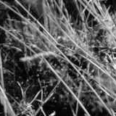
Smoothing with box filter

Slide 29
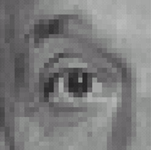
Practice with linear filters
0
0
0
?
0
1
0
0
0
0
Original
Source: D. Lowe

Slide 30
Practice with linear filters
0
0
0
0
1
0
0
0
0
Original
Filtered
(no change)
Source: D. Lowe

Slide 31
Practice with linear filters
0
0
0
?
0
0
1
0
0
0
Original
Source: D. Lowe

Slide 32
Practice with linear filters
0
0
0
0
0
1
0
0
0
Original
Shifted left
By 1 pixel
Source: D. Lowe

Slide 33
Practice with linear filters
0
0
0
-
1
1
1
?
0
2
0
1
1
1
0
0
0
1
1
1
(Note that filter sums to 1)
Original
Source: D. Lowe

Slide 34
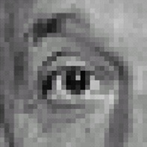
Practice with linear filters
0
0
0
-
1
1
1
0
2
0
1
1
1
0
0
0
1
1
1
Original
Sharpening filter
Accentuates differences with local average
Source: D. Lowe

Slide 35
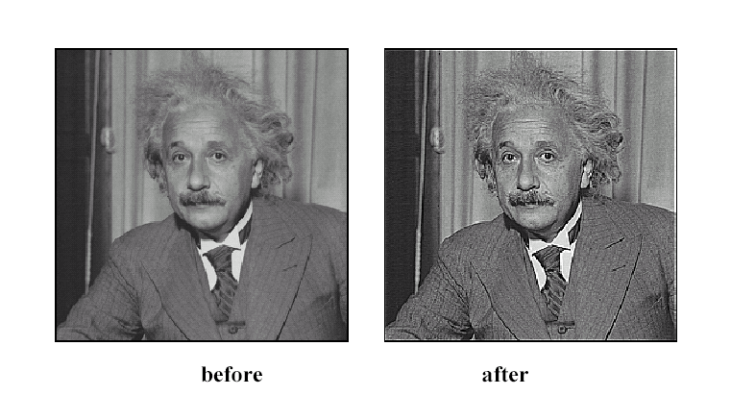
Sharpening
Source: D. Lowe

Slide 36
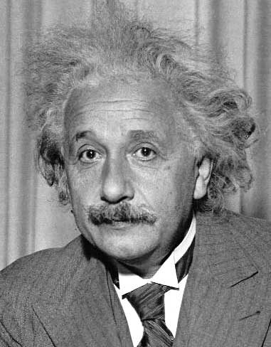
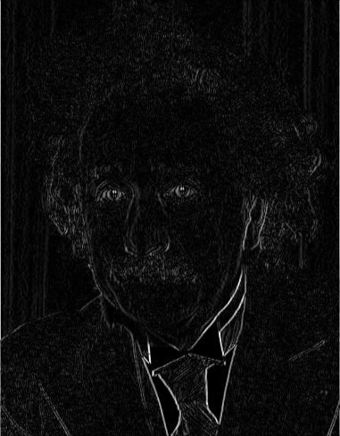
Other filters
1
0
-1
2
0
-2
1
0
-1
Sobel
Vertical Edge
(absolute value)

Slide 37
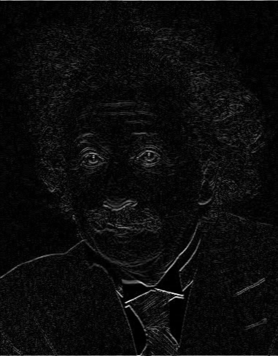
Other filters
1
2
1
0
0
0
-1
-2
-1
Sobel
Horizontal Edge
(absolute value)
Notes:
Questions at this point?

Slide 38
Filtering vs. Convolution
f=filter
I=image
2d filtering
h=filter2(f,I); or h=imfilter(I,f);
2d convolution
h=conv2(f,I);

Slide 39
Key properties of linear filters
Linearity:
imfilter(I, f₁ + f₂) =
imfilter(I,f₁) + imfilter(I,f₂)
Shift invariance: same behavior regardless of pixel location
imfilter(I,shift(f)) = shift(imfilter(I,f))
Any linear, shift-invariant operator can be represented as a convolution
Source: S. Lazebnik
Notes:
f is image

Slide 40
More properties
Commutative: a * b = b * a
Conceptually no difference between filter and signal
But particular filtering implementations might break this equality
Associative: a * (b * c) = (a * b) * c
Often apply several filters one after another: (((a * b₁) * b₂) * b₃)
This is equivalent to applying one filter: a * (b₁ * b₂ * b₃)
Distributes over addition: a * (b + c) = (a * b) + (a * c)
Scalars factor out: ka * b = a * kb = k (a * b)
Identity: unit impulse e = [0, 0, 1, 0, 0], a * e = a
Source: S. Lazebnik

Slide 41
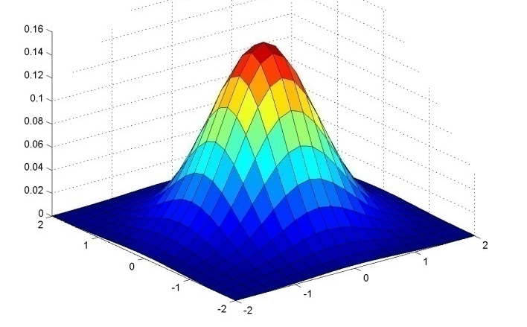
Important filter: Gaussian
Weight contributions of neighboring pixels by nearness
0.003 0.013 0.022 0.013 0.003
0.013 0.059 0.097 0.059 0.013
0.022 0.097 0.159 0.097 0.022
0.013 0.059 0.097 0.059 0.013
0.003 0.013 0.022 0.013 0.003
5 x 5, σ = 1
Slide credit: Christopher Rasmussen
Notes:
e^0 = 1, e^-1 = .37, e^-2 = .14, etc.

Slide 42
Smoothing with Gaussian filter

Slide 43
Smoothing with box filter

Slide 44
Gaussian filters
Remove “high-frequency” components from the image (low-pass filter)
Images become more smooth
Convolution with self is another Gaussian
So can smooth with small-width kernel, repeat, and get same result as larger-width kernel would have
Convolving two times with Gaussian kernel of width σ is same as convolving once with kernel of width σ√2
Separable kernel
Factors into product of two 1D Gaussians
Source: K. Grauman
Notes:
Linear vs. quadratic in mask size

Slide 45
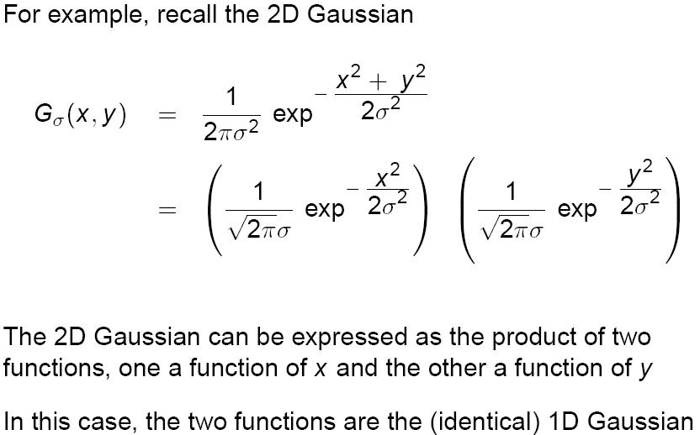
Separability of the Gaussian filter
Source: D. Lowe

Slide 46
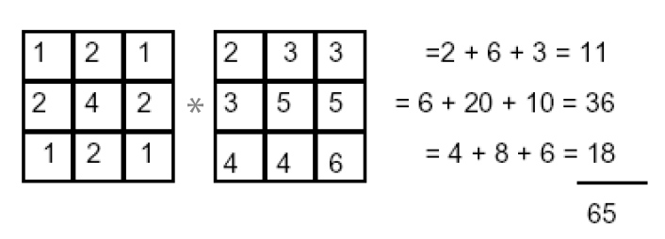
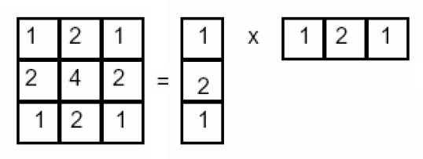
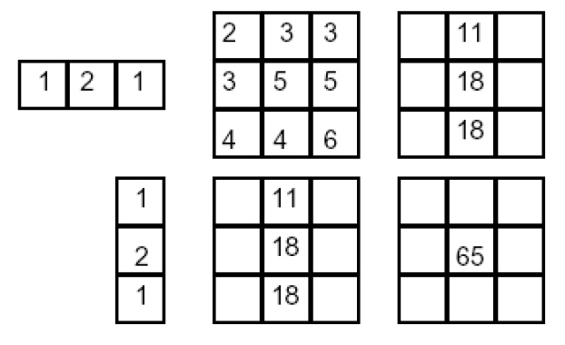
Separability example
2D convolution (center location only)
The filter factors into a product of 1D filters:
Perform convolution along rows:
*
=
Followed by convolution along the remaining column:
*
=
Source: K. Grauman
Notes:
Convolution vs filtering doesn’t matter here because the filter is symmetric

Slide 47
Practical matters
How big should the filter be?
Values at edges should be near zero
Rule of thumb for Gaussian: set filter half-width to about 3 σ

Slide 48
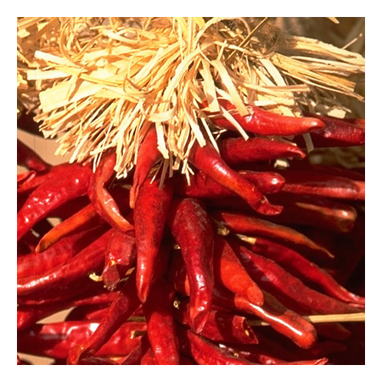
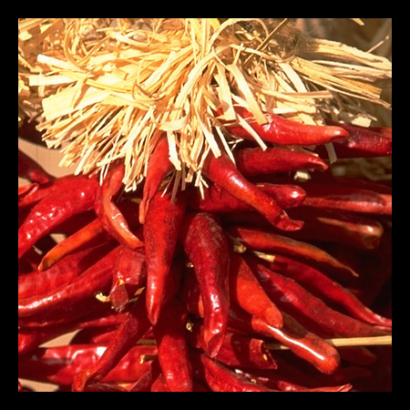
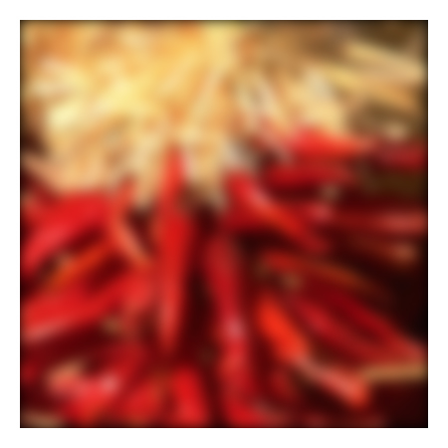
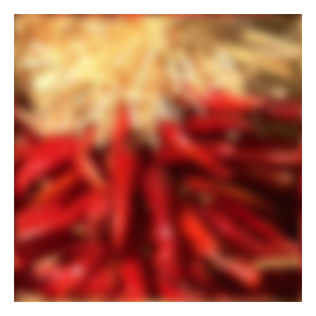
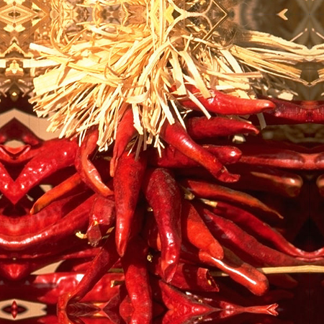
Practical matters
What about near the edge?
the filter window falls off the edge of the image
need to extrapolate
methods:
clip filter (black)
wrap around
copy edge
reflect across edge
Source: S. Marschner

Slide 49
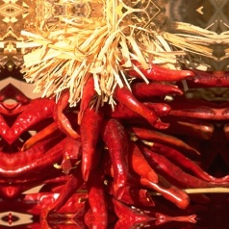
Recap of Filtering
Linear filtering is dot product at each position
Not a matrix multiplication
Can smooth, sharpen, translate (among many other uses)
Be aware of details for filter size, extrapolation, cropping
1
1
1
1
1
1
1
1
1

Slide 50
Review: questions
Write down a 3x3 filter that returns a positive value if the average value of the 4-adjacent neighbors is less than the center and a negative value otherwise
Write down a filter that will compute the gradient in the x-direction:
gradx(y,x) = im(y,x+1)-im(y,x) for each x, y
Slide: Hoiem
Notes:
[0 -1/4 0;
-1/4 1 -1/4;
0 -1/4 0]
[0 -1 1]

Slide 51
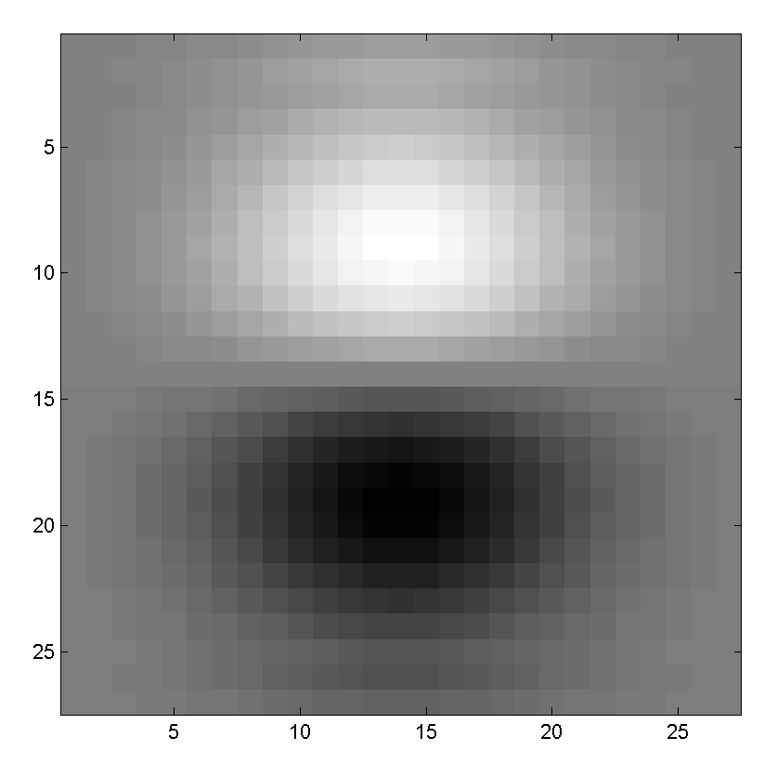
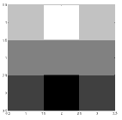
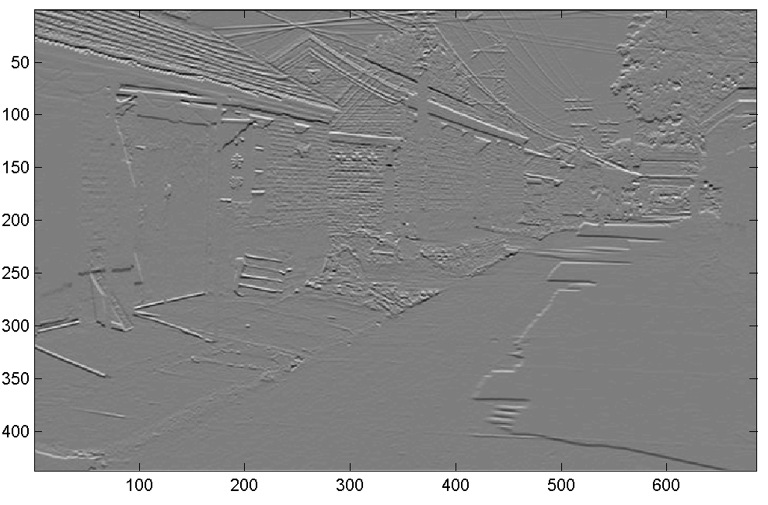
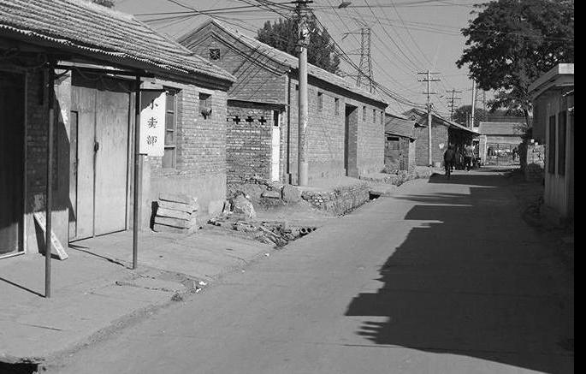
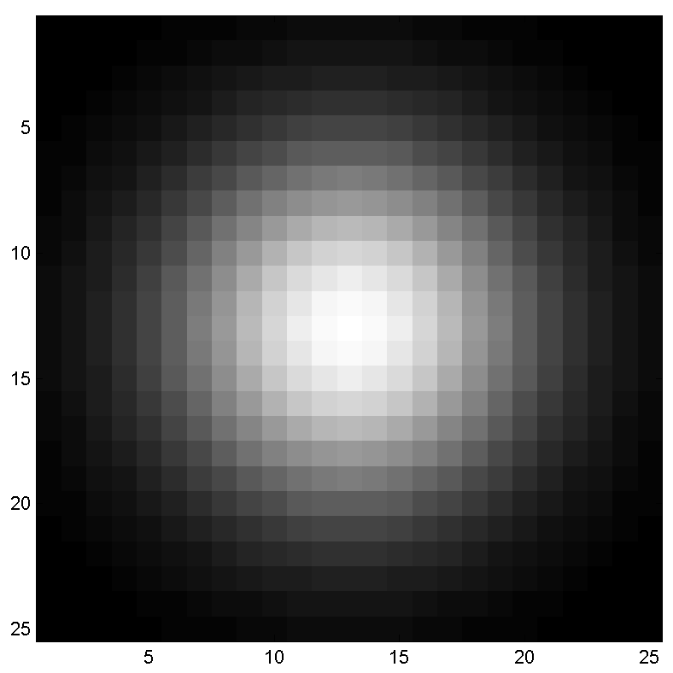
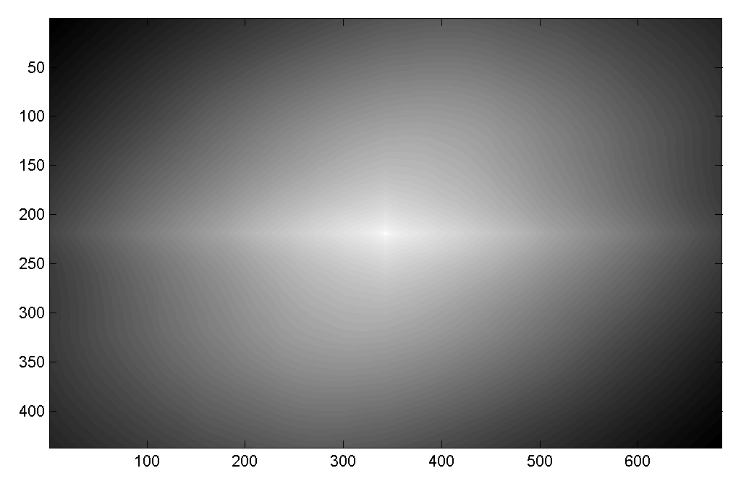
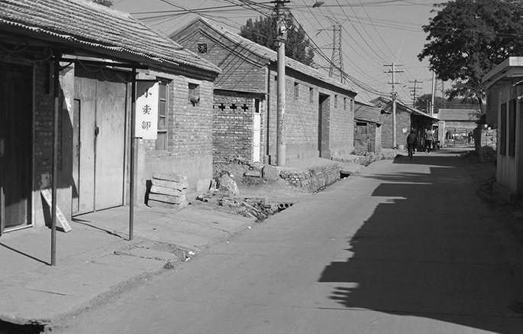
Review: questions
Filtering Operator
a) _ = D * B
b) A = _ * _
c) F = D * _
d) _ = D * D
3. Fill in the blanks:
A
B
E
G
F
C
H
I
D
Slide: Hoiem
Notes:
a) G = D * B
b) A = B * C
c) F = D * E
d) I = D * D

Slide 52
Hybrid Images
A. Oliva, A. Torralba, P.G. Schyns, “Hybrid Images,” SIGGRAPH 2006

Slide 53
Why do we get different, distance-dependent interpretations of hybrid images?
?
Slide: Hoiem

Slide 54
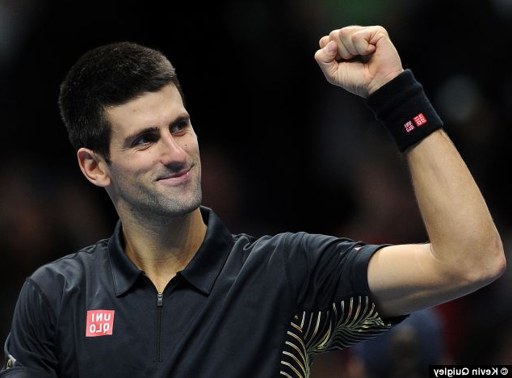
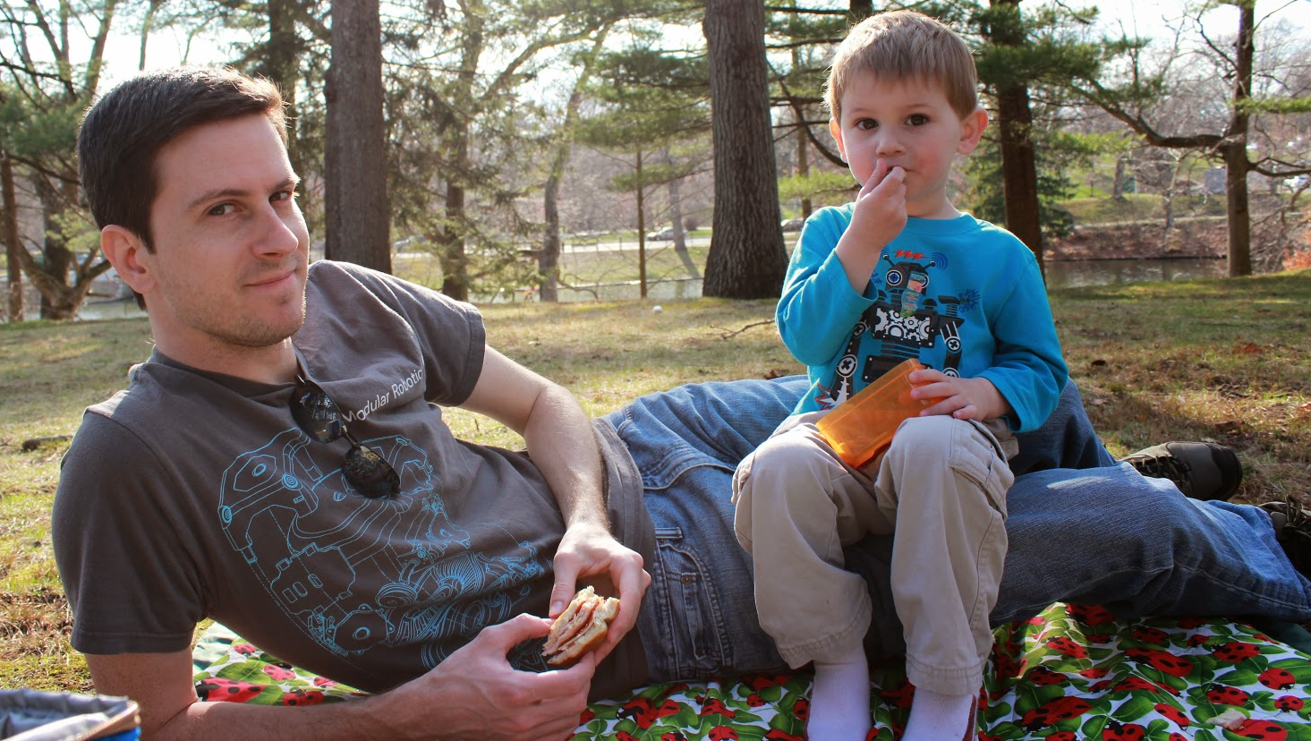

Slide 55
